Slide 1
Appliances
105 Scenic Overlook Drive
Lot 379

Slide 2
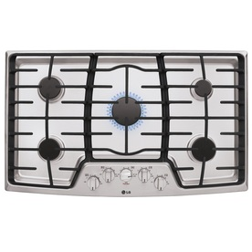
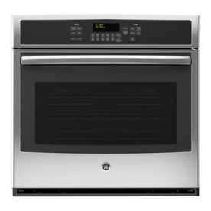
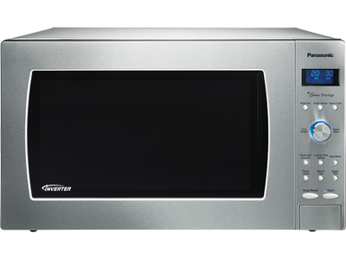
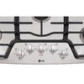
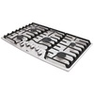
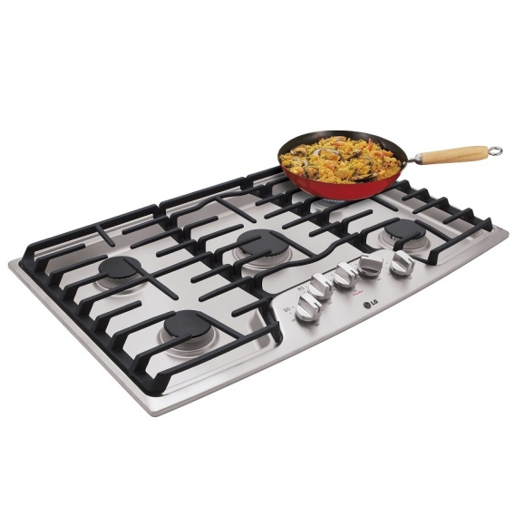
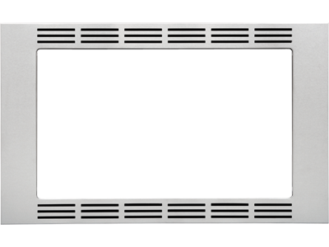
Kitchen Cooking
LG 5-Burner Gas Cooktop (Stainless) (Common:-in; Actual)
Item #: 516648 | Model #: LCG3611ST
GE Self-Cleaning with Steam Convection Single Electric Wall Oven (Stainless Steel) (Common: 30-in; Actual 29.75-in)
Item #: 507734 | Model #: JT5000SFSS
https://shop.panasonic.com/shop/model/NN-SD997S
2.2 Cu. Ft. Countertop/Built-In Microwave with Inverter Technology NN-SD997S Stainless
Model: NN-SD997S
https://shop.panasonic.com/shop/model/NN-TK922SS
27" Trim Kit for select Microwaves
Model: NN-TK922SS

Slide 3
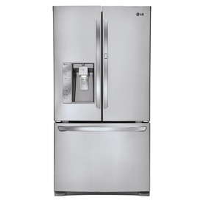
Refrigerator
LG 30.5-cu ft French Door Refrigerator with Single Ice Maker and Door within Door (Stainless Steel) ENERGY STAR
Item #: 406499 | Model #: LFX31945ST

Slide 4
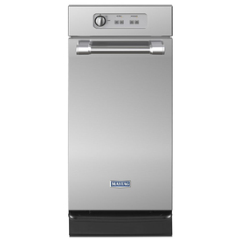
Compactor
Maytag 15-in Stainless Steel Undercounter Trash Compactor
Item #: 616402 | Model #: MTUC7500ADM

Slide 5
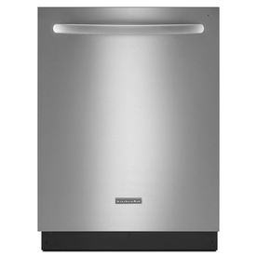
Dishwasher
KitchenAid Architect II 42-Decibel Built-in Dishwasher with Stainless Steel Tub (Stainless Steel) (Common: 24-in; Actual 23.875-in) ENERGY STAR
Item #: 571402 | Model #: KDTE404DSS

Slide 6
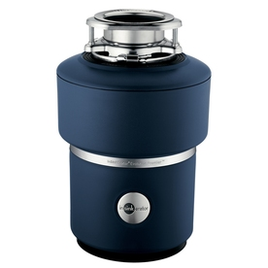
Garbage Disposer
InSinkErator Evolution 3/4-HP Garbage Disposal with Sound Insulation
Item #: 240436 | Model #: PREMIER
~$210

Slide 7
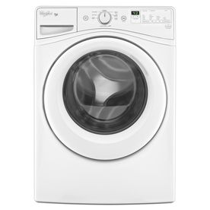
Washer
Whirlpool Duet 4.2-cu ft High-Efficiency Front-Load Washer (White) ENERGY STAR
Item #: 588938 | Model #: WFW72HEDW

Slide 8
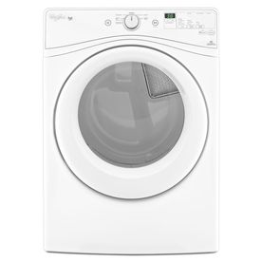
Dryer
Whirlpool Duet 7.4-cu ft Electric Dryer (White)
Item #: 592586 | Model #: WED72HEDW

Slide 9
Bar Microwave
Same as kitchen Panasonic unit

Slide 10
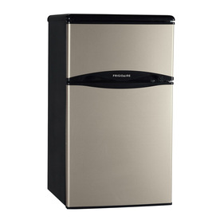
Bar Fridge
Frigidaire 3.1-cu ft Compact Refrigerator with Freezer Compartment (Silver Mist) ENERGY STAR
Item #: 326297 | Model #: LFPH31M6LM

