Slide 1
Bathroom Amenities
105 Scenic Overlook Drive
Lot 379

Slide 2
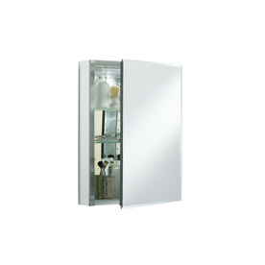
Loft Bathrom
KOHLER 20-in x 26-in Aluminum Metal Surface Mount and Recessed Medicine Cabinet
Item #: 1007 | Model #: CB-CLC2026FS
open to the left
hinge on left side

Slide 3
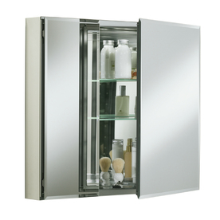
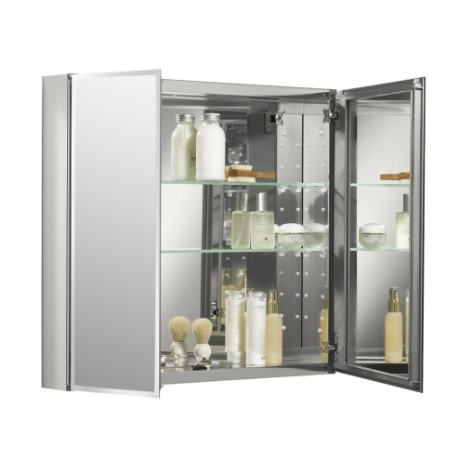
Master Bath
KOHLER 26-in H x 30-in W Metal Recessed Medicine Cabinet
Item #: 1241 | Model #: CB-CLC3026FS
doors open
Two butt up against each other centered over the vanity
Large doors on the outside edges as shown above

Slide 4
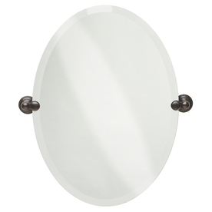
Main Powder
Delta Providence 26-in H x 19-in W Oval Tilting Frameless Bathroom Mirror with Venetian Bronze Hardware and Beveled Edges
Item #: 55896 | Model #: 134442

Slide 5

Guest Master
KOHLER Archer 20-in x 31-in Aluminum Metal Surface Mount and Recessed Medicine Cabinet
Item #: 296928 | Model #: 3073-NA
Install with hinges on the left

Slide 6
Bar Bath
Delta Providence 26-in H x 19-in W Oval Tilting Frameless Bathroom Mirror with Venetian Bronze Hardware and Beveled Edges
Item #: 55896 | Model #: 134442

