Slide 1
Lights and Fans
105 Scenic Overlook Drive
Lot 379

Slide 2
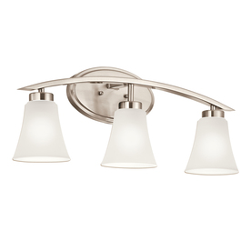
Loft Bathroom
Portfolio 3-Light Lyndsay Brushed Nickel Standard Bathroom Vanity Light
Item #: 321701 | Model #: 37256
Good

Slide 3
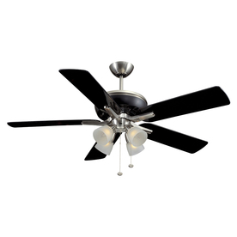
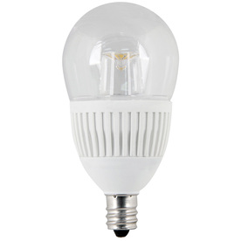
South Bedroom (Tony's Office)
Harbor Breeze Tiempo 52-in Brushed Nickel/Black Downrod Mount Ceiling Fan with Light Kit
Item #: 125500 | Model #: E TM52BNKB5CS
Utilitech 4.8-Watt (40W Equivalent) Candelabra Base (E-12) Warm White Dimmable Decorative LED Light Bulb
Item #: 477039 | Model #: LA15DMCCL300LED

Slide 4
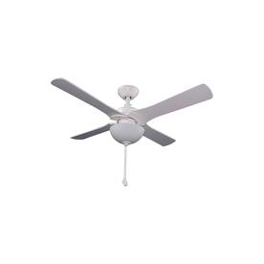
North Bedroom (Phyl's office)
Harbor Breeze Aero 42-in White Downrod Mount Ceiling Fan with Light Kit
Item #: 451794 | Model #: 00980

Slide 5
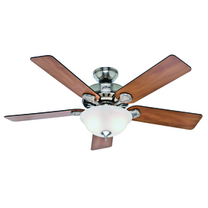
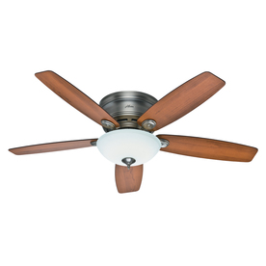
Loft
Hunter Low Profile IV Plus LED 52-in Antique Pewter Flush Mount Ceiling Fan with LED Light Kit
Item #: 355470 | Model #: 59002
Hunter Pro's Best 5 Minute 52-in Brushed Nickel Downrod or Flush Mount Ceiling Fan with Light Kit
Item #: 533145 | Model #: 53249

Slide 6
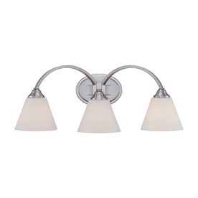
Master Bath
Portfolio 3-Light Cape Brook Brushed Nickel Bathroom Vanity Light
Item #: 564081 | Model #: LWS0038C1
Good

Slide 7
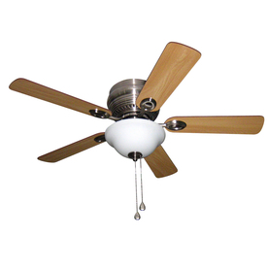
Master Bedroom
Utilitech 4.8-Watt (40W Equivalent) Candelabra Base (E-12) Warm White Dimmable Decorative LED Light Bulb
Item #: 477039 | Model #: LA15DMCCL300LED
Harbor Breeze Mayfield 44-in Brushed Nickel Flush Mount Ceiling Fan with Light Kit (5-Blades)
Item #: 331096 | Model #: BTH44BNK5C

Slide 8
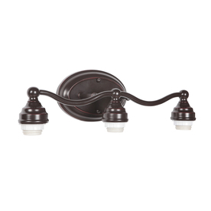
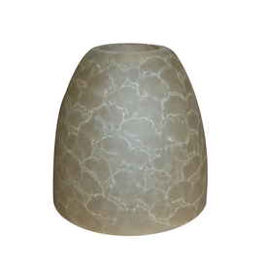
Main Floor Powder Room
Portfolio 3-Light Weathered Bronze Bathroom Vanity Light
Item #: 156831 | Model #: VB13-3WDBZ
Portfolio 4-7/8-in Amber Vanity Light Glass
Item #: 156638 | Model #: 566BC
Good

Slide 9
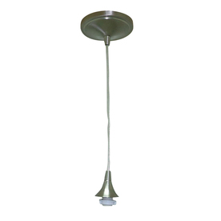
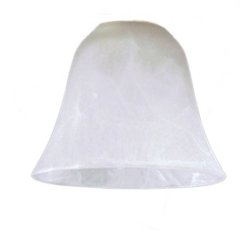
Kitchen Sink
Portfolio Nickel Mix and Match Mini Pendant Light
Item #: 394799 | Model #: CPM-1PNK
Portfolio 4.5-in H x 5.38-in W Alabaster Glass Mix and Match Mini Pendant Light Shade
Item #: 39040 | Model #: N635A
Good

Slide 10
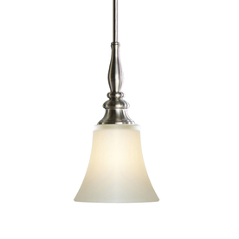
Peninsula
allen + roth 6.46-in W Brushed Nickel Mini Pendant Light with Frosted Shade
Item #: 589519 | Model #: FJ13-181
2 or 3?

Slide 11
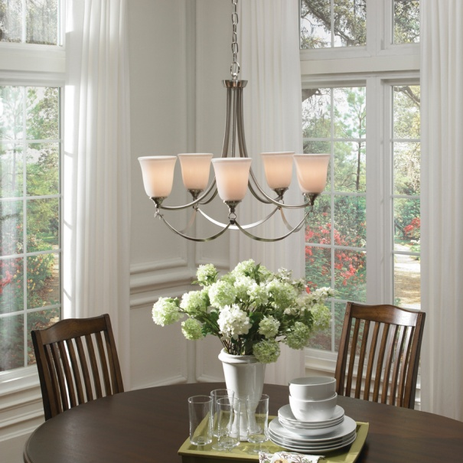
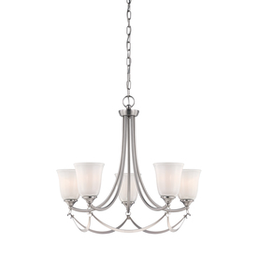
Dining Area
allen + roth Winnsboro 5-Light Brushed Nickel Chandelier
Item #: 402096 | Model #: LWSC0333C1

Slide 12
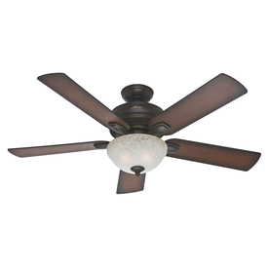
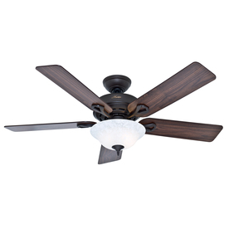
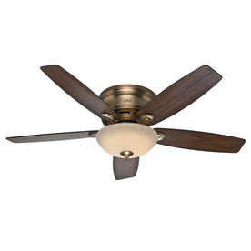
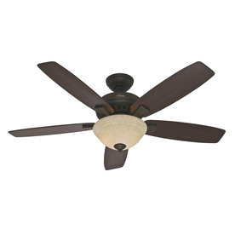
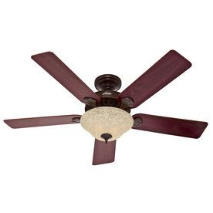
Great Room
Hunter Low Profile IV Plus LED 52-in Brushed Bronze Flush Mount Ceiling Fan with LED Light Kit
Item #: 355472 | Model #: 59003
Hunter Matheston 52-in Onyx Bengal Bronze Outdoor Downrod or Flush Mount Ceiling Fan with Light Kit
Item #: 545746 | Model #: 54092
Hunter The Kensington 52-in New Bronze Downrod or Flush Mount Ceiling Fan with Light Kit
Item #: 533101 | Model #: 53048
$294.91
Won't fit
Hunter Banyan 52-in New Bronze Downrod or Flush Mount Ceiling Fan with Light Kit
Item #: 545726 | Model #: 53176
Hunter Waldon 5 Minute 52-in Onyx Bengal Bronze Downrod or Flush Mount Ceiling Fan with Light Kit
Item #: 294991 | Model #: 53159
Best replacement choice:

Slide 13
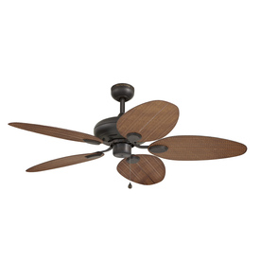
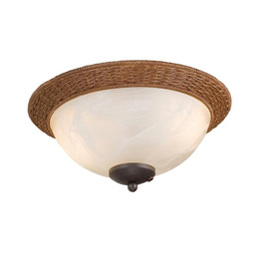
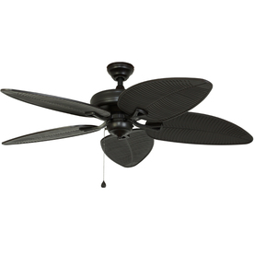
Screened Porches
Harbor Breeze Tilghman 52-in Aged Bronze Outdoor Downrod or Flush Mount Ceiling Fan ENERGY STAR
Item #: 294981 | Model #: WCK52NWZ5N
Harbor Breeze 2-Light Aged Bronze Ceiling Fan Light Kit with Alabaster Glass
Item #: 384193 | Model #: EC-WNWZ
Damp Rated, strong enough for screen porch use?
Light kit
Harbor Breeze Pacific Grove 52-in Oil Rubbed Bronze Outdoor Downrod or Flush Mount Ceiling Fan Adaptable ENERGY STAR
Item #: 451809 | Model #: 40101
Alternate if above won't work. Will need something else for light

Slide 14
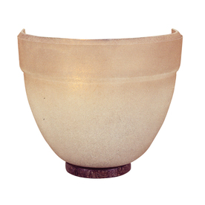
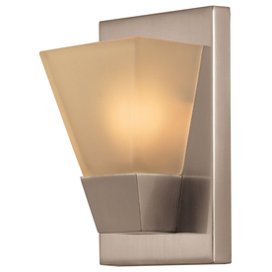
Stairwells
Portfolio 5.52-in W 1-Light Brushed Nickel Pocket Hardwired Wall Sconce
Item #: 204367 | Model #: FB09-030
Portfolio 6.5-in W 1-Light Bronze Pocket Hardwired Wall Sconce
Item #: 6841 | Model #: 6841
Lower level stairwell
Install downfacing
Upper level stairwell

Slide 15
Basement Powder Room
Portfolio 3-Light Weathered Bronze Bathroom Vanity Light
Item #: 156831 | Model #: VB13-3WDBZ
Portfolio 4-7/8-in Amber Vanity Light Glass
Item #: 156638 | Model #: 566BC
Good

Slide 16
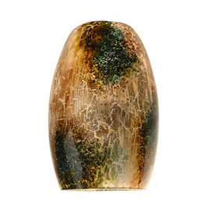
Bar Area
Portfolio Nickel Mix and Match Mini Pendant Light
Item #: 394799 | Model #: CPM-1PNK
Portfolio 7.25-in H x 4.75-in W Stone Crackle Glass Mix and Match Mini Pendant Light Shade
Item #: 266574 | Model #: N885SC
Good
2 over bar seating area
Over the bar top area,
not the chairs

Slide 17
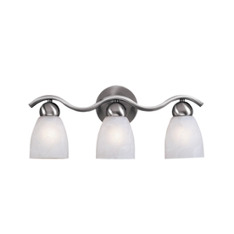
Guest Master Bath (basement)
Portfolio 3-Light Paces Brushed Nickel Bathroom Vanity Light
Item #: 208086 | Model #: 93243
Good

Slide 18
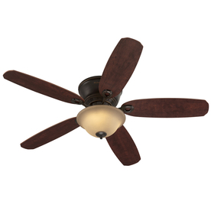
Guest Bedroom
Harbor Breeze Pawtucket 52-in Oil Rubbed Bronze Indoor Flush Mount Ceiling Fan with Light Kit and Remote Control
Item #: 593747 | Model #: 40692

Slide 19
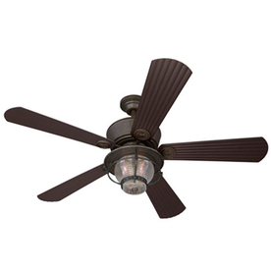
Family Room
Harbor Breeze Merrimack 52-in Antique Bronze Outdoor Downrod or Flush Mount Ceiling Fan with Light Kit and Remote Control
Item #: 80443 | Model #: 40094

Slide 20
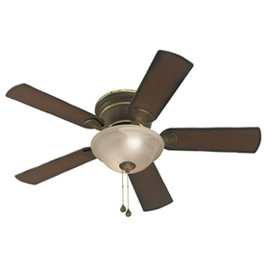
Home Theater
Harbor Breeze Keyport 44-in Walnut Flush Mount Ceiling Fan with Light Kit
Item #: 403520 | Model #: 40141
Install without light kit, but keep on hand it if we change our minds

Slide 21
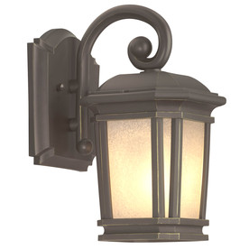
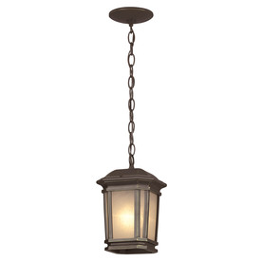
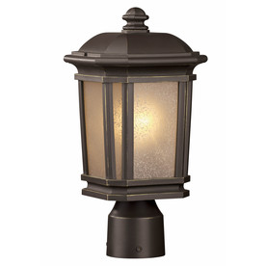
Front Porch
Portfolio Corrigan 10.87-in H Dark Brass Outdoor Wall Light
Item #: 337119 | Model #: 18201
Portfolio Corrigan 11-in H Bronze Outdoor Pendant Light
Item #: 337140 | Model #: 18204
Portfolio Corrigan 14.12-in H Dark Brass Post Light
Item #: 337134 | Model #: 18206
Good
Good

Slide 22
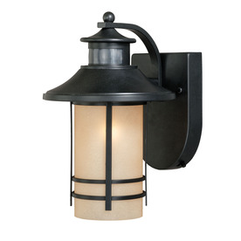
Main Deck
Portfolio Lloyd 11.5-in H Oil Rubbed Bronze Motion Activated Outdoor Wall Light
Item #: 482282 | Model #: MISSION MOTION BRON
Good

Slide 23
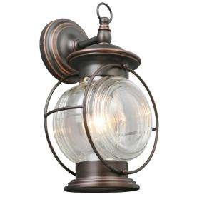
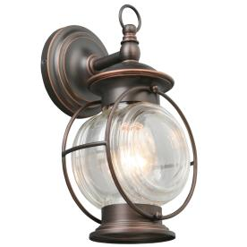
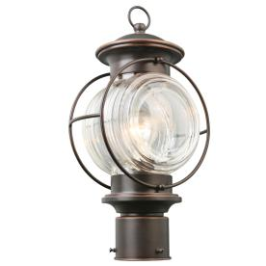
Lower Patio
Portfolio Caliburn 13.62-in H Oil Rubbed Bronze Outdoor Wall Light
Item #: 336713 | Model #: HRH1691AM
Portfolio Caliburn 12.25-in H Oil Rubbed Bronze Outdoor Wall Light
Item #: 336714 | Model #: HRH1691A
Portfolio Caliburn 15.25-in H Oil Rubbed Bronze Post Light
Item #: 336715 | Model #: HRH1801A
By the door and window (2)
By the Guest Bedroom and Home Theater (2)
Bottom of Stairs and walkway from lower parking

Slide 24
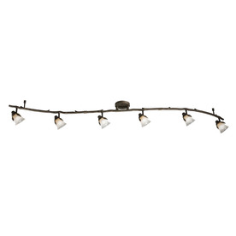
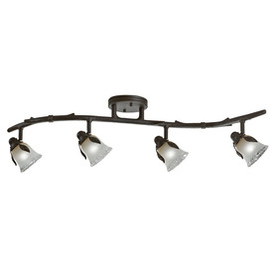
Task Lights
Portfolio Branches 6-Light Painted Olde Bronze Fixed Track Light Kit
Item #: 103638 | Model #: 16034
Portfolio Branches 4-Light Painted Olde Bronze Fixed Track Light Kit
Item #: 216892 | Model #: 16025
If needed

