Slide 1
Patio Patterns
105 Scenic Overlook Drive
Lot 379

Slide 2
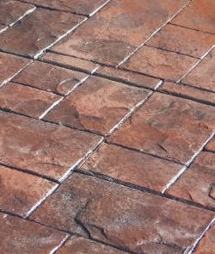
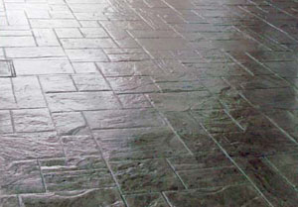
Patio
http://pepsilconcrete.net/stamped-concrete
http://toddrosedecorativeconcrete.com/decorative-concrete/

Slide 3
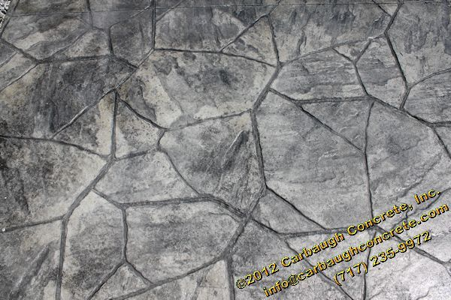
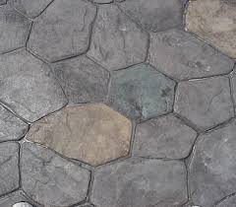
http://carbaughconcrete.com/services/decorative-concrete/patterns/arizona-flagstone/

Slide 4
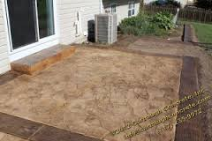
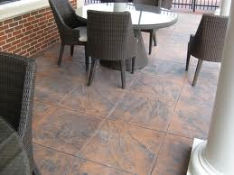
http://carbaughconcrete.com/services/decorative-concrete/patterns/pennsylvania-stone/
http://www.beautifyconcrete.com/commercial/stamped_concrete.php

Slide 5
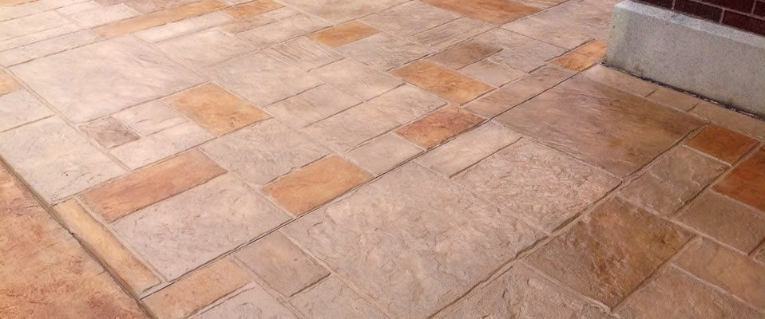
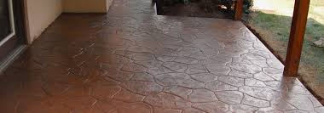
http://www.realhelpconcrete.com/
http://blackwaterconcrete.com/

Slide 6
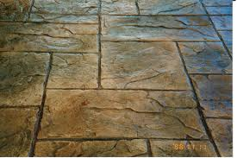
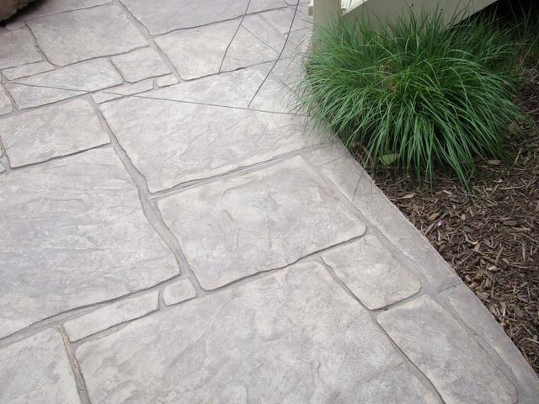
http://www.landscapinggallery.info/concrete/concrete-stamp-patterns.html
http://supreme-construction.com/2014/05/7-masonry-walkway-designs-youll-love/

