Slide 1
Plumbing and Appliances
105 Scenic Overlook Drive
Lot 379

Slide 2
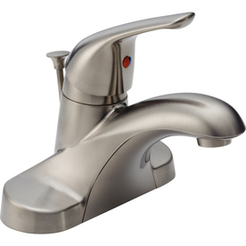
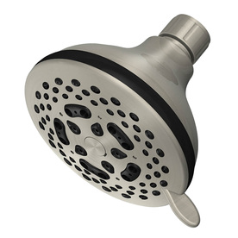
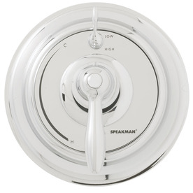
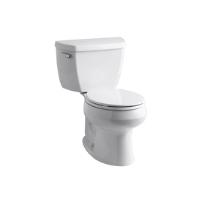
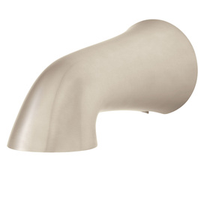
Loft Bathroom
Delta Foundations Stainless 1-Handle 4-in Centerset WaterSense Bathroom Sink Faucet (Drain Included)
Item #: 356838 | Model #: B510LF-SSPPU
Speakman Chrome Tub/Shower Trim Kit
Item #: 354979 | Model #: SM-5400
AquaSource 2.5-GPM (9.5-LPM) Nickel 7-Spray Showerhead
Item #: 426138 | Model #: 303
KOHLER Wellworth White 1.28-GPF (4.85-LPF) 12-in Rough-In WaterSense Round 2-Piece Standard Height Toilet
Item #: 331676 | Model #: 11464-0
Speakman Nickel Tub Spout
Item #: 549227 | Model #: S-1561-BN
Same bars and tp holder as master and guest bath

Slide 3
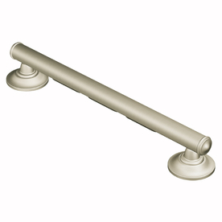
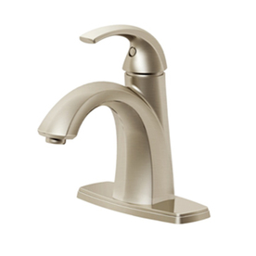
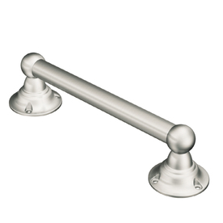
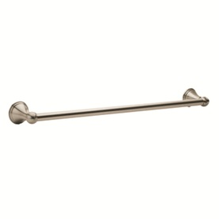
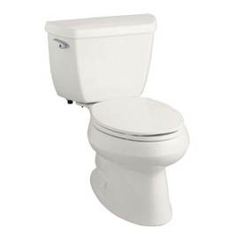
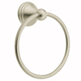
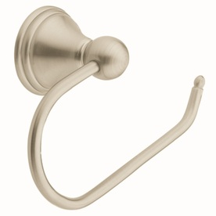
Master Bath
Pfister Selia Brushed Nickel 1-Handle Single Hole WaterSense Bathroom Sink Faucet (Drain Included)
Item #: 357232 | Model #: F-042-SLKK
Moen Home Care 16-in Brushed Nickel Wall Mount Grab Bar
Item #: 64197 | Model #: LR8716D1GBN
Moen Home Care 9-in Brushed Nickel Wall Mount Grab Bar
Item #: 124817 | Model #: LR2250DBN
KOHLER Wellworth White 1.28-GPF (4.85-LPF) 12-in Rough-In WaterSense Elongated 2-Piece Standard Height Toilet
Item #: 89230 | Model #: 3575-0
Moen Preston Spot Resist Brushed Nickel Single Towel Bar (Common: 24-in; Actual: 26.13-in)
Item #: 77917 | Model #: DN8424BN
Moen Preston Spot Resist Brushed Nickel Wall Mount Towel Ring
Item #: 78083 | Model #: DN8486BN
Moen Preston Spot Resist Brushed Nickel Surface Mount Toilet Paper Holder
Item #: 77631 | Model #: DN8408BN
Best fit between 18 and 24"
2 bars in room, could be different sizes
Moen Preston Spot Resist Brushed Nickel Single Towel Bar (Common: 18-in; Actual: 20.13-in)
Item #: 77905 | Model #: DN8418BN

Slide 4
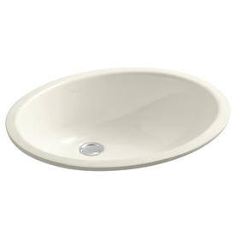
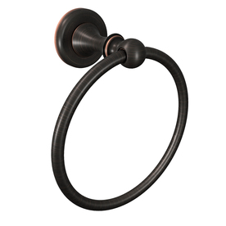
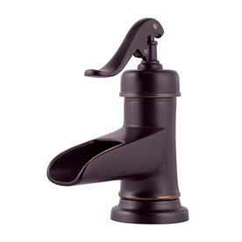
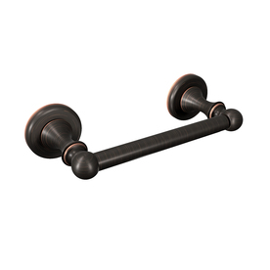
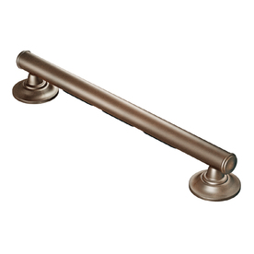
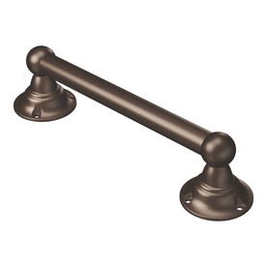
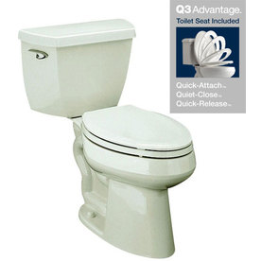
Main Floor Powder Room
Pfister Ashfield Tuscan Bronze 1-Handle Single Hole/4-in Centerset WaterSense Bathroom Sink Faucet (Drain Included)
Item #: 56044 | Model #: F-M42-YPYY
Moen Whitley Mediterranean Bronze Wall Mount Towel Ring
Item #: 379353 | Model #: DN1886BRB
KOHLER Caxton Biscuit Undermount Oval Bathroom Sink with Overflow
Item #: 76842 | Model #: R2210-96
Moen Whitley Mediterranean Bronze Surface Mount Toilet Paper Holder
Item #: 379348 | Model #: DN1808BRB
KOHLER Highline Classic Biscuit 1.28-GPF (4.85-LPF) 12-in Rough-In WaterSense Elongated 2-Piece Comfort Height Toilet
Item #: 331930 | Model #: 14799-96
Moen Home Care 16-in Old World Bronze Wall Mount Grab Bar
Item #: 16204 | Model #: LR8716D1GOWB
Moen Home Care 9-in Old World Bronze Wall Mount Grab Bar
Item #: 337683 | Model #: LR2250DOWB
Grab bar size best fit for room

Slide 5
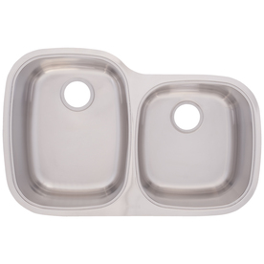
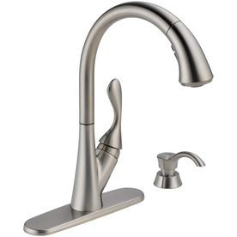
Kitchen
Franke USA 18-Gauge Double-Basin Undermount Stainless Steel Kitchen Sink
Item #: 205828 | Model #: UOSK900-18
Delta Ashton Stainless 1-Handle Pull-Down Sink/Counter Mount Traditional Kitchen Faucet
Item #: 8836 | Model #: 19922-SSSD-DST

Slide 6
Basement Powder Room
KOHLER Caxton Biscuit Undermount Oval Bathroom Sink with Overflow
Item #: 76842 | Model #: R2210-96
Pfister Ashfield Tuscan Bronze 1-Handle Single Hole/4-in Centerset WaterSense Bathroom Sink Faucet (Drain Included)
Item #: 56044 | Model #: F-M42-YPYY
KOHLER Highline Classic Biscuit 1.28-GPF (4.85-LPF) 12-in Rough-In WaterSense Elongated 2-Piece Comfort Height Toilet
Item #: 331930 | Model #: 14799-96
Bars same as for main floor powder room

Slide 7
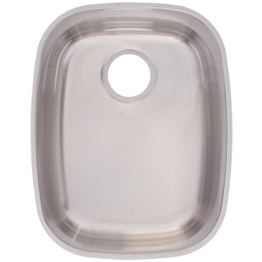
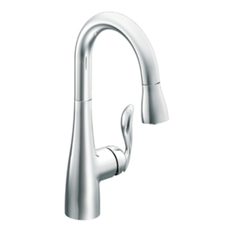
Bar
Franke USA FrankeUSA 18-Gauge Single-Basin Undermount Stainless Steel Kitchen Sink
Item #: 149054 | Model #: USDSK900-18
Moen Arbor Chrome 1-Handle Bar Faucet
Item #: 89236 | Model #: 5995
Microwave

Slide 8
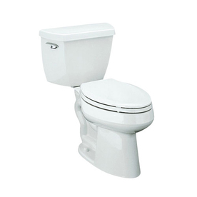
Guest Master Bath (basement)
Pfister Selia Brushed Nickel 1-Handle Single Hole WaterSense Bathroom Sink Faucet (Drain Included)
Item #: 357232 | Model #: F-042-SLKK
Bars and toilet holder same as master bath
KOHLER Highline Classic White 1.28-GPF (4.85-LPF) 12-in Rough-In WaterSense Elongated 2-Piece Comfort Height Toilet
Item #: 331929 | Model #: 14799-0
Shower head and control
Same as Master

