Slide 1
Range Hoods Only
105 Scenic Overlook Drive
Nebo, NC 28761
Lot 379

Slide 2
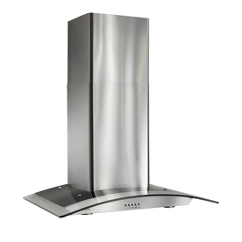
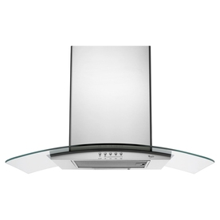
Range Hoods
Broan Convertible Wall-Mounted Range Hood (Stainless Steel) (Common: 36-in; Actual 36-in)
Item #: 311632 | Model #: B5636SS
Whirlpool Gold Ducted Wall-Mounted Range Hood (Stainless) (Common: 36-in; Actual 36-in)
Item #: 331971 | Model #: GXW6536DXS

Slide 3
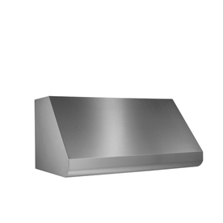
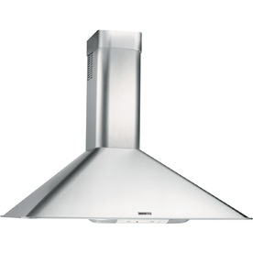
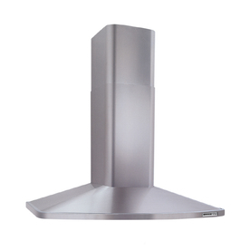
Range Hoods
Broan Convertible Wall-Mounted Range Hood (Stainless Steel) (Common: 36-in; Actual 36-in)
Item #: 60989 | Model #: RM503604
Broan Convertible Wall-Mounted Range Hood (Stainless Steel) (Common: 36-in; Actual 36-in)
Item #: 345023 | Model #: RM523604
Broan Ducted Wall-Mounted Range Hood (Stainless Steel) (Common: 36-in; Actual 35.87-in)
Item #: 308382 | Model #: E60E36SS

