Slide 1
Shower Doors
105 Scenic Overlook Drive
Nebo, NC 28761
Lot 379

Slide 2
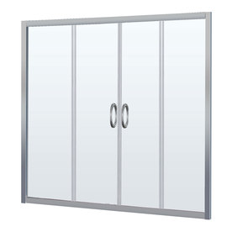
Loft Bathroom
DreamLine Visions 60-in W x 58-in H Brushed Nickel Frameless Bathtub Door
Item #: 412140 | Model #: SHDR-1160586-04

Slide 3
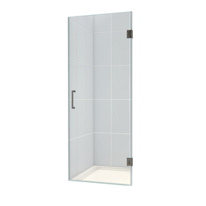
Master Bath
DreamLine 24-in Frameless Hinged Shower Door
Item #: 412353 | Model #: SHDR-20247210F-04

