Slide 1
Tile alternatives
105 Scenic Overlook Drive
Lot 379

Slide 2
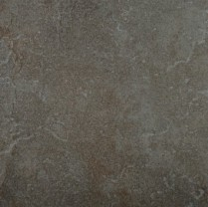

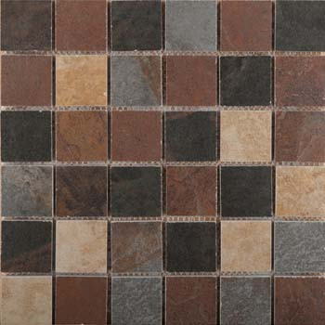
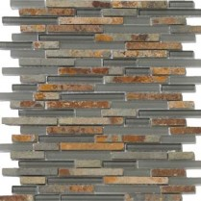
Master Bath
Main tile: Bombay Salsette 13x13 for floors and 7x7 for walls
http://emser.com/index.php?id1=collectionDetails&productID=213&id0=ceramic_porcelain&index=35
And two good accents candidates:
1st choice:
http://emser.com/index.php?productID=218&zoom=1&tabs=mosaicsAndDecos&id1=collectionDetails&id0=ceramic_porcelain&index=35
Emser Tile
2nd choice:
http://emser.com/index.php?tabs=sizeAndTrim&id1=collectionDetails&productID=625&id0=glass&super=219&index=85
in strips of 6.
They have a complementary mosaic for the shower floor:
http://emser.com/index.php?productID=217&zoom=1&tabs=mosaicsAndDecos&id1=collectionDetails&id0=ceramic_porcelain&index=35

Slide 3
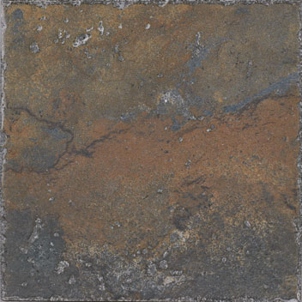
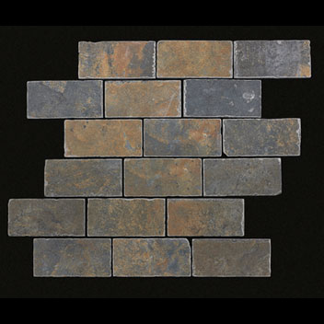
Master Bath (alt 1)
http://www.mannington.com/Residential/Porcelain/Antiquity/Antiquity/AQ0T06.aspx
http://www.mannington.com/Residential/Porcelain/Antiquity/Antiquity/Antiquity%20Trim/AQ0MMM.aspx
12x12 for floor
6x6 for walls
2x4 Mosaic

Slide 4
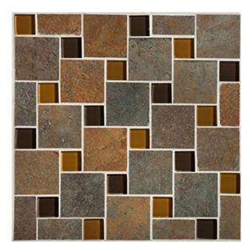
alt 1
Mannington Accent Gallery Iron Gate 10" x 10" Pinwheel Glass and Stone Mosaic Sheet
SKU: 8373938 Model: AQ0PMM ANTIQUITY

Slide 5
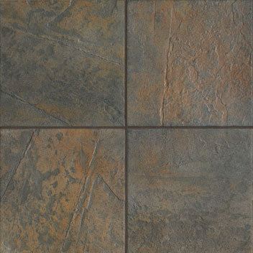
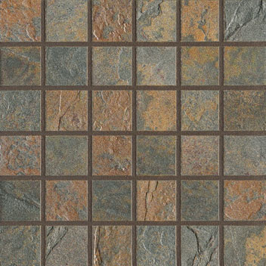
Alternate 2 – Serengeti Slate - Blue Nile
http://www.mannington.com/Residential/Porcelain/Serengeti-Slate/Serengeti%20Slate/Serengeti%20Slate%20Trim/SS2MMM.aspx
http://www.mannington.com/Residential/Porcelain/Serengeti-Slate/Serengeti%20Slate/SS2T06.aspx
12x12 for floor
6x6 for floors
2x2 mosaic for shower floor

Slide 6
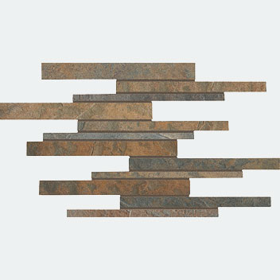
Alternate 2 - Blue Nile cont.
http://www.mannington.com/Residential/Porcelain/Serengeti-Slate/Serengeti%20Slate/Serengeti%20Slate%20Trim/SS2BMM.aspx
accent -

Slide 7
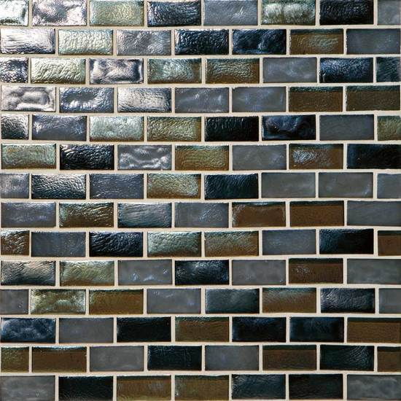
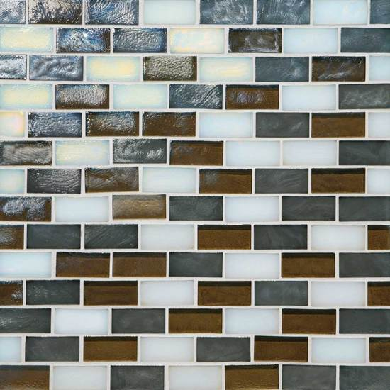
Alt 2 – other accents
Americanolean
Garden Oasis – Evening Fields
Americanolean
Garden Oasis – Marsh Fog
http://americanolean.com/series.cfm?series=187&Item=2575
http://americanolean.com/series.cfm?series=187&Item=2572

Slide 8
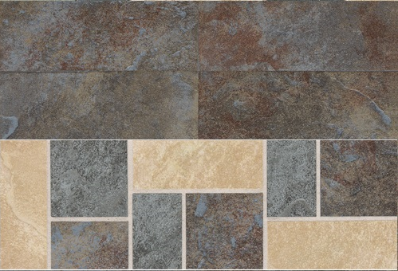
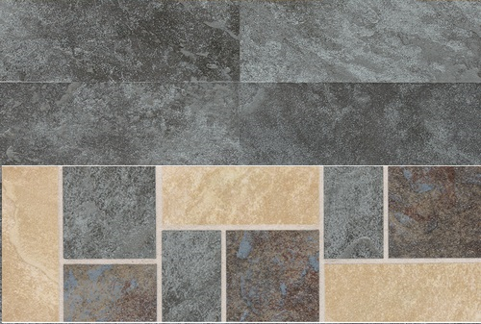
Daltile
Continental Slate
Tuscan Blue with cs75
English grey with cs75

Slide 9
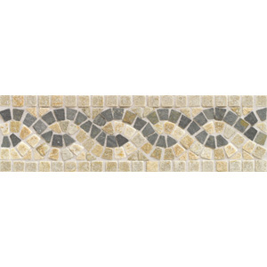
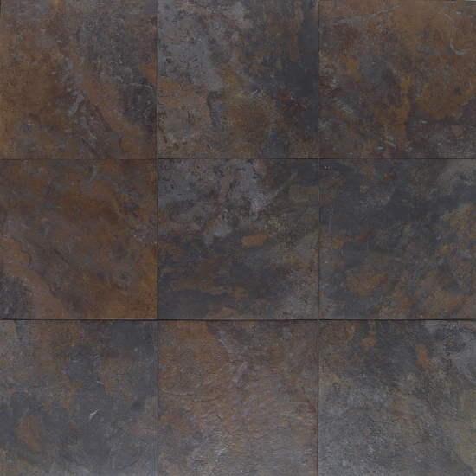
Americanolean
Amber Valley
River Moss AM87 with
China Gold/ChinaMulticolor
Serpentine 4x12 TU77

