Slide 1
Wall Plates
105 Scenic Overlook Drive
Nebo, NC 28761
Lot 379

Slide 2
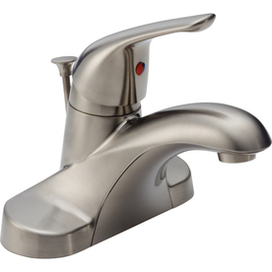
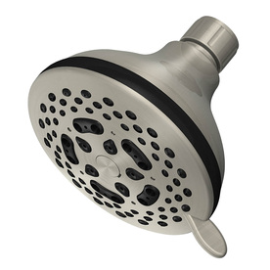
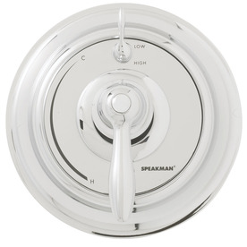
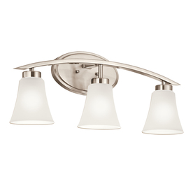
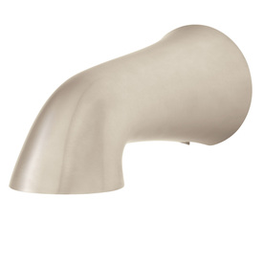
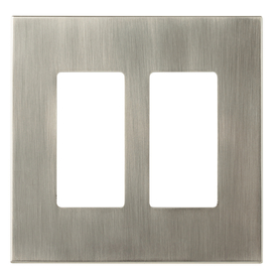
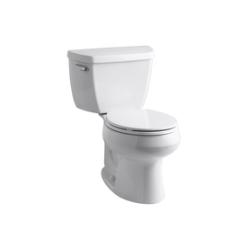
Loft Bathroom
allen +roth Linden 2-Gang Satin Nickel Standard Toggle Metal Wall Plate
Item #: 405527 | Model #: W27280-SN-U

Slide 3
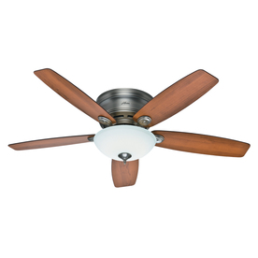
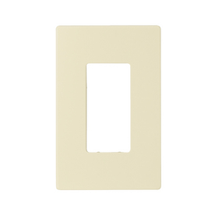
Loft
Cooper Wiring Devices 1-Gang Almond Decorator Duplex Receptacle Nylon Wall Plate
Item #: 279494 | Model #: PJS26A

Slide 4
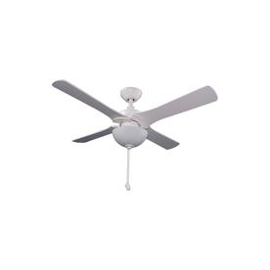
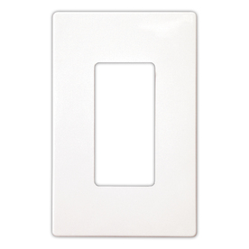
Loft North Bedroom
Cooper Wiring Devices 1-Gang White Standard Duplex Receptacle Nylon Wall Plate
Item #: 279489 | Model #: PJS26W

Slide 5
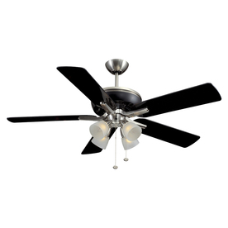
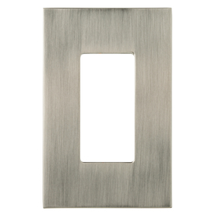
Loft South Bedroom
allen + roth Linden 1-Gang Satin Nickel Decorator Rocker Metal Wall Plate
Item #: 405531 | Model #: W27275-SN-U

Slide 6
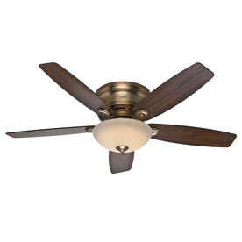
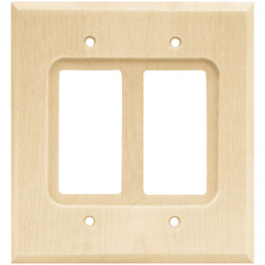
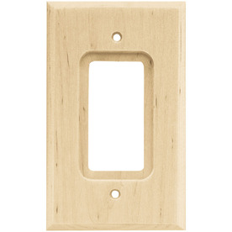
Great room
Brainerd 2-Gang Unfinished Birch Decorator Rocker Wood Wall Plate
Item #: 12882 | Model #: 64655
Brainerd 1-Gang Unfinished Birch Standard Toggle Wood Wall Plate
Item #: 20908 | Model #: 64668

Slide 7
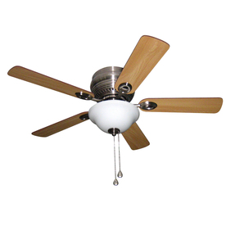
Master Bedroom
Cooper Wiring Devices 1-Gang Almond Decorator Duplex Receptacle Nylon Wall Plate
Item #: 279494 | Model #: PJS26A

Slide 8
Master Bedroom Closet
Cooper Wiring Devices 1-Gang Almond Decorator Duplex Receptacle Nylon Wall Plate
Item #: 279494 | Model #: PJS26A

Slide 9
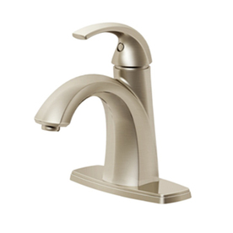
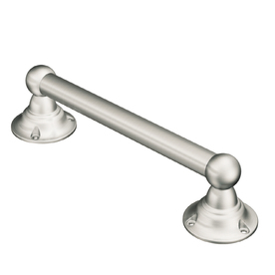
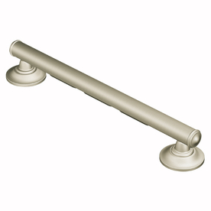
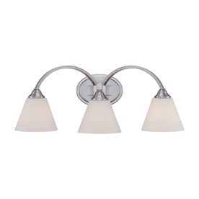
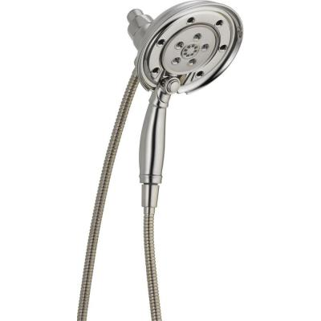
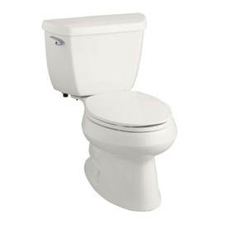
Master Bath
Control
allen +roth Linden 2-Gang Satin Nickel Standard Toggle Metal Wall Plate
Item #: 405527 | Model #: W27280-SN-U

Slide 10
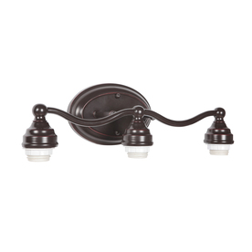
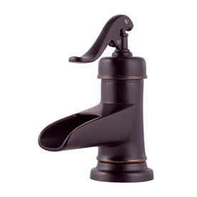
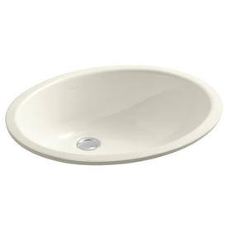
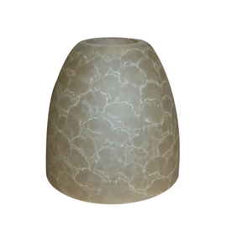
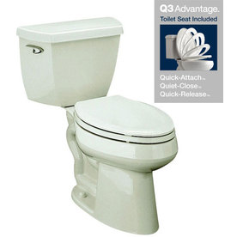
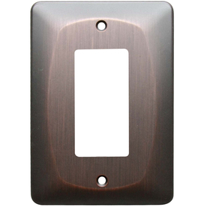
Main Floor Powder Room
allen + roth 1-Gang Dark Oil-Rubbed Bronze Decorator Rocker Metal Wall Plate
Item #: 364653 | Model #: Z2388R-EORB

Slide 11
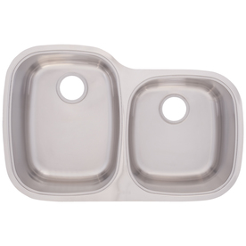
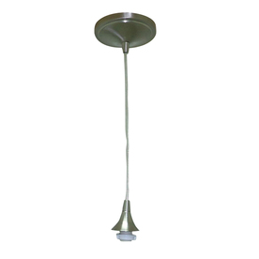
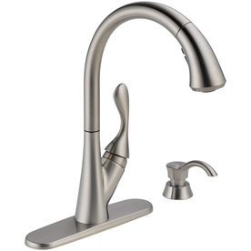
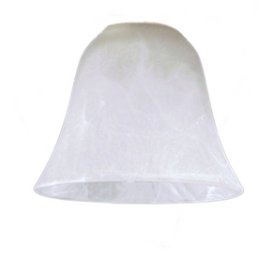
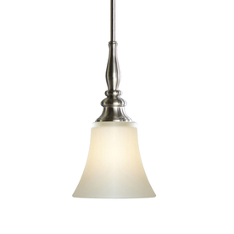
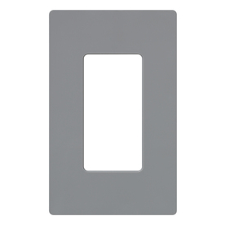
Kitchen
Lutron 1-Gang Gray Decorator Rocker Plastic Wall Plate
Item #: 48977 | Model #: CW-1-GR
Peninsula

Slide 12
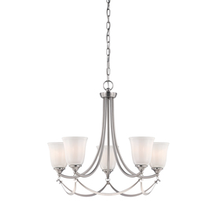
Dining Room
Same as Great Room

Slide 13
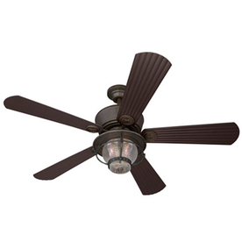
Basement Rec room
Stain to match floor
Brainerd 2-Gang Unfinished Birch Decorator Rocker Wood Wall Plate
Item #: 12882 | Model #: 64655
Brainerd 1-Gang Unfinished Birch Standard Toggle Wood Wall Plate
Item #: 20908 | Model #: 64668

Slide 14
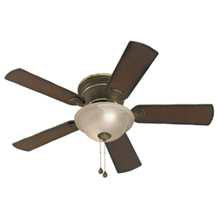
Basement Home Theater
Brainerd 2-Gang Unfinished Birch Decorator Rocker Wood Wall Plate
Item #: 12882 | Model #: 64655
Brainerd 1-Gang Unfinished Birch Standard Toggle Wood Wall Plate
Item #: 20908 | Model #: 64668

Slide 15
Basement Powder Room
allen + roth 1-Gang Dark Oil-Rubbed Bronze Decorator Rocker Metal Wall Plate
Item #: 364653 | Model #: Z2388R-EORB

Slide 16
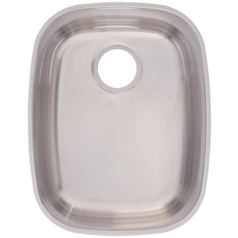
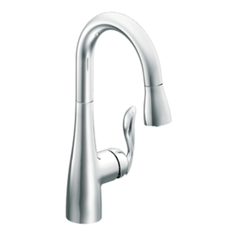
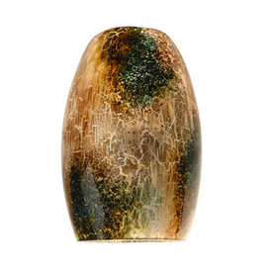
Bar
allen + roth Linden 1-Gang Satin Nickel Decorator Rocker Metal Wall Plate
Item #: 405531 | Model #: W27275-SN-U
allen + roth Linden 2-Gang Satin Nickel Standard Toggle Metal Wall Plate
Item #: 405527 | Model #: W27280-SN-U

Slide 17
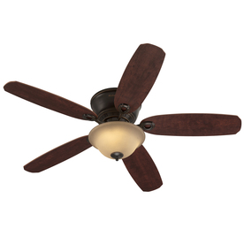
Guest Bedroom
allen + roth 1-Gang Dark Oil-Rubbed Bronze Decorator Rocker Metal Wall Plate
Item #: 364653 | Model #: Z2388R-EORB

Slide 18
Guest Closet
allen + roth 1-Gang Dark Oil-Rubbed Bronze Decorator Rocker Metal Wall Plate
Item #: 364653 | Model #: Z2388R-EORB

Slide 19
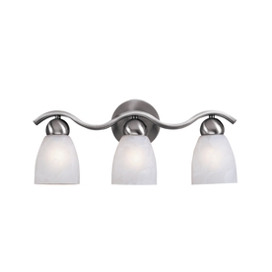
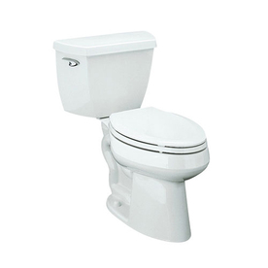
Guest Master Bath (basement)
Shower head and control
Same as Master
allen +roth Linden 2-Gang Satin Nickel Standard Toggle Metal Wall Plate
Item #: 405527 | Model #: W27280-SN-U

Slide 20
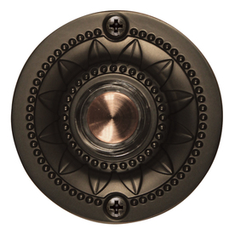
Door bell button
Utilitech Oil-Rubbed Bronze Doorbell Button
Item #: 358558 | Model #: UT-612-02

