Slide 1
Wall Plates Only
105 Scenic Overlook Drive
Nebo, NC 28761
Lot 379

Slide 2
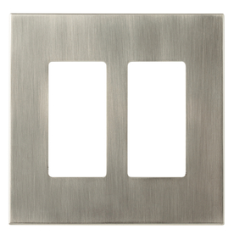
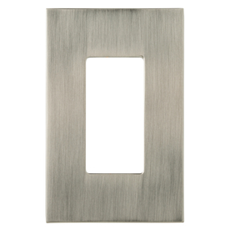
Brushed Nickel
allen + roth Linden 2-Gang Satin Nickel Standard Toggle Metal Wall Plate
Item #: 405527 | Model #: W27280-SN-U
allen + roth Linden 1-Gang Satin Nickel Decorator Rocker Metal Wall Plate
Item #: 405531 | Model #: W27275-SN-U

Slide 3
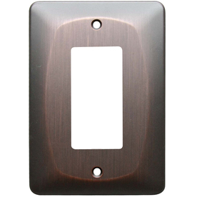
Bronze
allen + roth 1-Gang Dark Oil-Rubbed Bronze Decorator Rocker Metal Wall Plate
Item #: 364653 | Model #: Z2388R-EORB

Slide 4
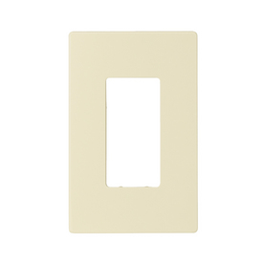
Almond
Cooper Wiring Devices 1-Gang Almond Decorator Duplex Receptacle Nylon Wall Plate
Item #: 279494 | Model #: PJS26A

Slide 5
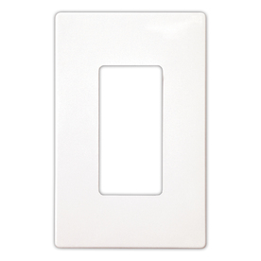
White
Cooper Wiring Devices 1-Gang White Standard Duplex Receptacle Nylon Wall Plate
Item #: 279489 | Model #: PJS26W

Slide 6
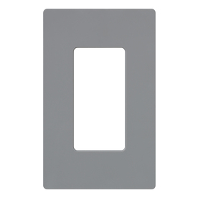
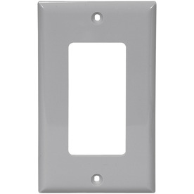
Grey
Lutron 1-Gang Gray Decorator Rocker Plastic Wall Plate
Item #: 48977 | Model #: CW-1-GR
Cooper Wiring Devices 1-Gang Gray Decorator Rocker Nylon Wall Plate
Item #: 89198 | Model #: 5151GY-BOX

Slide 7
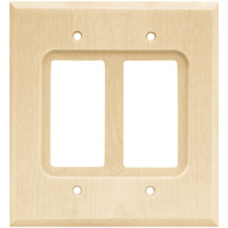
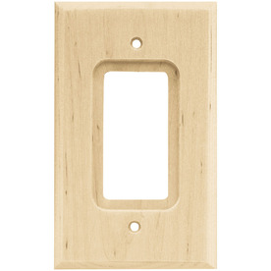
Wood
Brainerd 2-Gang Unfinished Birch Decorator Rocker Wood Wall Plate
Item #: 12882 | Model #: 64655
Brainerd 1-Gang Unfinished Birch Standard Toggle Wood Wall Plate
Item #: 20908 | Model #: 64668

