Slide 1
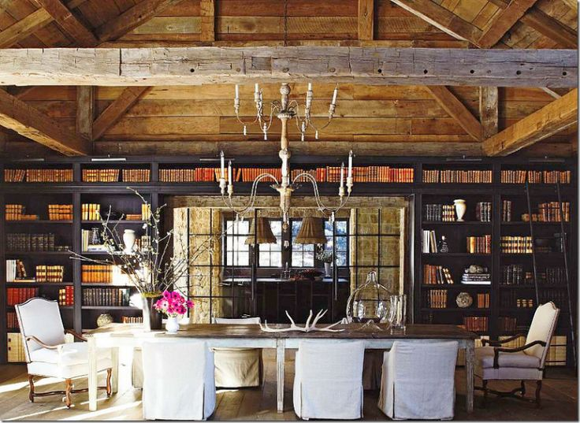
http://www.pinterest.com/pin/275704808410640405/

Slide 2
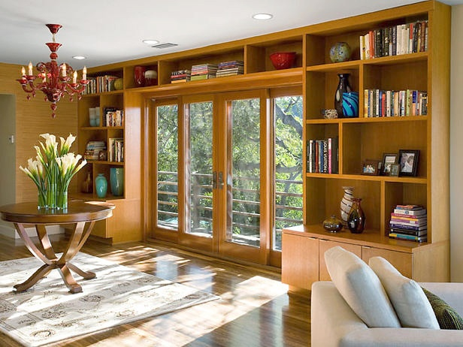
http://www.hgtv.com/decorating-basics/functional-and-stylish-wall-to-wall-shelves/pictures/index.html

Slide 3
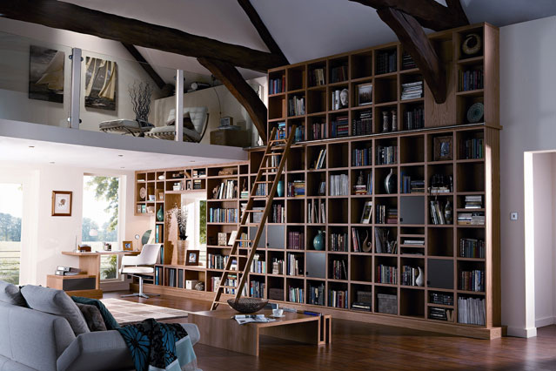
http://www.houseandgarden.co.uk/interiors/bookshelf-ideas-living-room-study-design/wall

