Slide 1
Linux Command Basics I
Tony Kombol

Slide 2

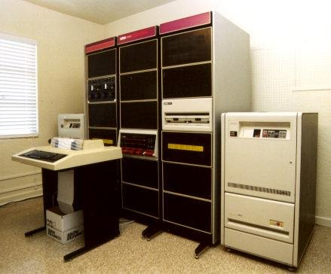
Computers and Terminals

Slide 3
Shells

Slide 4
What "the shell“ is that?
A program that
  receives commands from an input device (e.g. keyboard)
  passes them to the operating system to perform
In the “old days”, it was the only user interface available on a Unix computer
Nowadays users have choice:
  Graphical User Interfaces (GUIs)
  Command Line interfaces (CLIs) using a shell
bash is the most common shell on Linux systems
  Stands for Bourne Again Shell
  Enhanced version of the original Bourne shell program
Several shell programs available on a typical Linux system
  csh – “C shell”
  ksh – “Korn Shell:
  tcsh – c shell extentions
  zsh – korn shell extentions

Slide 5
What's xterm, gnome-terminal, konsole, etc.?
"Terminal emulators"
Programs that put a window in a GUI and let you interact with the shell
  As if it was a CLI
Many different terminal emulators available
Most Linux distributions supply several
  xterm, rxvt, konsole, kvt, gnome-terminal, nxterm, eterm

Slide 6
Starting a Terminal
Window managers usually start a terminal from a menu
Look through the list of programs to find terminal emulator
  KDE
    "konsole" and "terminal" on the Utilities menu
  Gnome
    "color xterm," "regular xterm," and "gnome-terminal" on the Utilities menu
Start up as many of these as you want
  Many of different terminal emulators
    All do the same thing
    Give you access to a shell session
  You will probably develop a preference for one, based on the different bells and whistles each one provides

Slide 7
PSA:
You're not logged in as root, are you?
Don't operate the computer as the “superuser”
  A.k.a.: root
Only become the superuser when absolutely necessary
Doing otherwise is:
  Dangerous
  Stupid
  Poor taste
Create your user accounts now!

Slide 8
Linux File Systems

Slide 9
File System Organization
Linux system files are arranged in a hierarchical directory structure
  A tree-like pattern of directories
    Called folders in other systems
    May contain files and other directories
  First directory is the root directory
  Root directory contains files and other directories (subdirectories)
    Each directory may contain:
      More files and subdirectories
        And so on and so on…

Slide 10
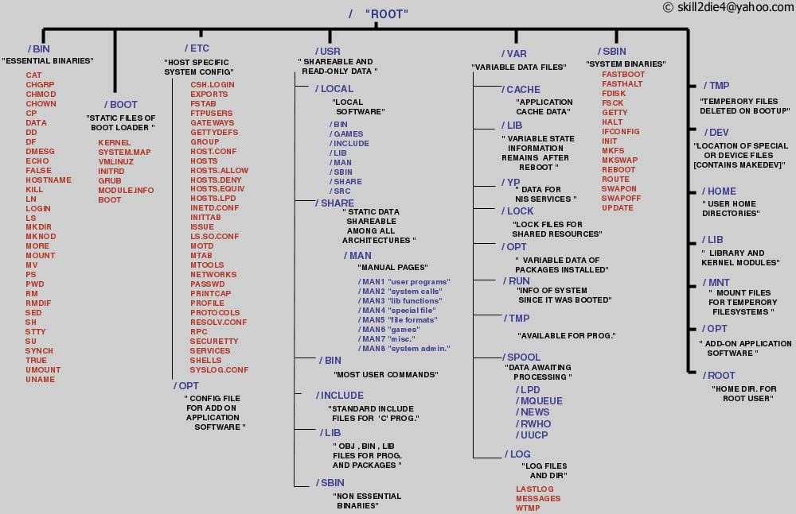
Typical Linux file directory structure

Slide 11
Inspecting directories and files

Slide 12
Looking Around
Handy commands:
  ls
    List files and directories
    Has several options
  cat
    Sends file contents to standard output
  more
    File contents sent to the screen one page at a time
  less
    View text files similar to man
    Allows scrolling up and down
  file
    Classify a file's contents

Slide 13
Examples of the ls command
Command | Result
ls | List the files in the working (current)directory
ls dir | List the files in the dir directory
ls /bin | List the files in the /bin directory
ls -l | List the files in the working directory in long format
ls -l /etc /bin | List the files in the /bin directory and the /etc directory in long format
ls -la .. | List all files (even ones with names beginning with a period character, which are normally hidden) in the parent of the working directory in long format

Slide 14
ls common options
-a: all
  Files starting with “.” are not listed by default
-d: directory
  List directories only, not the contents
-l: long
  List major fields:
    permissions, group, owner, size, date, name
-U: do not sort

Slide 15
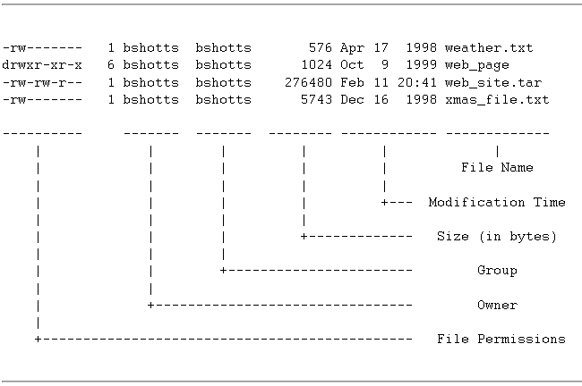
Example: ls -l (Long All Format)

Slide 16
Detail Explanation
File Name
  Name of the file or directory
Modification Time
  Last time the file was modified
  Time and Day are shown
  If the last modification occurred more than six months in the past, the date and year are displayed
Size
  Size of the file in bytes
Group
  Name of the group that has file permissions in addition to the file's owner

Slide 17
Detail Explanation
Owner
  Name of the user who owns the file
File Permissions (10 characters)
  First character is the type of file
    "-" indicates a regular (ordinary) file
    "d" indicates a directory
    Some other special indicators
  Next nine represent the file's access permissions
    First set of three characters represent the read, write, and execution rights of the file's owner
      r, w and x respectively
    Next set of three characters represent the rights for UIDs of the file's group
    Final set of three represent the rights granted to everybody else (the world)

Slide 18
Viewing File Contents

Slide 19
cat
conCATinate file
Can also list the contents files to a terminal
  Good for listing the contents of a file to a printing terminal
  Great for listing the contents of short files to a screen:
  [me@linuxbox me]$ cat .bashrc
    Sends the contents of the ".bashrc" file to the standard out
It works well with piping
  cat filename | some.program
pipe symbol

Slide 20
more
Allows file contents or piped output to be sent to the screen one page at a time
  To list the contents of the "/etc/services" file to the screen one page at a time using more:
    [me@linuxbox me]$ more /etc/services
  To perform a directory listing of all files and pipe the output of the listing using more:
    [me@linuxbox me]$ ls -al | more
    If the directory listing is longer than a page, it will be shown one page at a time
Cannot scroll back
  <Enter> - advance one line
  <Space> - advance one page

Slide 21
less
Displays text files
  Friendlier than cat or more
  Best for bigger files
Similar to the more command
  User can page up and down through the file
Invoked by simply typing:
  [me@linuxbox me]$ less text_file
Display the contents of the file
  Use the command q to get out

Slide 22
file
Examines a file and reports what type of data it contains
  Handy to know before choosing tool to do something with it
Command form:
  [me@linuxbox me]$ file name_of_file
Has many options:
  -bciknsvzL
  -f namefile
  -m magicfiles

Slide 23
File Type | Description | Viewable as text?
ASCII text | The name says it all | yes
Bourne-Again shell script text | A bash script | yes
ELF 32-bit LSB core file | A core dump file (a program will create this when it crashes) | no
ELF 32-bit LSB executable | An executable binary program | no
ELF 32-bit LSB shared object | A shared library | no
GNU tar archive | A tape archive file. A common way of storing groups of files. | no, use tar tvf to view listing
gzip compressed data | An archive compressed with gzip | no
HTML document text | A web page | yes
JPEG image data | A compressed JPEG image | no
PostScript document text | A PostScript file | yes
RPM | A Red Hat Package Manager archive | no, use rpm -q to examine contents
Zip archive data | An archive compressed with zip | no

Slide 24
File Manipulation
Copying, moving, etc.

Slide 25
Manipulating Files
Work with file and directories
  cp
    copy files and directories
  mv
    move or rename files and directories
  rm
    remove files and directories
  mkdir
    create directories

Slide 26
cp
Copies files and directories
  In its simplest form, it copies a single file:
    [me@linuxbox me]$ cp file1 file2
  Can also be used to copy multiple files to a different directory:
    [me@linuxbox me]$ cp file1 file2 file3 dir

Slide 27
Other useful examples of cp
Command | Results
cp file1 file2 | Copies the contents of file1 into file2. If file2 does not exist, it is created; otherwise, file2 is overwritten with the contents of file1.
cp -i file1 file2 | As above, but if file2 exists, the user is prompted before it is overwritten with the contents of file1.
cp file1 dir1 | Copy the contents of file1 (into a file named file1) inside of directory dir1.
cp -R dir1 dir2 | Copy the contents of the directory dir1. If directory dir2 does not exist, it is created. Otherwise, it creates a directory named dir1 within directory dir2.

Slide 28
mv
Performs two different functions depending on how it is invoked
  Moves one or more files to a different directory
  Renames a file or directory
To move files to a different directory:
  [me@linuxbox me]$ mv file1 file2 file3 dir
To rename a file:
  [me@linuxbox me]$ mv filename1 filename2

Slide 29
Examples of mv and some options
Command | Results
mv file1 file2 | If file2 does not exist, then file1 is renamed file2. If file2 exists, its contents are replaced with the contents of file1.
mv -i file1 file2 | As above, but if file2 exists, the user is prompted before it is overwritten with the contents of file1.
mv file1 file2 file3 dir1 | The files file1, file2, file3 are moved to directory dir1. dir1 must exist or mv will exit with an error.
mv dir1 dir2 | If dir2 does not exist, then dir1 is renamed dir2. If dir2 exists, the directory dir1 is created within directory dir2.

Slide 30
rm
Deletes (removes) files
  [me@linuxbox me]$ rm file
Can also be used to delete a directory and its contents:
  [me@linuxbox me]$ rm -r directory

Slide 31
Examples of rm and its options include
Command | Results
rm file1 file2 | Delete file1 and file2. Will not delete directories.
rm -i file1 file2 | As above, but the user is prompted before each file is deleted.
rm -r dir1 dir2 | Directories dir1 and dir2 are deleted along with all of their contents.

Slide 32
Danger:
Be careful with rm!
Once a file is deleted with rm, it's gone!
  Linux does not have an undelete command
  rm can inflict terrific damage on a system if not careful
    Particularly when used with wildcards
Before using rm with wildcards, try this helpful trick:
  Assume files are named file1things, file2things, file3things…
  Construct the command using ls instead of rm
    ls file*
      It lists:file1things, file2things, … filewings, filers, …
    Then try ls file*ings
      It lists:file1things, file2things, … filewings, …
    By doing this the effect of your wildcards can be seen before deleting the files
  After testing and verifying the command with ls, recall the command with the up-arrow key and then substitute rm for ls in the command
    rm file*th*

Slide 33
mkdir
Used to create directories
  [me@linuxbox me]$ mkdir directory

Slide 34
HELP!
me if you can…

Slide 35
man
Almost all UNIX and Unix-like operating systems have extensive documentation
  Known as man pages
    Short for "manual pages“
Use man to display the pages
  Each page is a self-contained document
Usage examples
  [me@linuxbox me]$ man man
  [me@linuxbox me]$ man ls

Slide 36
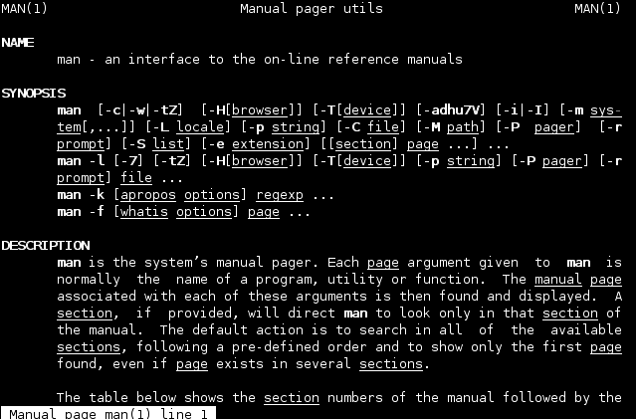

Slide 37
apropos
Don’t know the name of a command?
  apropos some_key_word
Will return names of commands
  With some_key_word in the man description files

Slide 38
--help
Many commands support the --help option
Get help for that command
  One stream of data
  Not as readable as man
Example: get extra help for the ls command:
  ls --help

Slide 39
Other

Slide 40
Shell helps:
The shell can help you with your typing!
  Autocomplete:
    Tab key
      Start a command or file name
      Hit Tab
      If what you typed is unique up to that point bash will complete the rest of the typing!
      If not unique a second tab will show matching options
  Recall:
    The up arrow will recall previous commands
    The down arrow moves back

Slide 41
Wrap-up

Slide 42
Top Linux Commands for Newbies
cat | Prints file contents to standard output. Good for listing the contents of short files to the screen. It works well with piping.
echo | Displays whatever you type in after echo on a new line in the command prompt.
ls | List the content of the current directory. It is the basic command to list contents of the file system.
cd | Change directory
man | Start the manual viewer. man stands for manual, so “man page” really means it’s manual page. Most Linux commands have manual pages that describe how the command is utilized.
find | Use the find command to find your files.
head | Show the first lines of a file (default is 10 lines)
tail | Show the last lines of a file (default is 10 lines)
mv | Use to move or rename files

