Slide 1

Linux Introduction
ITIS 2110

Slide 2
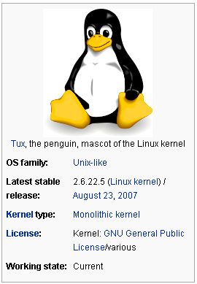
What is Linux
Unix-like computer operating system
One of the most prominent examples of free software and open source development
  Underlying source code can be freely modified, used, and redistributed by anyone
  Originally only ran on x86 processors

Slide 3
What is Linux (cont.)
Originally widely known for its use as servers
Linux has gained the support of corporations
  IBM, Sun Microsystems, Dell, Hewlett-Packard and Novell and others
Used as an operating system for a wide variety of computer hardware
  desktop computers
  supercomputers
  embedded devices
    mobile/smart phones
    routers
http://en.wikipedia.org/wiki/Linux

Slide 4
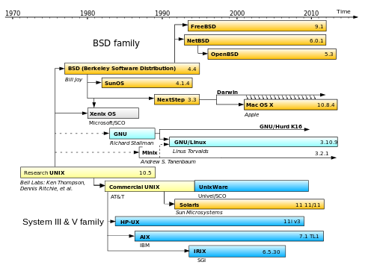
*NIX Family Map

Slide 5
Unix-like
An OS (operating system) that behaves in a manner similar to a Unix system
  Not necessarily conforming to or being certified to any version of the Single UNIX Specification
  Term can include free software / open source operating systems
    Inspired by Bell Labs’ Unix
    Designed to emulate its features
    Commercial and proprietary work-a-likes
    Even versions based on the licensed UNIX source code
      May be so “Unix-like” they are certified to bear the “UNIX” trademark
No formal standard for defining the term
  Some difference of opinion is possible as to whether a certain OS is “Unix-like” or not

Slide 6
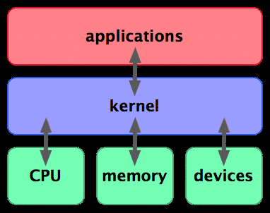
Kernel
Central component of most computer operating systems (OS)
  Manages the system's resources
    Communication between hardware and software components
  Basic component of an operating system
    Provides the lowest-level abstraction layer for the resources
      Memory
      Processors
      I/O devices
  Typically makes these facilities available to application processes
    Inter-process communication mechanisms
    System calls

Slide 7
Kernel
Core of the operating system
Different kernels types
    Depending on design and implementation
  Monolithic kernels
    Executes all the code in the same address space
      Attempt to increase the performance of the system
  Microkernels
    Run most of their services in user space
      Attempt to improve maintainability and modularity of the codebase
  Range of possibilities exists between these two
http://en.wikipedia.org/wiki/Kernel_%28computer_science%29

Slide 8
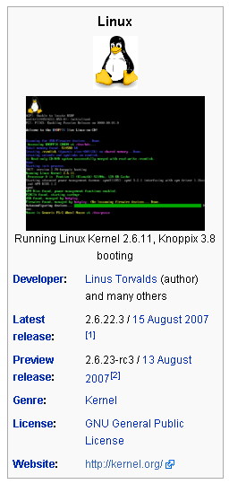
Linux kernel
A Unix-like OS kernel
  Namesake of the Linux family of operating systems
  Released under the GNU General Public License (GPL)
  Developed by contributors worldwide
Linux is one of the most prominent examples of free and open source software

Slide 9

Linux kernel (cont.)
Written by Linus Torvalds in 1991
  Early on, the Minix community contributed code and ideas to the Linux kernel
  At the time, the GNU Project had created many of the components required for a free software operating system, but its own kernel, GNU Hurd, was incomplete and unavailable
  BSD operating system had not yet freed itself from legal encumbrances
  Meant that despite the limited functionality of the early versions, Linux rapidly accumulated developers and users who adopted code from those projects for use with the new operating system
  Today the Linux kernel has received contributions from thousands of programmers
Linus Torvalds, creator of the
Linux kernel.

Slide 10
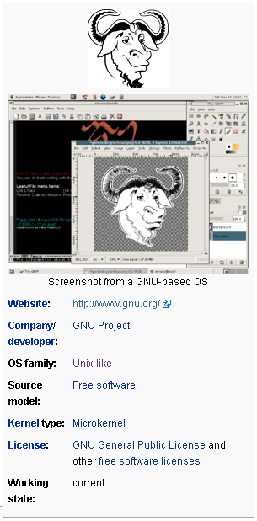
GNU
A computer operating system composed entirely of “free software”
  GNU is a recursive acronym
    GNU's Not Unix
  Design is Unix-like
    Differs from Unix by being free software and by not containing any Unix code
  GNU founded by Richard Stallman
    Original focus of the Free Software Foundation (FSF)
Project to develop GNU is known as the GNU Project
  Programs released under the auspices of the GNU Project are called GNU packages or GNU programs

Slide 11
Linux distribution
A Linux distribution
  Member of the Linux family of Unix-like operating systems
  Contains:
    Linux kernel
    Non-kernel parts of the GNU operating system
    Assorted other software

Slide 12
Linux distribution
Often simply called a distribution or distro
  Linux distributions have taken a wide variety of forms
    From fully-featured desktop and server operating systems
    To minimal environments
      Typically for use in embedded systems, or for booting from a floppy
      Live: boots from a CD or DVD
    Most (if not all) of the kernel and software packages are free and open source
  A "distro" simply refers to a particular assortment of applications married with a particularly compiled kernel
    “Out-of-the-box" capabilities meets most of the needs of its particular end-user base
    Aside from certain custom software
      such as installers and configuration tools

Slide 13
Linux distribution
Currently over three hundred Linux distribution projects in active development
  Constantly being revised and improved
Commercially-backed distributions
  Fedora (Red Hat), SUSE Linux (Novell), Ubuntu (Canonical Ltd.) and Mandriva Linux
Community distributions
  Debian and Gentoo
The bigger the user base for the distribution
  More elaborate procedures for assembling and testing a distribution prior to release
Wikipedia:
  http://en.wikipedia.org/wiki/List_of_Linux_distributions

Slide 14
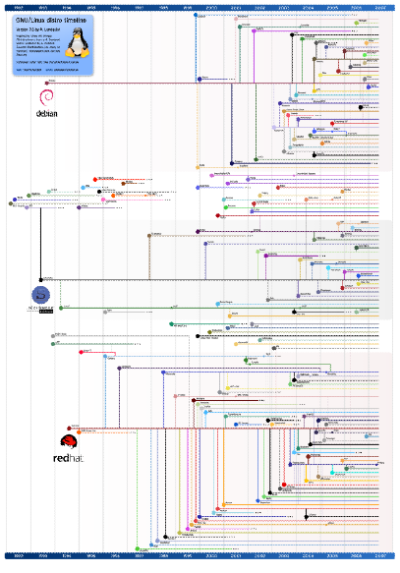
Linux Distribution Genesis
Timeline representing the development of various Linux distributions
Circa 2008

Slide 15
Choosing a Linux distribution
Debian
  A non-commercial distribution maintained by a volunteer developer community with a strong commitment to free software principles
  Ubuntu
    User friendly version of Debian
Red Hat Enterprise Linux
  Maintained by the American company of the same name
  Provides a community version in the form of Fedora
  CentOS
    A distribution derived from the same sources used by Red Hat
    Maintained by a dedicated volunteer community of developers with both 100% Red Hat - compatible versions
    An upgraded version available that is not always 100% upstream compatible

Slide 16
User interfaces in computing
User Interface (UI)
  Textual, Graphical, and/or Auditory information
    User sends commands to system
    System presents information to the user
  Control sequences to control the program
    User presents to the program
      Keystrokes with the computer keyboard
      Movements of the computer mouse
      Selections with the touch screen….

Slide 17
User interfaces in computing
Graphical User Interfaces (GUI)
  Accept input via devices
    Computer keyboard
    Mouse
  Provide articulated graphical output
    Standard output device (computer monitor)
Command Line Interfaces (CLI)
  User provides the input by typing a command string on the Standard Input Device
    Computer keyboard
    Printing terminal
  System provides output by printing text on the Standard Output Device
    Computer Monitor
    Printing terminal

Slide 18
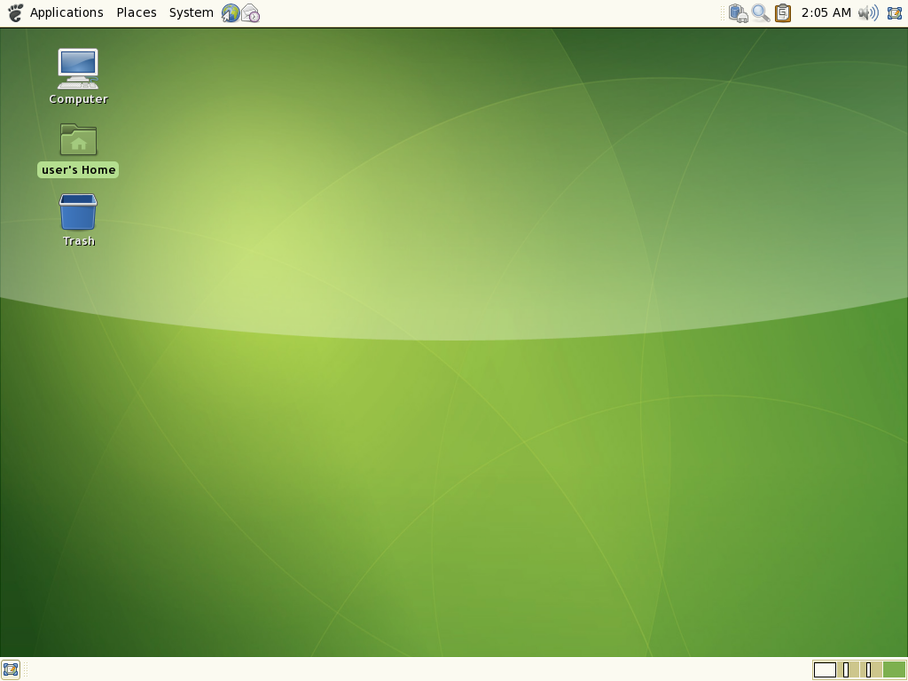
GUI: A typical GNOME 2.18 desktop
Today, GNOME and KDE are the dominant solutions, and often installed by default on Linux systems.

Slide 19
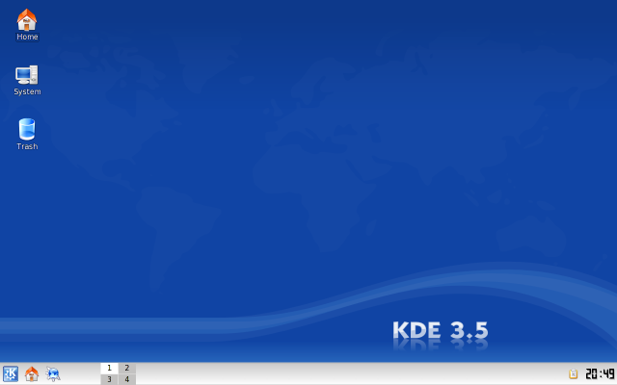
GUI: Screenshot of KDE 3.5.7 showing the default desktop

Slide 20
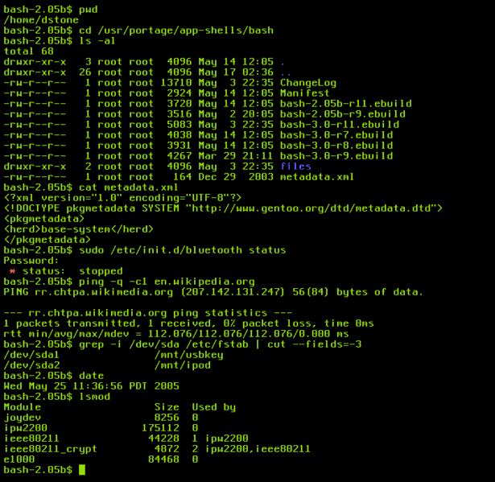
Linux systems usually provide a CLI of some sort through a shell, the traditional way of interacting with Unix systems.
Bash screenshot

