Slide 1
vi Introduction
Tony Kombol

Slide 2
Text Editors
Why text edit?
  Many programs and features require configuration
    Configuration is kept in files
      Usually in the /etc directory
  Changes typically done via:
    Text editor
      Almost all programs/devices have text configuration files
      Gives total control in configuring
    GUI
      May or may not have a GUI configuration program available
      Limited control via GUIs
        Can only do what the GUI is programmed to change

Slide 3
Text Editors
Why vi?
  It’s not pretty
  It’s not intuitive
  It’s not easy to use
  But: it’s everywhere
    Every Linux distro and UNIX system comes with vi or it’s cousin vim (vi improved)
    It is also a very powerful editor

Slide 4
vi basics
vi has two modes:
  Command mode
    Tells editor what to do next:
      insert
      save
      quit
      etc.
    Also allows navigation
  Insert mode
    Change data in the file
Starts in Command mode
  Bottom line of screen used for commands
  File contents (text) shows in upper lines
  Note: <Esc> will always return you to command mode

Slide 5
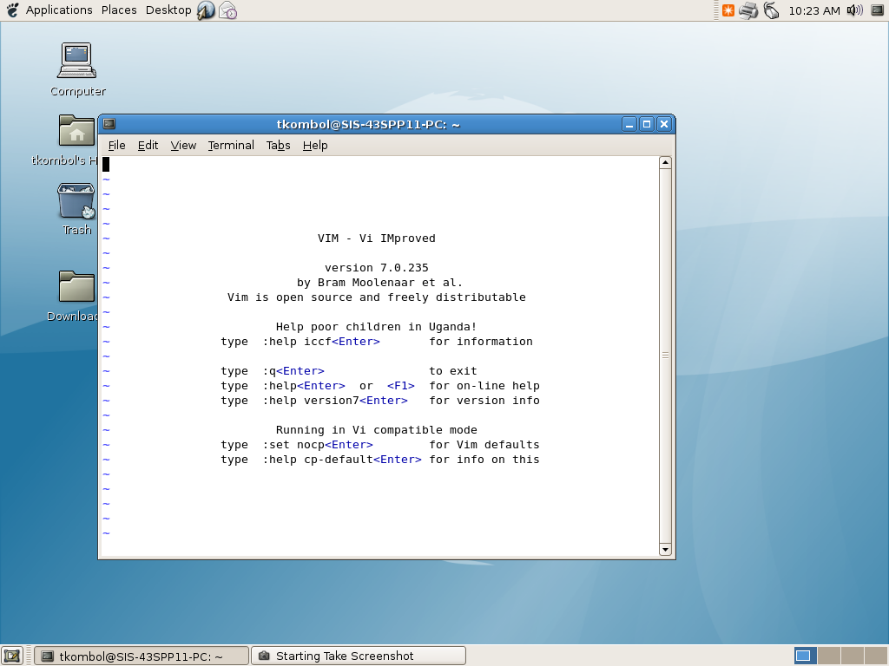
vi opened in Debian Linux

Slide 6
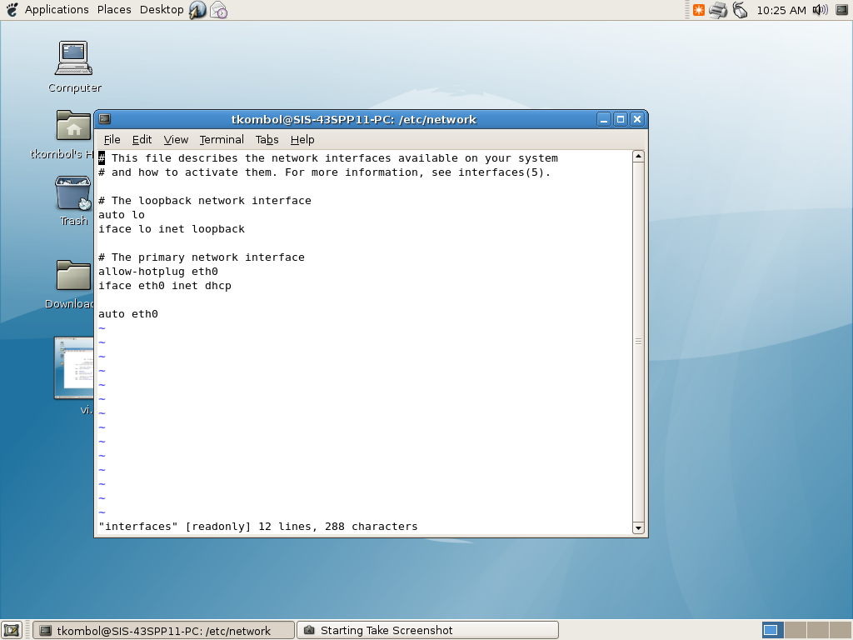
vi opening the /etc/network/interfaces file
Note: /etc/interfaces is owned by root, but user tkombol opened this file to edit. That is allowed, but tkombol does not have the authority to save any changes. Hence the warning of [readonly]

Slide 7
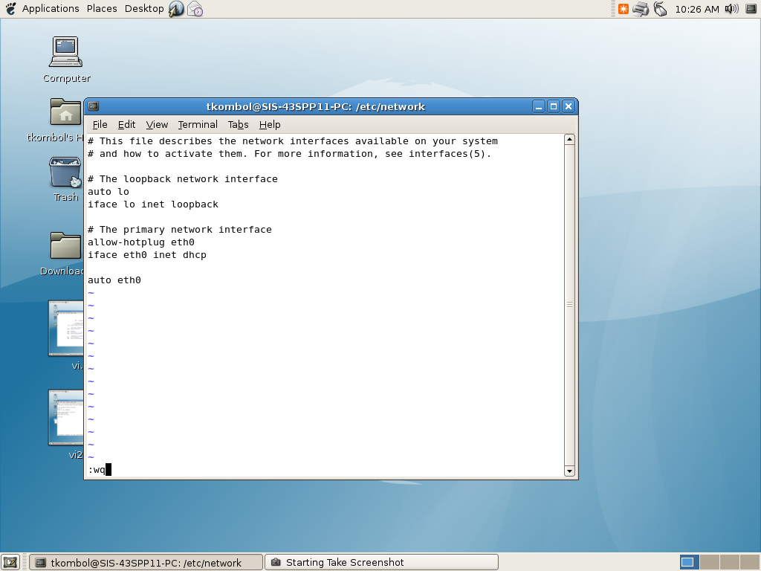
vi trying to write and quit the /etc/network/interfaces file

Slide 8
Basic File Commands
Save and exit:
  Make sure you are in command mode!
    hit <Esc> to be sure
  :w [filename]
    Save (write) the file
    Optional new filename
  :q
    Quit if no changes have been made
    Warn if changes made, will not exit
  :wq
    save file and quit
  :q!
    Force to quit
    Changes, if any, not saved

Slide 9
vi modes
Command/navigation mode
  Navigation
    Move cursor around in the text
  Delete, paste, find, etc.
    Enter commands from this mode
Insert mode
  Enter and edit text characters
  Use <Esc> to return to command mode

Slide 10
vi modes
Common commands to enter insert mode:
  i: insert text just before the cursor
  I: insert text at the beginning of the line the cursor is on
  a: append text after the cursor position
  A: append text at the line’s end
  o: insert a new line after the current line
  O: insert a new line before the current line
  s: substitute the character at cursor position and then insert
  S: substitute the current line
  r: replace the current character
  R: replace the current characters

Slide 11
Delete and block operations
(cut, copy and paste)
Can delete/manipulate characters in command model
In command model, use <v> to start a block operation
  Move cursor to select start of block
  Type v to start the block mark
  Type c to cut block , y to copy
  Type p to paste the block to right position of cursor
use shortcuts for delete
  dd: delete the current line
  dw: delete to end of the current word
use shortcuts for paste
  yy: copy the current line
  yw: copy the current word
  P: paste to the left position of cursor

Slide 12
Undo/redo/delete
u:
  undo last operation
U:
  undo all operations in a line
<ctrl-r>:
  redo
:e!
  give up all operations and begin edit again
x
  delete a character to the right
X
  delete a character to the left

Slide 13
search in text
vi supports to search and find a text in the whole file
  “/” or “?”
From command mode:
  /keyword to search forward (down)
  ?keyword to search backward (up)
Use n to find next

Slide 14
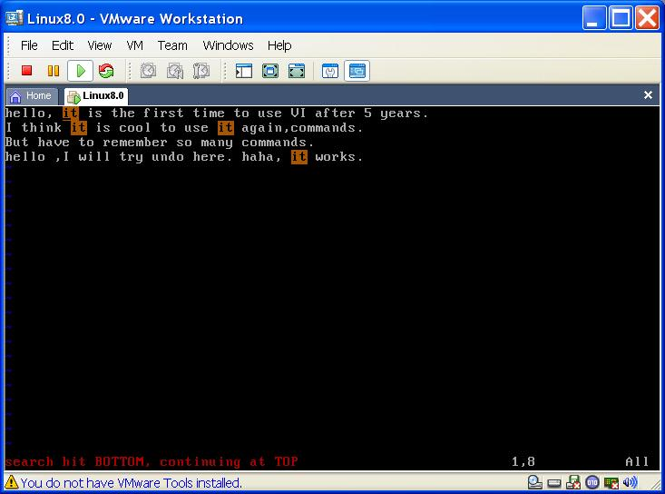

Slide 15
Last Note
The name of VI may change from distro to distro
  vi
  vim
  tinyvm
  Etc…

Slide 16
More resources
http://en.wikipedia.org/wiki/Vi
http://en.wikipedia.org/wiki/Vim_%28text_editor%29

