Slide 1
Lab 05
Firewalls

Slide 2
Firewall
Linux Tricks
  Groups
Firewall
  Insert a Linksys home “router” between:
    VM
    Service (lab servers)
  Configure firewall
    Check working normal
    Block http
    Block ssh

Slide 3
Linux Tricks
Groups

Slide 4
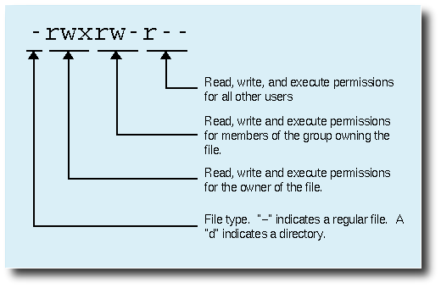
Groups
One of the permission sets
Controls the access to the file by a similar group of users

Slide 5
Key Files/Directories
/etc/passwd
  As before: the users
/etc/shadow
  Encrypted sensitive data
/etc/group
  Contains the group info
/etc/gshadow
  Used by the groups for sensitive data
    Similar to shadow

Slide 6
By GUI
Debian: Users and Groups
Debian:
  Use the Users and Groups panel
  In Applications → System tools → Administration
    Note: Gnome 3 no longer includes Users and Groups as part of the default installation
    Use Synaptic to install gnome-system-tools
  Look for the area to manage groups
    Varies in some Debian versions
  Group will have an option to add a group
    That will have an option to add members to the group
  Will also have a facility to update
    May be called “Properties”
  Will need to know root PW for your VM to use

Slide 7
By CLI
Need to have privileged account
  e.g. root authority
Open appropriate terminal
Many ways to create users and groups:
  E.g. for pre-existing users
    Create the group
      addgroup newgroupname
    add existing users to the group
      usermod –a –G groupname userID
  E.g. to create users in an existing group
    add the new user to an existing group
      useradd –G existingGroup newID
    Set the password for the new user
      passwd newID
Use man to find more options for the above commands

Slide 8
Group File Content
cdrom:x:24:vivek,student13,raj
_____ _ _ _____
| | | |
| | | |
1 2 3 4
Where,
  1 - group_name:
    It is the name of group.
    If you run ls -l command, you will see this name printed in the group field.
  2 - Password:
    Generally password is not used, hence it is empty/blank
    It can store encrypted password
    This is useful to implement privileged groups
    X → use gshadow
  3 - Group ID (GID):
    Each user must be assigned a group ID
    Same as the number in the /etc/passwd file
  4 - Group List:
    List of user names of users who are members of the group
    User names are separated by commas

Slide 9
/etc/group Example
#cat group
root:x:0:
daemon:x:1:
bin:x:2:
sys:x:3:
adm:x:4:lbcat
…
kmem:x:15:
dialout:x:20:tkombol,lbcat
fax:x:21:lbcat
…
audio:x:29:tkombol,lbcat
dip:x:30:lbcat
www-data:x:33:
backup:x:34:
operator:x:37:
…
utmp:x:43:telnetd
video:x:44:tkombol,lbcat
sasl:x:45:
plugdev:x:46:tkombol,lbcat
…
webadmin:x:1002:
web:x:1003:webadmin,tkombol
libuuid:x:117:
sambashare:x:118:
…
#

Slide 10
Gshadow File Content
general:!!:shelley:juan,bob
Where:
  Group name
    Name of the group
  Encrypted password
    !: no user is allowed to access the group using the newgrp command
    !!: same as !
      It also indicates that a password has never been set before
    If the value is null, only group members can log into the group.
  Group administrators
    Comma delimited list
    Can add or remove group members using the gpasswd command
  Group members
    Comma delimited list
    Regular, non-administrative members of the group
    Should be the same as in group

Slide 11
Firewall

Slide 12
Step 1: Set up HW
IP address assigned by:
- WAN side DHCP
- User Via Web interface
Port 1
switch
WAN or Internet
Linksys Router
Default IP: 192.168.1.1
VM on PC
192.168.1.n
(DHCP assigned
by Linksys)
Hades Server
Wall Connection
172.16.1.x
(DHCP assigned
by hades.lab)

Slide 13
Linksys Web Link
Sample Web
  http://ui.linksys.com/WRT54G/v5/1.00.2/Setup.htm

Slide 14
Lab Overview
Reset a Linksys router to factory defaults
Connect router between PC and lab server
  Lab side to WAN or Internet
  Workstation to one of the switch ports
Familiarize with router
  Check router WAN side IP address
  Check IP addresses assigned to VM(s) and workstation

Slide 15
Lab Overview
Ensure it works
  Try HTTP
    Browse the denoted URLs and IP addresses
  Try ssh
    Enter command to log on
    Do not need to log on
Try restrictions
  Restrict HTTP
  Restrict ssh

Slide 16
“Gotchas”
When you connect through the router you are no longer directly connected in the lab network
  No direct access to the hades server
    Access via the router
  Should have no impact to your VM for this lab
  Might impact how you do screen prints, etc.
  Investigate: can you access the NFS server?
    Why or why not?

Slide 17
Interesting Notes
When you connect the Linksys Router to the lab network
  The WAN (Internet) side gets an IP address from the DHCP server in hades.lab
  Linksys has its own DHCP server
    Enabled by default
    It grants addresses to elements connected to the LAN side
Use those facts to your advantage!

Slide 18
Notes:
Note: browsers and other devices can cache old results
  May need to force refresh

Slide 19
Other notes:
Firewall can be
  A piece of hardware inserted between pc and world
  Some software
  Both
Can block/pass
  MAC addresses
  IP addresses
  Specific hours
  Specific services (protocols)
  By ranges…
  AND MORE!
Capability varies by device

