Slide 1

ITIS2110
Lab 8

Slide 2
Scenario
There are web network problems at your site
Your manager has assigned you to track down the problem
  He “highly” suggests you use Wireshark to troubleshoot

Slide 3
Wireshark overview

Slide 4




Acknowledge
This document is basically a digest from “Wireshark User's Guide 25114 for Wireshark 1.0.0”
You can download the software and document at www.wireshark.org
  http://wiki.wireshark.org
All logos and trademarks in this document are property of their respective owner.

Slide 5
What is Wireshark?
Wireshark is a network packet/protocol analyzer
  A network packet analyzer will try to capture network packets and tries to display that packet data as detailed as possible
  It will format known protocols to make them more easily read
Wireshark is perhaps one of the best open source packet analyzers available today for UNIX and Windows

Slide 6
Some intended purposes
Network administrators use it to
  troubleshoot network problems
Network security engineers use it to
  examine security problems
Developers use it to
  debug protocol implementations
People use it to
  learn network protocol internals
Wireshark isn't an intrusion detection system (ids)
Wireshark will not manipulate things on the network
  Only monitors data visible on the port it is connected to

Slide 7
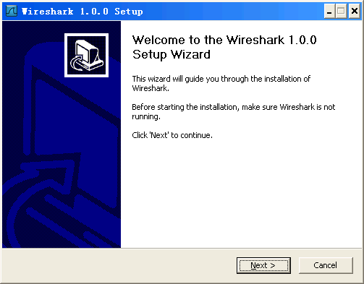
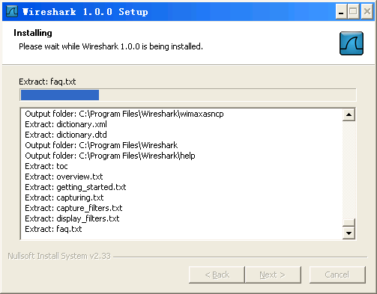
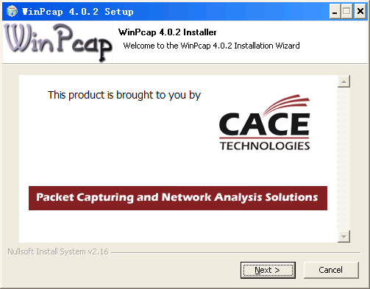
Install under Windows
Download
Install

Slide 8
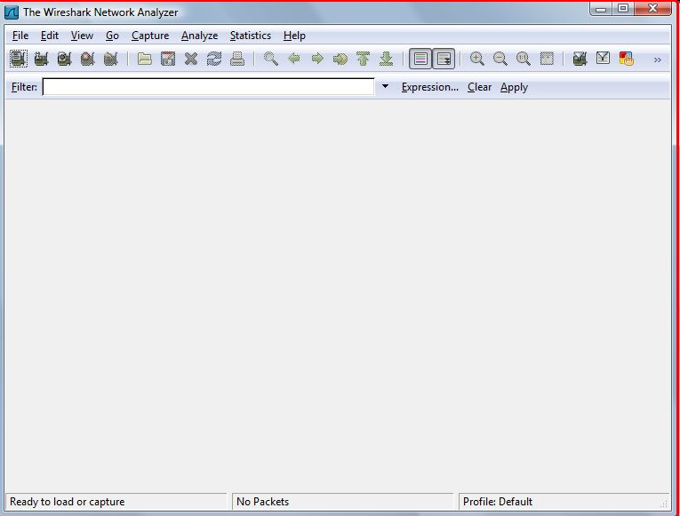
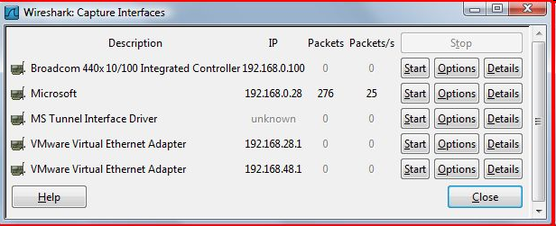
Install under Debian/ Ubuntu
# apt-get install wireshark

Slide 9
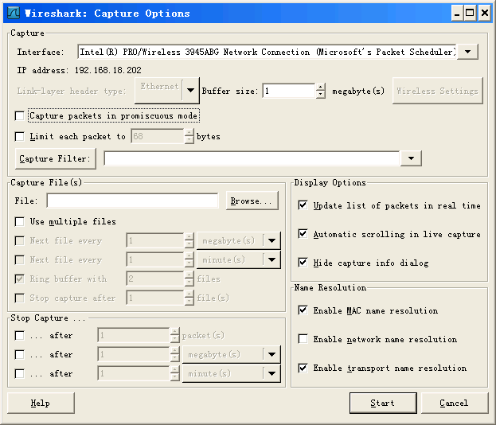
Configuration
This checkbox allows you to specify that Wireshark should put the interface in promiscuous mode when capturing. If you do not specify this, Wireshark will only capture the packets going to or from your computer (not all packets on your LAN segment).

Slide 10
IMPORTANT
In the real world:
  TURN PROMISCUOUS MODE OFF!
IF YOU'RE AT WORK, YOUR NETWORK ADMINISTRATOR MAY SEE YOU RUNNING IN PROMISCUOUS MODE
  SOMEBODY MAY DECIDE TO FIRE YOU FOR THAT

Slide 11
Videos
Wireshark Introduction
  http://media-2.cacetech.com/video/wireshark/introduction-to-wireshark/
Hak5 Wireshark
  http://hak5.org/episodes/haktip-64

Slide 12
More resources
http://wiki.wireshark.org
http://www.wireshark.org/docs/
Look on lab302-web.hades.lab for manual
  also at
    file:///student/ajkombol/Wireshark
Has a large and chunked version

Slide 13
Lab 8
Install Wireshark via terminal
Learn how to use
Capture some data
  Some specific Web (http) traffic
  ARP and DHCP
  Wireshark has options to save text data
Submit a report
20 pts

Slide 14
Notes
rcp vs scp
  rcp: remote copy
    Pure ascii/binary copy
  scp: secure copy
    Encrypts date before sending it
  When would rcp be better than scp?
See what happens on your machines when you compare rcp vs. scp
  Note: someone decided to “help” you
Try the fix
  Install the rsh-client on your VM
  Why doesn’t the fix “work”

Slide 15
Notes
SSH
  Secure logon to another system
  This is where the default prompt on the Linux systems pays off!
  uid@system:dir
Wireshark
  Although Wireshark is a GUI it works with text data
  Document as text

