Slide 1
Computing Basics

Slide 2
Data Organization

Slide 3
Data/Information Organization
Bit
Byte
  Nybble (½ byte)
Word
Double word
Etc.

Slide 4
Bit
One single “bit” of information
  Binary digiT
Contains one piece of binary information
  → two unambiguous states
    0/1
    true/false
    on/off
    yes/no
    0v/5v
    etc…

Slide 5
Byte
Associated collection of 8 bits
Can be assigned values:
  Numeric
    Integer
      Signed: -128 ← → 127
      Unsigned: 0 ← → 255
  Character: arbitrary assignments
    ASCII
      Most modern computers
    EBCDIC
      IBM Mainframe

Slide 6
Historical Note:
Byte referred to a machines character size
  Historically could be 6 or 7 or 8 bits
Octet
  A formal definition of an 8 bit unit
2002: IEEE formalized “B” as the symbol for a byte
  “o” is the symbol for octet
  “b” is the symbol for bit

Slide 7
Word
String of bits of an arbitrary length depending the on architecture of a referenced machine
  8 bits
    1st generation microprocessors
  16 bits
    1st generation mini-computers
    2nd generation microprocessors
  32 bits
    1st generation modern business mainframes
    2nd generation mini-computers
    3rd generation microprocessors
  64 bits
    2nd generation business mainframes
    3rd generation “minis”
    4th generation microprocessors
  128 bits
    Some GPUs
    PS3 - 128 bit registers

Slide 8
Historical Note:
Not all computers had word lengths that were multiples of 8 bits
  DEC PDP-8: 12 bits
  DEC PDP-10: 36 bits
  IBM 705: variable decimal (0-255)

Slide 9
Dword, Qword, Oword
Dword – Double word
  8 bit computers: 16 bits
  16 bit computers: 32 bits
    Most common – 4 bytes
Qword – Quad word
Oword – Octuple word

Slide 10
What is the largest integer value for an unsigned byte?
127
128
255
256
unlimited
30
30 sec

Slide 11
Data Types

Slide 12
Data Types
Numbers
  Integers
  Floating Point
    Real Numbers
Strings
  Collection of characters
  Length:
    Terminated
      Null (/0), New Line (/n), etc.
    Count field

Slide 13
Numeric Data
Part 1

Slide 14
Numbering Systems
Quick Overview

Slide 15
Decimal
  Counting example:
    000
    001
    002
    …
    009
    010
    011
    …
    019
    020
    021
    …
    089
    090
    091
    …
    099
    100
    101
    etc…
“Normal Numbers”
Ten symbols:
  Digits: 0, 1, 2, 3, 4, 5, 6, 7, 8, 9
342
Hundreds
Tens
Units

Slide 16
Binary
Two Values
  Represented by 2 symbols
    0 or 1
      ‘true’ or ‘false’
      ‘on’ or ‘off’
      0V or 5V
    Counting example:
      0000
      0001
      0010
      0011
      0100
      0101
      0110
      0111
      1000
      1001
      etc…
101
Hundreds
Tens
Units

Slide 17
Hexadecimal (Hex)
Sixteen Values
  Collection of 4 bits represented by 16 symbols
    0, 1, 2, 3, 4, 5, 6, 7, 8, 9, A, B, C, D, E, F
  Conveniently also a nybble
    ½ a byte
A19
Hundreds
Tens
Units

Slide 18
Hex Counting Example
00
01
02
03
04
04
06
07
08
09
0a
0b
0c
0d
0e
0f
10
11
12
13
14
14
16
17
18
19
1a
1b
1c
1d
1e
1f
20
21
22
23
24
24
26
27
28
29
2a
2b
2c
2d
2e
2f
…
90
91
92
93
94
94
96
97
98
99
9a
9b
9c
9d
9e
9f
a0
a1
a2
a3
a4
a4
a6
a7
a8
a9
aa
ab
ac
ad
ae
af
…
e0
e1
e2
e3
e4
e4
e6
e7
e8
e9
ea
eb
ec
ed
ee
ef
f0
f1
f2
f3
f4
f4
f6
f7
f8
f9
fa
fb
fc
fd
fe
ff

Slide 19
Hexadecimal
Two hex numbers can conveniently represent 1 byte or octet
  Gives 8 bits total
  E.g:
    1F = 0001 1111
    0C = 0000 1100
    33 = 0011 0011
    CF = 1100 1111

Slide 20
How many different symbols (values) are there in hexadecimal?
2
7
8
15
16
31
32
64
30 sec countdown
30

Slide 21
Octal
Eight values
  Collection of 3 bits to represent 8 values
    0, 1, 2, 3, 4, 5, 6, 7
  Handy representation in some environments
    Linux permissions
    PDP-8 achitecture

Slide 22
Octal Counting example
000
001
002
003
004
005
006
007
010
011
012
013
014
015
016
017
020
021
022
023
024
025
026
027
030
031
032
033
034
035
036
037
…
060
061
062
063
064
065
066
067
070
071
072
073
074
075
076
077
100
101
102
103
104
105
106
107
110
111
112
113
114
115
116
117
…
160
161
162
163
164
165
166
167
170
171
172
173
174
175
176
177
200
201
202
203
204
205
206
207
210
211
212
213
214
215
216
217
…

Slide 23
Binary, Octal, Decimal and Hexadecimal Comparisons
Binary Value | Octal Value | Decimal Value | Hex Value |  | Binary Value | Octal Value | Decimal Value | Hex Value
0000 | 00 | 0 | 0 |  | 1000 | 10 | 8 | 8
0001 | 01 | 1 | 1 |  | 1001 | 11 | 9 | 9
0010 | 02 | 2 | 2 |  | 1010 | 12 | 10 | A
0011 | 03 | 3 | 3 |  | 1011 | 13 | 11 | B
0100 | 04 | 4 | 4 |  | 1100 | 14 | 12 | C
0101 | 05 | 5 | 5 |  | 1101 | 15 | 13 | D
0110 | 06 | 6 | 6 |  | 1110 | 16 | 14 | E
0111 | 07 | 7 | 7 |  | 1111 | 17 | 15 | F
Memorize this table!

Slide 24
Binary – Decimal Conversions
Memorize this table!
Bits are designated by their position, from right to left, starting with 0 for the least significant bit (lsb) up to the most significant bit (msb)
  Bit 0 is the lsb
  In a 16 bit word bit 15 is the msb
The value of the binary number is the sum of all the values of the bits (a 1 or 0) times 2 raised to the power of the bit position
  Note: the values can be extended by doubling the decimal value for each increase in the position number
  CNI Appendix C.1 has more info
… | 2¹⁰ | 2⁹ | 2⁸ | 2⁷ | 2⁶ | 2⁵ | 2⁴ | 2³ | 2² | 2¹ | 2⁰
… | 1024 | 512 | 256 | 128 | 64 | 32 | 16 | 8 | 4 | 2 | 1

Slide 25
Conversions
Decimal to Hex
  Find largest power of 2 less than the number
    Write down its binary pattern
      8 → 2³ → 1000 (1 with 3 zeros following)
      64 → 2⁶ → 100000 (1 with 6 zeros following)
  Subtract that power value from the number
  Repeat the top two steps until 0 left
  Add up the binary numbers
  Convert to hex

Slide 26
Conversions
Hex to Decimal
  Write Hex as a binary string
  Write down corresponding decimal value for each binary 1
  Add up values

Slide 27
Conversions
85₁₀ → Hex
157₁₀ → Hex
16_{H} → Decimal
7E_{H} → Decimal

Slide 28
A_{H}=?₁₀
10
11
12
13
14
15
30
30 sec

Slide 29
What is the largest octal character?
1
2
7
8
9
10
E
F
30
30 sec

Slide 30
Resume 1/18

Slide 31
Character Data

Slide 32
Character Encoding
Use bit patterns to represent characters
  And other punctuation/information
Big three:
  ASCII
  UNICODE
  EBCDIC (IBM mainframes)
Note: the character “1” has a different value than the integer 1

Slide 33
ASCII
7 bits formally defined
  7 least significant bits of a byte
    →128 values
    8th bit set to 0
  8th bit set to 1 can be used for informal and de facto extensions
    IBM PC graphics
    Language character extensions
    Special character extensions

Slide 34
Sidebar
What is CRLF?
  How many characters is CRLF?

Slide 35
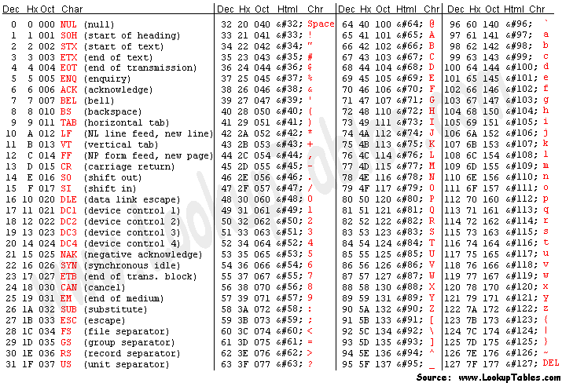
Base ASCII Codes

Slide 36
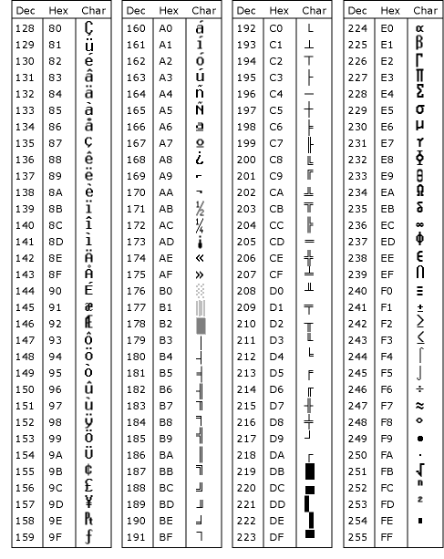
One example of an extended ASCII Code

Slide 37
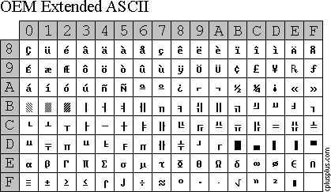
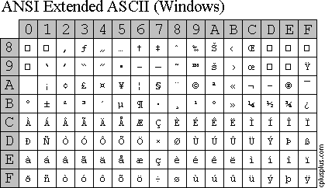

Slide 38
IBM PC (OEM) code pages
These code pages were designed to be compatible with text modes provided by graphics adapters, including VGA compatible text mode, that were used with MS-DOS and its clones. This limited code pages to 256 points, which often include box-drawing characters. Since the original IBM PC code page (number 437) was not really designed for international use, several incompatible variants emerged. Microsoft refers to these as the OEM code pages.
Examples include:
437 — The original IBM PC code page
737 — Greek
775 — Estonian, Lithuanian and Latvian
850 — "Multilingual (Latin-1)" (Western European languages)
852 — "Slavic (Latin-2)" (Central and Eastern European languages)
855 — Cyrillic
857 — Turkish
858 — "Multilingual" with euro symbol
860 — Portuguese
861 — Icelandic
862 — Hebrew
863 — French Canadian
865 — Nordic
866 — Cyrillic
869 — Greek
874 — Thai^{[4]}

Slide 39
EBCDIC
IBM Developed Code
  Extended Binary Coded Decimal Interchange Code
Used by mainframes
Extended from BCD
  8 bits used

Slide 40
 | 00 | 10 | 20 | 30 | 40 | 50 | 60 | 70 | 80 | 90 | A0 | B0 | C0 | D0 | E0 | F0
0 | NUL | DLE | DS |  | SP | & | - |  |  |  |  |  | { | } | \ | 0
1 | SOH | DC1 | SOS |  |  |  | / |  | a | j | ~ |  | A | J |  | 1
2 | STX | DC2 | FS | SYN |  |  |  |  | b | k | s |  | B | K | S | 2
3 | ETX | DC3 |  |  |  |  |  |  | c | l | t |  | C | L | T | 3
4 | PF | RES | BYP | PN |  |  |  |  | d | m | u |  | D | M | U | 4
5 | HT | NL | LF | RS |  |  |  |  | e | n | v |  | E | N | V | 5
6 | LC | BS | ETB | UC |  |  |  |  | f | o | w |  | F | O | W | 6
7 | DEL | IL | ESC | EOT |  |  |  |  | g | p | x |  | G | P | X | 7
8 | GE | CAN |  |  |  |  |  |  | h | q | y |  | H | Q | Y | 8
9 | RLF | EM |  |  |  |  |  | ` | i | r | z |  | I | R | Z | 9
A | SMM | CC | SM |  | ¢ | ! |  | :
B | VT | CU1 | CU2 | CU3 | . | $ | , | #
C | FF | IFS |  | DC4 | < | * | % | @
D | CR | IGS | ENQ | NAK | ( | ) | _ | '
E | SO | IRS | ACK |  | + | : | > | =
F | SI | IUS | BEL | SUB | | | ^ | ? | " |  |  |  |  |  |  |  | PAD

Slide 41
UNICODE
2 bytes to represent a character
  64K (65536) combinations
    0-65535
Especially useful when Internationalizing code
The ASCII characters are the first 128 values in UNICODE
  Basic Latin
http://unicode.org/charts/

Slide 42
Last Notes
Representation in text or programming languages:
  Binary
    Subscript 2: 101₂
    *Prefix b: 0b0101
  Octal
    Subscript 8: 755₈
    *Prefix 0 or o: 0755 or o755
  Decimal
    Subscript 10: 8394₁₀
    Nothing 8394
  Hexadecimal
    Subscript H: F8_{H}
    *Prefix x or 0x: x77f3 or 0x77f3
*Prefix notation are usually used by programming languages and notation varies by the language. Check your language for its notation.

