Slide 1
DNS
Domain Name Systems
Theory

Slide 2
How DNS works
Theory

Slide 3
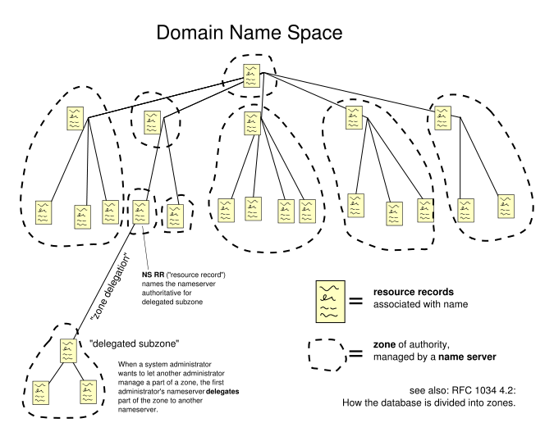
How DNS Works - Theory
Domain names
  Arranged in a tree
    Cut into zones
      Each served by a nameserver

Slide 4
How DNS Works - Theory
Domain name space consists of a tree of domain names
  Each node or leaf in the tree
    Has one or more resource records
    Holds information associated with the domain name
  The tree sub-divides into zones
    Zone consists of a collection of connected nodes
    Authoritatively served by an authoritative DNS nameserver
    Note that a single name server can host several zones

Slide 5
How DNS Works - Theory
When a system administrator wants to let another administrator control a part of the domain name space within his or her zone of authority
  Can delegate control to the other administrator
  Splits a part of the old zone off into a new zone
    Comes under the authority of the second administrator's name servers
  The old zone becomes no longer authoritative for what goes under the authority of the new zone

Slide 6
How DNS Works - Theory
Resolver looks up the information associated with nodes
  Knows how to communicate with name servers
    Sends DNS requests
    Heeds DNS responses
  Resolving usually entails iterating through several name servers to find the needed information
Some resolvers function simplistically and can only communicate with a single name server
  These simple resolvers rely on a recursing name server to perform the work of finding information for them

