Slide 1
Networked Storage
SAN and NAS

Slide 2
SAN
Storage Area Network
http://en.wikipedia.org/wiki/Storage_area_network

Slide 3
Storage Area Network (SAN)
An architecture to attach (remote) computer storage devices to servers
  Devices appear as locally attached to the operating system
    disk arrays, tape libraries, optical jukeboxes, etc.
  Device may be near, but not physically in the server like local storage is
    Device may be remote
  Cost and complexity is dropping
    SANs are still uncommon outside larger enterprises

Slide 4
Storage Area Network (SAN)
Works at the disk address level (block)
NAS contrasted to a SAN:
  network-attached storage (NAS)
    uses file-based protocols
      E.g. NFS or SMB/CIFS
    It is clear that the storage is remote
    Computers request an abstract file rather than a disk block

Slide 5
SAN
Network types

Slide 6
Network types
Most storage networks use the SCSI protocol for communication between servers and disk drive devices
  Does not use the SCSI low-level physical interface (e.g. electronics and cables)
    Its bus topology is unsuitable for networking

Slide 7
Network types
To form a network, a mapping layer is used to other low-level protocols:
  Fibre Channel Protocol (FCP)
    Maps SCSI over Fibre Channel
    Currently the most common.
  iSCSI
    Maps SCSI over TCP/IP
  HyperSCSI
    Maps SCSI over Ethernet
  FICON
    Maps over Fibre Channel (used by mainframe computers)
  ATA over Ethernet
    Mapping ATA over Ethernet
  SCSI and/or TCP/IP mapping over InfiniBand (IB)

Slide 8
SAN
Storage sharing

Slide 9
Storage sharing
SAN market Driving forces:
  Rapid growth of highly transactional data
  Requires high speed, block-level access to hard drives
    Data from email servers
    Databases
    High usage file servers
Historically
  Enterprises created "islands" of high performance SCSI disk arrays
  Each island was dedicated to a different application and visible as a number of "virtual hard drives"
    LUNs (Logical Unit Numbers)
SAN essentially connected those storage islands using a high-speed network
Operating system sees a SAN as a collection of LUNs
  Each maintains its own file systems on them

Slide 10
Storage sharing
Most reliable and most widely used are the local file systems
  Cannot be shared among multiple hosts
  If two independent local file systems resided on a shared LUN, they would be unaware of the fact
    Have no means of cache synchronization
    Eventually would corrupt each other
  Sharing data between computers through a SAN requires advanced solutions
    SAN file systems
    Clustered computing

Slide 11
Storage sharing
Despite such issues, SANs help to increase storage capacity utilization
  Multiple servers share the same growth reserve on disk arrays
In contrast, NAS allows many computers to access the same file system over the network and synchronizes their accesses
  Lately, the introduction of NAS heads allowed easy conversion of SAN storage to NAS

Slide 12
SAN
Benefits

Slide 13
Benefits
Sharing storage usually:
  Simplifies storage administration
  Adds flexibility
    Cables and storage devices do not have to be physically moved to move storage from one server to another
Side note:
  Spring 2016: 1 petabyte
    ~ $50,000 to $500,000
    Depending on speed, backup, etc.
    Aberdeen 1 PB SAN: $375,000
      High reliability
      Expandable to 4.3PB

Slide 14
Benefits
Other benefits include
  Ability to allow servers to boot from the SAN itself
    Allows for a quick and easy replacement of faulty servers
      The SAN can be reconfigured so that a replacement server can use the LUN of the faulty server
    Process can take as little as half an hour
      Relatively new idea being pioneered in newer data centers
    Number of emerging products designed to facilitate and speed up this process still further

Slide 15
Benefits
More effective disaster recovery processes
  SAN can span a distant location containing a secondary storage array
  Enables storage replication either implemented by
    disk array controllers
    server software
    specialized SAN devices
  IP WANs are often least costly method of long-distance transport
    Fibre Channel over IP (FCIP) and iSCSI protocols have been developed to allow SAN extension over IP networks
  Traditional physical SCSI layer could only support a few meters
    not nearly enough to ensure business continuance in a disaster.
  Demand for this SAN application has increased dramatically after the September 11th attacks in the United States, and increased regulatory requirements associated with Sarbanes-Oxley and similar legislation.

Slide 16
Benefits
Consolidation of disk arrays economically accelerated advancement of some of their advanced features:
  I/O caching
  Snapshotting
  Volume cloning
    Business Continuance Volumes or BCVs

Slide 17
SAN
SAN infrastructure

Slide 18
SAN infrastructure
SANs often utilize a Fibre Channel fabric topology
  Infrastructure specially designed to handle storage communications
  Provides faster and more reliable access than higher-level protocols used in NAS
  A fabric:
    Similar in concept to a network segment in a local area network
  A typical Fibre Channel SAN fabric is made up of a number of Fibre Channel switches.

Slide 19
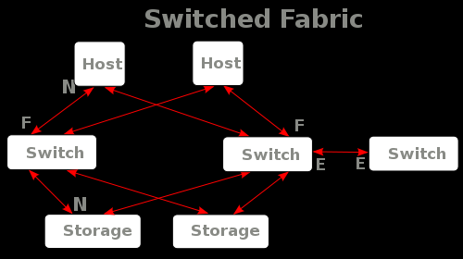
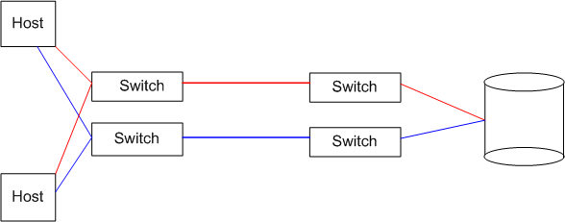
Fibre Channel/Fabric Example

Slide 20
SAN infrastructure
All major SAN equipment vendors also offer some form of Fibre Channel routing solution
  Bring substantial scalability benefits to the SAN architecture
    Allows data to cross between different fabrics without merging them
    Use proprietary protocol elements
    Top-level architectures being promoted are radically different
  Often enable mapping Fibre Channel traffic over IP or over SONET/SDH

Slide 21
SAN
Compatibility

Slide 22
Compatibility
Early problems with Fibre Channel SANs
  Switches and other hardware from different manufacturers were not entirely compatible
  Basic storage protocols FCP were standard
    Some of the higher-level functions did not interoperate well.
  Many host operating systems would react badly to other operating systems sharing the same fabric
  Many solutions were:
    Pushed to the market before standards were finalized
    Vendors innovated around the standards.

Slide 23
Compatibility
The combined efforts of the members of the Storage Networking Industry Association (SNIA) improved the situation during 2002 and 2003
Today most vendor devices interoperate nicely
  There are still many high-level functions that do not work between different manufacturers’ hardware

Slide 24
SAN
SANs in the Media and Entertainment

Slide 25
SAN
Storage virtualization and SANs

Slide 26
Storage virtualization and SANs
Storage virtualization
  Process of completely abstracting logical storage from physical storage
The physical storage resources are aggregated into storage pools
  Logical storage is created from the pool
Presents the user a logical space for data storage
  Transparently handles the process of mapping it to the actual physical location
Naturally implemented inside each modern disk array
  Using vendor's proprietary solution
Goal is to virtualize multiple disk arrays into a single monolithic storage device
  Made by different vendors
  Scattered over the network
  Can be managed uniformly

Slide 27
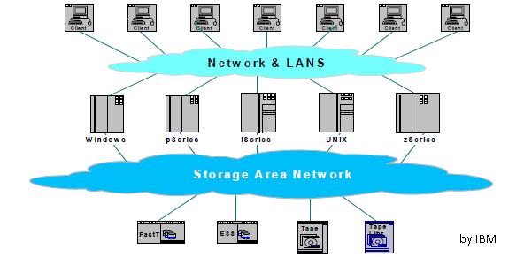
SAN Last note
SANs usually have their own network
  Kept separate from the “normal” network
    High speed
    Kept physically secure
      Don’t slow down with encryption, etc

Slide 28
NAS
Network Attached Storage
http://en.wikipedia.org/wiki/Network-attached_storage

Slide 29
Network-attached storage (NAS)
A file-level computer data storage
  Connected to a computer network
  Providing data access to heterogeneous network clients

Slide 30
NAS
Description

Slide 31
Description
NAS hardware is similar to the traditional file server equipped with direct attached storage (DAS)
  Differs considerably on the software side
  Operating system and other software on the NAS unit provides:
    Data storage
    Data access
    Management of these functionalities
  Use of NAS devices for other purposes is discouraged
  Many vendors also purposely make it hard to develop or install any third-party software on their NAS device
    Use closed source operating systems and protocol implementations
Basically, NAS devices are server appliances

Slide 32
Description
NAS units are commonly controeled through a web interface
  As opposed to monitor/keyboard/mouse
Minimal-functionality or stripped-down operating systems are used on NAS devices
  E.g. FreeNAS is in fact a "leaned-out" version of FreeBSD
    An open source NAS software meant to be deployed on standard computer hardware

Slide 33
Description
NAS systems usually contain one or more hard disks
  Arranged into logical, redundant storage containers or RAIDs
    Same as traditional file servers
  NAS removes the responsibility of file serving from other servers on the network
NAS uses file-based protocols such as
  NFS (popular on UNIX systems)
  SMB (Server Message Block) (MS Windows systems)
  NAS units rarely limit clients to only one protocol

Slide 34
Description
NAS provides both storage and filesystem
Often contrasted with SAN
  Provides only block-based storage
  Filesystem concerns left for the "client" side

Slide 35
Description
Boundaries between NAS and SAN systems starting to overlap
  Some products making the obvious next evolution
    Offering both file level protocols (NAS) and block level protocols (SAN) from the same system.
  However a SAN device is usually served through NAS as one large flat file, not as a file system per se.
  An example of this is Openfiler, a free product running on Linux

Slide 36
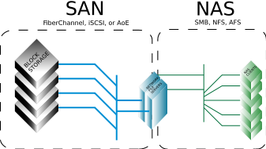

Slide 37
NAS
History

Slide 38
History
Network-attached storage introduced with the early file sharing Novell's NetWare server operating system and NCP protocol in 1983
Sun Microsystems' 1984 release of NFS allowed network servers to share their storage space with networked clients
3Com's 3Server and 3+Share software
  First purpose-built servers (including proprietary hardware, software, and multiple disks) for open systems servers
  Led the segment from 1985 through the early 1990s
3Com and Microsoft developed LAN Manager software and protocol to further this new market

Slide 39
History
Inspired by the success of file servers from Novell, IBM, and Sun, several firms developed dedicated file servers
Auspex Systems
  One of the first to develop a dedicated NFS server for use in the UNIX market
  A group of Auspex engineers split away to create the integrated Network Appliance "filer“
    Supported both Windows and UNIX, in the early 1990s, starting the market for proprietary NAS arrays.
Starting in the early 2000s, a series of startups emerged offering alternative solutions to single filer solutions in the form of clustered NAS

Slide 40
NAS
Benefits

Slide 41
Benefits
Availability of data might potentially be increased with NAS if it provides built-in RAID and clustering
Performance can be increased by NAS because the file serving is done by the NAS
  Not done by a server responsible for also doing other processing
  Performance of NAS devices depends heavily on
    The speed of and traffic on the network
    The amount of cache memory (RAM) on the NAS computers or devices

Slide 42
NAS Benefits
Note that a NAS is basically a server:
  All major components of a typical PC
    CPU, Motherboard, RAM, etc.
  Reliability is a function of how well it is designed
  Note:
    NAS without redundant;
      Data access paths
      Redundant controllers
      Redundant power supplies
    Usually less reliable than Direct Attached Storage (DAS) connected to a server
      Typically does not have redundancy for its major components

Slide 43
NAS
Drawbacks

Slide 44
Drawbacks
Due to the multiprotocol, and the reduced CPU and OS layer, the NAS has its limitations compared to the DAS/FC systems
  DAS: Direct Attached Storage
  FC: Fibre Channel
NAS reaches performance limitations if:
  NAS is occupied with too many users
  too many I/O operations
  CPU processing power that is too demanding
A server system is easily upgraded
  Adding one or more servers into a cluster
  CPU power can be upgraded
  NAS is limited to its own hardware, typically not upgradeable

Slide 45
Drawbacks
NAS may also fail to expose well-known services that are typical of a file server, or enable them in a way that is not efficient
  Examples are:
    Ability to compute disk usage of separate directories
    Ability to index files rapidly (locate)
    Ability to mirrorize efficiently with rsync
  You may still rsync, but through a NFS client
    That method fails to enumerate huge file hierarchies at the nominal speed of local drives
    Induces significant network traffic

Slide 46
Drawbacks
Key differences between DAS and NAS:
  DAS is simply an extension to an existing server and is not “networked”
  NAS sits on a network as its own entity
It is easier to share files with NAS
NAS typically has less CPU and I/O power compared to DAS

Slide 47
NAS
NAS uses

Slide 48
NAS uses
NAS is useful for more than just general centralized storage provided to client computers in environments with large amounts of data.
NAS can enable simpler and lower cost systems such as load-balancing and fault-tolerant email and web server systems by providing storage services.
The potential emerging market for NAS is the consumer market where there is a large amount of multi-media data.
Such consumer market appliances are now commonly available.
  Unlike their rackmounted counterparts, they are generally packaged in smaller form factors.
The price of NAS appliances has plummeted in recent years
  offering flexible network-based storage to the home consumer market for little more than the cost of a regular USB or FireWire external hard disk.
Many of these home consumer devices are built around ARM, PowerPC or MIPS processors running an embedded Linux operating system.
More recently, home NAS devices have incorporated support for the Universal Plug and Play protocol, enabling them to serve the growing number of networked home media players.

Slide 49
Sample low-end products
https://www.synology.com/en-us/
http://www.newegg.com/Product/ProductList.aspx?Submit=ENE&DEPA=0&Order=BESTMATCH&N=-1&isNodeId=1&Description=synology&x=0&y=0
Many vendors
  QNAP
  http://www.drobo.com/

Slide 50
NAS
NAS heads

Slide 51
NAS heads
A NAS head refers to a NAS which does not have any on-board storage, but instead connects to a SAN
  In effect, it acts as a translator between
    File-level NAS protocols (NFS,CIFS,etc.)
    Block-level SAN protocols (Fibre Channel, iSCSI)
It can combine the advantages of both technologies
"NAS head" is sometimes also used to refer to the portion of a self-contained NAS system other than its storage
  An example would be the ONStor Bobcat

Slide 52
NAS
NAS operating systems for consumer PCs

Slide 53
NAS OSs
Open source NAS-oriented distributions of Linux and FreeBSD are also available
  Including FreeNAS, NASLite and Openfiler
  Easy to configure via a Web-based Interface and run on low-end conventional computers.
Can run from
  LiveCD
  Bootable USB flash drive
  One of the mounted hard drives
Run using Samba, NFS daemon, and FTP daemons
  Freely available for those operating systems

Slide 54
Summary

Slide 55
Summary
Both provide storage over a network
  SAN – Block based
    Unformatted
    For one system/user
  NAS – File based
    Formatted
    Can be accessed by many systems/users
World is converging

Slide 56
SAN and NAS serve the same function by sharing disc space on a network.
True
False

