Slide 1
Networks and TCP/IP
Part 1 - Addressing

Slide 2
Quick Preview
Networked devices can only talk to devices they are directly connected to
  Typically via a switch or hub
  Can be a router
All computers in a network have to have unique address
  Includes
    Local computers
    All other computers/devices in the network
Need to change things easily
  Update a network card
  Replace a server with at better one
How can this be reliably (and easily) done?

Slide 3
TCP/IP
Term typically used as a single entity
- BUT in reality is…
Two separate but complementary protocols:
  IP
    Internet Protocol
      How to address machines (find machines)
  TCP
    Transmission Control Protocol
      How to reliably get data to machines (send data)
  Note: TCP is not the only protocol to send data

Slide 4
Part One
Networks in General

Slide 5
Physical Network Technologies
Circuit Switched Network
  Connection oriented
    Establish a solid, “permanent” connection before communication
    Circuit is reserved for exclusive use during the whole communication
    Example: POTS: Plain Old Telephone Service
Packet Switched Network
  Store forward network
    Packet(s) sent from node to node
    Intermediate nodes store and then pass to next node
    Circuits only established to pass packet to next node
    Examples: Post Office, Internet

Slide 6
Network Types by Scope
LAN
  Local area network
    Limited scope
      Single building or a small campus
      More typically homogeneous and high speed
    Typically can access directly
WAN
  Wide Area Networks
    Large region or Continental span
    Typically heterogeneous and lower speed
  Usually need router involved to access
MAN
  Metro-area network
    Regional (city wide)

Slide 7
Layered Model
OSI Model

Slide 8
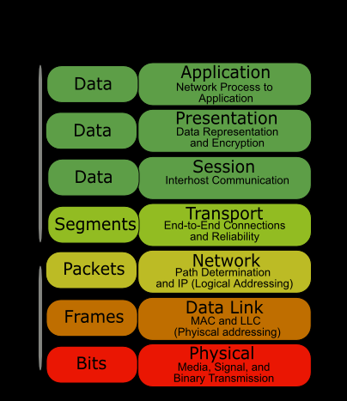
OSI – Open Systems Interconnect
OSI Model
  Open Systems Interconnection
    Not concerned with a particular technology at any level
  7 layers to define communications
  We need only be concerned with the first 3 or 4 layers at the infrastructure level

Slide 9
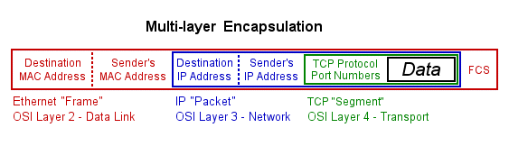
Data Encapsulation

Slide 10
Sidebar - Warning
The OSI and TCP/IP and Ethernet models do not have 1-1 mappings
  A layer in OSI may be defined by 1, 2 or 3 different TCP/IP layers/definitions
  A lot of different interpretations of mappings

Slide 11
OSI – Layer 1: Physical
Hardware and interconnection
  Electronic Interfaces
    Real live silicon
      Ethernet card
      Token-Ring card
  Cables
    E.g. Cat 5e cables
  Connectors
    E.g. RS-232C or RJ-45

Slide 12
OSI – Layer 1: Physical
Examples
  IEEE 802.5
    Token Ring hardware specs
  RS-232c
    “Traditional” Serial Link
  IEEE-488
    GPIB or HPIB
    Instrumentation Bus
  IEEE-1394
    FireWire
  IEEE-1284
    Parallel interface
    “Centronics”
  IEEE 802.3
    Most Common: 10/100/1000 Base T (for Ethernet)
    Many variants (coax, copper, fiber, etc.)
      10Base2 (Coax)
      10Base-T
      100Base-T
      1000Base-T
      1000Base-X (fiber)
      10GBase-T

Slide 13
OSI – Layer 2: Data Link
Local Network Addressing
  Getting data from one node to another adjacent (near-by) node
Examples
  Ethernet (802.3y, 802.3z, etc.)
  Token Ring (802.5)
  ATM (Asynchronous Transfer Mode)

Slide 14
OSI – Layer 3: Network Layer
Inter-network
  Getting data from one device to another within a network
  Establishing unique addresses on a network
Examples
  IP
  IPX
    Novell networks
  AppleTalk

Slide 15
OSI – Layer 4: Transport Layer
Service Identification
  “Reliably” getting data from node to node
  What application is it going to
Examples
  TCP
  UDP
  SPX
  AppleTalk

Slide 16
OSI – Layer 5: Session Layer
Communications between computers
  Maintains communications between applications on the computers

Slide 17
OSI – Layer 6: Presentation Layer
Standard interface
Data manipulation, if needed
  Encoding/Decoding
    EBCIC → ASCII
  Encrypting
  Serializing Objects
  Loading / Unloading data structure into XML

Slide 18
OSI – Layer 7: Application Layer
Interfaces directly to the application

Slide 19
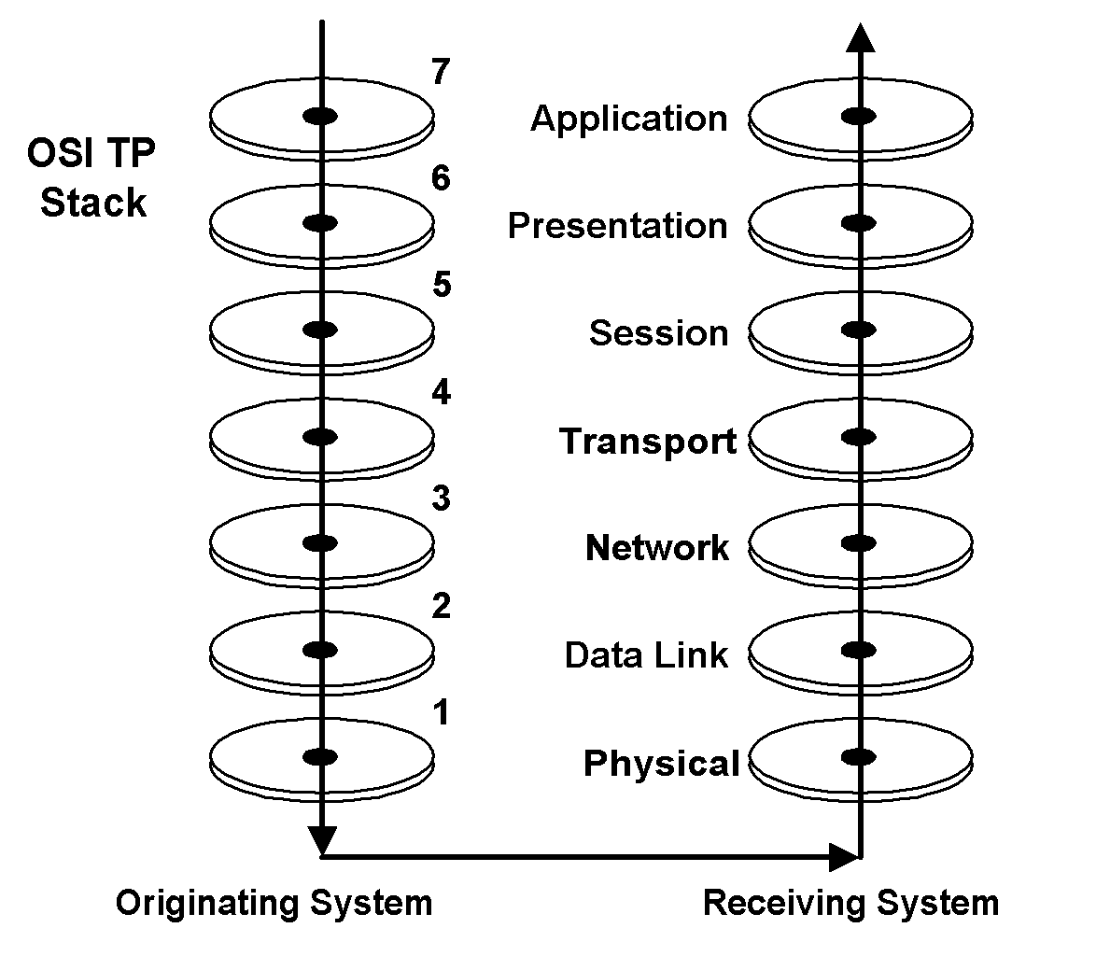
OSI – What’s it all Mean?
Sending Application
  Sends the data down the layers on its side where it finally gets sent over the physical media
Receiving Application
  Physical media receives the data and sends the data back up the layers to the receiving application
//

Slide 20
Resume 1/23

Slide 21
Part Two
Internet and TCP/IP

Slide 22
Sidebar: Mac Addresses
Media Access Control

Slide 23
MAC addresses:
Media Access Control
Every addressable network device has a unique address for each of its interfaces
  48 bits long
  281,474,976,710,656 addresses!
    48 bit addresses will run out about 2100!
      2013 update: could happen in 25 years
    64 bit standard has been defined!
      EUI-64
  Divided into 2 parts:
    Organization Unique Identifier (OUI) part
      Think of this as the manufacturer id
    Network Interface Controller (NIC) part
Note: there is also an EUI-48
  Basically the same as MAC-48

Slide 24
MAC addresses
Why not use MAC for all communication?
  What if network card fails and gets replaced?
  What if network card gets upgraded?
    Token ring → Ethernet
    Ethernet 10Mb/s → Fast Ethernet (100Mb/s)
    Ethernet1G → ????
  What if computer gets replaced?
Don’t want to update all the old card references with the new card address

Slide 25
Internet
What is it?

Slide 26
Internet
From Wikipedia:
  The Internet is a worldwide, publicly accessible network of interconnected computer networks that transmit data by packet switching using the standard Internet Protocol (IP).
  It is a "network of networks" that consists of millions of smaller domestic, academic, business, and government networks, which together carry various information and services, such as electronic mail, online chat, file transfer, and the interlinked Web pages and other documents of the World Wide Web.

Slide 27
Internet vs. World Wide Web (WWW)
The WWW is not the Internet
The Internet is not the WWW
WWW is a part of the Internet
Internet services consists of:
  WWW
  eMail
  FTP
  VoIP
  and many, many others…

Slide 28
IP
Internet Protocol

Slide 29
IP – Internet Protocol
Standard for how computers on networks are addressed
  IPv4
    “Current” standard
    4 bytes → 32-bit number
    ~4 billion potential addresses
    Running out of address space!
      Some estimated February 2011!!!!
      Fall 2011 – addresses all assigned!
  IPv6
    Next standard
      Became “mainstream” in 2009
    128-bit numbers
    ~3.4 x 10³⁸ potential addresses

Slide 30
Sidebar: How big is 3.4 x 10³⁸?
Course sand: ~1mm (10⁻³ meter)
1 cubic meter of sand has:
  1000 x 1000 x 1000 grains
  10⁹ grains (1 billion!)
  4 cubic meters is all IPv4 could address
1 cubic kilometer is:
  1000m x 1000m x 1000m = 10⁹ m³
  →10⁹ x 10⁹ or 10¹⁸ grains!
So 3.4 x 10³⁸ grains would fill
  3.4 x 10²⁰ cubic kilometers!
Volume of the Earth:
  1.08×10²¹ m³ or about 1x10¹² km³
  Fill about 3.4x10⁸ Earths!
    That’s 340,000,000
Volume of the Sun
  1.4x10¹⁸ km³
  About 200 Suns

Slide 31
Sidebar: How big is 3.4 x 10³⁸?
Another view
  About 100 billion stars in a galaxy (10¹¹)
  About 100 billion visible galaxies
  → 10²² stars in the visible universe!
  Enough address for the all the stars in 10¹⁶ universes
    10,000,000,000,000,000
    -or-
    10 quadrillion Universes!

Slide 32
Sidebar: How big is 3.4 x 10³⁸?
And now the bad news:
  Approximations vary, but best guess are there are about 1 x 10⁷⁹ atoms in the universe
  IPv6 can’t give each atom it’s own unique IP address ☹

Slide 33
And now, back to your regularly scheduled lecture…

Slide 34
Telephone Area Code Analogy
Every telephone has a four part number
  Country code
    United States – 1
    UK – 44
    Ireland – 353
  Area code
    North Carolina – 704, 980, 919, etc
    Montana – 406
  City (exchange) code
    Kannapolis – 932, 933, 938, etc
    Concord – 782, 783, etc.
  Residence/business number
    nnnn
1-704-687-8194

Slide 35
Area Code
First part tells country (optional)
Second part designates state or section of state (sometimes optional)
Third part is the city or part of city (used to be optional or partially optional)
Fourth part actual telephone (mandatory)

Slide 36
Hierarchy
This hierarchy helps find the phone in question
  What country is it in? – United State or Canada
    Nation Code 1
    What State? – North Carolina
      Area Code 704
      What city? – Charlotte
        City Exchange Code 687
          UNC Charlotte in the city
        What phone?
          Exchange code 8194
  1-704-687-8194

Slide 37
Hierarchy
Likewise a hierarchy helps find computers within a network
  What network? – UNCC
    What machine? – ajklinux1
Problem:
  There are a variety of sizes of companies with different needs for network capability
Hence the various classes of networks

Slide 38
How to divide up addresses for the Range of address Requirements? – IPV4

Slide 39
Divide and conquer
Each address has two parts:
  Network ID
    Identifies the organization or network
  Host ID
    Identifies a specific computer in the organization
32 bits → ~4 billion identifiers
Organizations have different requirements
  Large orgs
    Lots of computers
    Relatively few large orgs
  Small orgs
    Fewer computers
    Lots of small companies

Slide 40
IP Classes
IPv4 address is conventionally broken into four “dotted octets”
  e.g. four 8-bit address numbers separated by a period
    n.n.n.n
  Each octet has the range 0-255 decimal
    00-FF hexadecimal
  Usually written in the form:
    10.192.3.244 (decimal)
      Decimal is the most common
    0c.1f.3d.22 (hex)

Slide 41
IP Classes
IP addresses are grouped in to 5 categories
  Class A
  Class B
  Class C
  Class D
  Class E
Only Classes A-C are commonly used

Slide 42
Classes
3 Major Classes:
  Class A
    Fewest number of networks (organizations)
    Each network has a large number of potential hosts
  Class B
    Medium number of networks
    Medium number of hosts per network
  Class C
    Greatest number of networks
    Each having a small number of hosts per network

Slide 43
Class A
Class A
  Denoted by a 0 in the first (leftmost) bit of the address
    Bits 1 through 7 denote the network id
    Bits 8 through 31 denote host id
  0nnn nnnn.hhhh hhhh.hhhh hhhh.hhhh hhhh
  The first octet will be in the range 0-127
  Allows 126 unique network IDs
    0 and 127 are special cases
  Each network has 16,777,214 host IDs
    0 and 16,777,215 are special cases

Slide 44
Class B
Class B
  Denoted by a 10 in the first two bits of the address
    Bits 2 through 16 denote the network id
      14 bits
    Bits 16 through 31 denote host id
      16 bits
  10nn nnnn.nnnn nnnn.hhhh hhhh.hhhh hhhh
  First 2 octets in the range 128.0 to 191.255
  14 bits → 16,384 Class B networks
    16 bits → each network can have 65,534 hosts
      the first address and last address have special meaning

Slide 45
Class C
Class C
  Denoted by a 110 in the first three bits of the address
    Bits 3 through 24 denote the network id
      21 bits
    Bits 25 through 31 denote host id
      8 bits
  110n nnnn.nnnn nnnn.nnnn nnnn.hhhh hhhh
  First 3 octets in range 192.0.0 to 223.255.255
  21 bits → 2,097,152 Class C networks
    8 bits → each network can have 254 hosts
      0 and 255 are special cases

Slide 46
Class D
Class D
  “Multicast”
  Denoted by a 1110 in the first four bits of the address
  1110 mmmm.mmmm mmmm.mmmm mmmm.mmmm mmmm
  Address range is 224.0.0.0 to 239.255.255.255

Slide 47
Class E
Class E
  Experimental
  Denoted by a 1111 in the first four bits of the address
  1111 rrrr.rrrr rrrr.rrrr rrrr.rrrr rrrr
  Address range is 240.0.0.0 to 255.255.255.255

Slide 48
Network "rules"
Only machines in the same network can directly communicate with each other
  E.g.
    Class C network
      110n nnnn.nnnn nnnn.nnnn nnnn.hhhh hhhh
      Only machines with an IP address with the matching n bits!
    192.168.1.1
      Can communicate with:
        192.168.1.25
        192.168.1.103
        192.168.1.244
        Etc.
      Cannot directly communicate with:
        192.168.2.1 (different Class C network)
        172.16.1.1 (different Class altogether)

Slide 49
Subnetworks
Can split a network into smaller sub groups
  Physical reasons
    Computers in different buildings or campuses
  Logical reasons
    Computers belonging to different parts of a business
  Security reasons
    Don’t want engineering to get to financial data
  Performance reasons
    Don’t respond to messages not meant for a group
Accomplished with a subnet mask
  Different Classes have different default subnet masks

Slide 50
Subnets
Only addresses in the same network and same subnet can directly talk with each other
  Really just the same subnet
→
  192.168.1.2 can access 192.168.1.242
    Same network!
  192.168.1.2 cannot directly access:
    192.168.2.1 with a the default subnet of 255.255.255.0
    Different network!

Slide 51
Subnet Masks
Divided into two parts:
  Network address part
  Host address part
Denotes which part of the address is for
  Network ID (subnet)
  Host ID (within the subnet)
An IPv4 subnet mask has 32 bits to match the 32 IP address bits
  Uses same dotted notation as network addresses

Slide 52
Default Subnet Masks
Default subnet mask for a Class A network
  Network:
    0nnn nnnn.hhhh hhhh.hhhh hhhh.hhhh hhhh
  Subnet:
    1111 1111.0000 0000.0000 0000.0000 0000
    255.0.0.0
    FF.00.00.00
Default subnet mask for a Class B network
  Network:
    10nn nnnn.nnnn nnnn.hhhh hhhh.hhhh hhhh
  Subnet:
    1111 1111.1111 1111.0000 0000.0000 0000
    255.255.0.0
    FF.FF.00.00
Default subnet mask for a Class C network
  Network:
    001n nnnn.nnnn nnnn.nnnn nnnn.hhhh hhhh
  Subnet:
    1111 1111.1111 1111.1111 1111.0000 0000
    255.255.255.0
    FF.FF.FF.00

Slide 53
Subnet Mask Notes
1s are always first, 0s are always last
Subnet mask cannot be “broken”
  That is the 1s and 0s cannot be interwoven
The following subnet mask is illegal:
  11111111 00001111 11110000 00000000
  Note the string of 1s after some 0s
The following are legal:
  11110000 00000000 00000000 00000000
  11111111 11111111 10000000 00000000
  11111111 11111111 11111111 11111000

Slide 54
Shorthand notation
Shorthand notation
  Since:
    Strings of 1s and 0s cannot be broken
    1s must be always first
  / convention can be used
    Slash (/) followed by the number of 1s in the mask
Mask examples:
  255.255.255.0 → /24
  255.255.0.0 → /16
  255.0.0.0 → /8
  255.255.255.128 → /25
    11111111 11111111 11111111 10000000
  255.255.255.192 → /26
    11111111 11111111 11111111 11000000
  255.128.0.0 → /9
    11111111 10000000 00000000 00000000
CIDR notation: base address followed by /nn
  e.g. 172.16.4.0/24

Slide 55
IPv4 Wrapup

Slide 56
“Magic” network addresses
Private addresses:
  Class A
    10.0.0.0 → 10.255.255.255
      16,777,216 addresses
  Class B
    172.16.0.0 → 172.31.255.255
      1,048,576 addresses
      16 contiguous Class B networks
  Class C
    192.168.0.0 → 192.168.255.255
      65,536 addresses
      256 contiguous Class C networks
Reserved for private use
  For use inside a private LAN
  Are NOT found on the Internet!

Slide 57
Resume 1/25

Slide 58
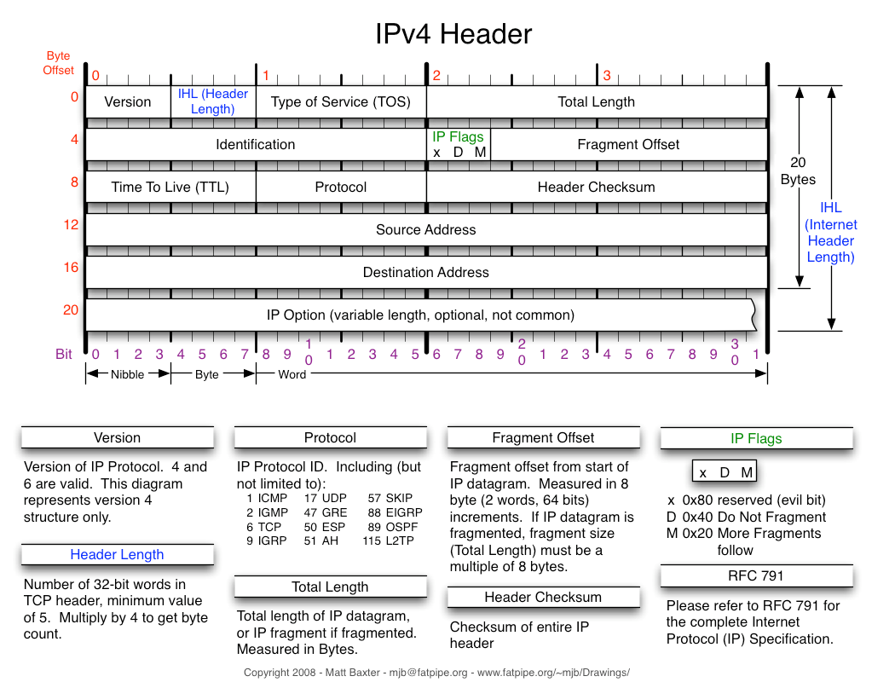
IPv4 Header

Slide 59
Remember Data Encapsulation?
This is where IP fits

Slide 60
Approximately how many IPv4 addresses are there:
4 thousand
4 million
4 billion
4 trillion
4 quadrillion
1
30 sec countdown

Slide 61
IPv6

Slide 62
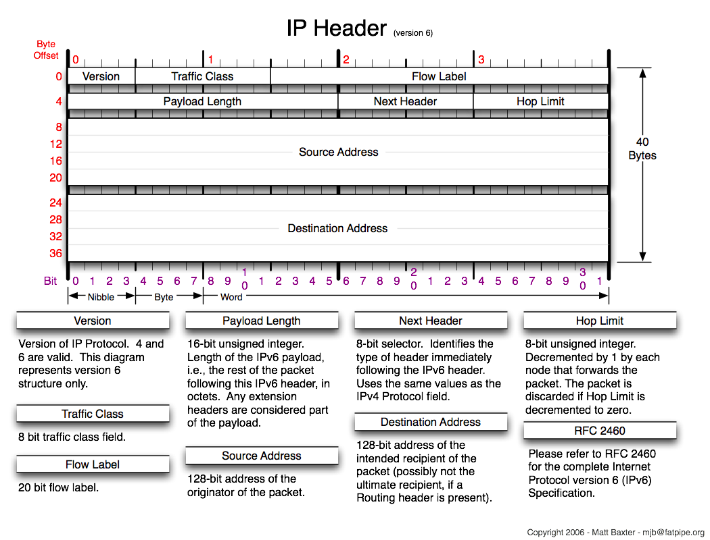
IPv6 Header Format

Slide 63
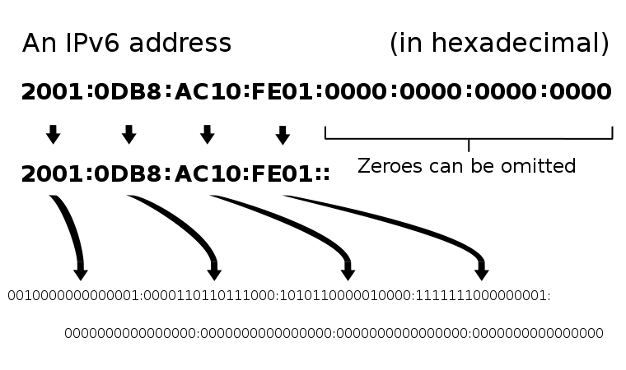
IPv6 Address Label Convention
Written with : separators in hex
  8 groups of 4 hex number (2 bytes)
    → 128 bits
One contiguous block of 0’s can be written shorthand with a :: notation
  Only one block is allowed since need to calculate how many 0’s of the 128 were “compressed”

Slide 64
IPv6 Address Label Convention
Written with : separators in hex
  8 groups of 4 hex number (2 bytes)
    → 128 bits
Other examples
a45d:37ef:ffee:0000:0000:0000:f000:0000
→
a45d:37ef:ffee::f000:0000
a45d:0000:0000:ffee:0000:0000:00fe:f000
→
a45d::ffee:0000:0000:00fe:f000

Slide 65
IPv4 or IPv6
When will IPv4 be obsolete?
  Guesses vary
    Never
      …, 82 Redditors offer their views on the matter. Here are a few that represent the general tenor:
        Well since I still support IPX for some legacy apps … in 100 years.
        Right after POTS dies. And then only after another 30 years.
        General IPv6 adoption is 18 months away. My college prof told me this in 1995, and he’s still right.
        Not in our career lifetime.
        IPv6 will take off during the year of the Linux desktop. You’ll pull IPv4 from my cold, dead hands
      NetworkWorld – Paul McNamara Mar 24, 2015
    5 years
      “We are probably four or five years away from IPv6 being relatively ubiquitous,” said Owen DeLong, director of professional services at Hurricane Electric, which bills itself as the world’s largest IPv6 backbone. “After that, I think IPv4 is going to become unsustainable and the people who are using it are going to be left behind.”
      GCN – William Jackson Mar 19, 2013
  My best guess
    When the cost of an IPv4 get too high
    All blocks assigned already
    Market forces will drive up IPv4 prices
    10-20 years?…
      Might have an HDTV type of solution

Slide 66
IP Summary
Internet Protocol
  The protocol for computers on a network to methodically identify, locate and address each other
  Used to route data from a source host to a destination host via one or more IP networks
  On a network all IP addresses must be unique
    This does not mean that all hosts everywhere must have unique IP addresses
    Hosts on different networks may use the same addresses

