Slide 1
Storage
HDD, SSD and RAID

Slide 2
HDD
Hard Disk Drives

Slide 3
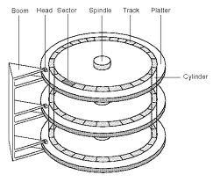
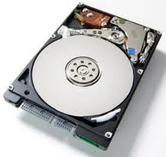
How does a hard drive work?

Slide 4
Hard Drive
The disk hardware:
  Writes data to a specific location on the drive
    On a selected platter
    On a specified track
    Rewriting a complete sectors
  1’s and 0’s
  Disks know nothing of files
The OS:
  Keeps track of file names
  File system
    Maps file names
      To where on the disk the 1’s and 0’s are kept for the data
    File may be broken up (fragmented)
      To fit available space chunks on disk
  Specific part of the disk is reserved for this mapping
    FAT, VFAT, FAT32, HPFS, NTFS, EXT2, EXT3, etc…

Slide 5
HDD performance (select features)
Seek time
  Average time required for boom to swing over the track (cylinder)
Rotational Latency
  Average time for the required data to rotate to the head
  Typically ½ the time to rotate once
Command processing time
  Typically very short compared to the above

Slide 6
HDD performance
Data transfer rate
  How fast can the data be read
  Related to
    Rotational speed
    Data density
    Relation to radius on disk
Other
  Drive buffering – extra memory on drive

Slide 7
HDD performance
Power consumption
  In general
    The faster it spins
    The more power is required
  Some drive have variable spin rates
Shock resistance
  Heads “fly” on air
  Shock will “crash” the heads onto the disk
    Destroys the disk

Slide 8
RAID
Redundant Array of Independent Disks

Slide 9
RAID
Redundant Array of Independent (Inexpensive) Disks
  2 or more drives
  → 1 drive
Various levels – RAID 0,1,2,3,4,5,6
  Also 10, 50, 60
  RAID 2, 3, 4 no longer used
RAID function can be done via hardware or software

Slide 10
RAID Sidebar: Common Levels
RAID 0: Striped
  2 or more drives configured as one
    Data is striped across multiple drives
  Pluses:
    “Larger” capacity
    Speed
      Can access data from multiple drives simultaneously
  Minuses:
    Higher Failure rate than single drive
    Total data loss if one drive fails

Slide 11
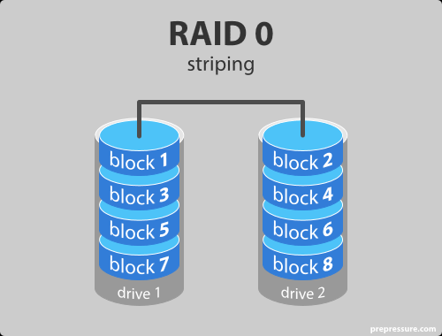
Raid 0

Slide 12
RAID Sidebar: Common Levels
RAID 1: Mirrored
  2 or more drives configured as one
    Usually 2 drives
    Data copied (duplicated) on both drives
  Pluses:
    Lower “failure” rate
    No data loss if one drive fails
  Minuses:
    “Wasted” drive space
      e.g. 50% for a 2 drive system
    Small performance impact

Slide 13
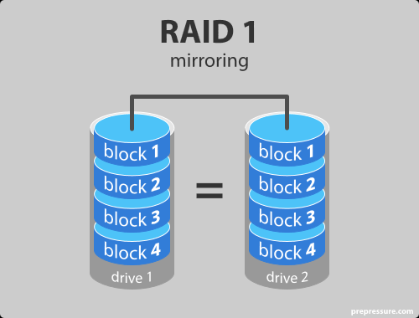
Raid 1

Slide 14
RAID Sidebar: Common Levels
RAID 5: Parity
  3 or more drives configured as one
    Data spread across multiple drives with parity
    If one drive fails, data can be rebuilt
  Pluses:
    “Larger” drive
    Faster
    Can survive one drive failure
  Minuses:
    More complex
    Some “wasted” drive space

Slide 15
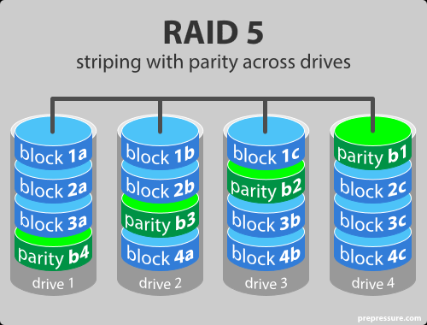
Raid 5

Slide 16
RAID Sidebar: Common Levels
RAID 6: Enhanced RAID 5
  4 or more drives configured as one
    Additional parity block
  Pluses:
    Improved data safety
    Can survive 2 drive failures
  Minuses:
    More “wasted” space
    Write penalty

Slide 17
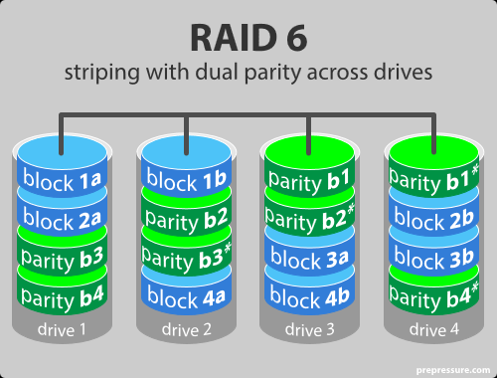
Raid 6

Slide 18
RAID Sidebar: Uncommon Levels
RAID 01: Combination of 0 and 1
  Mirror of stripes
RAID 10: Combination of 1 and 0
  Stripe of mirrors
4 or more drives (even #) configured as one
  Pluses:
    Speed
    Data safety
  Minuses:
    “Wasted” capacity

Slide 19
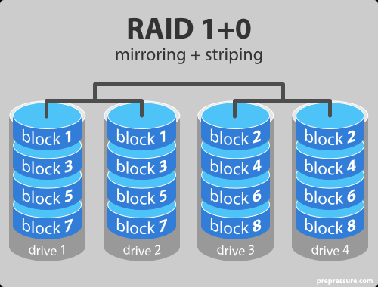
Raid 1+0

Slide 20
RAID Sidebar: Uncommon Levels
No common definition
  RAID 50: Combination of 5 and 0
    Sometimes referred to as 5+0
  RAID 60: Combination of 6 and 0
    Sometimes referred to as 6+0

Slide 21
JBOD
Just a Bunch of Disks
  Start with disk 1 and continue adding disks as needed
  All disk space can be used
  Easily expandable
    Just add a disk
  Any drive fails, all data lost

Slide 22
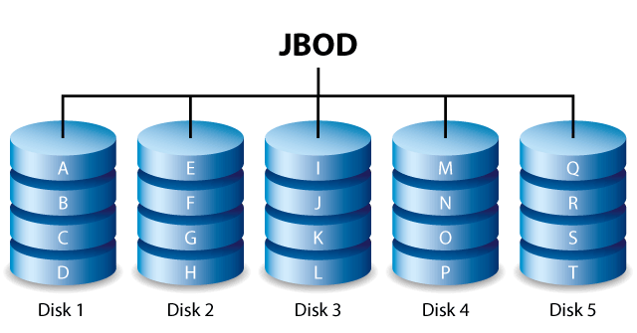
JBOD

Slide 23
Extra Note: LVM
Logical Volume Manager
  Logical layer
    Linux/Unix
  Allows the managing of disk space into volumes
    Can combine disks to create a volume
    Can divide a disk into multiple volumes
    Summary: can take one or more disks and turn them into one or more volumes
LVM can be used with RAID

Slide 24
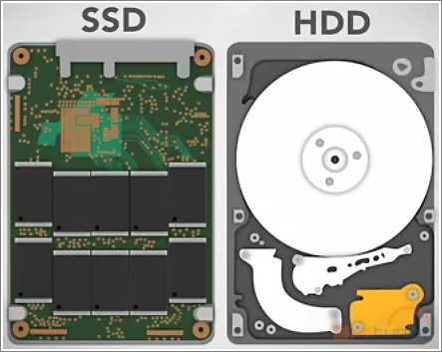
SSD
Solid State Drive
  All solid state
    No disk
    No heads
    No cylinders
    No tracks
  Still has sectors

Slide 25
SSD – Solid state drives
Faster access
  No mechanical movement
  Faster read/write speeds
Low power
  No need to spin disk or move boom
  About ½ to ¼ the power
Expensive
  Relatively expensive compared to HDD
  About 2-4x per GB
Lower capacity per unit
More reliable
Not effected by external magnetic fields
Write limits
  Beyond typical use
    ~1-2PB
    Completely rewriting a 1TB drive every day for over 3-5 years!

Slide 26
SSD
But
  Costs are decreasing
  Size is increasing
Many Disk Farms find SSD desirable:
  Less power to run drives
  Less power to run HVAC
  Less expense to maintain and replace

Slide 27
How many drive failures can Raid 6 Survive:
0
1
2
3
4

