Slide 1
Routing and Routers

Slide 2
Reading
Computer Networking Illuminated
  Chapter 8
    Section 8.5 will not be on test
Linux Administration: A Beginners Guide
  Static Routing
    291-292
  Dynamic Routing
    292-297
  Managing Routes
    318-323
  A Simple Linux Router
    323-325

Slide 3
Routing
What is it?

Slide 4
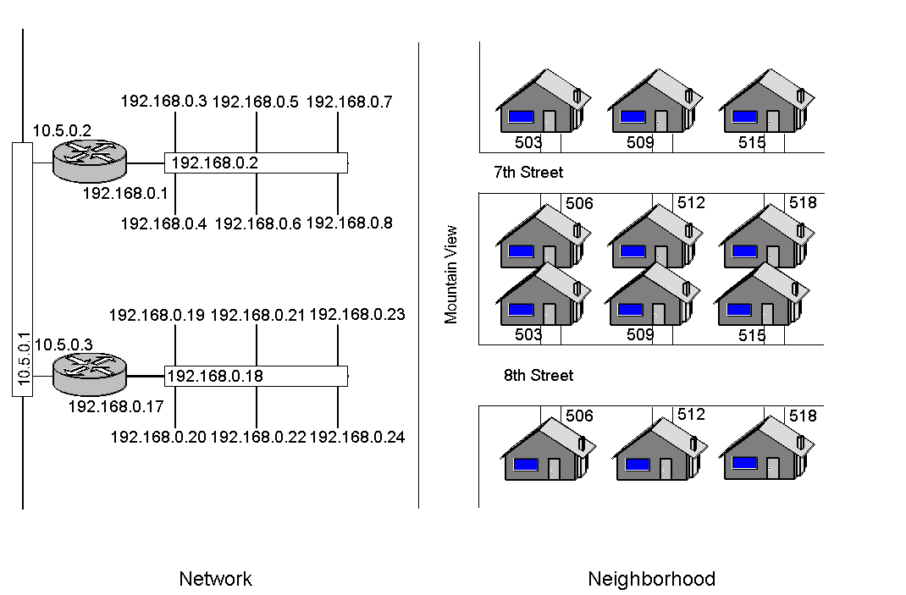
Routing – Street analogy

Slide 5
Routing- What is it?
Selecting paths in a computer network to send data
  Directs the forwarding and passing of logically addressed packets
    From the source network
    Toward the ultimate destination
    Through (typically) intermediary nodes
Hardware devices called routers direct the traffic
  Controlled by routing tables
    Lists the “best” routes to various network destinations
  Constructing good routing tables critical for efficient routing

Slide 6
Routing- What is it?
Small networks typically use manually configured routing tables

Slide 7
Routing- What is it?
Large networks:
  Complex topologies that change constantly
  Manual construction and maintenance of routing tables difficult
    Note: Most of the Public Switched Telephone Network (PSTN) uses pre-computed routing tables
      Fallback routes if the most direct route becomes blocked
Dynamic routing attempts to solve this problem
  Constructs routing tables automatically
  Based on information carried by routing protocols
  Allows the network to act nearly autonomously
    Avoiding network failures and blockages

Slide 8
Routing- What is it?
Dynamic routing dominates the Internet
  However: configuration of the routing protocols often requires a skilled touch
  Networking technology has not developed to the point of the complete automation of routing

Slide 9
Routing algorithms
Distance vector algorithms
Link-state algorithms

Slide 10
Routing Algorithms
Describe how to most effectively get packets:
  From one computer on a network
  To another computer on a network
Two main classes:
  Distance vector algorithms
  Link-state algorithms

Slide 11
Distance vector algorithms

Slide 12
Routing algorithms
Distance vector algorithms
Calculates distance and direction to any link in network
“Cost” calculated
  Usually by number of hops

Slide 13
Routing algorithms
Distance vector algorithms
Use the Bellman-Ford algorithm
  Assigns a number to each of the links between each node in the network
    “The cost” – not necessarily monetary
      Time
      Congestion
      Speed of network link
  Nodes will send information from point A to point B via the path that results in the lowest total “cost”
    (i.e. the sum of the costs of the links between the nodes used)

Slide 14
Routing algorithms
Distance vector algorithms (cont.)
Operates in a very simple manner:
  When a node first starts
    Knows of its immediate neighbors
    Direct cost involved in reaching them
  Information used to determine the routing table (distance table)
    List of destinations
    Total cost to each
    Next hop to send data

Slide 15
Routing algorithms
Distance vector algorithms (cont.)
  Each node regularly sends to each neighbor its own current idea of the total cost to get to all the destinations it knows of
  Neighboring node(s) examine this information
    Compare it to what they already 'know‘
    If there is an improvement on what they already have
      Insert in their own routing table(s)
  Over time, all the nodes in the network
    Discover the best next hop for all destinations
    Best total cost

Slide 16
Routing algorithms
Distance vector algorithms (cont.)
When one of the nodes involved goes down:
  Nodes which used it as their next hop for certain destinations:
    Discard those entries
    Create new routing-table information
  New information sent to all adjacent nodes
    The process is repeated
  Eventually all the nodes in the network receive the updated information
    Each discovers new paths to all the destinations which they can still "reach"

Slide 17
Routing algorithms
Distance vector algorithms (cont.)
Pros
  Simpler processing
  Good for simple, small networks
Cons
  Does not scale well
  Can induce routing loops

Slide 18
Link-state algorithms

Slide 19
Routing algorithms
Link-state algorithms
Each node uses as its fundamental data a map of the network in the form of a graph
  Each node floods the entire network with information about what other nodes it can connect to
  Each node then independently assembles this information into a map
  Using this map, each router then independently determines the best route from itself to every other node

Slide 20
Routing algorithms
Link-state algorithms (cont.)
Uses Dijkstra's algorithm
  Builds another data structure (a tree)
    Current node itself as the root
    Containing every other node in the network
  Starting with a tree containing only itself
    Adds, one at a time, nodes which have not added to the tree
    Adds the node which has the lowest cost to reach an adjacent node which already appears in the tree
    Continues until every node appears in the tree

Slide 21
Routing algorithms
Link-state algorithms (cont.)
This tree serves to construct the routing table
  Gives the best next hop, etc, to get from the node itself to any other network
  Metrics considers things like bandwidth, reliability, congestion

Slide 22
Routing algorithms
Link-state algorithms (cont.)
Pros
  Scales well
  No route looping problem
Cons
  More complex processing

Slide 23
Routed vs.
Routing Protocols
Confusion often arises between:
  "routed protocols“
  - and -
  "routing protocols"

Slide 24
Routed versus Routing Protocols
Routed protocols
  Any network protocol that provides enough information in its Network Layer address
    To allow a packet to be forwarded from one host to another host based on the addressing scheme
    Without knowing the entire path from source to destination

Slide 25
Routed versus Routing Protocols
Routed protocols (cont.)
  Define the format and use of the fields within a packet
    Packets generally are conveyed from end system to end system.
    Almost all layer 3 protocols and those that are layered over them are routable
      IP is an example

Slide 26
Routed versus Routing Protocols
Routed protocols (cont.)
  Layer 2 protocols such as Ethernet are necessarily non-routable protocols
    They contain only a link-layer address, which is insufficient for routing:
      Some higher-level protocols based directly on these without the addition of a network layer address are also non-routable
        For example: NetBIOS

Slide 27
Routed versus Routing Protocols
Routing protocols
  Used in the implementation of routing algorithms
    facilitate the exchange of routing information between networks
    allowing routers to build routing tables dynamically
  In some cases, routing protocols can themselves run over routed protocols:
    for example, BGP runs over TCP:
      care is taken in the implementation of such systems not to create a circular dependency between the routing and routed protocols

Slide 28
Routing Metrics

Slide 29
Routing metrics
Any value used by routing algorithms to determine whether one route should perform better than another
  Can cover such information as:
    bandwidth ● delay
    hop count ● path cost
    load ● MTU
    reliability ● communication cost
  Routing table stores only the best possible routes
  Link-state or topological databases may store all other information as well

Slide 30
Routing metrics (cont.)
Administrative distance
  Help select the best path when they "know" of two or more different routes to the same destination from two different routing protocols
  Administrative distance defines the reliability of a routing protocol
  Each routing protocol gets prioritized in order of most to least reliable using an administrative-distance value

Slide 31
Classes of Routing Protocols
Depending on the relationship of the router relative to other autonomous systems, various classes of routing protocols exist:
  Ad hoc network routing protocols
    Appear in networks with no or little infrastructure.
  Interior Gateway Protocols (IGPs)
    Exchange routing-information within a single autonomous system.
    Common examples include:
      IGRP (Interior Gateway Routing Protocol)
      EIGRP (Enhanced Interior Gateway Routing Protocol)
        Note: in spite of various Cisco marketing documents, EIGRP definitely does not class as a link-state protocol or as any sort of "hybrid" thereof.
      OSPF (Open Shortest Path First)
      RIP (Routing Information Protocol)
      IS-IS (Intermediate System to Intermediate System)
  Exterior Gateway Protocols (EGPs)
    Route between separate autonomous systems.
    EGPs include:
      EGP: Exterior Gateway Protocol
        used to connect to the former Internet backbone network
        now obsolete
      BGP: Border Gateway Protocol: the current version, BGPv4

Slide 32
Routing algorithms
Summary of routing algorithms
Distance-vector routing protocols
  Pros
    Simple and efficient in small networks
    Require little, if any management
  Cons
    Distance-vector algorithms do not scale well
    Poor convergence properties
    A node's entire routing table to be transmitted
    Distance-vector protocols suffer from the count-to-infinity problem

Slide 33
Routing algorithms
Summary of routing algorithms
Link-state routing
  Pros
    Reacts more quickly, in a bounded amount of time, to connectivity changes
    Link-state packets sent over the network are smaller than in distance-vector routing
    Only information about the node's immediate neighbors are transmitted
      Packets are small enough that they do not use network significant resources
  Cons
    Requires more storage and more computing to run than distance-vector routing

Slide 34
Routers
What are they?

Slide 35
Routers
Hardware:
  A computer
  2 or more networks cards
Software
  Control data through the network cards
Typically Specialized Computers
  Send messages across the Internet
  Allow the traffic of messages between networks

Slide 36
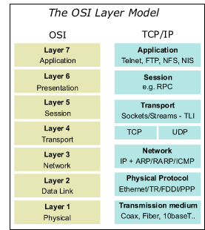
Flashback – OSI Model
Remember the OSI Model?
  Etc.
  Layer 4 – Transport
  Layer 3 – Network
  Layer 2 – Protocol
  Layer 1 – Physical

Slide 37
Basics
Router is an OSI Layer 3 switch
  Basic Switch review:
    Keeps track of MAC addresses connected to switch
    Send packets only to appropriate port with the destination MAC address
    Layer 2
      Sends data within a local network
  Layer 3 of the OSI Model
    Network layer
  Router works as a switch at the OSI Layer 3
    Sends data between networks

Slide 38
Switch recap
Basic switch works at Layer 2 of the OSI model (data-link)
  A LAN device that can also be called a multi-port bridge
  Switches Ethernet frames between Ethernet devices
Switches do not care about IP addresses
  Do not examine IP addresses as the frames flow through the switch
Switches keep a bridge forwarding table that shows what MAC addresses have been seen on what port

Slide 39
Router Examples

Slide 40
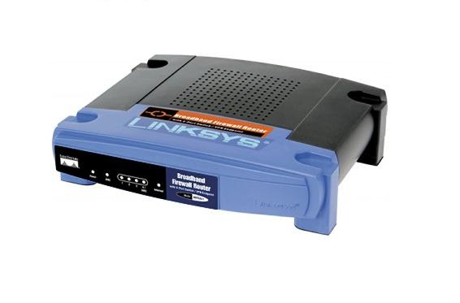
Examples
Low end
  Home
  SOHO
  Typically a Gateway
    Gets data from local network (edge) to exterior network (e.g. the Internet)
  Usually 2 ports
    Internet side (WAN)
    Home network side (LAN)
      switch, wireless, firewall, etc
Typical Players
  Belkin
  Buffalo
  Dlink
  Linksys
  Netgear
  Many, many more

Slide 41
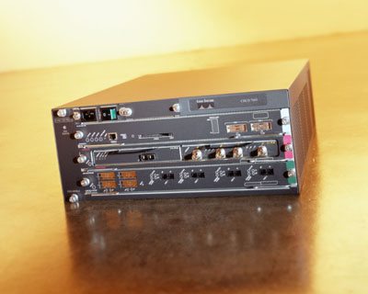
Examples
Mid-range
  Corporations
  Intra-campus
  Intra-business
  Small number of ports
    2-8 networks or subnets
Typical Players
  Cisco
  Juniper

Slide 42
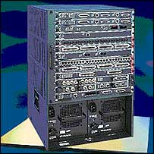
Examples
High-end
  Large corporations
  Many ports
    16-256 ports
Players
  Brocade
  Cisco
  Fujitsu

Slide 43
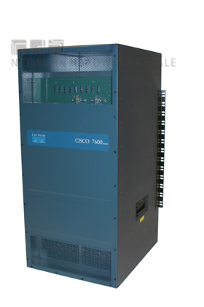
Examples
Beyond High end
  Super-computers
  Network Cards
Backbone of the whole internet
  Major Internet providers
    Sprint
    ATT
    CenturyLink

Slide 44
Router Function

Slide 45
Router function
2 major tasks:
  Ensure information does not go where it is not needed
  Ensure information does make it to the intended destination
May also incidentally:
  Translate between protocols
  Implement security

Slide 46
Configuration Tables
General
Windows
Linux
Proprietary routers

Slide 47
Concept

Slide 48
Review:
Network Addresses
"First address" in a network or subnet
  Network address
    A.K.A. wire address
  Not a valid host ID
  All 0s for the network or subnet host id
    e.g. for Class C, B and A networks
      192.168.5.0
      172.18.0.0
      10.0.0.0

Slide 49
Review:
Network Addresses
CIDR notation:
  Very useful when describing subnets
    192.168.001.000/25
      "first half" of the Class C after subnetting /25
    192.168.001.128/25
      "last half" of the Class C after subnetting /25
    192.168.002.000/26
      first set of addresses in the /26 subnet
      Last octet is 0000 0000
    192.168.002.064/26
      second set
      Last octet is 0100 0000
    192.168.002.128/26
      third set
      Last octet is 1000 0000
    192.168.002.192/26
      last set
      Last octet is 1100 0000
CIDR: Classless Inter-Domain Routing

Slide 50
Review:
Broadcast Addresses
"Last address" in a network or subnet
  Broadcast address
  Not a valid host ID
  All 1s for the network or subnet host id
    Examples for the 3 usual classes
      192.168.5.255
      172.18.255.255
      10.255.255.255

Slide 51
Review:
Broadcast Addresses
Everyone in the network or subnet heeds this address
  Examples:
    192.168.001.127
      Broadcast address for 192.168.001.000/25
    192.168.001.255
      Broadcast address for 192.168.001.128/25
    192.168.002.063
      Broadcast address for 192.168.002.000/26
      Last octet is 0011 1111
    192.168.002.127
      Broadcast address for 192.168.002.064/26
      Last octet is 0111 1111
    192.168.002.191
      Broadcast address for 192.168.002.128/26
      Last octet is 1011 1111
    192.168.002.255
      Broadcast address for 192.168.002.192/26
      Last octet is 1111 1111

Slide 52
Resume 2/6

Slide 53
Route
General Info

Slide 54
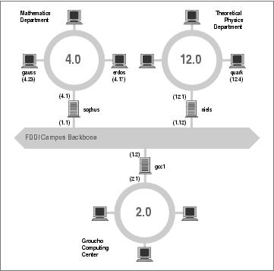
Route - Example
Net Topology at GMU
  Class B environment
    149.76.0.0
    Subnetted /24
  3 departments
    Using Ethernet
    149.76.2.0
      Computer Center
    149.76.4.0
      Math Dept
    149.76.12.0
      Physics Dept
  1 backbone network
    Using FDDI
    149.76.1.0
      3 routers attached
    No workstations
XXX (1.4)
Note: a backbone is not required
  It is one of several ways to do this
  Could replace with a router with sufficient ports
From
  http://www.faqs.org/docs/linux_network/x-087-2-issues.routing.html

Slide 55
Route - Example
3 gateways to backbone
  sophus
    Math Dept.
  niels
    Physics Dept
  gcc1
    Computing Center
Each gateway has 2 NICs
  One Ethernet
    To the department LAN
  One FDDI
    To the Backbone
XXX (1.4)
Note: FDDI is a fiber optic standard for data transmission. Can extend up to 200km.

Slide 56
Route - Example
For any Math Dept. computer to send data to another Math Dept. computer is no problem
  In same physical net
  In same IP subnet
But, how to get to another department?
XXX (1.4)

Slide 57
Route - Example
Sophus is connected to the math dept and the backbone
Set up a table
  sophus’ router view
    Where is data to go?
    What subnet
    What gateway
    Which interface
XXX (1.4)
Network | Netmask | Gateway | Interface
149.76.1.0 | 255.255.255.0 | - | fddi0
149.76.2.0 | 255.255.255.0 | 149.76.1.2 | fddi0
… | … | … | …
149.76.4.0 | 255.255.255.0 | - | eth0
149.76.12.0 | 255.255.255.0 | 149.76.1.12 | fddi0
… | … | … | …
0.0.0.0 | 0.0.0.0 | 149.76.1.2 | fddi0

Slide 58
Route - Example
Similar story for niels
Set up a table
  niels’ router view
    Where is data to go?
    What subnet
    What gateway
    Which interface
XXX (1.4)
Network | Netmask | Gateway | Interface
149.76.1.0 | 255.255.255.0 | - | fddi0
149.76.2.0 | 255.255.255.0 | 149.76.1.2 | fddi0
… | … | … | …
149.76.4.0 | 255.255.255.0 | 149.76.1.4 | fddi0
149.76.12.0 | 255.255.255.0 | - | eth0
… | … | … | …
0.0.0.0 | 0.0.0.0 | 149.76.1.2 | fddi0

Slide 59
Route Command
Windows

Slide 60
Route - Windows
Command:
  route print
    Displays the content of the route table

Slide 61
Route - Windows
C:/> route print
Network Address Netmask Gateway Address Interface Metric
0.0.0.0 0.0.0.0 157.57.8.1 157.57.11.169 1
127.0.0.0 255.0.0.0 127.0.0.1 127.0.0.1 1
157.57.8.0 255.255.248.0 157.57.11.169 157.57.11.169 1
157.57.11.169 255.255.255.255 127.0.0.1 127.0.0.1 1
157.57.255.255 255.255.255.255 157.57.11.169 157.57.11.169 1
224.0.0.0 224.0.0.0 157.57.11.169 157.57.11.169 1
255.255.255.255 255.255.255.255 157.57.11.169 157.57.11.169 1
Where:
0.0.0.0 is the default route
127.0.0.0 is the loopback network address
127.0.0.1 is the loopback address (self)
157.57.8.0 is the local subnet address
157.57.11.169 is the network card address
157.57.255.255 is the subnet broadcast address
224.0.0.0 is the multicast address
255.255.255.255 is the limited broadcast address

Slide 62
Route - Windows
Netmask:
  Defines what portion of the Network Address must match for that route to be used.
    In binary a 1 is significant (must match) and a 0 need not match.
  For example, a 255.255.255.255 mask is used for a host entry.
    The 255s (all 1s) means that the destination address of the packet to be routed must exactly match the Network Address for this route to be used.
  For another example, Network Address 157.57.8.0 has a netmask of 255.255.248.0.
    This netmask means the first two octets must match exactly, the first 5 bits of the third octet must match (248=1111 1000) and the last octet does not matter.
    Since 8 in the decimal number system is equivalent to 0000 1000 in binary, a match would have to start with 00001.
    Thus, any address of 157.57 and the third octet of 8 through 15 (15=0000 1111) will use this route.
    This is a netmask for a subnet route and is therefore called the subnet mask.
Gateway Address:
  The Gateway Address is where the packet needs to be sent.
  This can be the local network card or a gateway (router) on the local subnet.
Interface:
  The Interface is the address of the network card over which the packet should be sent out. 127.0.0.1 is the software loopback address.
Metric:
  The Metric is the number of hops to the destination. Anything on the local LAN is one hop and each router crossed after that is an additional hop. The Metric is used to determine the best route.

Slide 63
Route Command
Linux/Unix Family

Slide 64
Route - Linux
Command:
  route …
    Shows table
  route … add …
    Adds an element to the table
  route … del …
    Removes and element from the table

Slide 65
Route - Linux
Example 1
ajklinux:/etc# route
Kernel IP routing table
Destination Gateway Genmask Flags Metric Ref Use Iface
10.214.64.0 0.0.0.0 255.255.255.0 U 0 0 0 eth1
192.168.1.0 0.0.0.0 255.255.255.0 U 0 0 0 eth0
169.254.0.0 0.0.0.0 255.255.0.0 U 0 0 0 eth0
0.0.0.0 220.224.98.99 0.0.0.0 UG 0 0 0 eth1
Example 2
Destination | Gateway | Genmask | Flags | Metric | Ref | Use | Iface
192.168.2.2 | * | 255.255.255.255 | UH | 0 | 0 | 0 | eth0
192.168.2.0 | * | 255.255.255.0 | U | 0 | 0 | 0 | eth0
127.0.0.0 | * | 255.0.0.0 | U | 0 | 0 | 0 | lo
default | 192.168.2.1 | 0.0.0.0 | UG | 0 | 0 | 0 | eth0
U - Route is up
H - Target is a host
G - Use gateway

Slide 66
Route Commands
Commercial devices

Slide 67
Route - Commercial
Will vary by manufacturer
Typical Interface:
  Telenet – via a network connection
    What are pros and cons?
  Serial port – via a phyiscal cable
    What are pros and cons?

Slide 68
Route - Commercial
CISCO
  IOS – Command Summary:
Router> | - User EXEC mode
Router# | - Privileged EXEC mode
Router(config)# | - Configuration mode (notice the # sign indicates this is only accessible at privileged EXEC mode.)
Router(config-if)# | - Interface level within configuration mode.
Router(config-router)# | - Routing engine level within configuration mode.
Router(config-line)# | - Line level (vty, tty, async) within configuration mode.

Slide 69
Cisco IOS Commands
For example CLI IOS tutorial see:
  http://www.cisco.com/c/en/us/td/docs/ios/fundamentals/configuration/guide/15_1s/cf_15_1s_book/cf_cli-basics.pdf
  Cut and paste to a browser

Slide 70
Router Quiz

Slide 71
Routers:
Block all unwanted data
Pass data where it is needed
Ignore data if it doesn’t know its destination
All of the above
1 and 2 above
2 and 3 above
1 and 3 above
20

Slide 72
Assignment
See Web page for HW 4
  Will be assigned 2/8
  40 pts
  4+ weeks to complete it
    You will need it

