Slide 1
ITIS 2110
Lecture 21: Network Management: SNMP
Revised 3/30/14
Jinyue Xia

Slide 2
Outline
SNMP
  Concept: Manager and Agent
  MIB
  SNMP protocol
Network Management
  SMI (Structure of Management Information)
Notes:
Using SNMP, you can monitor network performance, audit network usage, detect network faults or inappropriate access, and in some cases configure remote devices.
SNMP is designed to be deployed on the largest possible number of network devices, to have minimal impact on the managed nodes, to have minimal transport requirements, and to continue working when most other network applications fail.

Slide 3
SNMP Overview
Simple Network Management Protocol
  a framework that provides facilities for managing and monitoring network resources on the Internet.
Components
  SNMP agent (a software)
  Managed Devices
  SNMP manager (an application program)
  Management Information Bases (MIBs)
  SNMP protocol itself
Notes:
SNMP agent is software that runs on a piece of network equipment (host, router, printer, or others) and that maintains information about its configuration and current state in a database Information in the database is described by Management Information Bases (MIBs)
An SNMP manager is an application program that contacts an SNMP agent to query or modify the database at the agent.
SNMP protocol is the application layer protocol used by SNMP agents and managers to send and receive data.

Slide 4
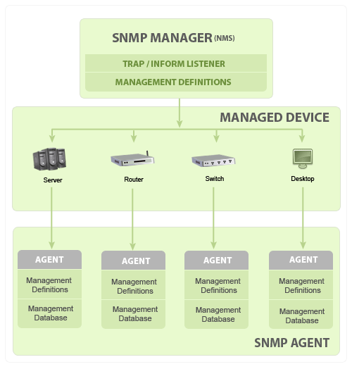
SNMP: Overview

Slide 5
SNMP Concept
Typical SNMP environment:
  Large number of systems to be managed
  One or more systems manage them
SNMP uses the concept of manager and agent.
  A manager, usually a host, controls and monitors a set of agents, usually routers or servers

Slide 6
Outline
SNMP
  Concept: Manager and Agent
  MIB
  SNMP protocol
Network Management
  SMI
Notes:
Using SNMP, you can monitor network performance, audit network usage, detect network faults or inappropriate access, and in some cases configure remote devices. SNMP is designed to be deployed on the largest possible number of network devices, to have minimal impact on the managed nodes, to have minimal transport requirements, and to continue working when most other network applications fail.

Slide 7
SNMP: SNMP Manager
SNMP Manager
  A manager or management system is a separate entity that is responsible to communicate with the SNMP agent implemented network devices.
  Typically, a computer that is used to run one or more network management systems.

Slide 8
SNMP: SNMP Manager
SNMP Manager: key functions
  Queries agents
  Gets responses from agents
  Sets variables in agents
  Acknowledges asynchronous events from agents
Notes:
Variables can be “free memory”, ‘’system name”, “how many processes running on the agent”

Slide 9
SNMP: Managed Devices
Managed Devices
  a part of the network that requires some form of monitoring and management
  E.g. routers, switches, workstations, printers, UPSs, etc…
Notes:
uninterruptible power supply

Slide 10
SNMP: Agent
Agent
  a program that is packaged within the network element.
  Enabling the agent allows it to collect the management information database from the device locally and makes it available to the SNMP manager, when it is queried for
  e.g. standard(Net-SNMP)
Notes:
Every SNMP agent maintains an information database describing the managed device parameters

Slide 11
SNMP: Agent
Agent Key Functions
  Collects management information about its local environment
  Stores and retrieves management information as defined in the MIB.
  Signals an event to the manager.
  Acts as a proxy for some non-SNMP manageable network node.

Slide 12
SNMP: Interactions
Application Layer Protocol

Slide 13
SNMP: Communication

Slide 14
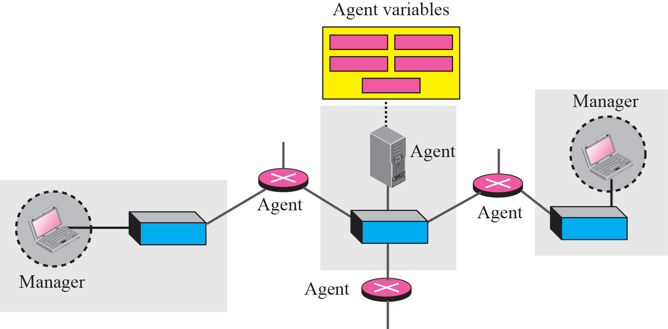
SNMP: Managers and Agents
MIB

Slide 15
SNMP: Managers and Agents
Agents Variables
  "free memory“
  "system name“
  "number of running processes“
  "default route“
  “toner cartridge status”
  etc.

Slide 16
Outline
SNMP
  Concept: Manager and Agent
  MIB
  SNMP protocol
Network Management
  SMI

Slide 17
SNMP: MIB
Management Information Bases
A MIB specifies the managed objects
A collection of all the objects that the manager can manage
10 Groups:
Stystem
Interface
Address translation
Ip
Icmp
Tcp
Udp
Egp
Transmission
snmp
Notes:
Every SNMP agent maintains an information database describing the managed device parameters
Typically these MIB contains standard set of statistical and control values defined for hardware nodes on a network.
In short, MIB files are the set of questions that a SNMP Manager can ask the agent. Agent collects these data locally and stores it, as defined in the MIB. So, the SNMP Manager should be aware of these standard and private questions for every type of agent.

Slide 18
SNMP: MIB
MIB files are the set of questions that a SNMP Manager can ask the agent
Agent collects these data locally and stores it, as defined in the MIB.
the SNMP Manager should be aware of these standard and private questions for every type of agent.
Notes:
Every SNMP agent maintains an information database describing the managed device parameters
Typically these MIB contains standard set of statistical and control values defined for hardware nodes on a network.
In short, MIB files are the set of questions that a SNMP Manager can ask the agent. Agent collects these data locally and stores it, as defined in the MIB. So, the SNMP Manager should be aware of these standard and private questions for every type of agent.

Slide 19
SNMP: MIB
MIB is a text file that describes managed objects using the syntax of ASN.1 (Abstract Syntax Notation 1)
ASN.1 is a formal language for describing data and its properties

Slide 20
SNMP: MIB
For SNMP, the MIB is a structured database (tree)
Each resource to be managed is represented by an object
Each agent (e.g., a router) maintains a MIB that reflects the status of its managed resources

Slide 21
SNMP: MIB
Each managed object is assigned an object identifier (OID)
    unique
    denotes specific characteristics of a managed device.
An OID can be represented as a sequence of integers separated by decimal points or by a text string:
Example:
  1.3.6.1.2.1.4.6.
  iso.org.dod.internet.mgmt.mib-2.ip.ipForwDatagrams
When an SNMP manager requests an object, it sends the OID to the SNMP agent.
Notes:
denotes specific characteristics of a managed device When queried for, the return value of each identifier could be different e.g. Text, Number, Counter, etc

Slide 22
SNMP: MIB
Managed objects are organized in a tree-like hierarchy and the OIDs reflect the structure of the hierarchy.
Each OID represents a node in the tree.
The OID 1.3.6.1.2.1 (iso.org.dod.internet.mgmt.mib-2) is at the top of the hierarchy for all managed objects of the MIB-II.
Manufacturers of networking equipment can add product specific objects to the hierarchy.

Slide 23
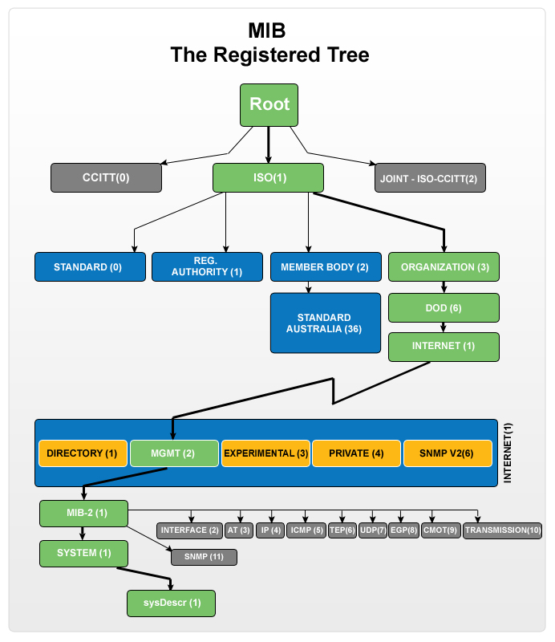
SNMP: MIB
Another example of OID for "sysDescr": .1.3.6.1.2.1.1.1

Slide 24
SNMP: MIB/definition
Specification of ipForwDatagrams in MIB-II.
ipForwDatagrams OBJECT-TYPE
SYNTAX Counter
ACCESS read-only
STATUS mandatory
DESCRIPTION
"The number of input datagrams for which this
entity was not their final IP destination, as a
result of which an attempt was made to find a
route to forward them to that final destination.
In entities which do not act as IP Gateways, this
counter will include only those packets which were
Source-Routed via this entity, and the Source-
Route option processing was successful."
::= { ip 6 }

Slide 25
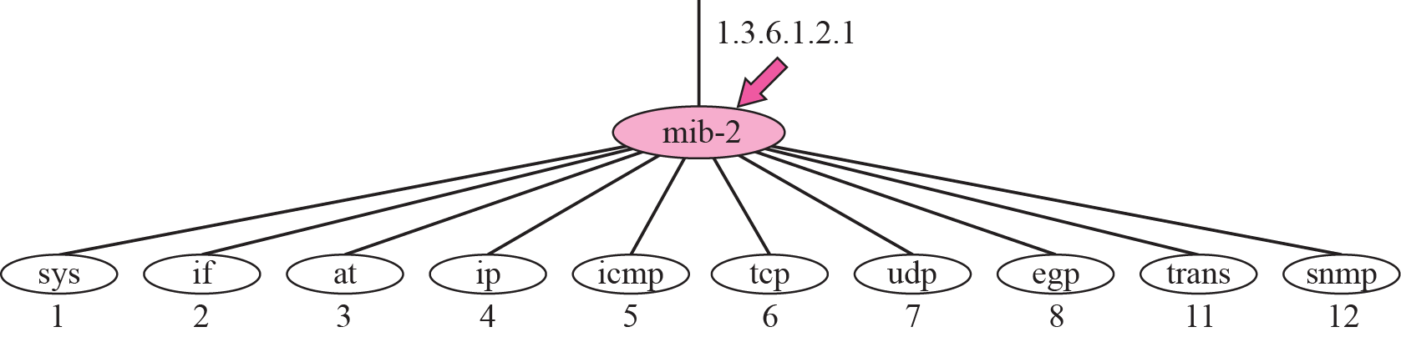
SNMP: mib-2

Slide 26
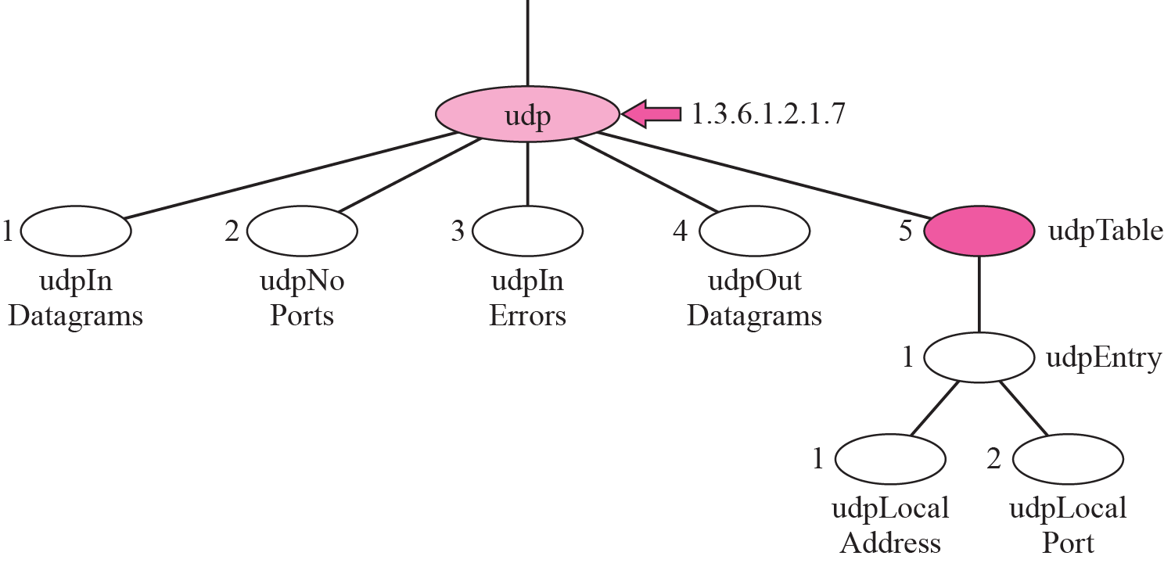
SNMP: mib-2/udp group

Slide 27
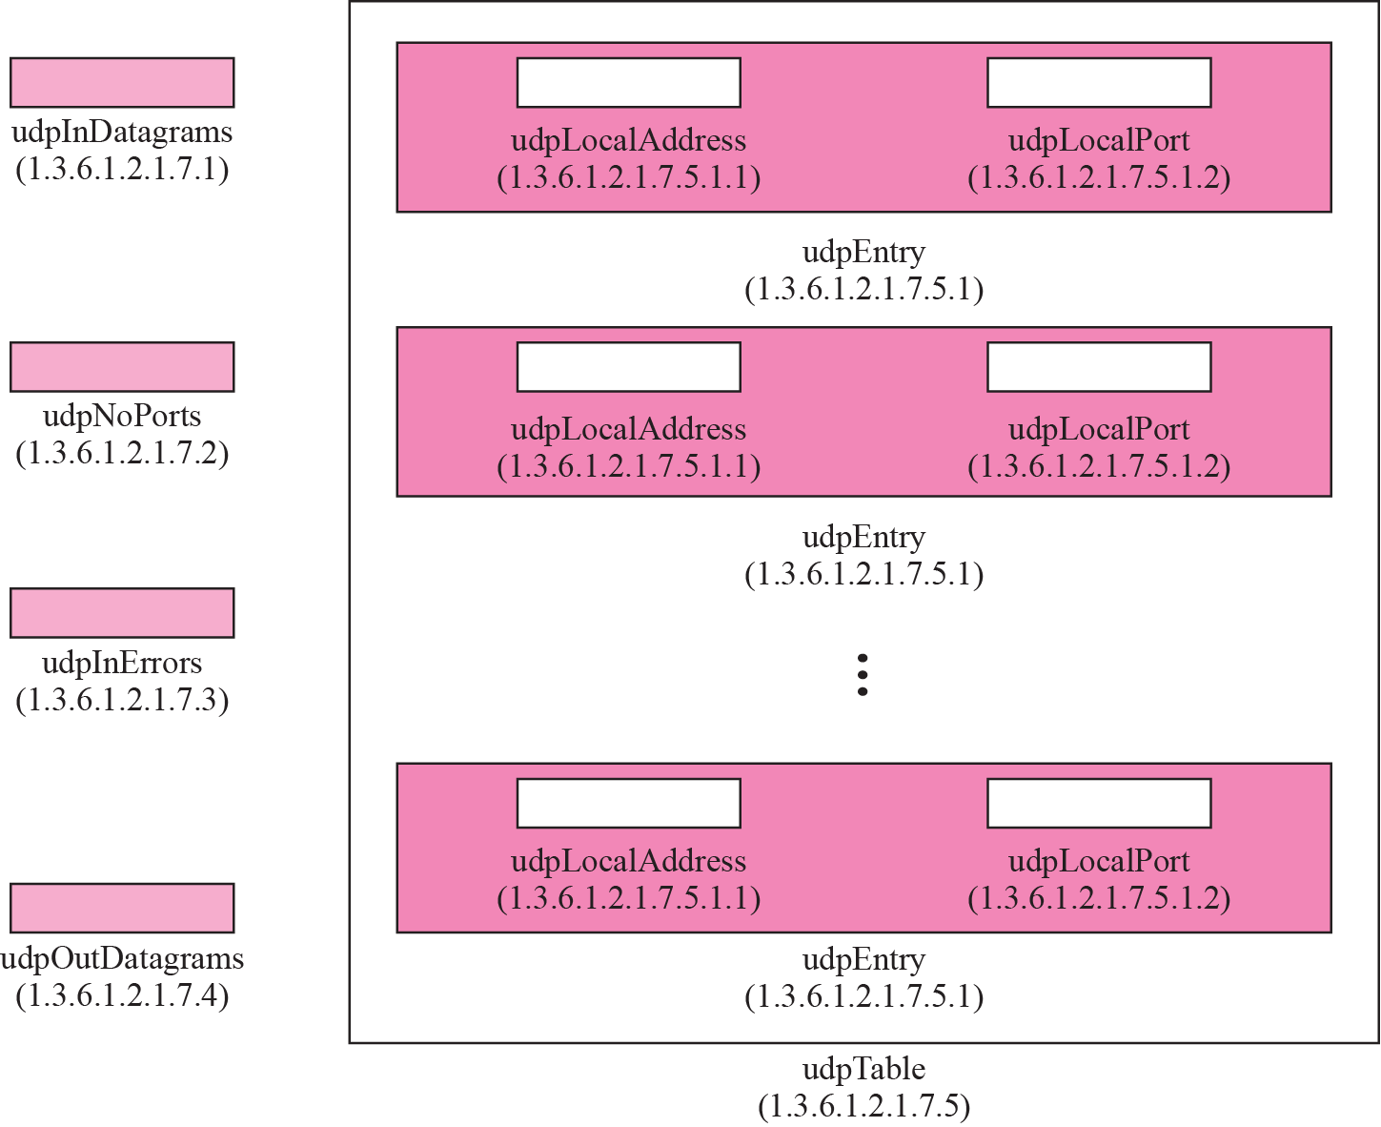
SNMP: mib-2/udp group
Variables and tables

Slide 28
SNMP: Continue on 04/02

Slide 29
Outline
SNMP
  Concept: Manager and Agent
  MIB
  SNMP protocol
Network Management
  SMI

Slide 30
SNMP: protocol
SNMP manager and an SNMP agent communicate using the SNMP protocol
  Generally: Manager sends queries and agent responds
  Exception: Traps are initiated by agent.

Slide 31
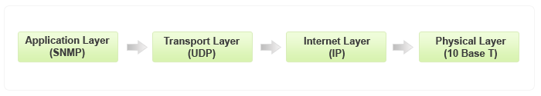
SNMP: protocol
Typical communication
  the SNMP messages are wrapped as User Datagram Protocol (UDP) and intern wrapped and transmitted in the Internet Protocol.
Notes:
Version2

Slide 32
SNMP: protocol
Get-request. Requests the values of one or more objects
Get-next-request. Requests the value of the next object, according to a lexicographical ordering of OIDs.
Set-request. A request to modify the value of one or more objects
Get-response. Sent by SNMP agent in response to a get-request, get-next-request, or set-request message.
Trap. An SNMP trap is a notification sent by an SNMP agent to an SNMP manager, which is triggered by certain events at the agent.
Notes:
This is Version 1
GET: The GET operation is a request sent by the manager to the managed device. It is performed to retrieve one or more values from the managed device.
GET NEXT: This operation is similar to the GET. The significant difference is that the GET NEXT operation retrieves the value of the next OID in the MIB tree.
GET BULK: The GETBULK operation is used to retrieve voluminous data from large MIB table.
SET: This operation is used by the managers to modify or assign the value of the Managed device.
TRAPS: Unlike the above commands which are initiated from the SNMP Manager, TRAPS are initiated by the Agents. It is a signal to the SNMP Manager by the Agent on the occurrence of an event.
INFORM: This command is similar to the TRAP initiated by the Agent, additionally INFORM includes confirmation from the SNMP manager on receiving the message.
RESPONSE: It is the command used to carry back the value(s) or signal of actions directed by the SNMP Manager.

Slide 33
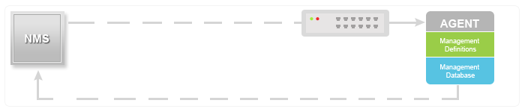
SNMP: protocol
Get-request.
Get-next-request.
Set-request.
Notes:
GET: The GET operation is a request sent by the manager to the managed device. It is performed to retrieve one or more values from the managed device.
GET NEXT: This operation is similar to the GET. The significant difference is that the GET NEXT operation retrieves the value of the next OID in the MIB tree.
GET BULK: The GETBULK operation is used to retrieve voluminous data from large MIB table.
SET: This operation is used by the managers to modify or assign the value of the Managed device.

Slide 34

SNMP: protocol
Trap. An SNMP trap is a notification sent by an SNMP agent to an SNMP manager, which is triggered by certain events at the agent.
  e.g. linkDown: Even that an interface went down
Notes:
TRAPS: Unlike the above commands which are initiated from the SNMP Manager, TRAPS are initiated by the Agents. It is a signal to the SNMP Manager by the Agent on the occurrence of an event.
INFORM: This command is similar to the TRAP initiated by the Agent, additionally INFORM includes confirmation from the SNMP manager on receiving the message.
RESPONSE: It is the command used to carry back the value(s) or signal of actions directed by the SNMP Manager.

Slide 35
SNMP: protocol
Traps
  Traps are triggered by an event
Defined traps include:
  linkDown: Even that an interface went down
  coldStart - unexpected restart (i.e., system crash)
  warmStart - soft reboot
  linkUp - the opposite of linkDown
  (SNMP) AuthenticationFailure
  …
Notes:
Version2

Slide 36
SNMP: protocol
Get-response
INFORM: includes confirmation from the SNMP manager on receiving the message.
Notes:
RESPONSE: It is the command used to carry back the value(s) or signal of actions directed by the SNMP Manager.
INFORM: This command is similar to the TRAP initiated by the Agent, additionally INFORM includes confirmation from the SNMP manager on receiving the message.

Slide 37
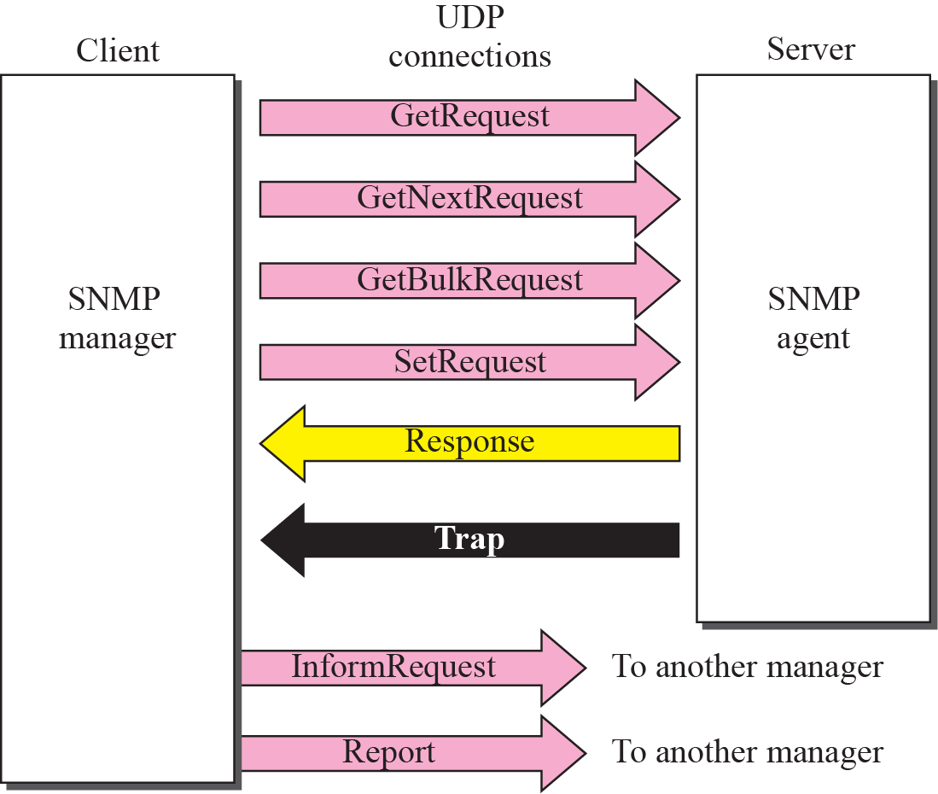
SNMP: protocol

Slide 38
SNMP: versions
Three versions are in use today:
  SNMPv1 (1990)
    Define basic data type
  SNMPv2c (1996)
    Adds “GetBulk” function and some new types
    Adds RMON (remote monitoring) capability
  SNMPv3 (2002)
    SNMPv3 started from SNMPv1 (and not SNMPv2c)
    Addresses security
All versions are still used today
Many SNMP agents and managers support all three versions of the protocol.
Notes:
GET BULK: The GETBULK operation is used to retrieve voluminous data from large MIB table.

Slide 39
SNMP: ports
SNMP uses the services of UDP on two well-known ports, 161 and 162. The well-known port 161 is used by the server (agent), and the well-known port 162 is used by the client (manager).

Slide 40
Outline
SNMP
  Concept: Manager and Agent
  MIB
  SNMP protocol
Network Management
  SMI

Slide 41
SNMP: MIB
MIB is a structured database (tree)
Each resource to be managed is represented by an object
  A managed object is one of any number of specific characteristics of a managed device
    Managed objects comprise one or more object instances which are essentially variables
Each agent (e.g., a router) maintains a MIB that reflects the status of its managed resources

Slide 42
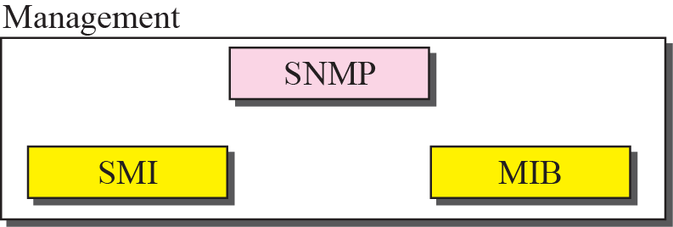
Management Components
SMI
  Structure of Management Information
  SMI defines the general rules for naming objects, defining object types (including range and length), and showing how to encode objects and values.
Notes:
You have objects which are managed by the mangers, so then you need to define rules of how to name objects, specify the types of objects and how to encode objects and values for sure

Slide 43
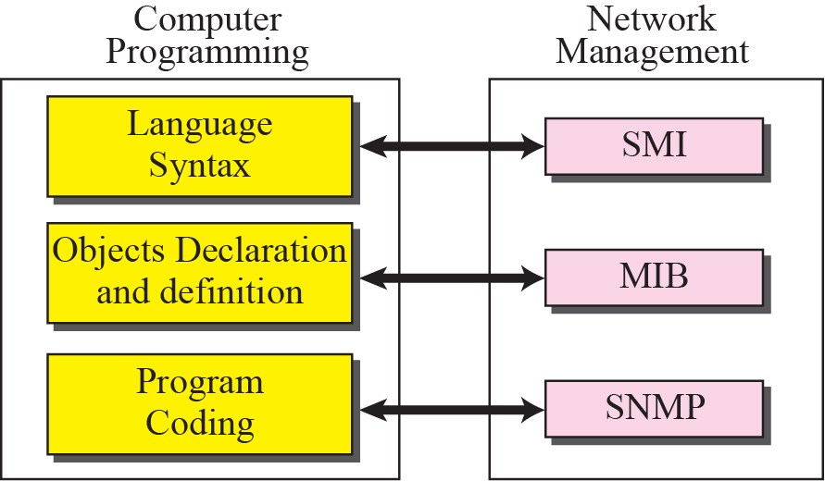
Programming and management

Slide 44
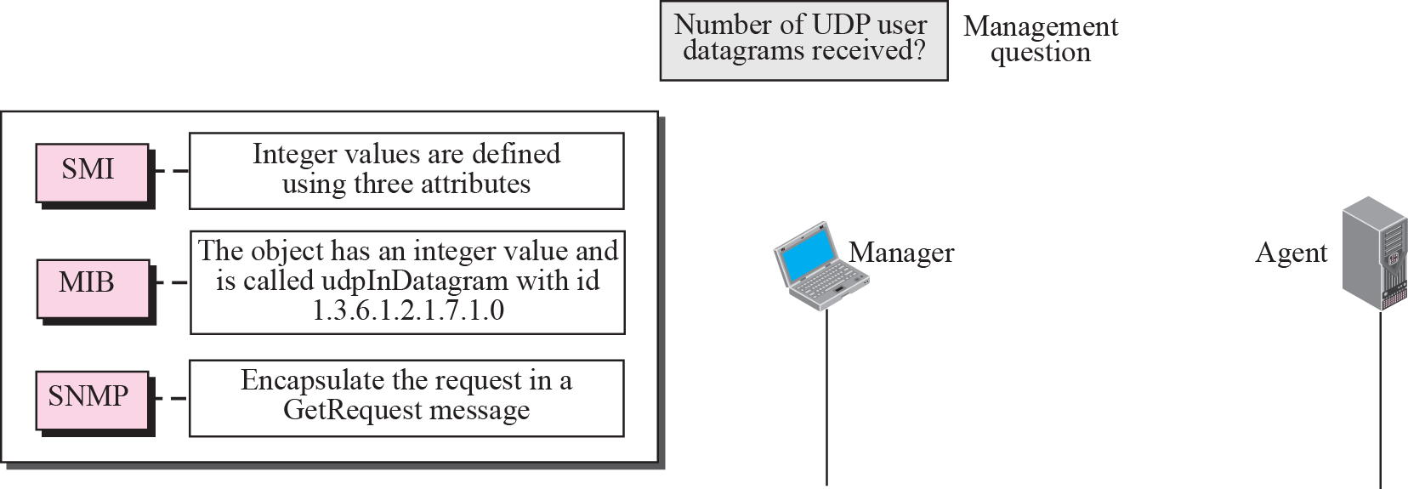
Management Overview

Slide 45
Role of SMI
The Structure of Management Information is a component for network management. Its functions are:
  To name objects.
  To define the type of data that can be stored in an object.
  To show how to encode data for transmission
  over the network.
SMI is a guideline for SNMP. It emphasizes three attributes to handle an object: name, data type, and encoding method.
Notes:
Each resource to be managed is represented by an object. E.g. variables in agent

Slide 46
SMI
A common representation for data between both manager and agent
Defines the syntax (using ASN.1) to describe management information
  Data types and
  Rules used to define managed objects in a MIB

Slide 47
Summary
SNMP
  Components
    Manger agent
    MIB
    SNMP protocol
  SMI

