Slide 1
SNMP
Simple
Network
Management
Protocol

Slide 2
What is it?

Slide 3
SNMP
Simple Network Management Protocol
  Part of the internet protocol suite
    Defined by the Internet Engineering Task Force (IETF)
  Used by network management systems
    Monitor network-attached devices for conditions that warrant administrative attention
    Manage said systems

Slide 4
SNMP
Consists of a set of standards for network management
  Application Layer protocol
  Database schema
  Set of data objects

Slide 5
SNMP
SNMP exposes management data
  Variables on the managed systems
  Describe the system configuration
Variables can be queried by managing applications
  Some can be set

Slide 6
Overview and basic concepts

Slide 7
Overview and basic concepts
Typical SNMP environment:
  Large number of systems to be managed
  One or more systems manage them
An agent :
  Software component
  Runs on each managed system
  Reports information via SNMP to the managing systems

Slide 8
Overview and basic concepts
SNMP agents reports data of interest on the managed systems
  Variables such as:
    "free memory“
    "system name“
    "number of running processes“
    "default route“
    “toner cartridge status”
    etc.

Slide 9
Overview and basic concepts
Managing system can retrieve the information through protocol operations
  GET
  GETNEXT
  GETBULK
Agent can send data without being asked using protocol operations
  TRAP
  INFORM

Slide 10
Overview and basic concepts
Management systems can
  Send configuration updates
  Send controlling requests
Uses the SET protocol operation to actively manage a system

Slide 11
Overview and basic concepts
Configuration and control operations:
  Only used when changes are needed to the network infrastructure
Monitoring operations:
  Usually performed on a regular basis

Slide 12
Overview and basic concepts
Variables accessible via SNMP are organized in hierarchies
Management Information Bases (MIBs)
  Contains the hierarchies and other metadata describing each variable’s
    type
    description

Slide 13
Management Information Bases
MIBs

Slide 14
Pre-Quiz: SNMP can
Monitor devices
Change devices
Warn of errors
All of the above
None of the above

Slide 15
Management Information Bases
SNMP itself does not define the information a managed system can offer
  e.g. variables
SNMP is an extensible design
  Available information defined by management information bases
    a.k.a. MIBs

Slide 16
Management Information Bases
MIBs describe the structure data on a device
  Use a hierarchical namespace containing object identifiers (OID)
  Each OID identifies a variable that can be read or set via SNMP
MIBs use a notation defined by ASN.1

Slide 17
Side Note: ASN.1
Abstract Syntax Notation One

Slide 18
Abstract Syntax Notation One (ASN.1)
Abstract Syntax Notation One (ASN.1)
  Standard and flexible notation
  Describes data structures for
    Representing
    Encoding
    Transmitting
    Decoding data
Provides a set of formal rules
  Describes the structure of objects
    Independent of machine-specific encoding techniques
    Precise, formal notation minimizes ambiguities

Slide 19
Abstract Syntax Notation One (ASN.1)
Joint ISO and ITU-T standard
  Originally defined in 1984
    Part of CCITT X.409:1984
  Moved to its own standard, X.208 (1988)
    Due to wide applicability
  Substantially revised in 1995
    Covered by the X.680 series
Structure of Management Information (SMI)
  An adapted subset of ASN.1
  Specified in SNMP to define sets of related MIB objects
    Termed MIB modules.

Slide 20
Management Information Bases
MIB hierarchy can be depicted as:
  A tree with a nameless root
  Levels which are assigned by different organizations
Top-level MIB OIDs belong to different standards organizations
  CCITT
  ISO
Lower-level object IDs are allocated by associated organizations

Slide 21
Management Information Bases
Model permits management across all layers of the OSI reference model
  Can extend into applications
    databases
    email
    Java EE reference model
    Etc.
  MIBs can be defined
    for a specific set of information and operations
    for a specific type or group

Slide 22
Management Information Bases
A managed object¹ is one a specified characteristic of a managed device
  Managed objects comprise one or more object instances which are essentially variables
    Identified by their OIDs
¹sometimes called an MIB object, an object, or a MIB

Slide 23
Management Information Bases
Two types of managed objects exist:
  Scalar objects
    Define a single object instance
  Tabular objects
    Define multiple related object instances
    Grouped in MIB tables

Slide 24
Management Information Bases
Example of a managed object
  atInput
    A scalar object that contains a single object instance
      An integer value
    Indicates the total number of input AppleTalk packets on a router interface
Object identifier (or object ID or OID)
  Uniquely identifies a managed object in the MIB hierarchy

Slide 25
Examples
Resource:
  http://www.mibdepot.com/index.shtml
Example: 3Com device
  http://www.mibdepot.com/cgi-bin/xsearch_index3.cgi?id=173627
Example 2:
  http://www.oid-info.com/get/1.3.6.1.2.1

Slide 26
From the top
example
  1.3.6.1.4.1.11
Start with the top level OID assignment
  http://www.alvestrand.no/objectid/top.html
    and work the way down

Slide 27
SNMP basic components

Slide 28
SNMP basic components
SNMP-managed networks consist of three key components:
  Managed devices
  Agents
  Network-management systems (NMS)

Slide 29
SNMP basic components
Managed device
  Network node that contains an SNMP agent
    Resides on a managed network
  Collect and store management information
    Make information available to NMSs using SNMP
Managed devices
  Sometimes called network elements

Slide 30
SNMP basic components
Managed devices can be any type of device including, but not limited to:
  Routers and access servers
  Switches and bridges
  Hubs
  IP telephones
  Computer hosts
  Printers

Slide 31
SNMP basic components
Agent
  Network-management software (NMS) module
    Executable program
    Resides in a managed device
  Has local knowledge of management information
    Translates that information into a form compatible with SNMP

Slide 32
SNMP basic components
Network Management Systems
  Execute applications that monitor and control managed devices
  NMS provide
    Bulk of the processing
    Memory resources required for network management
  One or more NMS may exist on any managed network

Slide 33
SNMP architecture

Slide 34
SNMP architecture review
SNMP framework consists of
  Master agents
  Subagents
  Management stations

Slide 35
Master agent
Software running on an SNMP-capable network component
  For example a router, that responds to SNMP requests from the management station
Acts as a:
  Server in client-server architecture terminology
  Daemon in operating system terminology
Relies on subagents to provide information about the management of specific functionality
Can also be referred to as managed objects

Slide 36
Subagent
A piece of software running on an SNMP-capable network component
  Implements the information and management functionality defined by a specific MIB of a specific subsystem
    For example the ethernet link layer

Slide 37
Subagent
Some capabilities of the subagent are:
  Gathering information from managed objects
  Configuring parameters of the managed objects
  Responding to managers' requests
  Generating alarms or traps

Slide 38
Management station
Manager or management station
  Final component in the SNMP architecture
Functions as the equivalent of a client in the client-server architecture
  Issues requests for management operations
    On behalf of a administrator or application
  Receives traps from agents

Slide 39
SNMP oddity:
System has:
  Many servers
    Each managed device on the network
  Few clients
    Usually one or two
    Devices that monitor and manage the “servers”
“Backwards” from the usual client/server environment

Slide 40
SNMP protocols

Slide 41
SNMPv1 MIB tables
SNMPv1 SMI defines highly structured tables
  Used to group instances of a tabular object
  Object that contains multiple variables
Tables are composed of zero or more rows
  Indexed in a way that allows SNMP to retrieve or alter an entire row with a single Get, GetNext, or Set command

Slide 42
Data Types
Integer
Octet Strings
Object IDs

Slide 43
Application-wide data types
Seven application-wide data types exist in the SNMPv1 SMI:
  Network addresses
  Counters
  Gauges
  Time ticks
  Opaques
  Integers
  Unsigned integers

Slide 44
SNMPv2

Slide 45
SNMPv2 and structure of management information
The SNMPv2 SMI is described in RFC 2578
  Has additions and enhancements to the SNMPv1 SMI-specific data types
    Including bit strings, network addresses, and counters
  Bit strings are defined only in SNMPv2
    Comprise zero or more named bits that specify a value
  Network addresses represent an address from a particular protocol family
  Counters are non-negative integers that increase until they reach a maximum value and then return to zero
    SNMPv1: a 32-bit counter size is specified
    SNMPv2: 32-bit and 64-bit counters are defined

Slide 46
SNMPv3

Slide 47
SNMPv3
SNMPv3 defined by RFC 3411–RFC 3418
  also known as 'STD0062'
SNMPv3 primarily added security and remote configuration enhancements
SNMPv3 is the current standard version of SNMP
  IETF considers earlier versions "Obsolete" or "Historical"

Slide 48
SNMPv3
SNMPv3 provides important security features:
  Message integrity
    Ensure that a packet has not been tampered with in transit
  Authentication
    Verify that the message is from a valid source
  Encryption of packets
    Prevent snooping by an unauthorized source

Slide 49
Version 3
SNMPv3 provides three important services:
  Authentication
  Privacy
  Access control

Slide 50
Usage examples

Slide 51
Usage examples
Monitoring device uptimes
  sysUpTimeInstance
Inventory of OS versions
  sysDescr
Collect NIC information
  ifName
  ifDescr
  ifSpeed
  ifType
  ifPhysAddr
Measuring NIC throughput
  ifInOctets
  ifOutOctets
Querying a remote ARP cache
  ipNetToMedia

Slide 52
Other SNMP topics

Slide 53
Autodiscovery
SNMP by itself is simply a protocol for collecting and organizing information
Most toolsets implementing SNMP offer some form of discovery mechanism
  Standardized collection of data common to most platforms and devices
  Used to get a new user or implementer started
One of these features is often a form of automatic discovery
  New devices discovered in the network are polled automatically

Slide 54
Autodiscovery
For SNMPv1 and SNMPv2c
  Presents a security risk
  Your SNMP read communities will be broadcast in cleartext to the target device
While security requirements and risk profiles vary from organization to organization
  Care should be taken when using a features like these
  Special regard to common environments such as
    Mixed-tenant datacenters
    Server hosting and colocation facilities
    Similar environments

Slide 55
Negative impact
SNMP implementations vary across platform vendors
  SNMP is often an added feature
    Not an element of the core design
  SNMP's tree structure and linear indexing may not always mate well with the internal data structures that are elements of a platform's basic design
  Using SNMP to query certain data sets may result in high CPU utilization
    Negative effects on operation
    One example of this would be large routing tables
      such as BGP or IGP

Slide 56
Security implications
SNMP versions 1 and 2c are subject to packet sniffing
  The clear text community string from the network traffic
  No encryption
All versions of SNMP are subject to brute force and dictionary attacks for guessing the community strings/authentication strings,
  Do not implement a challenge-response handshake
SNMP can work over TCP and other protocols
  Most commonly used over UDP
    Connectionless and vulnerable to IP spoofing attacks
  All versions are subject to bypassing device access lists that might have been implemented to restrict SNMP access
    SNMPv3's other security mechanisms should prevent a successful attack

Slide 57
Security implications
SNMP's configuration capabilities can be misconfigured and used to cause much damage
  'write' capabilities are very rarely used in practice
    Lack of security in SNMP versions before SNMPv3
  Lack of security is particularly serious with SNMPv1 or v2c over UDP
    Clear text community strings can be intercepted and combined with IP spoofing
SNMP tops the list of the SANS Institute's Common Default Configuration Issues
  The issue of default SNMP community strings set to ‘public’ and ‘private’
  Number ten on the SANS The Top 10 Most Critical Internet Security Threats for the year 2000
For more detail on SNMP security implications see the CERT SNMP Vulnerabilities FAQ

Slide 58
Last Notes
SNMPv3 is the most secure
SNMPv1 is the most used¹
  “easiest”
Typical systems will try the most secure version first
  Then roll back towards v1
¹https://www.digitalocean.com/community/tutorials/an-introduction-to-snmp-simple-network-management-protocol (2014)

Slide 59
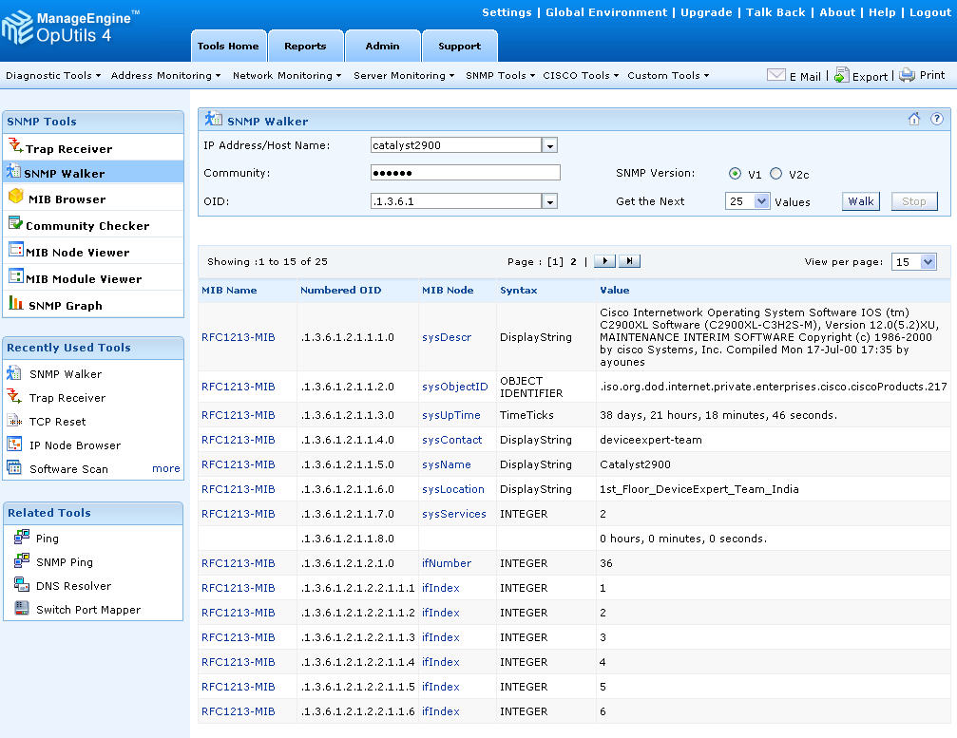

Slide 60
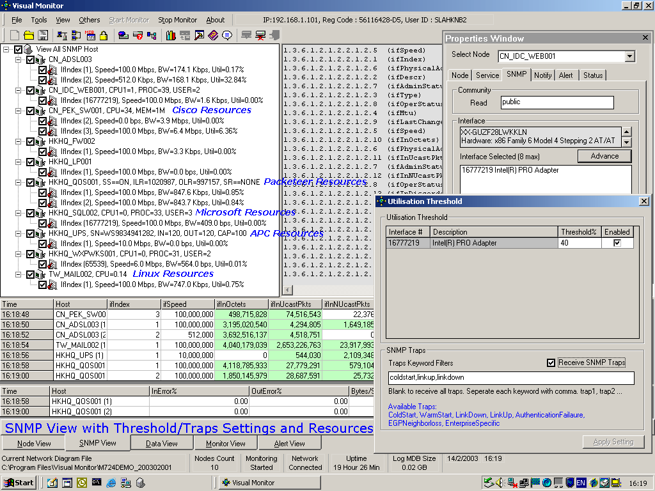

Slide 61
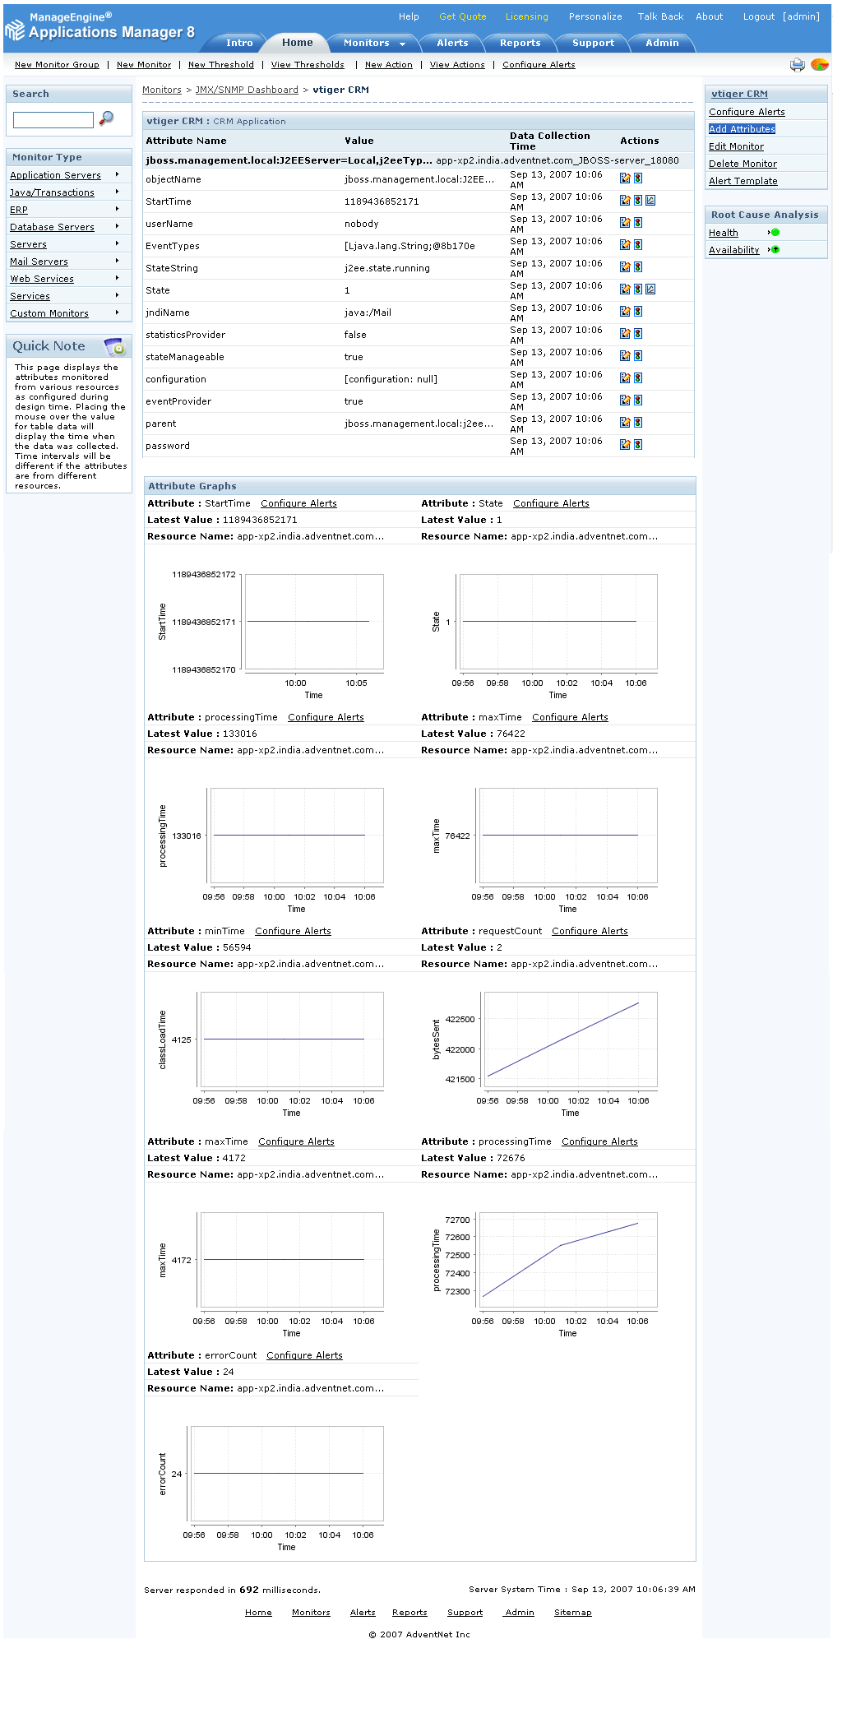

Slide 62
Post-Quiz: SNMP can
Monitor devices
Change devices
Warn of errors
All of the above
None of the above

Slide 63
Summary
SNMP is a protocol to define a framework for network management tasks
By itself is just a definition
  Must be “made real” by products

Slide 64
More Info
SNMP Data Types.pptx

