Slide 1
SNMP
Simple
Network
Management
Protocol

Slide 2
What is it?
SNMP

Slide 3
SNMP
Simple Network Management Protocol
  Part of the internet protocol suite
    Defined by the Internet Engineering Task Force (IETF)
  Used by network management systems
    Monitor network-attached devices for conditions that warrant administrative attention
    Manage those systems
      e/g/ Set or reset their configuration

Slide 4
SNMP
SNMP “exposes” management data
  Variables on the managed systems
  Values within the system
Variables can be queried by managing applications
Some variables can be set

Slide 5
Overview and basic concepts

Slide 6
Overview and basic concepts
Typical SNMP environment:
  Large number of systems to be managed
    Via SNMP Agents
  By one or more system managers
    Via SNMP Managers

Slide 7
Overview and basic concepts
An SNMP agent :
  Software component
  Runs on each managed system
  Reports information via SNMP to the managing systems

Slide 8
Overview and basic concepts
SNMP agents reports data of interest on the managed systems
  Variables such as:
    "free memory“
    "system name“
    "number of running processes“
    "default route“
    “toner cartridge status”
    etc.

Slide 9
Overview and basic concepts
Managers can retrieve the information through protocol operations
  GET
  GETNEXT
  GETBULK
Agents can send data without being asked using special protocol operations
  TRAP
  INFORM

Slide 10
Overview and basic concepts
Managers can
  Send configuration updates
  Send controlling requests
Uses the SET protocol operation to actively manage a system

Slide 11
Overview and basic concepts
Monitoring operations:
  Done by managers
  Usually performed on a regular basis
    E.g. periodic polling
Configuration and Control operations:
  Done by managers
  Only when changes are needed

Slide 12
Overview and basic concepts
SNMP Variables are organized in hierarchies called MIBs
  Management Information Bases
  Contains the data and metadata describing each variable’s
    type
    description

Slide 13
Management Information Bases
MIBs

Slide 14
Management Information Bases
SNMP itself does not define the information within a managed system
  e.g. Specific systems variables
SNMP is an extensible design
  Available information defined by management information bases
    a.k.a. MIBs
  System designers decide what info is appropriate for a particular device

Slide 15
Management Information Bases
MIBs describe the structure data for a device or class of devices
  Use a hierarchical namespace containing object identifiers (OID)
  Each OID identifies a variable that can be read or set via SNMP
MIBs use a notation defined by ASN.1

Slide 16
Management Information Bases
MIB hierarchy can be depicted as:
  A tree with a nameless root
  Levels which are assigned by different organizations
Top-level MIB OIDs belong to different standards organizations
  CCITT
  ISO
Lower-level object IDs are defined by their organizations

Slide 17
Management Information Bases
A managed object¹ is a specified characteristic of a managed device
  Managed objects comprise one or more object instances which are essentially variables
    Identified by their OIDs
¹sometimes called an MIB object, an object, or a MIB

Slide 18
Management Information Bases
Two types of managed objects exist:
  Scalar objects
    Define a single object instance
  Tabular objects
    Define multiple related object instances
    Grouped in MIB tables

Slide 19
Management Information Bases
Example of a managed object on an HP printer
  Object identifier (or object ID or OID)
    1.3.6.1.2.1.43.9.2.1.1
    Identifies the output capacity
    prtOutputIndex
      A scalar object that contains a single object instance
        An integer value
      0 or larger
        0 means out of paper

Slide 20
From the top
example
  1.3.6.1.4.1.11
Start with the top level OID assignment
  http://www.alvestrand.no/objectid/top.html
    and work the way down

Slide 21
Other Examples
Resource:
  http://www.mibdepot.com/index.shtml
Example: 3Com device
  http://www.mibdepot.com/cgi-bin/xsearch_index3.cgi?id=173627
Example 2:
  http://www.oid-info.com/get/1.3.6.1.2.1

Slide 22
SNMP basic components

Slide 23
SNMP basic components
SNMP-managed networks consist of three key components:
  Managed devices
  Agents
  Network-management systems (NMS)

Slide 24
SNMP basic components
Managed device
  Network node that contains one or more SNMP agents
    Resides on a managed network
  Collect and store management information
    Make information available to NMSs using SNMP
Managed devices
  Sometimes called network elements
Act as servers on the network

Slide 25
SNMP basic components
Managed devices can be any type of networked device including, but not limited to:
  Routers and access servers
  Switches and bridges
  Hubs
  IP telephones
  Computer hosts
  Printers
  File servers
  Web servers

Slide 26
SNMP basic components
Agent
  Network-management software (NMS) module
    Executable program
    Resides in a managed device
  Has local knowledge of management information
    Translates that information into a form compatible with SNMP

Slide 27
SNMP basic components
Network Management Systems
  Execute applications that monitor and control managed devices
  NMS provide
    Bulk of the processing
    Memory resources required for network management
  One or more NMS may exist on any managed network
Act as clients on the network

Slide 28
SNMP oddity:
Typical system has:
  Many servers
    Each managed device on the network is a server
  Few clients
    Usually one or two
    Devices that monitor and manage the “servers”
“Backwards” from the usual client/server environment

Slide 29
Which are more common in an SNMP environment
Clients
Dwarves
Magic Elves
Servers
Teabags

Slide 30
SNMP protocols

Slide 31
SNMP Versions
SNMPv1
SNMPv2
SNMPv3

Slide 32
SNMPv1 MIB tables
SNMPv1 defines highly structured tables
  Used to group instances of a tabular object
  Object that contains multiple variables
Tables are composed of zero or more rows
  Indexed in a way that allows SNMP to retrieve or alter an entire row with a single Get, GetNext, or Set command

Slide 33
Data Types
Integer
Octet Strings
Object IDs

Slide 34
Application-wide data types
Seven application-wide data types exist in the SNMPv1 SMI:
  Network addresses
  Counters
  Gauges
  Time ticks
  Opaques
  Integers
  Unsigned integers

Slide 35
SNMPv2

Slide 36
SNMPv2 and structure of management information
Enhancements to the v1 datatypes

Slide 37
SNMPv3

Slide 38
SNMPv3
SNMPv3 defined by RFC 3411–RFC 3418
  also known as 'STD0062'
SNMPv3 primarily added security and remote configuration enhancements
SNMPv3 is the current standard version of SNMP
  IETF considers earlier versions "Obsolete" or "Historical"

Slide 39
SNMPv3
SNMPv3 provides important security features:
  Message integrity
    Ensure that a packet has not been tampered with in transit
  Authentication
    Verify that the message is from a valid source
  Encryption of packets
    Prevent snooping by an unauthorized source

Slide 40
Other SNMP topics

Slide 41
Negative impact
SNMP implementations vary across platform vendors
  SNMP is often an added feature
    Not an element of the core design
  SNMP's tree structure and linear indexing may not always mate well with the internal data structures that are elements of a platform's basic design
  Using SNMP to query certain data sets may result in high CPU utilization
    Negative effects on operation
    One example of this would be large routing tables
      such as BGP or IGP

Slide 42
Security implications
SNMP versions 1 and 2c are subject to packet sniffing
  The clear text community string from the network traffic
  No encryption
All versions of SNMP are subject to brute force and dictionary attacks for guessing the community strings/authentication strings

Slide 43
Security implications
SNMP's configuration capabilities can be misconfigured and used to cause much damage
  'write' capabilities are very rarely used in practice
    Lack of security in SNMP versions before SNMPv3
  Lack of security is particularly serious with SNMPv1 or v2c over UDP
    Clear text community strings can be intercepted and combined with IP spoofing
SNMP tops the list of the SANS Institute's Common Default Configuration Issues
  The issue of default SNMP community strings set to ‘public’ and ‘private’
  Number ten on the SANS The Top 10 Most Critical Internet Security Threats for the year 2000
For more detail on SNMP security implications see the CERT SNMP Vulnerabilities FAQ

Slide 44
Last Notes
SNMPv3 is the most secure
SNMPv1 is the most used¹
  “easiest”
Typical systems will try the most secure version first
  Then roll back towards v1
¹https://www.digitalocean.com/community/tutorials/an-introduction-to-snmp-simple-network-management-protocol (2014)

Slide 45
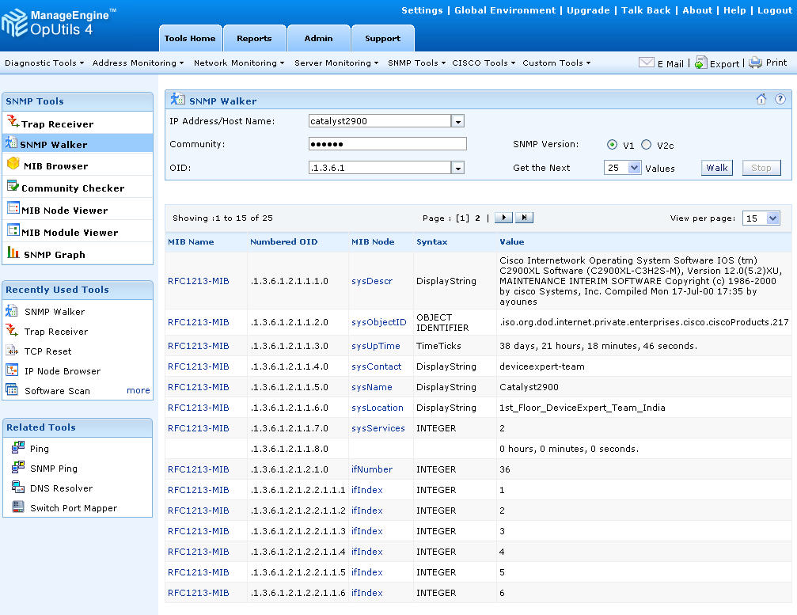

Slide 46
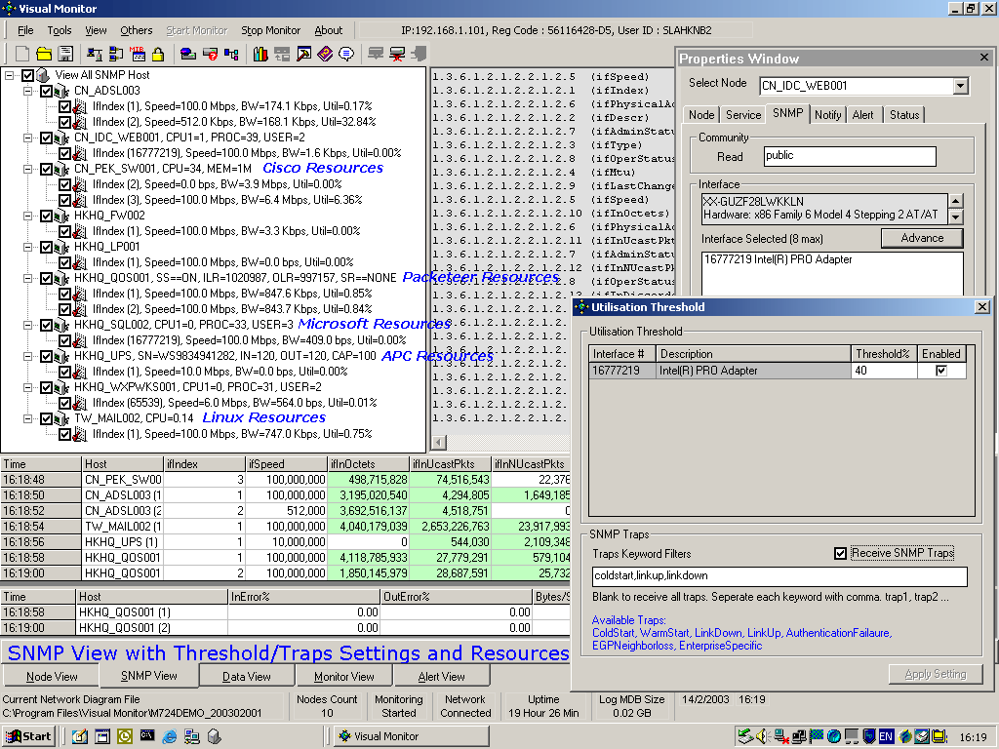

Slide 47
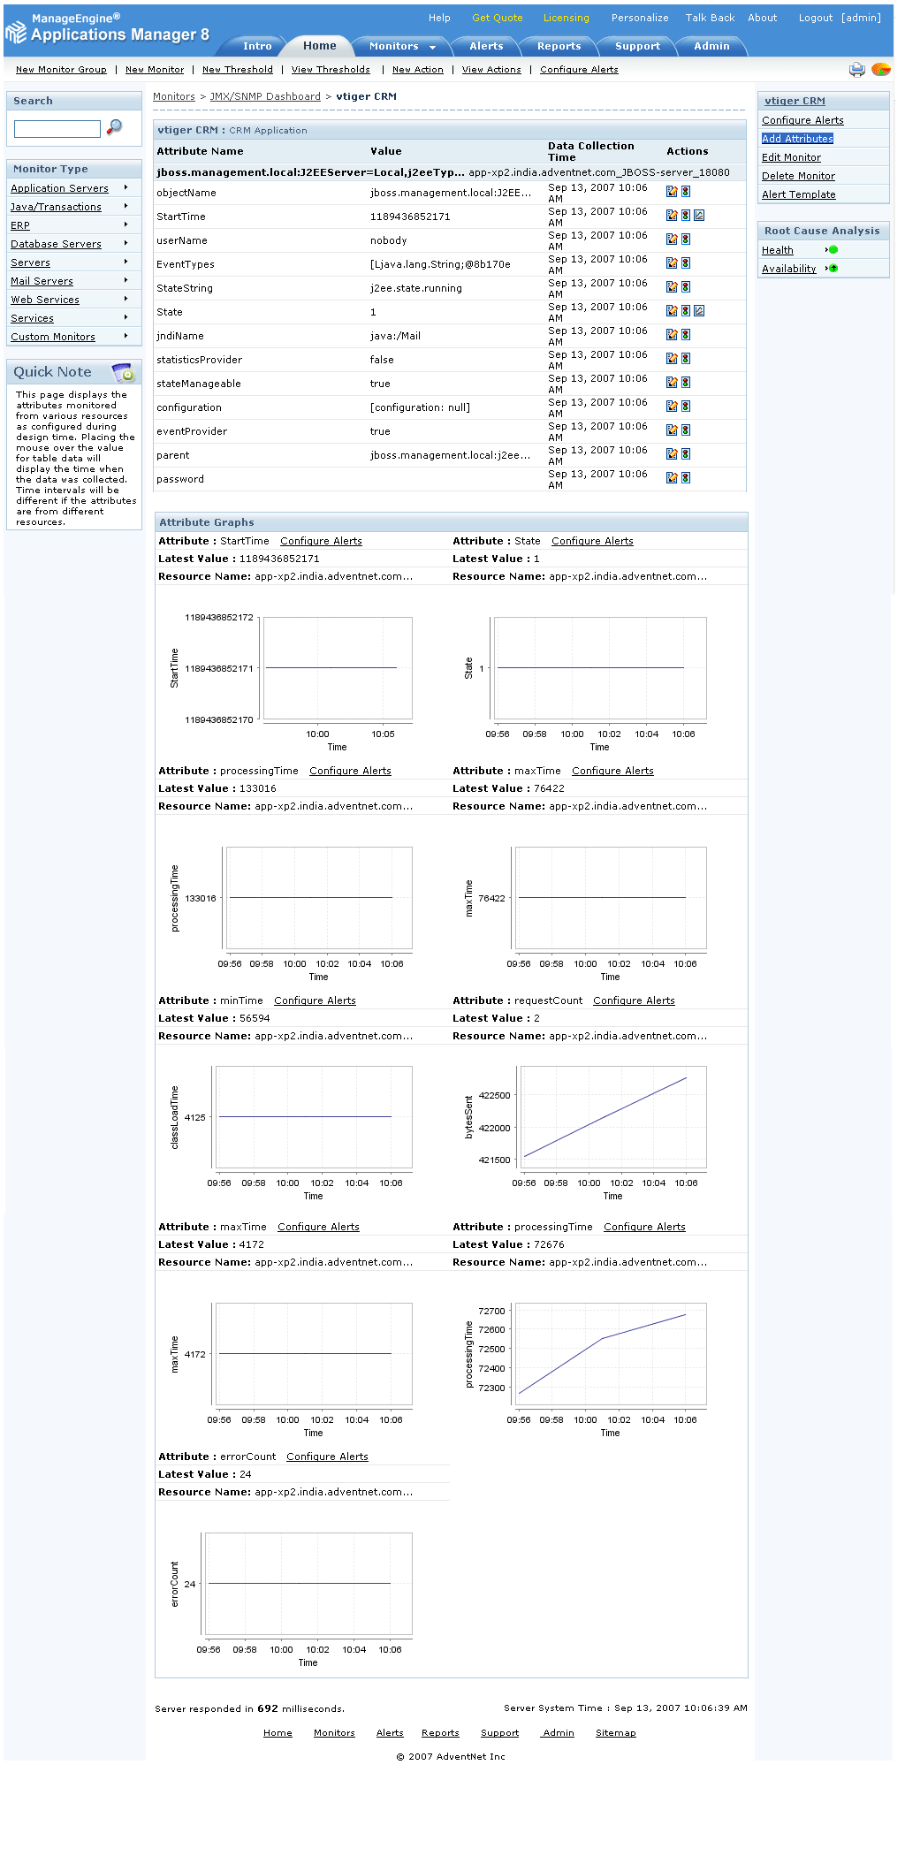

Slide 48
SNMP can:
Monitor devices
Change devices
Warn of errors
All of the above
None of the above

Slide 49
Summary
SNMP is a protocol to define a framework for network management tasks
By itself is just a definition
  Must be “made real” by products

Slide 50
More Info
SNMP Data Types.pptx

