Slide 1
LAN Vulnerabilities

Slide 2
Local Area Network
How to connect computers?
  Point to Point?
  Sharing a medium?
Topologies
  Ring
  Bus
  Star

Slide 3
Ethernet
Most popular LAN technology
Original Ethernet is Bus topology
CSMA/CD for Media Access Protocol
Devices
  Repeater, Bridge, Hub, Switch
  Coaxial Cable -> Twisted Pair (Category 5…)
10M -> 100M -> 1G

Slide 4
Hubs
Layer-1
A device that connects several computer on Ethernet
Have a number of RJ-45 ports
Hubs do no processing on network traffic--they simply repeat the incoming signal to all available ports.

Slide 5
Switches
Layer-2
Connects several computers in a network by a number of RJ-45 ports
  Same as Hubs
Every port works as a Bridge
  A switch has table of (MAC, port) pairs
Store and Forward, Cut through
Each device can act independently from other devices

Slide 6
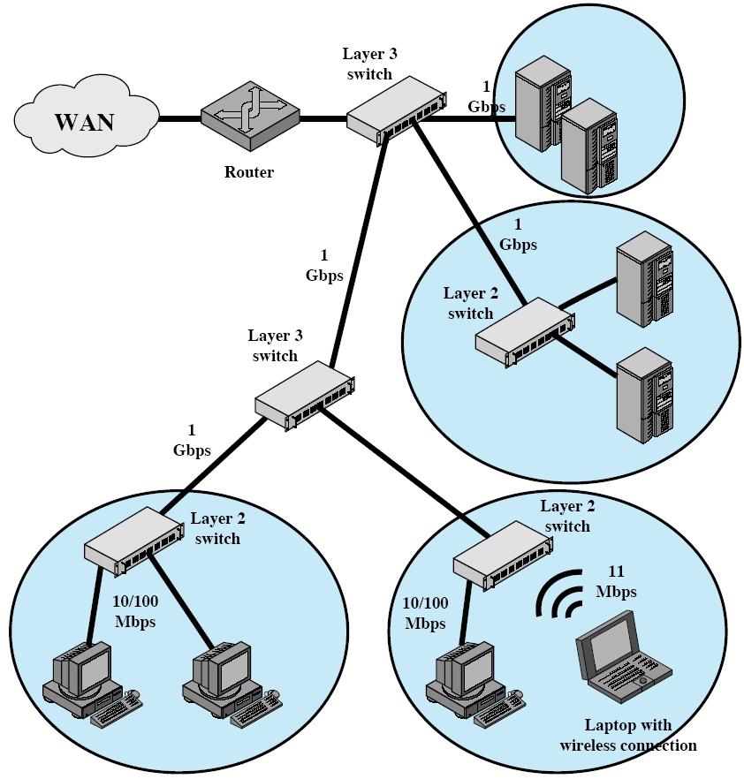
Example: local networking

Slide 7
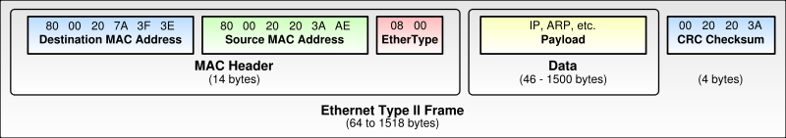
Ethernet Frame

Slide 8
Physical (MAC) Address
Why need address?
Each Network Card is assigned a physical address
  Usually assigned by hardware manufacturer
Network Card will only accept the frames that is destined to it

Slide 9
Network Sniffing
Basically, network sniffing is to eavesdrop the network to capture the packets transmitted over the network.

Slide 10
Components of a Sniffer
The hardware: adapter with promiscuous mode capability
Driver: capture the packets and store them in the buffer.
Packet filter: filter the packets according to user rules.
Packet analyzer: analyses the packets, and generate human readable reports.
Examples:
  TcpDump, Wireshark

Slide 11
How to sniff?
Frames are transmitted on Ethernet
  Broadcast Frames
    Examples?
    All computers read the frame
  Non-broadcast frames
    Examples?
    Only the target computer reads the frame
    Can the frame be read by other computers?
      Hub?
      Switch?

Slide 12
Detecting Sniffing
A LAN with many computers, we want to detect which one of them is sniffing
We know all IP addresses of those computers
What happens if we send a ARP request with an IP address and a non-broadcasting MAC address?
  E.g. fake broadcast FF:FF:FF:FF:FF:FE

Slide 13
Layer-2 Switch
Switches learn the binding of port and MAC address
  By examining MAC addresses of frames arrives from each port
The association may change, when
  A different computer is plugged into a port

Slide 14
Port Stealing
Attacker floods the switch with forged gratuitous ARP reply packets with the source MAC address being that of the target host and the destination MAC address being that of the attacker.
Since the destination MAC address of each flooding packet is the attackers MAC address, the switch will not forward these packets to other ports, meaning they will not be seen by other hosts on the network
A race condition: because the target host will send packets too. The switch will see packets with the same source MAC address on two different ports and will constantly change the binding of the MAC address to the port. Remember that the switch binds a MAC address to a single port. If the attacker is fast enough, packets intended for the target host will be sent to the attacker’s switch port and not the target host.
When a packet arrives, the attacker performs an ARP request asking for the target hosts’ IP address. Next, the attacker stops the flooding and waits for the ARP reply. When the attacker receives the reply, it means that the target hosts’ switch port has been restored to its original binding.
The attacker now sniffs the packet and forwards it to the target host and restarts the attack…

Slide 15
Port Stealing
1
2
3
Layer 2 switch
Gratuitous ARP (forged)
A
Attacker
B
Notes:
The attack starts by having the attacker flood the switch with forged gratuitous ARP packets with the
source MAC address being that of the target host and the destination MAC address being that of the
attacker. The flooding process described here is different than the flooding process used in CAM
table flooding. Since the destination MAC address of each flooding packet is the attackers MAC
address, the switch will not forward these packets to other ports, meaning they will not be seen by
other hosts on the network. Now, a race condition exists because the target host will send packets
too. The switch will see packets with the same source MAC address on two different ports and will
constantly change the binding of the MAC address to the port. Remember that the switch binds a
MAC address to a single port. If the attacker is fast enough, packets intended for the target host will
be sent to the attacker’s switch port and not the target host. The attacker has now stolen the target
hosts’ switch port. When a packet arrives to the attacker, the attacker performs an ARP request
asking for the target hosts’ IP address. Next, the attacker stops the flooding and waits for the ARP
reply. When the attacker receives the reply, it means that the target hosts’ switch port has been
restored to its original binding. Now, the attacker can sniff the packet, then forward it to the target
host and restart the flooding process waiting for new packets.

Slide 16
ARP Spoofing
Also called ARP poisoning
Goal is to poison victim’s ARP cache to map an IP address to a wrong MAC address
  arp –a
  Attacker can become man-in-the-middle
Method: Send fake ARP messages

Slide 17
ARP – Address Resolution Protocol
mapping from IP addresses to MAC addresses
Request
08:00:20:03:F6:42
00:00:C0:C2:9B:26
.1
.2
.3
.4
.5
140.252.13
arp req | target IP: 140.252.13.5 | target eth: ?
Reply
08:00:20:03:F6:42
00:00:C0:C2:9B:26
.1
.2
.3
.4
.5
140.252.13
arp rep | sender IP: 140.252.13.5 | sender eth: 00:00:C0:C2:9B:26

Slide 18
Example ARP Request
+ | Bits 0 - 7 | 8 - 15 | 16 - 31
0 | Hardware type = 1 |  | Protocol type = 0x0800
32 | Hardware length = 6 | Protocol length = 4 | Operation = 1 (request)
64 | SHA (first 32 bits) = 0x000958D8
96 | SHA (last 16 bits) = 0x1122 |  | SPA (first 16 bits) = 0x0A0A
128 | SPA (last 16 bits) = 0x0A7B |  | THA (first 16 bits) = 0xFFFF
160 | THA (last 32 bits) = 0xFFFFFFFF
192 | TPA = 0x0A0A0A8C

Slide 19
Example ARP Reply
+ | Bits 0 - 7 | 8 - 15 | 16 - 31
0 | Hardware type = 1 |  | Protocol type = 0x0800
32 | Hardware length = 6 | Protocol length = 4 | Operation = 2 (reply)
64 | SHA (first 32 bits) = 0x000958D8
96 | SHA (last 16 bits) = 0x33AA |  | SPA (first 16 bits) = 0x0A0A
128 | SPA (last 16 bits) = 0x0A8C |  | THA (first 16 bits) = 0x0009
160 | THA (last 32 bits) = 0x58D81122
192 | TPA = 0x0A0A0A7B

Slide 20
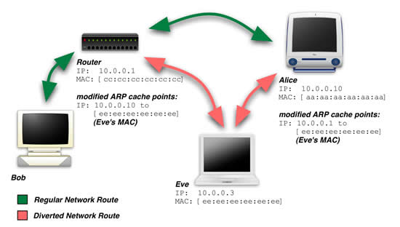
ARP Spoofing

