Slide 1
Domain Name System
Tony Kombol
ITIS 3110

Slide 2
DNS!

Slide 3
overview
history
features
architecture
records
name server
resolver
dnssec

Slide 4
before dns
Mapping IP addresses was done using a hosts file stored on every computer
Master HOSTS.TXT was at Stanford Research Institute
  now SRI International
Computers had to update their copy of the host file any time a change was made mapping
A more scalable solution was required

Slide 5
history
DNS was the solution
Invented in 1983 at UCB
Server rewritten in 1985, became BIND
  Berkeley Internet Name Domain
  Originally on Unix
Distributed database of name and IP address mapping
Supports other record types

Slide 6
Side note
Dozens of versions of DNS now available
  https://en.wikipedia.org/wiki/Comparison_of_DNS_server_software

Slide 7
features
DNS is split into zones
A zone can be split into sub-zones
A zone can delegate control of a sub-zone to another server
A sub-zone may be under the control of a different organization

Slide 8
features
Replication
  Read-only copies of entire zones can be sent to other servers
  Replication can be used for load-balancing or failure mitigation

Slide 9
features
Caching
  Query responses can be cached to speed subsequent queries
  Every query response has an associated lifetime that it will be cached for

Slide 10
Who controls DNS records?
Nobody and Everybody
  Nobody
    No single entity controls the mappings
  Everybody!
    Every entity controls their own mappings

Slide 11

dns explained

Slide 12
structure
DNS is a tree-like structure
Split into ‘zones’
Servers for the root zone are all over the world
All records in a zone are maintained by the same entity
A portion of a zone can be delegated to another entity

Slide 13
IANA
Internet Assigned Numbers Authority
  Original group
  Maintained the Top level domain names
    Original
      .com, .edu, .net, .org, …
    Country Code
      .us, .ca, .uk, .tv, …
    Generic Top Level (ICANN era)
      .aero, .biz, .guitars, …
ICANN (Internet Corporation for Assigned Names and Numbers)
  Currently performs the actual work
https://en.wikipedia.org/wiki/List_of_Internet_top-level_domains

Slide 14
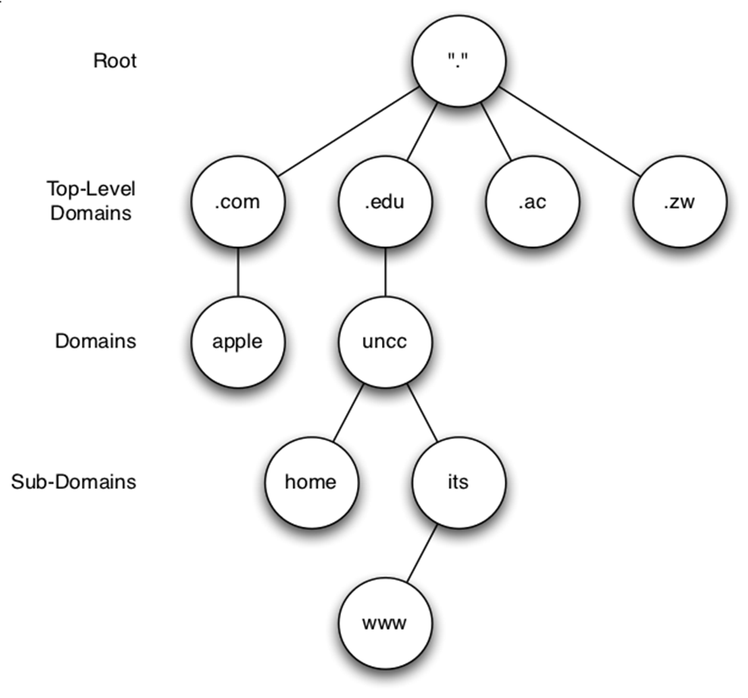
structure
Controlled by IANA
Controlled by owners of the domain

Slide 15
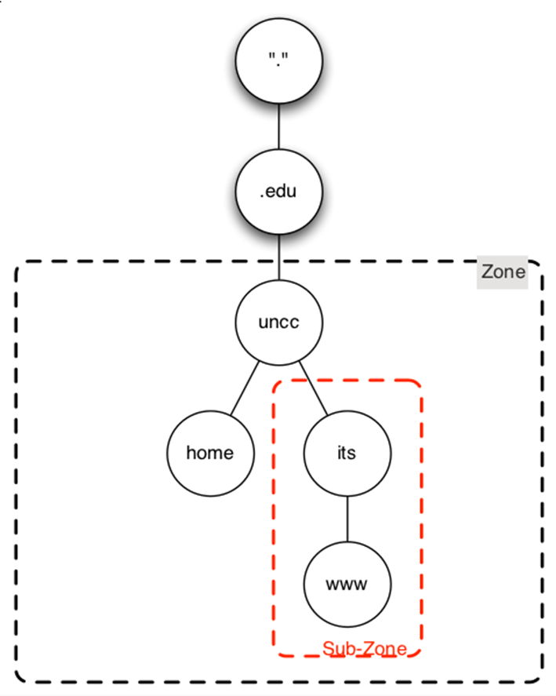
structure

Slide 16
records
Everything is a resource record
Resource records map a key to a value

Slide 17
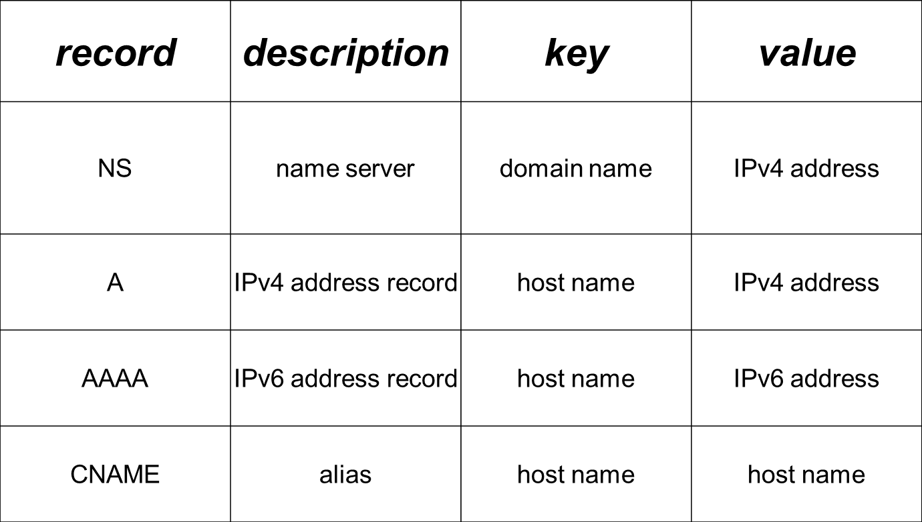
Key Resource Records

Slide 18
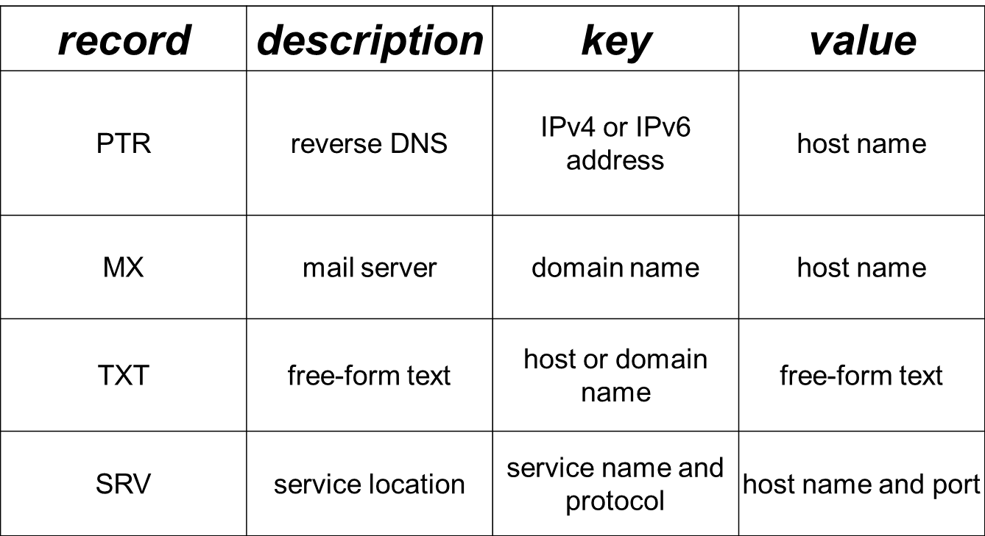
Key Resource Records

Slide 19
start of authority
SOA record is required for every zone
Contains:
  Authoritative name server and email contact
  Serial number of zone
  Refresh, retry, and expire times for zone replication
  Cache time-to-live for negative responses

Slide 20
example zone
Email address, note the . instead of the @
$TTL 20m
example.com. IN SOA ns.example.com. admin08.uncc.edu. (
2009102003 ; serial
2d ; refresh
15m ; retry
2w ; expire
30m ; negative cache TTL
)
@ IN NS ns1.example.com.
@ IN NS ns2.example.com.
@ A 10.3.254.17
www A 10.3.254.17
test CNAME www
ns1 A 10.3.254.2
ns2.example.com. A 10.3.254.10
Note: @ is shorthand for the domain name

Slide 21
What is that number in the second position in some records?
General formula:
  name (optional)
  ttl (optional)
  address-class
  record type
  data
Format my vary depending on the record type
Sample MX record:
mydomain.com. 14400 IN MX 10 mydomain.com.
mydomain.com. 14400 IN MX 30 server2.mydomain.com
Domain: mydomain.com.
Record type data
Address class and record type
Optional TTL override

Slide 22
glue records
Used to delegate a sub-zone to another server
Prevent circular dependencies
Hard-coded A (or AAAA) records of the sub-zone’s DNS servers
  Normal NS records use domain names
  See previous example
  Problem if the name server finds itself
  Fixed by the name server setting an IP address
These are set in the parent name servers

Slide 23
name server
Server-side of DNS
Runs on port 53
  uses udp or tcp
TCP only used when:
  Response is too big for UDP
  UDP not responding

Slide 24
name server
Can have authority over zero or more zones
  Server with zero zones is a caching name server
  Many different name server implementations are available
We will be using BIND in the lab
  BIND9
  BIND 10 has been released to the world

Slide 25
resolving addresses
Two ways an address can be resolved
  Iteratively
  Recursively
Iterative usually used by servers
  Returns partial responses (or errors)
Recursive usually used by clients
  Returns complete responses (or errors)
  Will recurse until a server responds with an iterative lookup

Slide 26
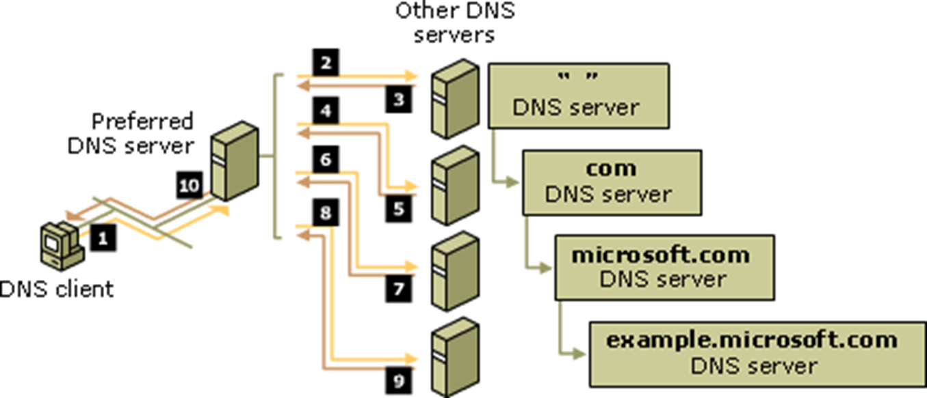
resolving addresses looking for example.microsoft.com
http://i.technet.microsoft.com/cc775637.8918bf2b-e317-48c4-aeba-10f73127d1b3(en-us,WS.10).gif

Slide 27
clients
Besides Web browsers:
nslookup, host, and dig
  all DNS clients
  Talk directly to a DNS server
  Bypasses host’s resolver library
dig is recommended as it is very informative
  part of dnsutils

Slide 28
Dig Tutorial
Dig
  Domain Information Groper
Online YouTube
  http://www.youtube.com/watch?v=bdHl-w3V_4w

Slide 29
dig
$ dig www.google.com
; <<>> DiG 9.6.0-APPLE-P2 <<>> www.google.com
;; global options: +cmd
;; Got answer:
;; ->>HEADER<<- opcode: QUERY, status: NOERROR, id: 27210
;; flags: qr rd ra; QUERY: 1, ANSWER: 7, AUTHORITY: 0, ADDITIONAL: 0
;; QUESTION SECTION:
;www.google.com. IN A
;; WHEN: Wed Jan 26 15:35:14 2011
;; MSG SIZE rcvd: 148

Slide 30
dig (cont.)
;; ANSWER SECTION:www.google.com. 38207 IN CNAME www.l.google.com.
www.l.google.com. 173 IN A 74.125.47.103
www.l.google.com. 173 IN A 74.125.47.104
www.l.google.com. 173 IN A 74.125.47.105
www.l.google.com. 173 IN A 74.125.47.106
www.l.google.com. 173 IN A 74.125.47.147
www.l.google.com. 173 IN A 74.125.47.99
;; Query time: 7 msec
;; SERVER: 4.2.2.2#53(4.2.2.2)
;; WHEN: Wed Jan 26 15:35:14 2011
;; MSG SIZE rcvd: 148

Slide 31
response codes
Help you troubleshoot when DNS has problems
Below are a few you might encounter
  NOERROR
    Query completed successfully
  NXDOMAIN
    Query returned with a “no such domain” error
  SERVFAIL
    Unable to contact the server

Slide 32
resolver library
DNS lookups on a host are handled by the resolver library
/etc/resolv.conf
  Specifies DNS servers
/etc/nsswitch.conf
  Specifies how addresses lookups are performed
    Handles other databases as well

Slide 33
getent
Retrieves information from:
  config files
  databases
E.G.
  getent hosts
    Retrieves the contents of the hosts file
  getent hosts localhost
    Retrieves the contents for localhost in the hosts file
getent works on a variety of data formats

Slide 34
getent
$ getent hosts www.google.com
74.125.47.106 www.l.google.com www.google.com
74.125.47.147 www.l.google.com www.google.com
74.125.47.99 www.l.google.com www.google.com
74.125.47.103 www.l.google.com www.google.com
74.125.47.104 www.l.google.com www.google.com
74.125.47.105 www.l.google.com www.google.com

Slide 35
/etc/resolv.conf
search unc.edu oit.unc.edu
domain unc.edu
nameserver 152.2.21.1
nameserver 152.2.253.100

Slide 36
security considerations
Implementations of DNS (e.g. bind) have a history of security flaws
Any server in your path can modify responses
Any server in your path can see requests
Zone transfers are a security hole

Slide 37
DNSSEC

Slide 38
dnssec
Extension to DNS to cryptographically sign responses
Guarantees resource records have not been tampered with
Ensures NXDOMAIN responses are genuine
Implemented using resource records

Slide 39
dnssec records
record | description
DNSKEY | Public key
DS | Delegation signer, added to parent zone, validates this zone
NSEC | Next secure record, for validating negative responses
NSEC3 | NSEC replacement
RRSIG | DNSSEC signature

Slide 40
dnssec
Uses public-private key cryptography
Two key sets
  Zone-signing key
  Key-signing key

Slide 41
zone-signing key
Used to sign all records in a zone
Should be switched out often since it will be used often
Stored in a DNSKEY resource record

Slide 42
key-signing key
Used to sign a zone-signing key
Stored in a DNSKEY resource record
A pointer to KSK’s resource record and its digest are stored in a DS record in parent zone
  Creates a chain of trust

Slide 43
NSEC records
NSEC records create a linked-list of all records in a zone
NXDOMAIN responses can reference the NSEC records that would come before and after the query
  This proves that there is no record exists
  Shows if someone inserted a fake record

Slide 44
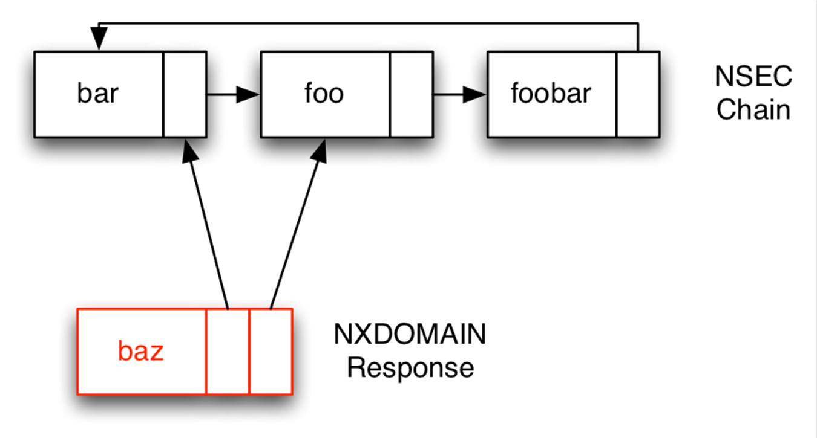
NSEC records

Slide 45
NSEC3 Records
Replace NSEC records
Linked list of the hash of each record in a zone
NXDOMAIN responses can reference the two NSEC records that would come before and after the query

Slide 46
dnssec limitations
All DNS servers in lookup chain must support DNSSEC to ensure results are genuine
DNSSEC allows walking of a domain via NSEC records
  Fixed in RFC5155 with introduction of NSEC3 records

