Slide 1
LDAP
http://en.wikipedia.org/wiki/Ldap

Slide 2
Lightweight Directory Access Protocol
LDAP

Slide 3
LDAP
An application protocol
  Queries and modifies directory services
  Runs over TCP/IP

Slide 4
LDAP
Directory
  A set of objects with similar attributes
    Organized in a logical and hierarchical manner
  Example:
    Telephone directory
      Series of names (either of persons or organizations)
      Organized alphabetically
      Each name has an address and phone number
  LDAP often used by other services for authentication

Slide 5
Why LDAP
Directories are good for :
  Quick data recovery
  Hierarchical oriented data
  Data that fields may repeat
    John is an engineer and a manager and a mentor
Directories are not good for
  Relational type data
  Data that is updated often

Slide 6
LDAP
LDAP directory tree
  Often reflects various boundaries
    Political
    Geographic
    Organizational
  Depends on the model chosen

Slide 7
LDAP
LDAP deployments today tend to use Domain Name System (DNS) names for structuring the topmost levels of the hierarchy
  Deep inside the directory might appear entries representing:
    People
    Organizational units
    Printers
    Documents
    Groups of people
    Anything else which represents a given tree entry
      or multiple entries

Slide 8

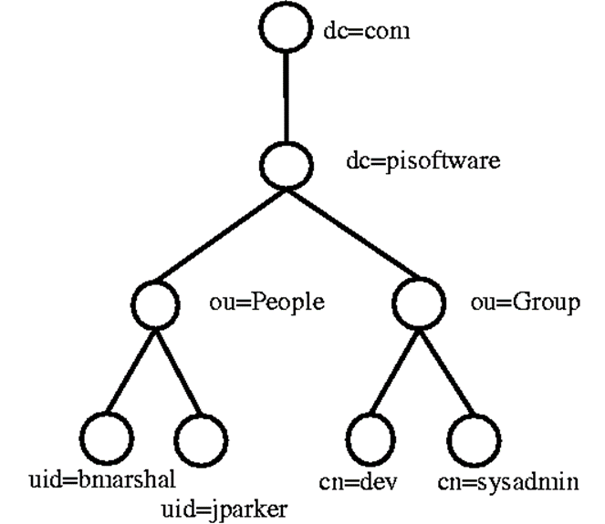
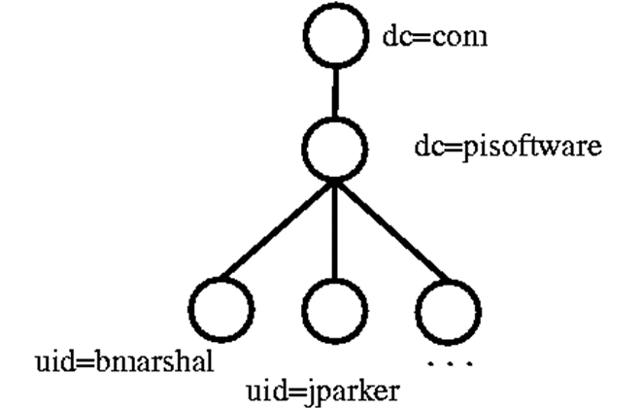


LDAP Data Structure

Slide 9
LDAP
Current version: LDAPv3
  Specified in a series of Internet Engineering Task Force Standard Track Requests for comments (RFCs)
    Detailed in RFC 4510

Slide 10
Protocol overview

Slide 11
Protocol overview
Client starts an LDAP session by connecting to an LDAP server
  Default on TCP port 389
  Can use UDP
Client sends operation requests to the server
  Server sends responses in turn
With some exceptions the client need not wait for a response before sending the next request
  Server may send the responses in any order

Slide 12
Protocol overview
The client may request the following operations:
  Start TLS
    Optionally protect the connection with Transport Layer Security (TLS), to have a more secure connection
  Bind
    Authenticate and specify LDAP protocol version
  Search
    Search for and/or retrieve directory entries
  Compare
    Test if a named entry contains a given attribute value
  Add a new entry
  Delete an entry
  Modify an entry
  Modify Distinguished Name (DN) - move or rename an entry
  Abandon
    Abort a previous request
  Extended Operation
    Generic operation used to define other operations
  Unbind
    Close the connection (not the inverse of Bind)
In addition the server may send "Unsolicited Notifications" that are not responses to any request
  e.g. before it times out a connection

Slide 13
Directory structure

Slide 14
Directory structure
Protocol accesses LDAP directories
Follows the 1993 edition of the X.500 model:
  Directory is a tree of directory entries
  Entry consists of a set of attributes
  An attribute has
    a name
    an attribute type or attribute description
    one or more values
  Attributes are defined in a schema
  Each entry has a unique identifier:
    Distinguished Name (DN)
      Consists of its Relative Distinguished Name (RDN) constructed from some attribute(s) in the entry
      Followed by the parent entry's DN
  Think of the DN as a full filename and the RDN as a relative filename in a folder

Slide 15
Directory structure
DN may change over the lifetime of the entry
  For instance, if entries move within a tree
To reliably and unambiguously identify entries
  a UUID might be provided in the set of the entry's operational attributes

Slide 16
Directory structure
Example entry represented in LDAP Data Interchange Format (LDIF)
  LDAP is a binary protocol:
  dn: cn=John Doe,dc=example,dc=com
  cn: John Doe
  givenName: John
  sn: Doe
  telephoneNumber: +1 888 555 6789
  telephoneNumber: +1 888 555 1234
  mail: john@example.com
  manager: cn=Barbara Doe,dc=example,dc=com objectClass: inetOrgPerson
  objectClass: organizationalPerson
  objectClass: person
  objectClass: top
  dn (distinguished name) is the name of the entry; it's not an attribute nor part of the entry
  "cn=John Doe" is the entry's RDN
  "dc=example,dc=com" is the DN of the parent entry.
  Other lines show the attributes in the entry
    Attribute names are typically mnemonic strings
    "cn" for common name,
    "dc" for domain component
    "mail" for e-mail address
    "sn" for surname

Slide 17
Directory structure
A server holds a subtree starting from a specific entry
  e.g. "dc=example,dc=com" and its children.
Servers may also hold references to other servers
  An attempt to access "ou=department,dc=example,dc=com" could return a referral or continuation reference to a server which holds that part of the directory tree.
Client can then contact the other server
Some servers also support chaining
  Server contacts other server(s) and returns the results to the client

Slide 18
Directory structure
Server may return, in any order:
  the values in an attribute
  the attributes in an entry
  the entries found by a search operation
Follows from the formal definitions
  an entry is defined as a set of attributes
  an attribute is a set of values
  sets need not be ordered

Slide 19
Operations

Slide 20
Operations
Client gives each request a positive Message ID
  Server response has the same Message ID
Response includes a numeric result code indicating
  Success
  Some error condition
  Or some other special cases
Before the response, the server may send other messages with other result data
  For example:
    Each entry found by the Search operation is returned as a message

Slide 21
StartTLS
StartTLS operation establishes Transport Layer Security (the descendant of SSL) on the connection
  Provides data confidentiality and/or data integrity protection
    Protect from tampering
During TLS negotiation server sends its X.509 certificate to prove its identity
  Client may also send a certificate to prove its identity
  Client may then use SASL/EXTERNAL to have this identity used in determining the identity used in making LDAP authorization decisions

Slide 22
Bind (authenticate)
Bind operation authenticates the client to the server
  Simple Bind can send the user's DN and password in plaintext
    Connection should be protected using Transport Layer Security (TLS)
  Server typically checks the password
    Against the userPassword attribute in the named entry
  Anonymous Bind (with empty DN and password) resets the connection to anonymous state
  SASL (Simple Authentication and Security Layer) Bind provides authentication services through a wide range of mechanisms
    Kerberos or the client certificate sent with TLS
Bind also sets the LDAP protocol version
  Normally clients should use LDAPv3
  Default in the protocol but not always in LDAP libraries
Bind had to be the first operation in a session in LDAPv2
  Not required in LDAPv3 (the current LDAP version)

Slide 23
Search and Compare
Search operation is used to both search for and read entries
  Parameters are:
    baseObject
      The DN (Distinguished Name) of the entry at which to start the search
    scope
      BaseObject (search just the named entry, typically used to read one entry), singleLevel (entries immediately below the base DN), or wholeSubtree (the entire subtree starting at the base DN).
    filter
      How to examine each entry in the scope
        E.g. (&(objectClass=person)(|(givenName=John)(mail=john*)))
          Search for persons who either have given name John or an e-mail address starting with john
    derefAliases
      Whether and how to follow alias entries (entries which refer to other entries)
    attributes
      Which attributes to return in result entries.
    sizeLimit, timeLimit
      Max number of entries, and max search time.
    typesOnly
      Return attribute types only, not attribute values.

Slide 24
Search and Compare (cont.)
Server returns:
  Matching entries
  Maybe continuation references (in any order)
  Followed by the final result with the result code
Compare operation:
  Takes
    a DN
    an attribute name
    an attribute value
  Checks if the named entry contains that attribute with that value

Slide 25
Update operations
Add, Delete, and Modify DN
  All require the DN of the entry that is to be changed
Modify takes a list of attributes to modify and the modifications to each:
  Delete the attribute or some values, add new values, or replace the current values with the new ones.
Add operations also can have additional attributes and values for those attributes

Slide 26
Update operations
Modify DN (move/rename entry) takes
  New RDN (Relative Distinguished Name)
  (optionally) the new parent's DN
  Flag which says whether to delete the value(s) in the entry which match the old RDN
  Server may support renaming of entire directory subtrees
An update operation is atomic:
  Other operations will see either the complete new entry or the old one
    LDAP does not define transactions of multiple operations
    If you read an entry and then modify it, another client may have updated the entry in the mean time
    Servers may implement extensions which support this, however

Slide 27
Extended operations
Extended Operation
  A generic LDAP operation can be used to define new operations
  Examples include:
    Cancel
    Password Modify
    Start TLS operations

Slide 28
Abandon
Abandon: operation requests that the server aborts an operation named by a message ID
  The server need not honor the request
  Neither Abandon nor a successfully abandoned operation send a response
Cancel: extended operation which does send a response
  Not all implementations support cancel

Slide 29
Unbind:
Unbind abandons any outstanding operations and closes the connection
  It has no response
  Name is of historical origin:
    It is not the opposite of the Bind operation
Clients can abort a session by simply closing the connection
  But should use Unbind
  Otherwise server cannot tell the difference between a failed network connection (or a truncation attack) and a discourteous client

Slide 30
LDAP URLs

Slide 31
LDAP URLs
LDAP URL format exists
  Clients support in varying degree
  Servers return in referrals and continuation references
    see RFC 4516
Typical form:
  ldap://host:port/DN?attributes?scope?filter?extensions
Notes:
Values following the DN must be in order.
If a value is not used place a null (e.g. two ?? In a row).
Unused attributes at the end don’t need trailing ?’s

Slide 32
Other data models

Slide 33
Other data models
As LDAP has gained momentum
  Vendors have provided it as an access protocol to other services
  Implementation then recasts the data to mimic the LDAP/X.500 model
    How closely this model is followed varies
  For example
    There is software to access SQL databases through LDAP
    LDAP does not readily lend itself to this
    X.500 servers may support LDAP as well
Similarly, data which were previously held in other types of data stores are sometimes moved to LDAP directories
  Unix user and group information can be stored in LDAP
    Accessed via PAM and NSS modules
  LDAP is often used by other services for authentication

Slide 34
Usage

Slide 35
Usage
Applications
  Reasons to choose LDAP for a service
    Widely supported
      Data presented in LDAP is available to many clients and libraries
  LDAP is very general and includes basic security
    Can support many types of applications
  Choosing a few general protocols like LDAP and HTTP for various services
    Allows focusing on a few protocols
    Instead of having to maintain and upgrade many specialized protocols
  Two common applications of LDAP are
    Computer user/group data
    Address book information (persons, departments etc)
      Many e-mail clients support LDAP lookups
  Some tasks LDAP does not handle well:
    Model a relational database
    Data whose ordering must be preserved
      An extension does exist for this
    Data that is consistently updated

Slide 36
Usage
Naming structure
  An LDAP server can return referrals to other servers for requests the server itself will not/can not serve
    A naming structure for LDAP entries is needed so one can find a server holding a given DN
    A structure already exists in the Domain name system (DNS)
      Servers' top level names often mimic DNS names
  If an organization has domain name foo.example
    Its top level LDAP entry will therefore typically have the DN:
      dc=foo,dc=example (where dc means domain component)
    If the ldap server is also named ldap.foo.example, the organization's top level LDAP URL becomes
      ldap://ldap.foo.example/dc=foo,dc=example
  Below the top level, the entry names will typically reflect the organization's internal structure or needs rather than DNS names

Slide 37
Terminology

Slide 38
Terminology
The LDAP terminology one can encounter can be confusing
  Some of this confusion is due to misunderstandings
    Other examples are due to its historical origins
    Others arise when used with non-X.500 services that use different terminology
  For example,
    "LDAP" is sometimes used to refer to the protocol, other times to the protocol and the data
    An "LDAP directory" may be the data or also the access point.
  An "attribute" may be
    the attribute type
    the contents of an attribute in a directory
    an attribute description (an attribute type with options)
  An "anonymous" and an "unauthenticated" Bind are different Bind methods that both produce anonymous authentication state
    So both terms are being used for both variants
  The "uid" attribute should hold user names rather than numeric user IDs

Slide 39
Resume 3/15

Slide 40
Videos
Video 1:
  http://www.youtube.com/watch?v=F2nFtlS8uEo
Other:

Slide 41
LDAP
Is only good for telephone number lookup
Is good for rapidly changing data
Does not handle hierarchical data well
Content can be customized to the organization’s needs

Slide 42
Resources:
http://www.ldapman.org/articles/intro_to_ldap.html
http://quark.humbug.org.au/publications/ldap/ldap_tut.html

