Slide 1
Infrastructure II
NTP

Slide 2
NTP

Slide 3
"Does Anybody Really Know What Time It Is?"*
Time keeping is one of most fundamental aspects of computer infrastructure
Many protocols rely on accurate clocks
Correlating information from multiple systems impossible with out a shared clock
*Does Anybody Realy Care (CTA aka Chicago, 1969)
http://www.youtube.com/watch?v=8qssWO8NSq0

Slide 4
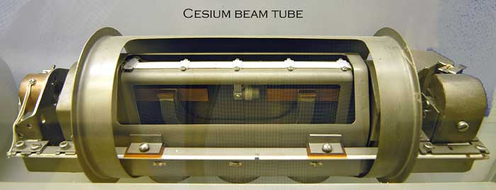
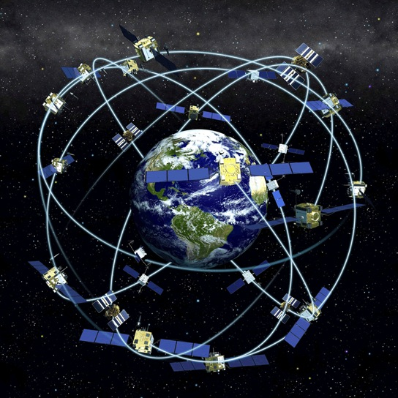
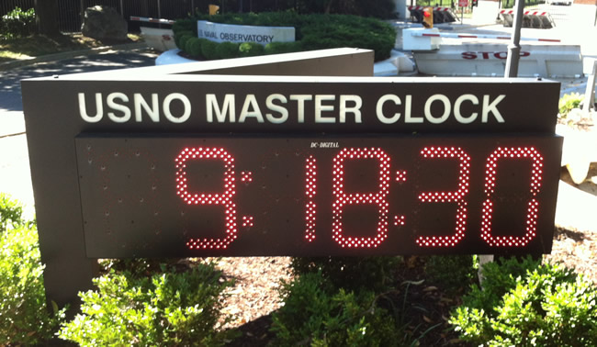
Time
Sources

Slide 5
Side note:
Difference between precision and accuracy
Accuracy
  Closeness to the actual value
    E.g. the clock is 1 hour off
Precision
  How much it does not vary
    E.g. the clock varies approximately a microsecond in a year
So which is better?
  A clock might not vary by more than a picosecond, but be off by one hour
  A clock might be “correct”, but vary by a millisecond second to second

Slide 6
Network Time Protocol (NTP)
Port 123/udp
Can maintain time to fractions of a second
Can use external time source
  e.g. Atomic clock or GPS clock
Most computers and devices act as a client

Slide 7
Network Time Protocol (NTP)
All servers belong to a ‘Stratum’
  Denotes how far from the time source they are referencing
    Prevents Loops
      Can only sync with servers in same stratum or higher
    Stratum 0: time source
    Stratum 1: server directly attached to time source
    Stratum 2: connected to Stratum 1 server(s)
    Etc…
Versions available for:
  UNIX family
  Windows family
    SNTP for 2000 and XP
    Full NTP for Server 2003 and Vista

Slide 8
Security concerns
Only a few security problems have been identified in the reference implementation of the NTP codebase in its 25+ year history
The protocol has been undergoing revision and review over its entire history
  As of January 2011, there are no security revisions in the NTP specification and no reports at CERT
The current codebase for the reference implementation has been undergoing security audits from several sources for several years now
  There are no known high-risk vulnerabilities in the current released software

Slide 9
NTP: Security Considerations
Default configuration is usually client-only
Supports authentication if working in a paranoid environment

Slide 10
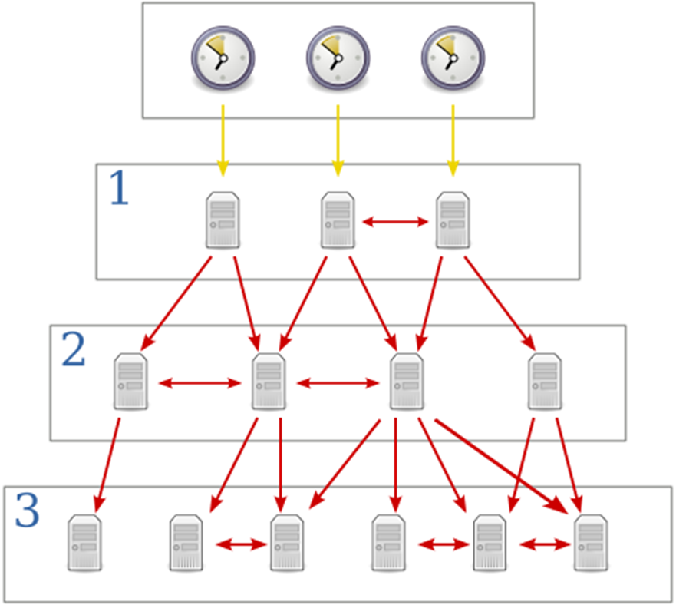

NTP Stratum

Slide 11
Clock strata
NTP uses a hierarchical, semi-layered system of levels of clock sources
Each level of this hierarchy is termed a stratum
  Assigned a layer number starting with 0 (zero) at the top
The stratum level defines its distance from the reference clock and exists to prevent cyclical dependencies in the hierarchy
Note 1: the stratum level is not a guarantee of quality or reliability
  It is common to find stratum 3 time sources that are higher quality than other stratum 2 time sources
Note 2: This definition of stratum is also different from the notion of clock strata used in telecommunication systems

Slide 12
Clock strata
Stratum 0
  Devices such as
    Atomic clocks (cesium, rubidium)
    GPS clocks
    Radio clocks (e.g. WWV)
  Stratum-0 devices are traditionally not attached to the network
    Instead they are locally connected to computers
      e.g., via an RS-232 connection using a pulse per second signal
        Corrects for the time-delay across the wire
Stratum 1
  These are computers attached to Stratum 0 devices.
  Normally they act as servers for timing requests from Stratum 2 servers via NTP
  These computers are also referred to as time servers
  They are typically attached to the network

Slide 13
Clock strata
Stratum 2
  Computers that send NTP requests to Stratum 1 servers
  Normally a Stratum 2 computer will reference a number of Stratum 1 servers and use the NTP algorithm to gather the best data sample
    Dropping any Stratum 1 servers that seem obviously wrong
  Stratum 2 computers will peer with other Stratum 2 computers to provide more stable and robust time for all devices in the peer group
  Stratum 2 computers normally act as servers for Stratum 3 NTP requests
Stratum 3
  These computers employ exactly the same algorithms for peering and data sampling as Stratum 2
  Can themselves act as servers for stratum 4 computers, and so on…

Slide 14
Clock strata
NTP supports up to 256 strata
  Only the first 16 are employed
  Any device at Stratum 16 is considered to be unsynchronized
  Some systems may reject a time update from a "too highly numbered" stratum
  Note: Depends on what version of NTP protocol in use

Slide 15
SNTP - Simple Network Time Protocol
A less complex implementation of NTP
  Uses the same protocol
  Does not require the storage of state over extended periods of time
Used in some embedded devices and in applications where high accuracy timing is not required
  See RFC 1361, RFC 1769, RFC 2030, RFC 4330 and RFC 5905

Slide 16
NTP timestamps
64-bit timestamps used by NTP consist of
  32-bit part for seconds
  32-bit part for fractional second
Gives NTP:
  Time scale that rolls over every 2³² seconds
    ~136 years
  Theoretical resolution of 2⁻³² seconds
    ~233 picoseconds
    1 psec is 1 trillionth of a second
NTP uses an epoch of January 1, 1900
  First rollover occurs in 2036
    Before the UNIX year 2038 problem

Slide 17
NTP timestamps
Implementations should disambiguate NTP time using a knowledge of the approximate time from other sources
  NTP only works with the differences between timestamps and never their absolute values
    Wraparound is invisible as long as the timestamps are within 68 years of each other
    This means that the rollover will be invisible for most running systems, since they will have the correct time to within a very small tolerance
  However, systems that are starting up need to know the date within no more than 68 years
    Given the large allowed error, it is not expected that this is too onerous a requirement
  One suggested method is to set the clock to no earlier than the system build date
    Many systems use a battery powered hardware clock to avoid this problem

Slide 18
NTP timestamps
Even so, future versions of NTP may extend the time representation to 128 bits:
  64 bits for the second
  64 bits for the fractional-second
The current NTP4 format has support for Era Number and Era Offset, that when used properly should aid fixing date rollover issues
  According to Mills (quote):
    The 64 bit value for the fraction is enough to resolve the amount of time it takes a photon to pass an electron at the speed of light.
    The 64 bit second value is enough to provide unambiguous time representation until the universe goes dim.

Slide 19
Clock synchronization algorithm
To synchronize its clock with a remote server NTP clients must compute the round-trip delay time and the offset
  Round-trip delay
    d = (t3-t0) – (t2-t1)
  Offset
    o = ((t1-t0) + (t2-t3)) /2
  Where:
    t0 when the request packet was sent
    t1 when the request packet was received
    t2 when the response packet was sent
    t3 when the response packet was received
    (t3-t0) time on the client side between the sending of the request packet and the receiving of the response packet
    (t2-t1) time the server waited before sending the answer

Slide 20
Clock synchronization algorithm
NTP synchronization is correct when:
  both the incoming and outgoing routes between the client and the server have symmetrical nominal delay
  If the routes do not have a common nominal delay
    Synchronization has a systematic bias of half the difference between the forward and backward travel times

Slide 21
Stratum 0 clocks are usually directly connected to the network
True
False
1
30 sec countdown

Slide 22
Why do NTP and Syslog need to work together:
Both share the same base protocol
All systems need a common time base for log timestamps
TCP requires synchronized packet transfers
It keeps the NSA synchronized
9
30 sec countdown

