Slide 1
ITIS 3110
Network Hardening

Slide 2
Firewalls

Slide 3
firewalls
First-line of defense
Drops unwanted network traffic
Only able to make decisions at OSI layers 3 and 4
  Network and Transport

Slide 4
firewall types
stateless
stateful
application

Slide 5
stateless firewall
Decisions made on a per-packet basis
Every packet evaluated individually
Easy to implement
Fast and lightweight
Possible to craft packets that bypass it

Slide 6
stateful firewall
Decisions made on a per-connection basis
A connection is a set of related packets
Stores information about every connection
Able to reassemble fragmented packets
Can fake connections for stateless protocols
  e.g. UDP

Slide 7
application firewall
Decisions made on a per-application basis
Can be generic or application-specific
  Generic often found on clients
  Application-specific on servers
Generic:
  Win XP SP2+
  OS X 10.5+
Application-specific:
  mod_security
    (Apache)

Slide 8
mod_security
Web Servers
  Security features for Apache, IIS, nginx
  Embeddable web app firewall
Decisions made on a per-HTTP request basis
Very similar to an Intrusion Prevention System
  (IPSes are discussed later)

Slide 9
firewall actions
Allow
  Traffic is permitted
Deny
  Traffic is prevented from reaching destination
  Sender is notified of failure
Drop
  Traffic is prevented from reaching destination
  Silently dropped

Slide 10
firewall placement
Aim is to block traffic as close to the source as possible
Three standard locations for firewalls:
  Border
  Subnet
  Host

Slide 11
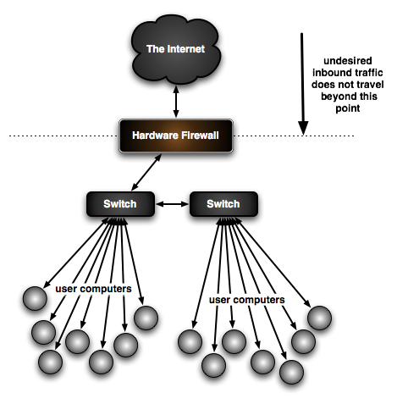
border firewall
Between your network and the Internet
Usually fairly open
Allow inbound traffic for public services
  E,g, Web Servers
Deny outbound traffic for high-value services
  E.g. Personnel databases

Slide 12
subnet firewall
Between subnets within your network
Protects the subnet from the rest of your network (or vise versa)
  HR records from the rest of the organization
  Finance services from the rest of the org
Subnet will often hold related services
  e.g. users, telephones, servers

Slide 13
host firewall
Between a host and the world
Often used as a last line of defense for secure services
E.g.
  Accounting system host firewall might only permit inbound connections from the accounting subnet

Slide 14
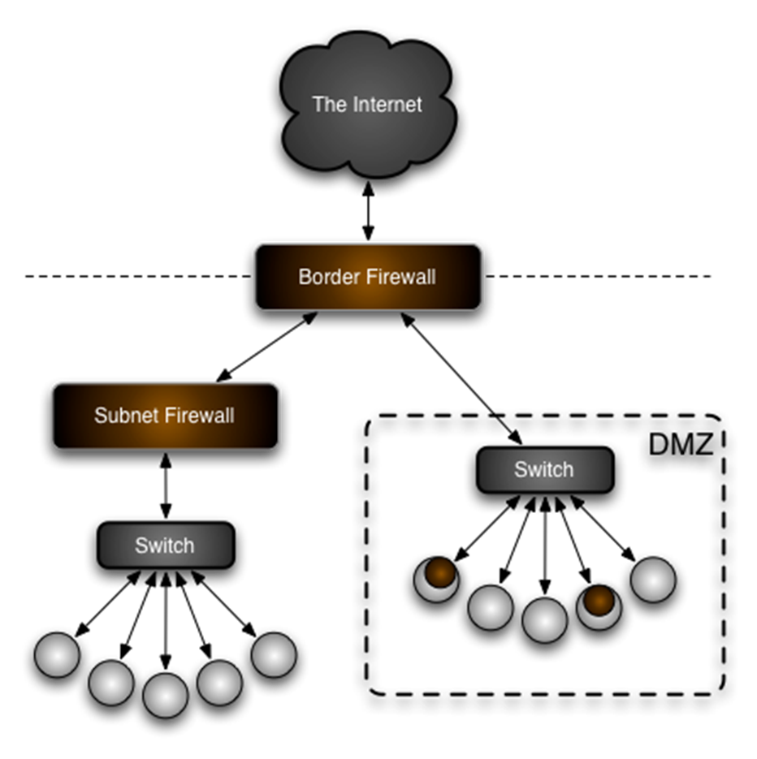
demilitarized zone
Network segment for public-facing servers
Secondary firewall protects internal hosts from DMZ hosts
Border and secondary firewall may be combined in one device

Slide 15
Best location for a firewall:
Directly on the host (all client computers)
On critical servers
Close as possible to potential sources of infection
On all subzones
At all boundaries
30
Has 30 second countdown

Slide 16
Other

Slide 17
network address translation
Mapping of IP addresses to other IP addresses
  One to many is most common instance
NAT is often grouped with firewalls
  But it is not a firewall
Provides some security
  Devices behind a NAT device are not directly addressable

Slide 18
port forwarding
Forwarding of traffic destined for one host to another
Can forward all ports to one host or one port to another host and port
Often used to expose a service running on a server behind a NAT device

Slide 19
deep packet inspection
Real-time analysis of a packet’s content all the way to OSI layer 7
  Application layer
Understands and tracks connections
Very resource intensive

Slide 20
Intrusion Detection and Prevention

Slide 21
IDS
Intrusion Detection Systems

Slide 22
IDS - intrusion detection systems
Studies network traffic using DPI
  Flags suspicious traffic
Can be:
  Network-based (NIDS)
  - or -
  Host-based (HIDS)
Rule-based classification system
  Vendor usually publishes predefined rules
  End users can write their own

Slide 23
IDS NIDS
Placed where it can see all traffic of interest
Logs all activity of interest
  Usually sends messages to appropriate resources

Slide 24
IDS NIDS
Baseline
  Note normal traffic for your network
Set rules to note abnormal traffic
  False Positives
    Wastes time investigating “normal” traffic

Slide 25
IDS - HIDS
Detect changes on a host
  Usually only monitor base OS files
  Need policies to monitor all file

Slide 26
IPS
Intrustion Protection Systems

Slide 27
IPS - intrusion prevention systems
“Extension” to IDS
  Monitors traffic
  Able to block connections that are deemed malicious

Slide 28
IPS - intrusion prevention systems
Must be placed inline (between)
  so it can interrupt connections

Slide 29
IDS/IPS
Both are intrusion oriented
However:
  IDS monitors only
    Passive
    Must see all traffic of interest
      Place on inbound/outbound router port
      Mirror all ports on switch
  IPS stops unwanted/”illegal” traffic
    Active
    Must be between source and destination

Slide 30
ids/ips examples
Many vendors provide turn-key systems
  Cisco, HP TippingPoint, Juniper
Turn-key systems have advantage of
  optimizations
  offload engines
  ease of management and updates
Snort is an open-source IDS/IPS
  Can run on your own hardware

Slide 31
Hardening

Slide 32
network devices
  Routers, switches, etc. require hardening and patching
  Essentially special-purpose computers
NSA has security guides
Vendors also publish hardening guides
Remember to
  Set good passwords
  Disable insecure access protocols

Slide 33
networked attached devices
Anything with an IP address is a potential target for hackers
  Famous HP printer hack
Keep all network devices patched and behind a firewall if possible
Does your printer really need a route to the Internet?

Slide 34
rogue equipment
Rogue equipment can wreak havoc on a network
Effects can range
  from added insecurity
  to denial of service

Slide 35
network loop
A network loop occurs when two ports of a switch are connected to each other
Connection may be direct or through other equipment
Causes denial of service from packets being sent over and over
Most modern network hardware can detect simple loops using Spanning Tree Protocol

Slide 36
rogue dhcp
DHCP is the protocol clients use to receive dynamic IP addresses
Rogue servers may be accidental or malicious
Accidental servers cause denial of service by handing out bogus leases
Malicious servers can cause clients to route all traffic through a packet sniffer

Slide 37
rogue switch
Rogue switches most likely to cause network loops
They may also broadcast bogus routing, VLAN, or other network management information
Bogus information should be discarded by a properly configured infrastructure

Slide 38
rogue router
Rogue routers can cause network loops as well as introducing rogue DHCP servers
Especially easy with consumer-grade “cable” routers

Slide 39
rogue wireless access points
Most access points also include a router
  Therefore suffer from all the same afflictions
Can also bridge wireless and wired networks
Introduce a major security hole into a corporate network
Business grade access points are capable of
  Detecting rogue APs
    Performing DoS against them
    (via wired or wireless)

Slide 40
Side note: TJ Maxx
2007:
  Hackers who stole 45 million customer records from the parent company of TK Maxx
    Breaking into the retail company's wireless LAN
  TK Maxx's parent company, TJX, had secured its wireless network using Wired Equivalent Privacy (WEP)
    One of the weakest forms of security for wireless LANs
  Hackers broke in and stole records the in the second half of 2005 and throughout 2006
    Including millions of credit card numbers

Slide 41
virtual private networks
VPNs allow users to access the network from remote locations
VPNs should be vigorously defended
Two-factor authentication is a must for any security-conscience organization

Slide 42
two-factor authentication
Requiring two or more of three authentication factors:
  “something you know”
    e.g. password
  “something you have”
    e.g. access card or dongle
  “something you are”
    e.g. fingerprint or eye scan
UNCC’s VPN requires a shared secret key
  In addition to your username and password
Many organizations use a token device that displays a new random number ever minute
  e.g. RSA SecurID

Slide 43
iptables
Linux’s firewall system
  Also ip6tables for IPv6
Many tools exist to help you generate rulesets
  http://easyfwgen.morizot.net/gen/

