Slide 1
REPLICATION & LOAD BALANCING
ITIS 3110

Slide 2
Topics
Replication methods
  Primary/Backup
  Master/Slave
  Multi-master
Load-balancing methods
  DNS Round-Robin
  Reverse Proxy

Slide 3
Replication

Slide 4
Replication: What is it?
Duplication of data between multiple machines
Two main uses
  Failure mitigation
  Load balancing

Slide 5
Replication: Types
Primary/Backup
Master/Slave
Multi-Master

Slide 6
Primary/Backup

Slide 7
Replication: Primary/Backup
Ensures availability of a ‘resource’
Only one server provides access to resource at a time
Does not provide any load balancing
Uses:
  Services which do not understand replication
  Services which would be too expensive to replicate
    Too much active state

Slide 8
Replication: Primary/Backup
Primary server is active
  Has exclusive lock on resource
Backup server is on standby
Heartbeat between Primary and Backup
  Allows each server to keep track of the other’s state
  Heartbeat can be in-band or out-of-band
    In-band: “standard” comm path
      e.g. over same network link
    Out-of-band: separate or special comm path
      e.g. serial, secondary network connection, etc.

Slide 9
Primary/Backup: Failover
When the heartbeat is lost:
  Backup steals lock on resource
    Ensures primary is down
      e.g. cut comm link or power
    Performs recovery on resource
      e.g. fsck
    Backup may even steal primary’s MAC address!
  Backup becomes primary
  Previous primary will become backup once heartbeat re-established

Slide 10
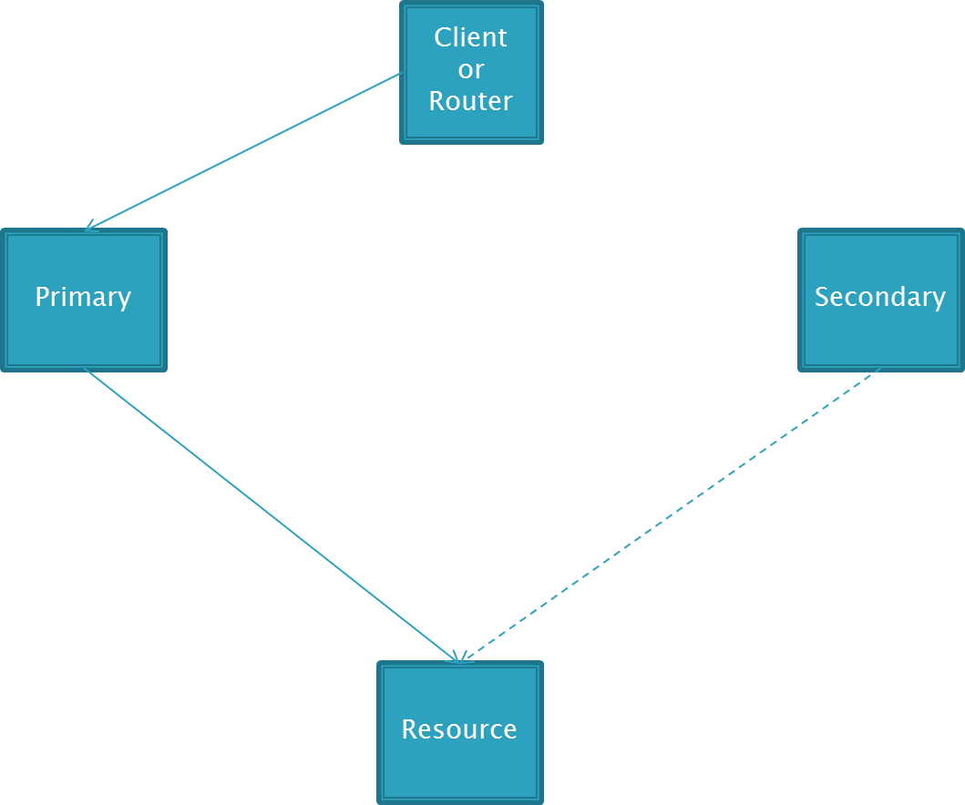
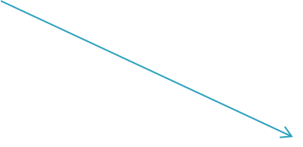
Primary/Backup: Diagram
heartbeat
Standby
Comm
Link

Slide 11
Primary/Backup: Examples
File Servers
  Disk array is the resource
Virtual Machine Servers
  Virtual Machine is the resource

Slide 12
Master/Slave

Slide 13
Replication: Master/Slave
All servers can be read
Only master server accepts writes
Can provide rudimentary load balancing
Must be implemented in a protocol
Uses
  Stateless, Read-Heavy protocols

Slide 14
Master/Slave: Updating Slaves
Can be push or pull
  Master pushes changes to slaves
  Slaves pull changes from master

Slide 15
Master/Slave: Updating Slaves
Most protocols support incremental updates
  Every change is versioned
  Master keeps a journal of changes
  Slave asks for updates since a particular version
  Master replays journal from version requested
All protocols support full updates
  Master sends complete data set to slave

Slide 16
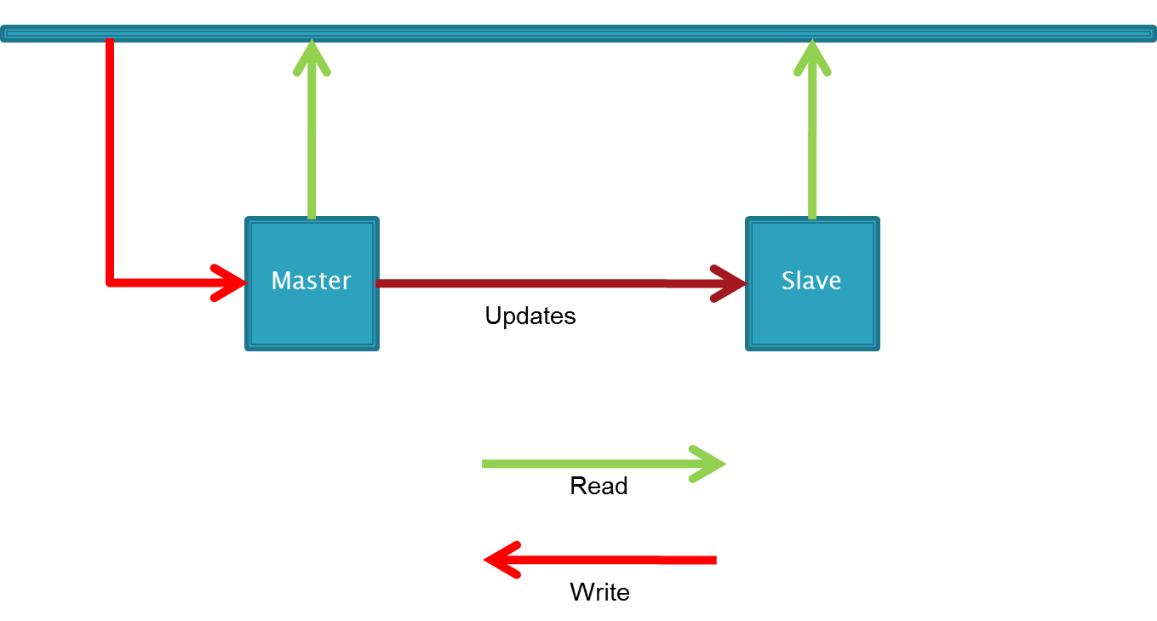
Master/Slave: Diagram

Slide 17
Master/Slave: Examples
DNS
Kerberos
LDAP
Databases

Slide 18
Multi-Master

Slide 19
Replication: Multi-Master
Any node can accept read or writes
Will distribute writes to all other nodes
Very complicated to implement
Cluster file systems use this method

Slide 20
Multi-Master
Master A
Master B
Master C
Master D

Slide 21
Distributed Shared Memory
Multi-master replication technique
Shares memory space between multiple machines
  Not all the memory needs to be in the same location
  However, accessing an address gets the same “entity”, regardless of physical location
Common usage is to distribute HTTP session state between web servers

Slide 22
Distributed Shared Memory
Shared Memory Model
Physically Distributed Memory

Slide 23
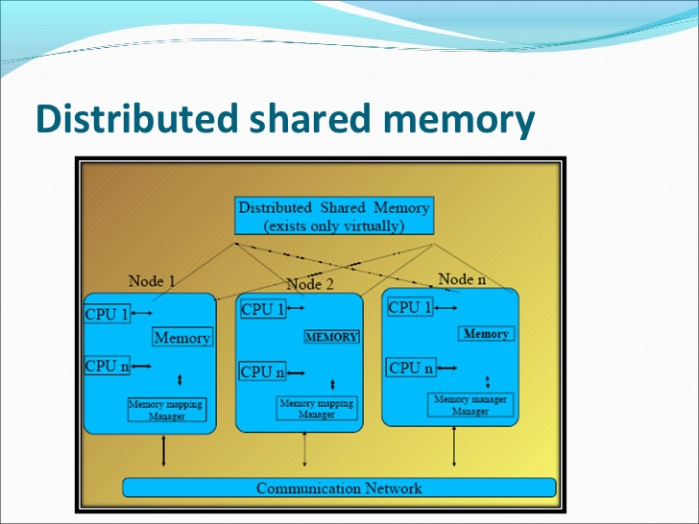

Slide 24
Load Balancing

Slide 25
Load Balancing
Load balancing distributes load across multiple servers
Often relies on replication to distribute data to the multiple servers

Slide 26
Load Balancing
DNS Round-Robin
Reverse Proxy

Slide 27
Round-robin
Computer operations:
  One method of having different program process take turns using the resources of the computer
    Limit each process to a certain short time period
    Then suspending that process to give another process a turn (or "time-slice").
  This is often described as round-robin process scheduling
Origination:
  https://en.wikipedia.org/wiki/Round-robin_%28document%29

Slide 28
DNS Round-Robin
Simplest Method
Multiple DNS records for a single address
DNS server will return addresses in different order every time it is requested
  Typically permuted
Does not assign work based on load
Can not detect failed servers

Slide 29
DNS Round-Robin: google.com
www.google.com. 604213 IN CNAME www.l.google.com.
www.l.google.com. 52 IN A 74.125.67.106
www.l.google.com. 52 IN A 74.125.67.103
www.l.google.com. 52 IN A 74.125.67.104
www.l.google.com. 52 IN A 74.125.67.99
www.l.google.com. 52 IN A 74.125.67.147
www.l.google.com. 52 IN A 74.125.67.105

Slide 30
DNS Round-Robin: Examples
DNS
Kerberos
LDAP
SMTP
HTTP

Slide 31
DNS Round-Robin: SMTP
SMTP does not require replication
Servers receive and transmit mail
  MX records control the Round-Robin
They do not need to all have the same mail messages
MX records are used for SMTP
  Priority
    Records with the lowest number get the mail
    Equal priority the email is share (e.g. round robin)

Slide 32
DNS Round-Robin: HTTP
HTTP is an odd beast
Purest form is stateless
  Shared file system is sufficient
Sessions, other state complicates matters
  Reverse Proxy is simpler
  DNS Round-Robin + Distributed Shared Memory works too

Slide 33
Load Balancing: Reverse Proxy
Device that sits in front of a group of servers and direct traffic
  Client traffic is terminated on load balancer
  Load balancer opens new connection to one back-end server and forwards client data
Often used for Web servers
Many companies provide ‘turn-key’ solutions
Can make intelligent decisions when forwarding traffic to servers
  Send less traffic to heavily loaded servers
  Skip down servers

Slide 34
Reverse Proxy: Uses
SSL endpoint
Compression
Caching
Intrusion Prevention

Slide 35
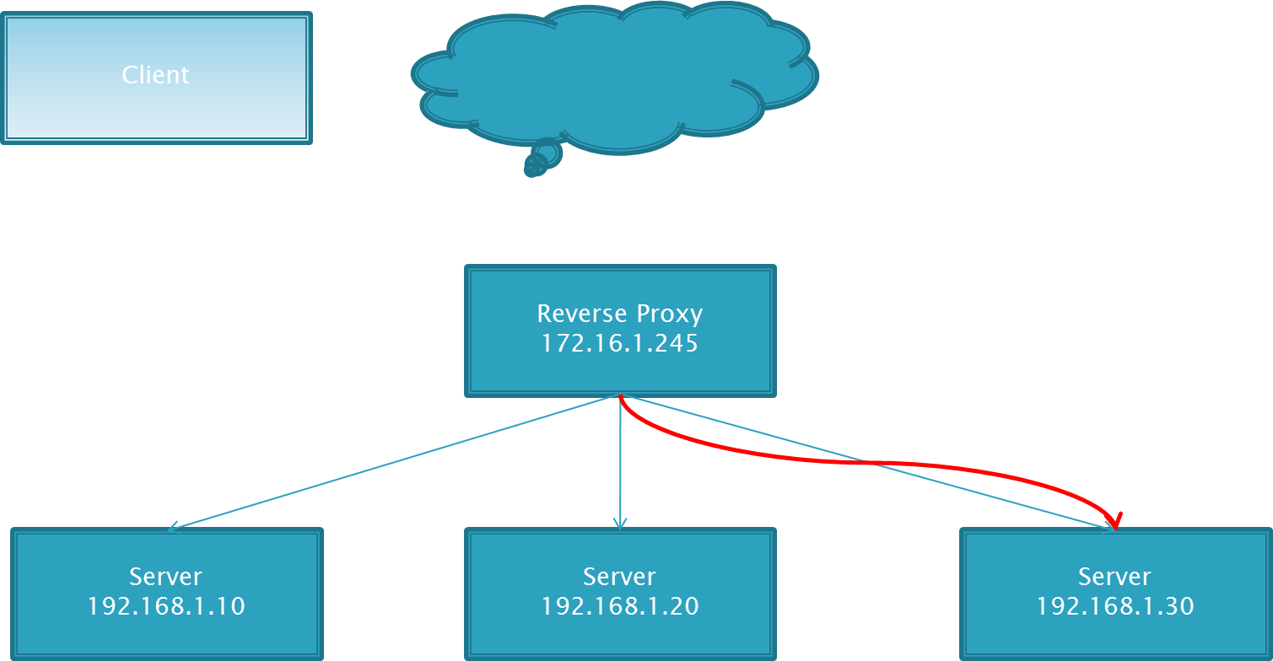
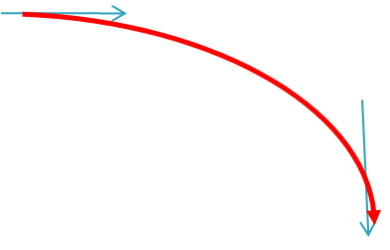
Reverse Proxy: Diagram

Slide 36
Reverse Proxy: Examples
FTP
HTTP

Slide 37
Reverse Proxy: HTTP
Many HTTP reverse proxies support session pinning
Session pinning:
  A user session will always be forwarded to same server
  Allows that server to keep track of session data for that user

