Slide 1
spf
sender policy framework

Slide 2
From OpenSPF
Note: http://www.openspf.org/ is a good reference source for SPF

Slide 3
Explain how SPF works in 1 minute http://www.openspf.org/FAQ/How_does_it_work
Domains use public records (DNS) to direct requests for different services (web, email, etc.) to the machines that perform those services
  All domains already publish email (MX) records to tell the world what machines receive mail for the domain
SPF works by domains publishing "reverse MX" records to tell the world what machines send mail from the domain
  When receiving a message from a domain
    Recipient can check those records to make sure mail is coming from where it should be coming from
With SPF, those "reverse MX" records are easy to publish:
  One line in DNS is all it takes

Slide 4
What does SPF actually DO? http://www.openspf.org/FAQ/What_it_does
Spammer forges a hotmail.com address
  Tries to spam you
  They connect from somewhere other than Hotmail
When the message is sent, you see:
  MAIL FROM: forged_address@hotmail.com
    Don't have to take his word for it
    Ask Hotmail if the IP address comes from their network
(In this example) Hotmail publishes an SPF record
  That record tells you (your computer) how to find out if the sending machine is allowed to send mail from Hotmail
If Hotmail says they recognize the sending machine
  It passes
    You can assume the sender is who they say they are
  If the message fails SPF tests
    It's a forgery
  That's how you can tell it's probably a spammer

Slide 5
sender policy framework
Client validation system
Verifies envelope sender is permitted to send mail on behalf of the domain
  In practice, only verifies IP address
Aims to prevent rogue mail servers
SPF provides no information about the contents of an email

Slide 6
how spf works
SPF is stored in DNS
An SPF record type is available
  Its use is not widespread
    RFC 4408
  Deprecated in 2014?
    RFC 7208
  RFC 7372?
Using a TXT record is more common

Slide 7
how spf works
An SPF record designates permitted and rejected sender(s) for a domain
Mail from a non-permitted sender may be safely rejected

Slide 8
what spf checks
SPF evaluation performed on two pieces of information
  Client email address
  Client IP address
Client email is retrieved or derived from:
  Envelope sender (MAIL FROM)
  HELO/EHLO host name

Slide 9
what spf checks
Evaluation is always performed on envelope sender
Evaluation should be performed twice if envelope sender and HELO domains differ
  The RFC is unclear on how to merge the results of the evaluations
  Likely that the ‘best’ outcome is accepted

Slide 10
reading spf records
(spf or txt record)
Always start with ‘v=spf1’
Read left-to right
Evaluation stops when a mechanism is matched
Last element of a SPF record should always be an ‘all’ or a ‘redirect’
If no mechanisms are matched, the result returned is ‘Neutral’

Slide 11
3 example spf records
(lines are wrapped)
  gmail.com. 300 IN TXT "v=spf1 redirect=_spf.google.com"
  _spf.google.com. 107 IN TXT "v=spf1 ip4:216.239.32.0/19 ip4:64.233.160.0/19 ip4:66.249.80.0/20 ip4:72.14.192.0/18 ip4:209.85.128.0/17 ip4:66.102.0.0/20 ip4:74.125.0.0/16 ip4:64.18.0.0/20 ip4:207.126.144.0/20 ip4:173.194.0.0/16 ?all”
  hotmail.com. 3600 IN TXT "v=spf1 include:spf-a.hotmail.com include:spf-b.hotmail.com include:spf-c.hotmail.com include:spf-d.hotmail.com ~all“

Slide 12
spf mechanisms
ALL
  Matches anything
A
  Matches if client IP matches one of the IP addresses of the named domain
  Performs DNS lookup on named domain
    Looks for A record if client IP is IPv4
    AAAA if client IP is IPv6

Slide 13
spf mechanisms
IP4, IP6
  Matches if client IP is in the named netblock
  Variants for IPv4 and IPv6
  Netblock must in CIDR format
    e.g. 172.16.1.0/24

Slide 14
spf mechanisms
MX
  Matches if client IP is one of the servers in the MX records of the named domain
PTR
  Matches if PTR record for client IP exists and maps to a host in the named domain

Slide 15
spf mechanisms
EXISTS
  Matches if the named domain exists
  Can be used to emulate DNS blacklists
  e.g.
    ‘v=spf1 -exists:%{ir}.zen.spamhaus.org’

Slide 16
spf mechanisms
INCLUDE
  Matches if the result of the referenced policy was PASS
  Name is poorly chosen

Slide 17
spf qualifiers
“+” Pass
  Client is permitted to send mail for the domain
  Pass is implied if the qualifier is omitted
“–” Fail
  Client is not authorized to send mail for the domain

Slide 18
spf qualifiers
“~” SoftFail
  Client should not send mail for the domain
  Mail should not be blocked solely on a SoftFail
  Result can be used by spam filtering software
“?” Neutral
  No assertion on if client is authorized
  Must be treated same as if there were no SPF record

Slide 19
spf modifiers
SPF modifiers
  Provide additional information
  Do not directly affect the evaluation of SPF records

Slide 20
spf modifiers
redirect
  Redirect to a different SPF record
  Replaces result of this SPF record
  Redirect or All should always be last element of a SPF record

Slide 21
spf modifiers
exp
  Provides an explanation of why SPF validation failed to the client
  The TXT record is looked up at named domain and its contents is used as the explanation
  SPF macros can be used to make the explanation more informative

Slide 22
selected spf macros
A number of macros are available in SPF records
Form: %{some stuff }
Macros are expanded during SPF evaluation
Some stuff:
  s = client email address
  l = local part of client email address
  o = domain of client email address
  h = domain name from HELO or EHLO

Slide 23
selected spf macros
Some stuff (cont.)
  d = client domain name
  i = client IP address
  v is
    "in-addr" - if client IP is IPv4
    "ip6" - if client IP is IPv6
      Used to construct PTR addresses
      e.g.
        %{ir}.%{v}.arpa

Slide 24
spf macro transformers
Some stuff (cont.)
  r - reverse macro, splitting on ‘.’ by default
    e.g.
      %{ir} will reverse an IP address
  0-128 - number of delimited components to keep
  e.g.
    if d is ‘www.example.com’
    %{d2} is ‘example.com’

Slide 25
spf macro delimiters
Allows you to specify a delimiter to be replaced with periods
  Available delimiters are in the set
    .-+,/_=
  e.g.
    if l is ‘jwatso8+foo’
    %{l+} is ‘jwatso8.foo’

Slide 26
example spf records (redux)
  gmail.com. 300 IN TXT "v=spf1 redirect=_spf.google.com"
  _spf.google.com. 107 IN TXT "v=spf1 ip4:216.239.32.0/19 ip4:64.233.160.0/19 ip4:66.249.80.0/20 ip4:72.14.192.0/18 ip4:209.85.128.0/17 ip4:66.102.0.0/20 ip4:74.125.0.0/16 ip4:64.18.0.0/20 ip4:207.126.144.0/20 ip4:173.194.0.0/16 ?all”
  hotmail.com. 3600 IN TXT "v=spf1 include:spf-a.hotmail.com include:spf-b.hotmail.com include:spf-c.hotmail.com include:spf-d.hotmail.com ~all“

Slide 27
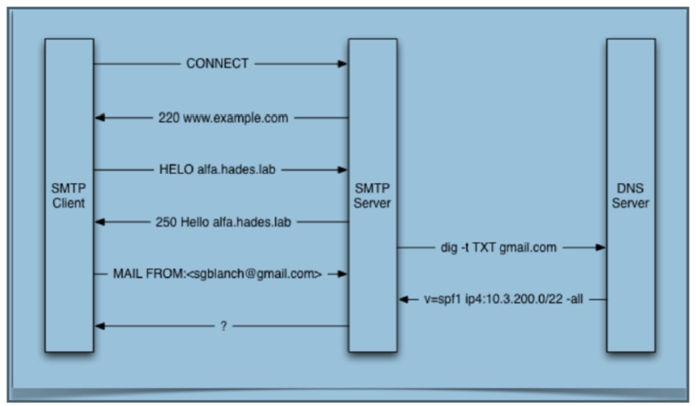
spf example

Slide 28
spf header
SMTP servers should add a ‘Received-SPF’ header to any E-Mail where a SPF record was checked
The Received-SPF header should contain the result of the SPF check

Slide 29
Example spf headers
Received-SPF: Pass (mybox.example.org: domain of
myname@example.com designates 192.0.2.1 as permitted sender)
receiver=mybox.example.org; client-ip=192.0.2.1;
envelope-from=<myname@example.com>; helo=foo.example.com;
Received-SPF: Fail (mybox.example.org: domain of
myname@example.com does not designate
192.0.2.1 as permitted sender)
identity=mailfrom; client-ip=192.0.2.1;
envelope-from=<myname@example.com>;

Slide 30
spf limitations
Only works if everyone uses it
Only prevents mail from unauthorized hosts
  Even then only if servers check it
Does not verify the sender, only their domain
Does not verify the contents of a message
SPAM can (and will) still find a way

Slide 31
sender id

Slide 32
sender id
Microsoft Sender ID is a superset of SPF
MS owns the patents
  Many open-source projects are wary of implementing it despite Microsoft’s promises

Slide 33
sender id
Sender ID has two modes of operation
  mfrom
    validates envelope sender, just like SPF
  pra
    validates Purported Responsible Address

Slide 34
sender id’s pra
Purported Responsible Address
  email address of most likely responsible party
Derived by applying heuristics to a number typical E-Mail headers
  Defined in RFC 4407

Slide 35
sender id problems
Sender ID violates SPF specification by trying to use a SPF record to verify the PRA
Recommended practice is to add an empty Sender ID PRA record
  Prevents evaluation of your SPF record in determining PRA
  ‘spf2.0/pra ?all’

Slide 36
sender id recommendations
(per jason watson)
I do not feel it adds much value to pure SPF
I recommend a neutral PRA record to prevent unintended consequences of Sender ID evaluating your SPF record
mfrom will still evaluate your SPF record in the same manner as pure SPF

