Slide 1

Agile Software
Development
Brian Moseley

Slide 2
What is
Waterfall?

Slide 3
Requirements
Analysis
Design
Code
Test
Deliver

Slide 4
What are
problems with
Waterfall?

Slide 5
Key issues:
- Time to Market
- Lack of Flexibility

Slide 6
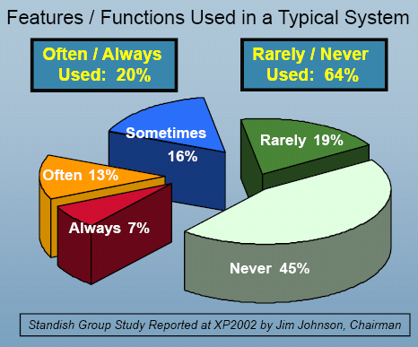

Slide 7
Vanguard’s
heavy-weight
process history

Slide 8
How do we
become
Better, Faster, and
Cheaper?

Slide 9
What is
Agile software
development?

Slide 10
Agile software development is:
A group of software development methodologies
Based on iterative and incremental development
Evolving requirements and solutions
Highly collaborative
Achieved by self-organizing, cross-functional teams
Scrum
XP
DSDM
Crystal
FDD

Slide 11
The Agile Manifesto
  Individuals and interactions over processes and tools
  Working software over comprehensive documentation
  Customer collaboration over contract negotiation
  Responding to change over following a plan

Slide 12
How do Agile methods differ from Waterfall?

Slide 13


The Scrum Approach
Requirements
Design
Code
Test
Rather than doing all of one thing at a time...
...Scrum teams do a little of everything all the time

Slide 14
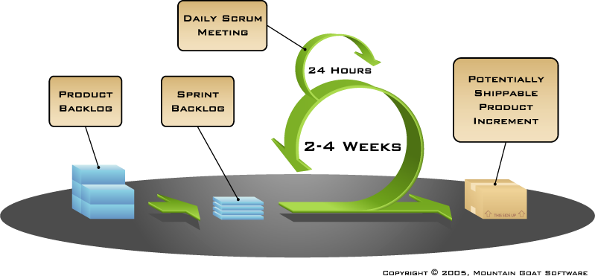
Elements of Scrum

Slide 15
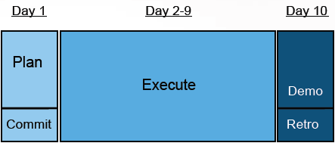
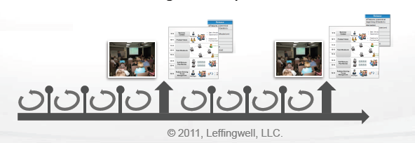
Elements of a Sprint

Slide 16
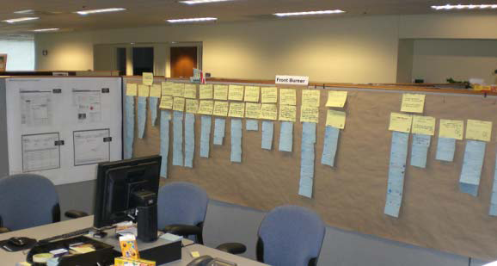
The Daily Scrum

Slide 17






Roles and Responsibilities
Product Owner
Implements vision,
manages and
communicates priorities.
Sponsors/executives
Define vision and objectives,
remove organizational impediments.
Product manager (LM)
Clears obstacles,
enables the team,
facilitates improvement.
Team members
Self-organize to
deliver business value
at a predictable rate.
Scrum Master
Facilitates team activities,
measures and communicates progress.

Slide 18
High-level Delivery Plan
2 weeks
Agile Planning
2 weeks
Sprint Zero
2 weeks per sprint
Working Sprints
Working Sprints
Working Sprints
Working Sprints
Planning team shapes
vision for the project,
defines “One Big Thing”,
and loosely defines
Features to be built
Cross-functional Scrum
team is assembled
to further assess value
and effort of features
to be delivered.
Deliver working software
Feature 1
Deliver working software
Features 2 and 3
Features and Feature Sets
Sprint Release Plan
Product Backlog -Stories
Sprint 1 Front Burner

Slide 19
Agile in action
Discovered pre-existing production defect. What do we do?
Discovered that legacy system has high complexity and risk to accommodate business need? What do we do?
Discovered that team would need longer than expected to build complex solution to handle all clients. What do we do?

Slide 20
Next Steps for Vanguard
Evolve from
“Doing Scrum”
to ”Being Agile”

