Slide 1
ITIS 3320
Tony Kombol

Slide 2
About the Instructor

Slide 3
Basics
Tony Kombol
  Office: Woodward 333G
  Telephone: 687-8194
  Email: tkombol@uncc.edu

Slide 4
Educational Background
B.S. – University of Wisconsin Parkside
  Math
  Physics
  Applied Science and Technology
M.S.E.E – University of Iowa
  Computer Engineering
A.A.S.D. - RCCC
  Motorsports Management

Slide 5
Experience
IBM
  Programming
    C, C++, Java, PLI, PL/S, etc.
  Testing
    Manufacturing, TDSS
  Project Management
  Web Design/Support
    Manufacturing
    HTML, JavaScript, CGI, WebSphere, etc.
  Deployment
  Mainframes, RS6000, AS/400, PCs
Luther College
  Physics Department
  Computer Science
Area 1 Community College (Iowa)
  Electronics
Queens College (Ad Hoc)
  Computer Science
UNCC – Adjunct Faculty
  ITIS

Slide 6
Misc.
NASCAR fan
Married
  One high-school student
  One college student
Grew up in Montana

Slide 7
Web Site
ITIS3320 Home Page
  http://webpages.uncc.edu/~tkombol/ITIS3320/ITIS3320Home.htm
  Class Schedule
  Text
  Assignments
  Other interesting material
Read!
General:
  http://webpages.uncc.edu/~tkombol/
  Office Hours
  General Information

Slide 8
About you, the Students

Slide 9
Briefly Introduce Yourself
Name
Why in this Class
  Required
  Curious
  Insane
Background
What you hope to get out of the class
Anything else you would like to share
  Major
  Hometown
  Etc.

Slide 10
ITIS3320 Highlights

Slide 11
Class Etiquette
Be prompt
Watch the cell phones!
If you have relevant experience share with class
Above all: Ask questions!

Slide 12
Class Format
Two weekly 1½ hour lectures:
  Tue Thu
  8:00-9:15 AM
Attendance Required
Two major tests
  Mid-term
  End-term
Assignments
Projects (2)

Slide 13
Grade Criteria
1 Mid-term Exam
  Covers first half only
1 End-term Exam
  Covers last half only
Two Projects
Assignments/Exercises
  Homework
  “Test Fests”
  Beginning E-Mail
  Ending E-Mail
Class participation

Slide 14
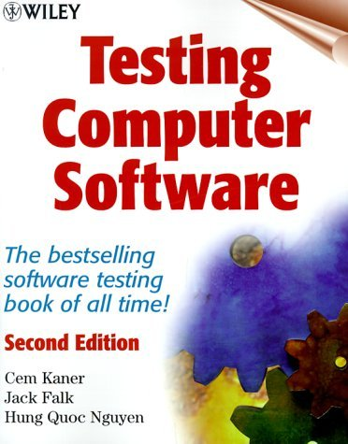
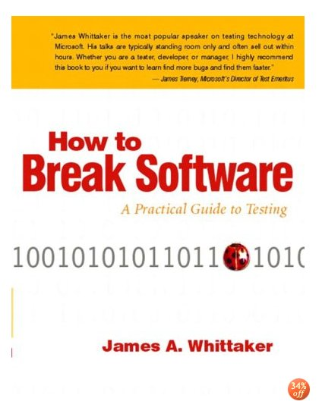
Books
Testing Computer Software, 2ND Ed.
  Authors: Cem Kaner, Jack Falk, Hung Quoc Nguyen
  Covers basics of testing
How to Break Software
  Author: James A. Whittaker
  Covers basics of how to find bugs

Slide 15
Again: 3320 Web Site
http://webpages.uncc.edu/~tkombol/ITIS3320/ITIS3320Home.htm
Contains
  Class schedule
    Access to power-point material
  Assignments
  Final project
  Much, Much more!
Check frequently

Slide 16
Assignments

Slide 17
Criteria
The Obvious:
  Submit your own work
    May study in groups
      0 points for plagiarism

Slide 18
Assignments
Substantial penalty if late
  Typically ½ off
Papers
  Must be typed
  Must have cover sheet
    Name
    Class
    Assignment name
Email format
  No attachments
    Unless explicitly asked for
  Plain text or HTML enabled
  Subject line:
    3320 Assignment Name
    E.g.
      3320 Cold Test
      3320 Assignment 3
  Must come from UNCC student email account
Points off if not in proper format

Slide 19
Homework
Typically 10 or 20 points
  20 or so
  Total of 200 to 300 points
  Includes Test Fests
Written assignments will be graded on:
  Content
  Grammar and spelling

Slide 20
Requirements
Text Books:
  Testing Computer Software
  How to Break Software
UNCC e-Mail account
  Communication
Access to Woodward 335 Lab
  All CCI students have access
    See Tech TA’s if badge don’t work
    Woodward 332

Slide 21
Material Covered

Slide 22
Material Covered
“Testing Computer Software”
  All chapters
  Chapters 14 and 15 may be optional
“How to Break Software”
  All chapters

Slide 23
Misc. Class Info
Woodward 335
  Computer Lab
    Available to ALL COIT students
  Need Student ID badge for Access
  Register with Lab T.A.s if badge don’t work
  Printers! No Charge!

Slide 24
Think!
Part of class methodology will try to get you to THINK!
  Synthesize concepts out of previous given material
  Minimal handheld steps

Slide 25
Actual Class Material!

Slide 26
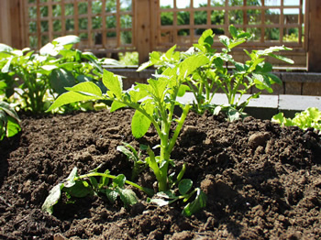
Potatoes!

Slide 27
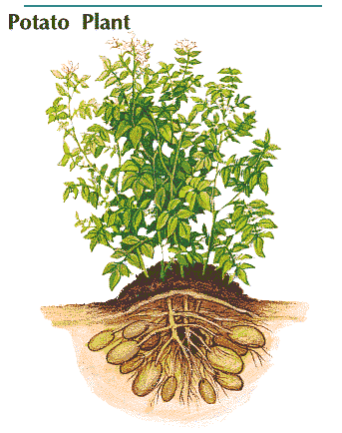
Potato Hill

Slide 28
Testing
Finding program errors is like digging for potatoes
  You know they are out there
  You know roughly where they are
  You don’t know:
    How big they are till you look for them
    How many there are
    How deep you need to dig to find all of them
  Accept you probably won’t find every one

Slide 29
Java Refresher
ITIS 4166/5166 TAs, James Cody and Shanjun Cheng, will be offering the bi-annual java tutorial this semester
  Open to all students enrolled in SIS courses
Tutorial Part 1
  Friday 01/23/09
  4:00-6:00pm, Woodward 335
Tutorial Part 2
  Friday 01/30/09
  4:00-6:00pm, Woodward 335
Tutorial notes will be available Monday (01/19)
  http://webpages.uncc.edu/~jcody3/java-tutorial/index.html

Slide 30
First Assignments
Cold Debug
  Due Wednesday, January 14th by noon
Beginning e-Mail
  Due Friday, January 16th by 5pm

