Slide 1
Test Case Design
Chapter 7

Slide 2
Overview
What is a good test case
Equivalence classes
Boundary analysis
Testing state transitions
Testing race conditions
Error guessing

Slide 3
Characteristics of a Good Test
It has a reasonable probability of catching an error
It is not redundant
It’s the best of breed
  Use the tests that will most likely find errors
It is not too simple or too complex
  Intelligently combine tests into test cases
It makes program failures obvious
  After designing a test write down the expected results
  Make printouts as short a possible
  Automatically scan large results for data

Slide 4
Equivalence Classes and
Boundary Values
Equivalence Classes
  Test the same thing
  If one test catches a bug the other tests will also
  If one test misses a bug the other tests will also
  Considered equivalent if:
    Involve same input variable
    Result in similar operations in the program
    Affect the same output
    Force the same error conditions

Slide 5
Equivalence Classes and
Boundary Values
Finding Equivalence Classes
  Different people will come up with different lists of equivalence classes
  Recommendations:
    Don’t forget equivalence classes for invalid inputs
    Organize classifications in a table or outline
    Look for ranges of number
    Look for membership in a group
    Analyze responses to lists and menus
    Look for variables that must be equal
    Create time-determined equivalence classes
    Look for variable groups that must calculate to a certain value or range
    Look for equivalent output events
    Look for equivalent operating environments

Slide 6
Equivalence Classes and
Boundary Values
Finding Equivalence Classes
  Don’t forget equivalence classes for invalid inputs
    Invalid inputs are a good source of finding bugs
    Use value at and near extremes
    Book example: valid numbers 1 <= x <= 99 give four equivalence classes
      1-99 ok
      0 or less too small
      100 or larger to big
      Any non numeric digit

Slide 7
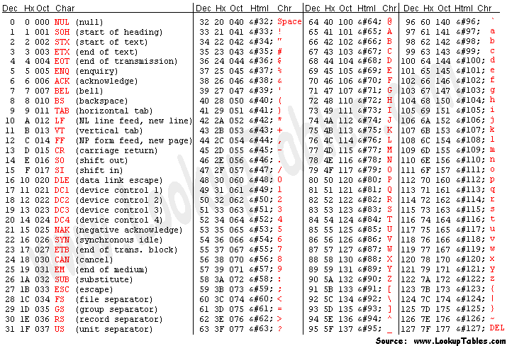
American Standard Code for Information Interchange - ASCII

Slide 8
Equivalence Classes and
Boundary Values
Finding Equivalence Classes
  Organize classifications in a table or outline
    Use table or outline depending on situation
    Each has pluses and minuses
    Use a good spreadsheet or outline program

Slide 9
Equivalence Classes and
Boundary Values
Finding Equivalence Classes
  Look for ranges of number
    Test within range (good)
    Test out of range (errors)
      For numerics: 3 typical error classes
        Numbers lower than range
        Numbers higher than range
        Non-numbers
    Don’t forget multiple ranges (e.g. tax brackets)

Slide 10
Equivalence Classes and
Boundary Values
Finding Equivalence Classes
  Look for membership in a group
    If an input is in a group all members of that group are in that equivalence class
    Example:
      England is in the European group
        France and Germany are in that equivalence class
        China and Canada are not (invalid class)
    Can have sub-classes

Slide 11
Equivalence Classes and
Boundary Values
Finding Equivalence Classes
  Analyze responses to lists and menus
    Selection of list or menu elements that give a different response will be in different equivalence classes
    Example:
      State drop downs that have names, standard abbreviations and postal codes would have 50 equivalence classes
        MT, Mont, and Montana are an equivalence class
        IA, NY, Florida are in different equivalence classes

Slide 12
Equivalence Classes and
Boundary Values
Finding Equivalence Classes
  Look for variables that must be equal
    Check for values once valid but may no longer be valid
    Put no longer valid choices in their own equivalence class

Slide 13
Equivalence Classes and
Boundary Values
Finding Equivalence Classes
  Create time-determined equivalence classes
    An event related to another event can cause an error
    Three basic equivalent classes
      Before the related event
      At or within a small window of the related event
      After the related event

Slide 14
Equivalence Classes and
Boundary Values
Finding Equivalence Classes
  Look for variable groups that must calculate to a certain value or range
    Three interior angles of a triangle add to 180º
      Plane geometry
    Places within 25 miles of a zip code

Slide 15
Equivalence Classes and
Boundary Values
Finding Equivalence Classes
  Look for equivalent output events
    Graphics: Draw a 6" long line
      Is it a line
      Is it 6”
      What if all or part of the line is outside of a boundary?
        E.g. plotter at the edge of the paper
    Random number generated between 0 and 100
      Can it generate 101 in error
      Are 0 and 100 valid?
      Is 1.56 valid
        Must it be integer?

Slide 16
Equivalence Classes and
Boundary Values
Finding Equivalence Classes
  Look for equivalent operating environments
    Designed for Intel Pentium IV processor
      Will it work on AMD Athlon
      Will it work on Intel 486
      Will it work on Intel Core Duo

Slide 17
Equivalence Classes and
Boundary Values
Boundaries of Equivalence Classes
  Use only one or two test cases for equivalence classes
  Use values at class boundaries
    For number valid between 0 and 100
    Two boundaries: 0 and 100
      Check 0, 1, 99 and 100
      Maybe add 101
        Programmer might have had incorrect boundary check
        <=100 instead of <100
        < 99 instead of <=99
        <> 100 instead of <100
    Be aware of “close enough”
      1/3 + 1/3 = 2/3
      .333 + .333 <> .667
  Test values at each edge

Slide 18
Visible State Transitions
If there is a visible change has there been a state change in the program
  Menu choices
    Each option must be tested
  Options (checklists, radio buttons)
    Each must be checked
  Different view
    Expected view
  Each pathway must be tested
    Correct action
    Does different data present problems
  Menu maps
    Explicitly draw out possible paths
    Review possible interactions, different paths leading to same states

Slide 19
Race Conditions and
Other Time Dependencies
Does going fast or slow effect the program
  Run on various speed machines
  Run with various speed operators
Try actions during state changes
  Keyboard or mouse inputs
  Various I/O
Look for time-outs (force one if you can)
  Stress it with usual and unusual input at that point
Test under heavy loads
  Multiple programs
  Multiple users (if OS capable)
  Do lots of “normal” work while under load
Watch for bad performance

Slide 20
Load Testing
Test every limit
  File size
  Memory usage
  Speed of I/O
  Number of files open
  Disk full
  Long usage time before restarting or resetting
Test for large and small extremes

Slide 21
Error Guessing
With experience you’ll develop intuition
Try values or scenarios you feel may break the program
  E.g. 0, null files, etc
Follow your instincts to expose errors
  Don’t need to justify special case testing
Track these special tests!

Slide 22
Function Equivalence Testing:
Automation, Sensitivity Analysis and Random Input
Function Equivalence: two programs do equivalent operations.
  E.g. same input to the programs gives the same result
Use the more mature and stable program (reference function) as a comparison when testing the new program (test function)

Slide 23
Function Equivalence Testing:
Automation, Sensitivity Analysis and Random Input
Methods to employ
  Automation of function Equivalence testing
  Sensitivity analysis
  Random inputs
  Generalized Equivalence Testing

Slide 24
Function Equivalence Testing:
Automation, Sensitivity Analysis and Random Input
Automation of function Equivalence testing
  Easy to use if:
    Don’t have to have correct values on hand
      Compare to reference function
    Program can be automated
      Compare values to be equal (or close enough)
    Use files
      Source of test data
      Place to keep results
      May need extra program to compare files

Slide 25
Function Equivalence Testing:
Automation, Sensitivity Analysis and Random Input
Automation of function Equivalence testing
  Harder to use if:
    Manual entry or data handling is required
      May be able to use key/mouse capture and replay

Slide 26
Function Equivalence Testing:
Automation, Sensitivity Analysis and Random Input
Automation of function Equivalence testing
  Costs to consider
    Time/cost for manual tests vs. creating automation programs
      Number of days to do manually
        Remember to estimate retesting
      How much time the automated tools will save
      Multiply time saved by twice salary (overhead)
      Propose, if short term savings or long term (up to 3 years)

Slide 27
Function Equivalence Testing:
Automation, Sensitivity Analysis and Random Input
Sensitivity analysis
  Automation allows more tests
  Careful choose tests at more “usual” and critical points
    Around boundaries
    Across the whole range
    Transition areas
    Special values
    Cases where small value changes can make large result variations
      E.g. near tan 90°

Slide 28
Function Equivalence Testing:
Automation, Sensitivity Analysis and Random Input
Random inputs
  Use a proven, capable random value generator
    RNG: Random Number Generator
  A RNG is really pseudo-random
    Same seed will produce same result sequences
  Watch for what values produced
    Only 65536 results if based on 2 bytes?
    Integer vs. floating point

Slide 29
Function Equivalence Testing:
Automation, Sensitivity Analysis and Random Input
Generalized Equivalence Testing
  If the unit under test uses same processes as another product
    Use output from other products as appropriate
  Beware of potential licensing problems
  Include results in reports
  Don’t assume the other products are bug free
    Investigate before using

Slide 30
Regression Testing

Slide 31
Regression Testing
Once a bug has been fixed there are two major concerns:
  Was the bug fixed
  Was something else broken by the fix
This is called Regression Testing
  May be the highest percentage testing for a long life product

Slide 32
Regression Testing:
Checking if a Bug Fix Worked
Was the bug reported the one that was fixed
  Programmer may have fixed a similar problem instead
  Was the root of the bug fixed, or were only the symptoms addressed
  Any unwanted consequences from fix

Slide 33
Regression Testing:
The Standard Battery of Tests
Regression Test Library
  Set of tests to be reused to test overall function of product
  Shows everything still works
    Old bugs have not reappeared
    Fixes haven’t created new problems
  Can be tedious
    Been there/done that syndrome
  Use a careful subset of complete test
    Boundary conditions
    Fixed problems
    Combine test cases
    Automate if possible
  Main point is to ensure the program is still working

Slide 34
Executing the Tests
You’ve made the test case, now use it effectively
  If program has different install options
    Run program after each different install
    Make sure each install option completely works
  Print test documents for special cases
  For special paper sizes
    Actually print, don’t rely on what shows on screen
  If special ASCII characters used again, print them
  Watch for initial state errors
    Reinstall if necessary

Slide 35
Not in Book
Log all your results!
  Errors found
    Obvious why…
      Track errors and fixes
  Tests that passed
    Not so obvious
      Why log?

Slide 36
Summary
Test as much as possible, but
  Don’t use excessive equivalent tests
Use the “best” tests
Make sure failures are obvious
Test at boundaries
  Just at, above, and below
Automate if economically advantageous
Regression Test!
Log results of running EVERY test

