Slide 1
Localization Testing
Chapter 9

Slide 2
Localization Testing
Overview
  Care must be taken “translating” a program to a new
    Environment
      Hardware
      Software
      People
    Culture
      People

Slide 3
Localization
Change of a product for a new environment
  Possibly new language
  Change in culture

Slide 4
Localization Testing
Was the Base Code Changed
  Typically if the program was designed for localization no base code changes are required
  Localization done by
    Setting options
    Different support files or tables
  Design for localization
    Advantages
      Easier to translate
      Fewer errors translating
    Disadvantages
      Longer development times
      Larger, more complex program

Slide 5
Localization Testing
Work With Someone Fluent in the Language (and Culture)
  "All your base are belong to us..."
    Translation of the Japanese game Zero Wing to English
      http://allyourbase.planettribes.gamespy.com/index.shtml
      http://en.wikipedia.org/wiki/All_your_base_are_belong_to_us
    Don’t let your translation effort be an international embarrassment
  A bilingual, fluent native of the target audience would be ideal

Slide 6
Localization Testing
Is the Text Independent From the Code
  If product will be translated into more than one language
    Ensure text has been separated from code
      Don’t take programmers word for it
      Look inside executables
  Some (but few) messages must be embedded
    Critical error messages
      E.g. Can’t access hard disk

Slide 7
Localization Testing
Translated Text Expands
  Foreign words or phrases may be larger or smaller than the English phrase
    Count on them being larger
    German text on average is 1/3 larger
      May be worse for short words or phases
    Example:
      English: Control
      German: Steuerungstaste

Slide 8
Localization Testing
Character Sets
  Foreign languages use different characters from the standard English set
    7 bits (128 values) contain the standard English characters (upper and lower case), numbers, and symbols (#, $, %, etc.) and control characters
    Adding an extra bit to 8 give the Extended ASCII Code sets
      Not standard but convention
      IBM Extention has simple graphic characters and some of the common European characters used (á, â, ã, ë, ê, ű, etc.)
      Note: especially with printers there are many different upper ASCII symbols
  Code pages
    The set of 255 may be customized to a country or region
    These are called code pages and have a numeric code page reference
      437 American
      850 ISO international standard
      874 Thai

Slide 9
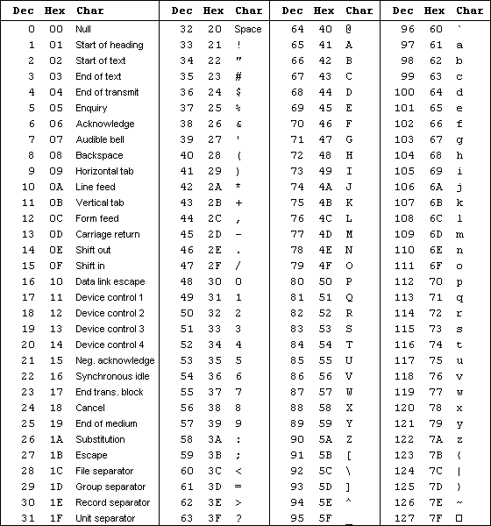
Base:

Slide 10
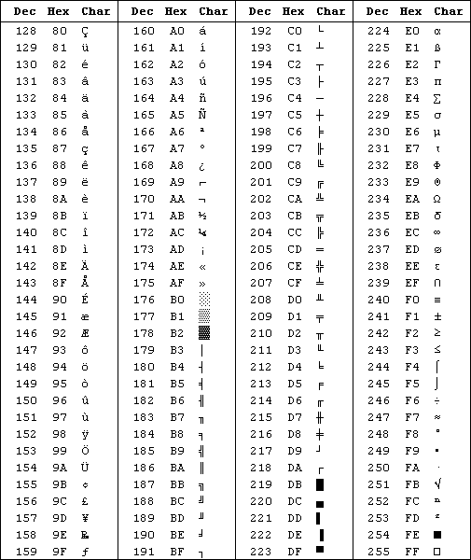
Extended:

Slide 11
Localization Testing
Character sets
  SBCS (Single Byte Character Set)
    Grew from the ASCII set
    255 character limit
  DBCS (Double Byte Character Set)
    Grew from need for more than 255 characters
    65535 characters

Slide 12
Localization Testing
Keyboards
  Keyboards vary by country
  Different characters
  Different placement
  “Dead keys”
    Allows 2 stokes to precisely define a character

Slide 13
Localization Testing
Text Filters
  Program may filter data entered
    May filter properly for English
      Check if it impacts a translation
      E.g. restricted to only English characters
    May filter content in certain areas
      E.g. proper restriction of file names, main text entry, etc.

Slide 14
Localization Testing
Loading, Saving, Importing and Exporting High and Low ASCII
  Create test files of all 255 characters or supported subset
  Try all the characters with each supported code page
    Verify each code page is properly imported, exported and displayed
    Try each supported language

Slide 15
Localization Testing
Different Operating System Language
  Does the new OS have different conventions
  E.g.
    DOS didn’t support blanks in name
    \ vs. / between Windows and UNIX
    Name length restrictions

Slide 16
Localization Testing
Hot Keys
  “Quick access” keys
    Single character, typically 1st or important character in command
    Changing languages usually has a different command with a different hot key
      All changed correctly
      Any leftover oddballs from previous language

Slide 17
Localization Testing
Garbled in Translation
  To save space messages may be built from small phrases
    “Error in reading ” + “drive ” + driveLetter
    “Error in reading ” + “file “ + fileName
    “Error in reading “ + “display status.”
  Sentence structure varies among languages
    Translated phrases may not be semantically correct when combined in the localized version

Slide 18
Localization Testing
Garbled in Translation
  The Dairy Association's huge success with the campaign "Got Milk?" prompted them to expand advertising to Mexico. It was soon brought to their attention the Spanish translation read "Are you lactating?“
  Coors put its slogan, "Turn it loose," into Spanish, where it was read as "Suffer from diarrhea."
  Scandinavian vacuum manufacturer Electrolux used the following in an American campaign: "Nothing sucks like an Electrolux."
  Clairol introduced the "Mist Stick," a curling iron, into German only to find out that "mist" is slang for manure. Not too many people had use for the "manure stick."
  An American T-shirt maker in Miami printed shirts for the Spanish market which promoted the Pope's visit. Instead of "I saw the Pope" (el Papa), the shirts read "I saw the potato" (la papa).
  The Coca-Cola name in China was first read as "Ke-kou-ke-la," meaning "Bite the wax tadpole" or "female horse stuffed with wax," depending on the dialect. Coke then researched 40,000 characters to find a phonetic equivalent "ko-kou-ko-le," translating into "happiness in the mouth."

Slide 19
Localization Testing
Error Message Identifiers
  Establish a unique identifier for each message
  This will help ensure the proper message is being reported
  Numbers are ideal, e.g. (233)
  The same text may be used even though the event that caused the message may be different
    A unique event identifier will help differentiate
  Ensure the number is consistent across localizations

Slide 20
Localization Testing
Hyphenation Rules
  Rules change from language to language, and even between dialects
    Spelling may change if hyphenated
Spelling rules
  Dialects may have different spellings
  Does spell checker take into account

Slide 21
Localization Testing
Sorting Rules
  Sorting may be different in various countries
  May not follow code values (ASCII)
Upper and Lower Case Conversion
  Beware of case conversion for non-English characters
    English chars convert easily by adding or subtracting 32
    Not true for other characters
Underscoring Rules
  Again, rule vary by country

Slide 22
Localization Testing
Printers
  Printers now will likely have character sets for many countries
  Ensure the characters set are accessible by the localization
  Test printing using the alternate character sets
Sizes of Paper
  European paper standards are different from American
    Close, but will have bad margins
    Test that margins are correct for different paper

Slide 23
Localization Testing
CPU’s and Video
  Investigate which video cards and monitors are popular in the target countries
  Test using those combinations
Rodents
  Check what mice are used
  Again, test that the mouse works with your product

Slide 24
Localization Testing
Data Formats and Setup Options
  Beware of different format conventions
    Time:
      12 vs. 24 hour
      Colon or other separators
    Date:
      U.S.: 1/31/2006 mm/dd/yyyy
      Europe: 31/1/2006 dd/mm/yyyy
      Asian: 2006/1/31 yyyy/mm/dd
    Numeric separator
      , vs. .
    # symbol not universal
    Negative numbers
    Money symbols

Slide 25
Localization Testing
Rulers and Measurements
  Metric vs. English
  Displays and printing
    Picas

Slide 26


Localization Testing
Culture-Bound Graphics
  Beware icons that may not be appropriate
    Thumbs up
      “Good” or “Great” - America
      “Up yours” - many countries
        Middle east, Nigeria, Australia….
    Okay sign
      “OK” - America
      “Zero” - Quebec
      “Evil eye” - various
      “Anus” - Germany

Slide 27
Localization Testing
Culture-Bound Output
  Calendar formats
  Standard invoice forms
  Address formats

Slide 28
Localization Testing
European Product Compatibility
  Is product compatible with popular European products
  Is the localized version compatible

Slide 29
Localization Testing
Memory Availability
  Localization usually makes program larger
  Does the localized version still have the same memory requirements
  Likewise, are the typical computers in the localized area have the same memory as US

Slide 30
Localization Testing
Do GUIs Solve the Problem?
  NO!
  Same problems and more
    Text box sizes
    Graphics concerns
    Etc.

Slide 31
Localization Testing
Automated Testing
  Core code should NOT have changed
    Test basics anyway (just in case)
  Automate where possible
    Especially non-UI aspects

Slide 32
Localization Testing
Summary
  Watch out for proper translations
  Program size may change with localizations
  Non-offensive graphics in one country may be offensive in another
  Ensure you understand the rules for each country
    Spelling
    Hyphenation
    Sort order
    Etc.

