Slide 1

ITIS3100
By Fei Xu

Slide 2




Acknowledge
This document is basically a digest from “Wireshark User's Guide 25114 for Wireshark 1.0.0”
You can download the software and document at http://www.wireshark.org/
http://wiki.wireshark.org
All logos and trademarks in this document are property of their respective owner.

Slide 3
What is Wireshark?
Wireshark is a network packet/protocol analyzer.
  A network packet analyzer will try to capture network packets and tries to display that packet data as detailed as possible.
Wireshark is perhaps one of the best open source packet analyzers available today for UNIX and Windows.

Slide 4
Some intended purposes
network administrators use it to troubleshoot network problems
network security engineers use it to examine security problems
developers use it to debug protocol implementations
people use it to learn network protocol internals
Wireshark isn't an intrusion detection system.
Wireshark will not manipulate things on the network, it will only "measure" things from it.

Slide 5
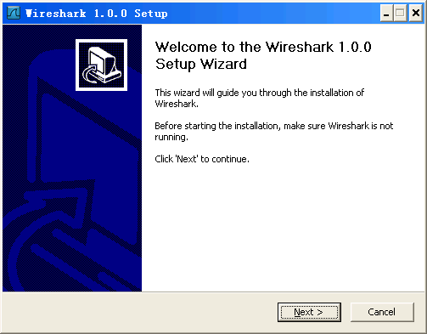
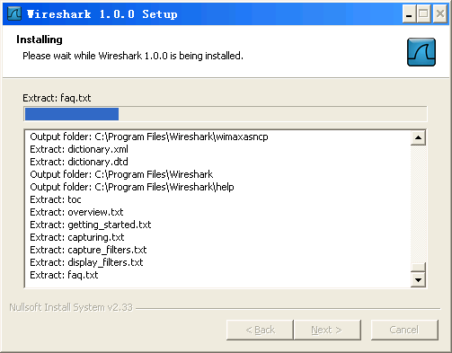
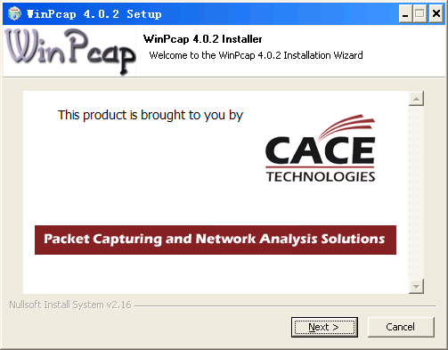
Install under Windows
Download
Install

Slide 6
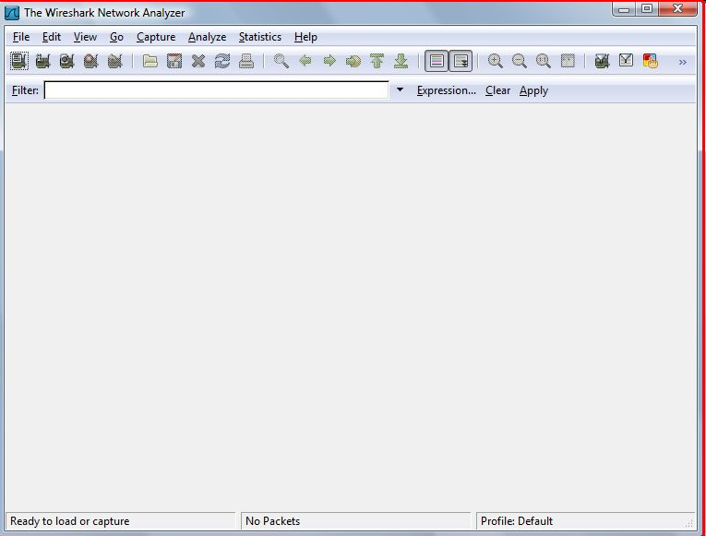
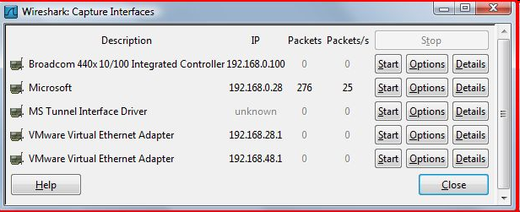
Install under Debian/ Ubuntu
# apt-get install wireshark

Slide 7
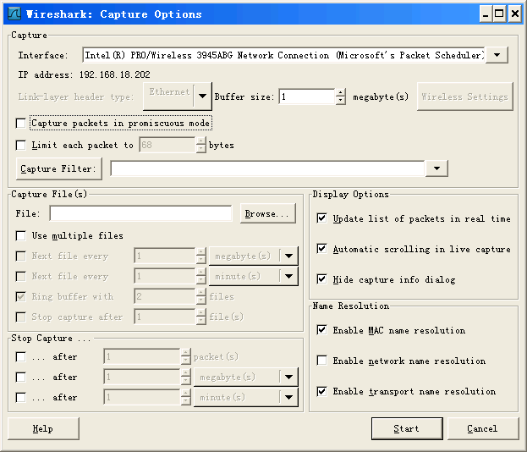
Configuration
This checkbox allows you to specify that Wireshark should put the interface in promiscuous mode when capturing. If you do not specify this, Wireshark will only capture the packets going to or from your computer (not all packets on your LAN segment).

Slide 8
IMPORTANT
TURN PROMISCUOUS MODE OFF!
IF YOU'RE AT WORK, YOUR NETWORK ADMINISTRATOR MAY SEE YOU RUNNING IN PROMISCUOUS MODE AND SOMEBODY MAY DECIDE TO FIRE YOU FOR THAT.

Slide 9

Live Demo
HTTP
DNS
ARP
Photo credit: Jeff Kubina

Slide 10
More resource
http://wiki.wireshark.org
Search “wireshark tutorial”

