Slide 1
Programming the Web using XHTML and JavaScript
Chapter 7
Introduction to Programming and JavaScript

Slide 2
Programming

Slide 3
Programming Techniques
Solving Problems: Brute Force
  Traveling Salesman Problem
Traveling Salesman

Slide 4
Programming Techniques
Seattle
Chicago
New York
Boston
Philadelphia
St. Louis
Washington
Denver
Atlanta
Houston
Los Angeles

Slide 5
Programming Techniques
Brute Force
  Traveling Salesman Problem
Algorithm
  “A detailed sequence of actions to perform to accomplish some task”¹
  Al-Khawarizmi
    Died about 840 A.D.
    HUGE influence on algebra (name comes from his book)
1. Free On-Line Dictionary of Computing

Slide 6
Control Structures
Sequence
  Do this.
  Do something else.
  Do something different.
  Do another thing.

Slide 7
Control Structures
Sequence
Conditional (if-then, branching)
  1. Do this.
  2. Do something else.
  3. If some condition is true then
  3a. Do this bit
  Otherwise
  3b. Do these things.
  4. Do another thing.
The steps you do only if the condition is true
The steps you do only if the condition is false

Slide 8
Control Structures
Sequence
Conditional
Looping (iteration)
  1. Do this.
  2. Do something else.
  3. Do the following steps x number of times
  3a. Do this sub-step
  3b. Do another sub-step.
  4. Do another thing.

Slide 9
Control Structures
Sequence
Conditional
Looping
Transfer (go to)
  1. Do this.
  2. Go to step 4.
  3. Do something else.
  4. Do another thing.
  5. Go to step 1.
Never gets executed

Slide 10
Programming Techniques
Unstructured
  “Go To Statement Considered Harmful”
  Edsger W. Dijkstra, 1968
Structured
  Top-down construction
Object-Oriented
  “Objects” composed of data and instructions
  Self-contained

Slide 11
Control Structures
Flowcharts (graphical symbols)

Slide 12
Control Structures
Pseudocode (half code, half natural)
  While the stoplight is red, stop.
  If the stoplight is green then continue on.
Advantages:
  Avoids programming language technicalities
  Easy to understand and change

Slide 13
Computer Languages
Source Code
  Written in “English” words
  Human readable
Machine Code
  1’s and 0’s
  Executable (readable) by the machine

Slide 14
Computer Languages
Programming languages
  C, C++, Java, COBOL, FORTRAN, …
  Typically creates a stand-alone program
Scripting languages
  Parochial View:
    JavaScript, VBScript
    “Mini” program that runs inside another program
    Cannot be used outside that application
  Big View
    Wikipedia: Scripting Language

Slide 15
Computer Languages
Compilers
  Translates entire source file once
  Produces a single executable file
    Platform dependent
    E.g. Wintel vs. Linux vs. Apple
Interpreters
  Translates source statements one at a time
  Immediately executes each statement
  Typically platform independent

Slide 16
JavaScript
Browsers typically support two “languages”:
  HTML
    Translate the tags
    Display the content appropriately
  JavaScript
    Interpret a line
    Execute the line
Both are executed in order

Slide 17
JavaScript
JavaScript code composed of:
  Instructions/Commands/Statements
  Case sensitive!
  Inserted directly into HTML
    Either <head> or <body>
  <script> element
    <script>
    (scripting commands)
    </script>

Slide 18
JavaScript
More than one scripting language
Must specify JavaScript in XHTML code
  <script type=“text/javascript”>
  …
  </script>
Note: default scripting language can be specified by a <meta> tag
Note: there are other script languages: vbscript, tcl, xml, and many more!

Slide 19
JavaScript
Don’t confuse HTML with JavaScript
  <script type=“text/javascript”>
  …
  </script>
JavaScript
HTML

Slide 20
JavaScript
Can have multiple <script> elements in one HTML document
Ch07-Ex-01.htm

Slide 21
JavaScript
Can access JavaScript code stored in an external file
  <script src=“my_code.js” type=“text/javascript”>
  …
  </script>
Only JavaScript code in the .js file, not the <script> tags

Slide 22
JavaScript
External files
  Good for repeated code
  Hides code from casual users

Slide 23
Entomology of Programming

Slide 24
Entomology of Programming
“a branch of zoology that deals with insects ”, i.e., debugging

Slide 25

Entomology of Programming

Slide 26
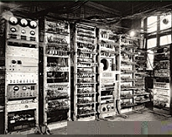
Entomology of Programming

Slide 27
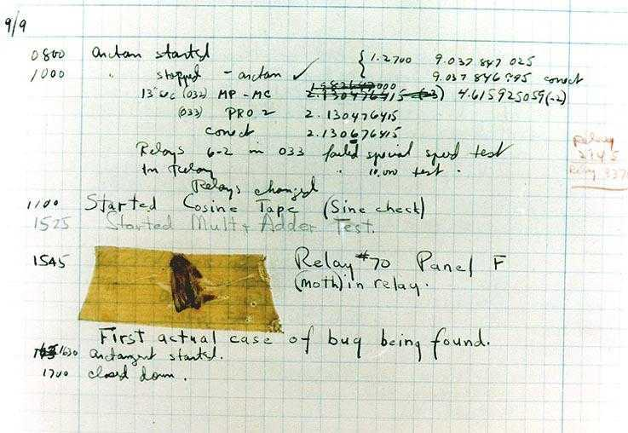
Entomology of Programming
Naval Surface Warfare Center Computer Museum at Dahlgren, Virginia

Slide 28
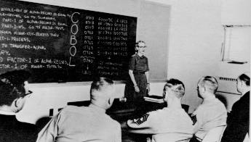
Entomology of Programming

Slide 29
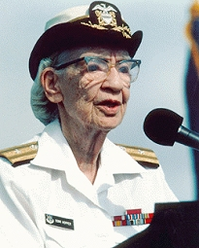
Entomology of Programming

Slide 30
Entomology of Programming
Two basic types of errors:
  Syntax
    Constructed improperly
    “Spelled wrong”
  Logic
    Constructed properly but does not achieve the
    desired result
    “Spelled right but wrong words”

Slide 31
Entomology of Programming
Spelling
<script type=“test/javascript”>
alert(“My first JavaScript.)
Alert(“Too exciting for words.”)
alert[“This is big time stuff.”]
</script>
Closing quote
Capital letter
Square brackets

Slide 32
Entomology of Programming
Sample errors
  Ch07-Ex-02.htm

Slide 33
Entomology of Programming
Browser errors
  Message box:
    Line number – not always accurate
    Error message – not always informative
  Skips:
    Invalid line and
    All subsequent lines in same <script> element

Slide 34
Entomology of Programming
Fixing errors methods:
  Correct line by line
  Use trial and error
  Rewrite code entirely
  Use comments to eliminate items
    One line at a time
    A block at a time

Slide 35
Entomology of Programming
Preventing errors
  Code and test:
    Code a small piece
    Test if it works as anticipated
      Fix any problems
    Code some more
    Test new function
      Fix any problems
  Repeat until done!

Slide 36
Comments
Help other readers understand code
Help yourself at a later time
Eliminate sections of code during debugging

Slide 37
JavaScript Comments
Single-line comment : // …
<script …>
alert(“Hi!”) // A friendly greeting
// End of this script element
</script>
Everything after the // is ignored on that line

Slide 38
JavaScript Comments
Multiple-line comment: /* …. */
<script …>
/* This is a
multiple line
comment. */
/* So is this */
</script>
Everything between the /* and */ is ignored regardless of number of lines

Slide 39
Comments
Don’t confuse with HTML comment:
<!--
This is an HTML comment
-->

Slide 40
Interactivity

Slide 41
Interactivity
HTML has form elements like text boxes, check boxes, radio buttons, etc.
JavaScript permits processing of these elements

Slide 42
Interactivity
Event:
  An action associated with some object
Types of events:
  Click
  Select
  Mouseover
Ch07-Ex-03.htm

Slide 43
Interactivity
Browser automatically tracks events
Programmers job is to write code that responds to events
Event Handler

Slide 44
Interactivity
Sequence of events:
  User does something
    Clicks the button
  Browser automatically detects an event
    Click generates a specific event
  Browser generates an event
    A click occurred for a specific button
  Event handler is triggered
    Some code associated with the button clicked is run
  JavaScript commands associated with that event are processed
    User written code exercises associated with that event

Slide 45
Interactivity
onclick attribute describes the action(s) to take when a click event is detected
  <input type=“button” onclick=“alert(‘You clicked me’)” />
alert is JavaScript exception to <script> rule
Ch07-Ex-04.htm

Slide 46
Interactivity
Mouse events
  onmouseover – when cursor is moved over an object
  onmouseout – when cursor over an object moves away from the object
Ch07-Ex-05.htm

Slide 47
Interactivity
Multiple JavaScript commands are valid
  <input type=“button” onclick=“alert(‘You clicked me’)”;
  onmouseout=“alert(‘Well done’)” />
Use with care!
  Ch07-Ex-04a
  Works differently with IE and FireFox

Slide 48
Quotes notes
HTML or JavaScript
  'some stuff…' or "sum stuff…"
    May start with either
    Must be paired
  Can be embedded, one pair in another
    'Some stuff "inside quote" rest of stuff!'
  Use artfully when intermixing JavaScript and HTML commands, etc.

Slide 49
Quotes notes…
<input …. onclick=“alert(“message”)” />
??????
Starts onclick attributes
Ends onclick attributes
<input …. onclick=‘alert(“message”)’ />
Starts onclick attributes
Ends onclick attributes
Starts alert message text
Ends alert message text
<input …. onclick=“alert(‘message’)” />
Same as above but starting with “ instead of ‘

Slide 50
Sidebar:
Forms:
  Can have as many as you want on a page
  HOWEVER!!!!
    Usually only want 1 or 2 forms per page
  Think of as a questionnaire:
    Group the questions or items that belong together
      Survey: name, age, birthday, hometown
      Order: Item name, catalog number, quantity, price

Slide 51
Assignment
PTW 7
See Assignments Web Page
Grade based on:
  Appearance
  Technical correctness of code

