Slide 1
Programming the Web using XHTML and JavaScript
Chapter 15
Strings, Dates, and Cookies

Slide 2
Introduction to strings

Slide 3
Validation and
Verification

Slide 4
Validation vs. Verification
Valid – meets certain criteria
  For example:
    a value is purely numeric
    a text value is no more than seven characters in length
Verified – “represents the truth”
  User is allowed to access system
    User ID is defined to the system
    Password is correct a given User ID

Slide 5
Validation vs. Verification
Verification is hard to accomplish “safely” with JavaScript
Why?
  Two reasons ---

Slide 6
Verification
Data and program to verify have to reside on the user’s computer
  → the list of UIDs and passwords
    Need to be downloaded to the user’s PC
    Takes time to download (and verify)
  Anyone can see!

Slide 7
Validation
Validation accomplished easily in JavaScript
Assume an input screen that requests:
  Name
    Must have at least an entry
  Student Identification Number (SID)
    Rules:
      Exactly eight digits
      Numerals only (no alphabetical characters)

Slide 8
Validation
To validate the SID check:
  Entry is exactly eight digits in length
  Each digit is in the range 0 to 9 only
Remember
  Data input via a text box appears to JavaScript as a string
String variables are actually string objects

Slide 9
Validation
String objects possess:
  ~30 methods
    For example:
      Search within the string for a substring
      Change the case of the string
      Replace one character in a string with another character
  One property:
    length (the number of characters in the string)

Slide 10
Validation
Assume the form looks like this …
Ch15-Ex-01

Slide 11
Validation
Value stored in the SID text box is referred to as:
  document.surferInfo.SIDBox.value
This is a string object so its length is referred to as:
  document.surferInfo.SIDBox.value.length
Can validate its length with a conditional statement like this …
Ch15-Ex-02

Slide 12
Validation
How can we check the individual string characters?
String objects include a substring method
Syntax (JavaScript) is
  substring(n,m)
Starting character position
Ending character position plus one, i.e. up to but not including this character

Slide 13
Validation
Thus,
  var myName = “Bruce”
  var char1 = myName.substring(0,1)
  would result in char1 containing “B”
Also,
  var myName = “Bruce”
  var char1 = myName.substring(2,4)
  would result in char1 containing “uc”

Slide 14
Validation
In substring(n,m), the number of characters that are being referred to is:
m – n
So, substring(2,4) refers to
  2 characters (4-2=2)
  Specifically the 3rd and 4th characters

Slide 15
Validation
Just to confuse you:
There is another substring function
  substr(s,l)
  Where:
    s: starting position (required)
    l: length (optional)
    To count back from the end of the string use a negative number for s
    If length is omitted the substring is taken to the end

Slide 16
Validation
There is also a single character extraction function: charAt(n)
That extracts the n^{th} character:
  var myName = “Bruce”
  var char1 = myName.charAt(1)
  Results in char1 containing “r”
Note that “extract” really means “copy”

Slide 17
Validation
Handy Function: indexOf()
Returns the first position of a character or string of characters
  If not found returns -1
  First position is 0
Ch15-Ex-02a

Slide 18
Validation
Collating sequence
  Computers represent everything as a numeric value
  Thus, every keyboard symbol has a value
  The ASCII code (used in PCs) defines the values for all symbols
    7 bits – 128 values
    Extended uses 8 bits – 256 total values

Slide 19
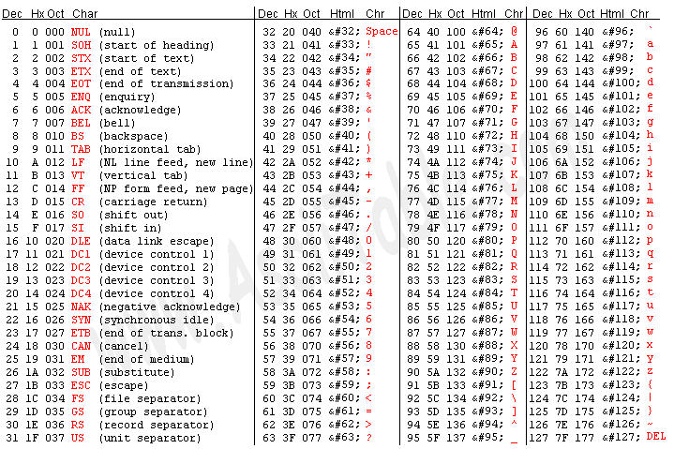
ASCII Codes
http://www.asciitable.com/

Slide 20
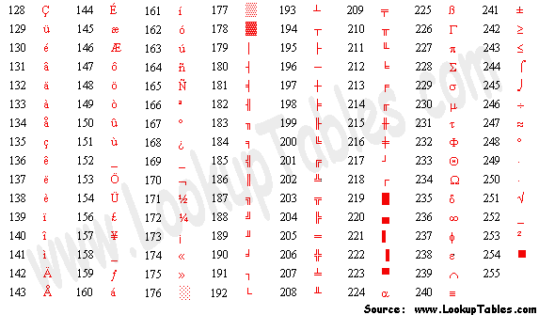
One of the extended ASCII Code pages

Slide 21
Validation
Since every symbol has a value, a hierarchy can be established
Thus, “A” is “less than” “B” because the ASCII code for an A (65) is less than the ASCII code for a B (66)
“Z” (90) is less than “a” (97)
Can use these relationships to see if a character in a string falls within a given range

Slide 22
Validation
To validate the SID, we want to:
  Extract a single character
  Check to see that it’s a value in the numeric digit range (decimal values 48 – 57)
  Repeat until all characters have been checked

Slide 23
Validation
theChar=document.surferInfo.SIDBox.value.substring(0,1)
if (theChar < "0" || theChar > "9") alert("Invalid SID")
Really means
If (the ASCII value of the character is less than 48 or
the ASCII value of the character greater than 57) alert(“Invalid SID”)

Slide 24
Validation
With a loop it is easy to repeat the process for each character in SIDBox:
  for (…)
  {
  theChar=document.surferInfo.SIDBox.value.substring(0,1)
if (theChar<“0” || theChar>”9“) alert(“Invalid SID”)
  }

Slide 25
Validation
Now we have to repeat this process for each character in SIDBox:
  for (i=0; i<=7; i++)
  { theChar=document.surferInfo.SIDBox.value.substring(0,1)
if (theChar<“0” || theChar>”9“) alert(“Invalid SID”)
  }

Slide 26
Validation
Need some way to control the loop and refer to subsequent characters in the substring:
  for (i=0; i<=7; i++)
  {
  theChar=document.surferInfo.SIDBox.value.substring(i,i+1)
if (theChar<“0” || theChar>”9“) alert(“Invalid SID”)
  }
Ch15-Ex-03

Slide 27
Validation
Once we know the SID is invalid there’s no point in continuing the loop
  (Unless we want to painfully point out each invalid character individually)
So, how to we stop a loop before it’s finished?
With a break statement

Slide 28
Validation
When JavaScript encounters break it acts like the continuing condition of the loop is false and immediately exits the loop
Ch15-Ex-04

Slide 29
Date Objects

Slide 30
Date Objects
JavaScript can access the computer’s date and time via a Date object
Create a new one by:
  var timeandDate = new Date()
Date objects include a number of methods

Slide 31
Date Objects
Method | Meaning | Units
getFullYear() | 4-digit year | 2000, 2001, etc.
getMonth() | Month no. | 0-11
getDate() | Day of month | 1-31
getDay() | Day of week | 0-6
getHours() | Hour no. | 0-23
getMinutes() | Minute no. | 0-59
getSeconds() | Second no. | 0-59

Slide 32
Date Objects
We can use Date objects to display the current date and time
Ch15-Ex-05
  What is the “problem”?
    Hint: there are two
  How can this be improved?

Slide 33
Cookies

Slide 34
Cookies
Persistent data is data that exists over a long term
Data created and manipulated in a JavaScript program ceases to exist when the containing Web page is changed
Problem: How can we maintain data over a long period of time?

Slide 35
Cookies
Why not write directly to the user’s hard drive?
  Security!
Imagine if any Web page you accessed could write data/programs to your hard drive
Instead …

Slide 36
Cookies
Cookies
  String data stored in a special format
  May be long term persistent or temporary
  Small file (2,000 – 4,000 characters max.)
  Not more than a certain number from any one Internet domain (300 for Netscape)
  Create a cookie by assigning a string value to the cookie property of the document object

Slide 37
Cookies
A cookie string consists of five parts in the following order:
  Cookie’s name and value
  Expiration date
  Pathname of the Web page creating the cookie
  Domain name of the server creating the cookie
  Security parameter to restrict access

Slide 38
Cookies
For example, creating only the first part (name and value):
  document.cookie = “userName=Fred”
Cookie Name
Value
Creates a cookie named userName whose value is Fred

Slide 39
Cookies
Setting the expiration date requires storing two data items in the cookie:
  Name and value
  Expiration date
Expiration date must be specified in Greenwich Mean Time (GMT) format

Slide 40
Cookies
Browsers store time as the number of milliseconds (thousandths of a second) from January 1, 1970 to now
When we create a new Date object, the browser sets its value to the number of milliseconds from 1/1/1970.

Slide 41
Cookies
To change the value of a date object we need to add a certain number of milliseconds to it:
  Compute milliseconds
  Assign new value to the date object
The getTime() method of a date object returns the current date in millisecond format
Ch15-Ex-06

Slide 42
Cookies
Now all we have to do is compute the number of milliseconds from now until the cookie should expire
For a 30-day expiration that’s:
  30 * 24 * 60 * 60 * 1000

Slide 43
Cookies
To create an expiration date:
  var expDate = new Date()
  var currentDate = expDate.getTime()
  var thirtyDays = 30*24*60*60*1000
  var fromNow = currentDate + thirtyDays

Slide 44
Cookies
Now set the date object to that value using the setTime method:
  expDate.setTime(fromNow)
Ch15-Ex-07

Slide 45
Cookies
More compactly:
  var expDate = new Date()
  expDate.setTime(expDate.getTime() + 30*24*60*60*1000)

Slide 46
Cookies
JavaScript also provides:
  A setMonth() method to set month values directly …
  Ch15-Ex-08
  As well as a toGMTString() method to convert date/time strings directly to GMT format

Slide 47
Cookies
Once you’ve established a cookie’s expiration date you assign it to a cookie:
  var expDate = new Date()
  var currentMonth = expDate.getMonth()
  expDate.setMonth(currentMonth+1)
  document.cookie = "userName=Fred;expires=" + expDate.toGMTString()

Slide 48
Cookies
However, JavaScript limited to reading only the “name=value” part of a cookie, not it’s expiration date
How can you read the value of an existing cookie?

Slide 49
Cookies
By using the string method named split()
split() requires a parameter
  Used to parse a string into substrings at every location of the parameter

Slide 50
Cookies
For example:
  var basicString = "alpha&beta&gamma"
  var thePieces = basicString.split("&")
Creates an array of strings named thePieces such that:
thePieces[0] = “alpha”
thePieces[1] = “beta”
thePieces[2] = “gamma”
Ch15-Ex-09

Slide 51
Cookies
How can we create multiple cookies?
By assigning a new “name=value” to document.cookie
But, there is only one document.cookie file?
  It can contain multiple “cookies”!

Slide 52
Cookies
  document.cookie=“userName=Fred”
  document.cookie=“password=George”
It looks like the second statement replaces the first document.cookie
However, there is only one cookie
So what really happens is that the two values are appended together
Ch15-Ex-10

Slide 53
Cookies
To separate these into their constituent parts we execute a split twice
Ch15-Ex-11

Slide 54
Extra Information
Text Boxes: How to keep passwords private while typing them in
  PW:<input type='password' name='pw'>
  Ch15-Ex-12

Slide 55
Extra Information
Upper or Lower Case?
  When validating information case matters!
  People out of habit may use capitalization, etc.
  Site may require all upper case
    A real pain to type
How to ease the problem?
  toUpperCase()
  toLowerCase()
  Ch15-Ex-13

Slide 56
Assignment
See Assignments Web Page
Grade based on:
  Appearance
  Technical correctness of code
  Proper results

