Slide 1
Visual Studio
ASP Web Site
Lab 1

Slide 2
Warnings!
If you use the local drive on the lab machines (C:) the data may be lost!
  Machine gets “cleaned” when rebooted
  Supposedly rebooted every night
To keep your work files:
  Use a MS network drive
    Not H: (or any drive on the Novell system)
    “Net use” to a MS friendly drive share:
      net use v: \\coit-ts2003\yourid
  Use a thumb (USB) drive

Slide 3
Lab 1 Overview
Create an XML file
  Contains street addresses for a city
Create an XSL file (XML Stylesheet)
  Contains instructions of how to display the XML file
Create a Web Form file
  Actual .asp web file
  Reads the XML and XSL file
    Creates the formated output
  “.html on steroids”

Slide 4
Idiosyncrasies
Lab machines are on a Novell Network
  H: drive is a shared drive on a Novell Server
Visual Studio is a Microsoft product
  Not completely compatible with Novell
  May look like it works, but…
Need an MS compatible shared drive
  Server: coit-ts2003.uncc.edu
  Access by:
    Bring up a command prompt window
    Type: net use v: \\coit-ts2003.uncc.edu\userid
    v: can be any letter
    Userid is the same as your UNCC id
    Password will be last 4 digits of your 800 UNCC id

Slide 5
Idiosyncrasies
Visual Studio
  Remembers “things”
    Previous use
    Things you may not want remembered
  Will try to “help” you
    In ways you don’t want help

Slide 6
Achtung!
Follow the lab commands carefully!
  Think! – What are you doing and why!
Pay careful attention to details:
  Spelling
  Capitalization
  Change default names of objects when they are created(if specified)
  Proper order
  Is there more than one work item specified in a sentence?
Follow the lab commands carefully!
    Think! – What are you doing and why!

Slide 7
coit-ts2003 Servers
There are two DIFFERENT types of servers on coit-ts2003!
  1 file server (optional)
  1 web (http) server (mandatory)
MS File Server (optional “v” drive)
  Accessible from campus only
    Accessible from a campus networked computer
      net use v: \\coit-ts2003.uncc.edu\userid
    Change to v: and use as a normal drive
MS Web Server (IIS)
  Write-Accessible from campus only
    Access using ftp

Slide 8
Getting started in Lab
Logon to lab system (Novell)
  UID: your standard UNCC id and pw
Establish a net share to coit-ts2003:
  Ensure v: is not assigned to another drive:
    Type: net use
      Review drive assignments that are reported
      If v is listed type: net use v: /d
  Connect to v:
    Type: net use v: \\coit-ts2003\userid
      Where userid is the same as your UNCC Novell ID
      Password is your last 4 digits of your 800 id number
  Start Visual Studio 2005
    It may start in a “new user” mode
    Select Visual Basic option

Slide 9
Getting started in Lab
Note: the use of “v” for the drive letter has no special meaning
  May assign any letter that is not currently used by the computer
  For this class:
    v: drive will refer to the Windows 2003 file server

Slide 10
Compete Lab
Follow the Steps in Lab 1 – XML 2005
  Create XML file
  Create XSL
  Create Web Page
  Upload to the web server using FTP
    Also on coit-ts2003
  Test from another machine
There is one ^{small} deliberate error in the results of this lab
  Correct it before submitting

Slide 11
VS Basic Procedures
Start VS
Create Project or Web Site
  File → New → Web Site…
    ASP.NET Web Site
    Browse…
      Select your drive/directory
    Add your name for a directory to build your site
    Ensure Language is Visual Basic
    Click OK
Note: there are multiple ways to do almost everything in VS!

Slide 12
VS Basic Procedures
You should now have the basis for a web site
  Base .aspx page
    e.g. Default.aspx
    Note Design and Source buttons at bottom of main page

Slide 13
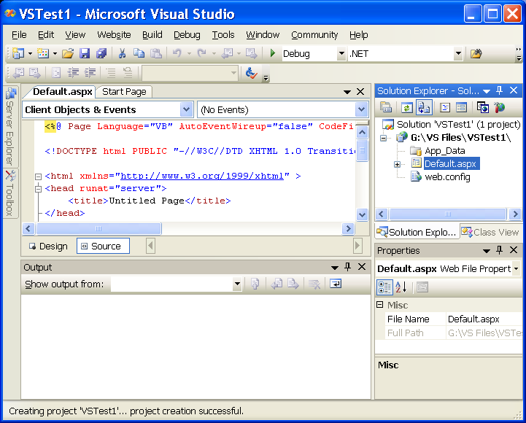
VS Basic Procedures

