Slide 1
The Web Wizard’s Guide to Web Design
Chapter 1
Planning a Web Site

Slide 2
Identifying the Audience
Who is most important?
  Designer
  Your Client (the sponsor)

Slide 3
Identifying the Audience
Neither!
Successful design meets the needs of the audience, not the designer or the sponsor!

Slide 4
Identifying the Audience
Users:
  Who are they?
  Why are they here?
  What are they looking for?
  How do they think?

Slide 5
Target Market
Who is the target market in the following Web Sites?

Slide 6
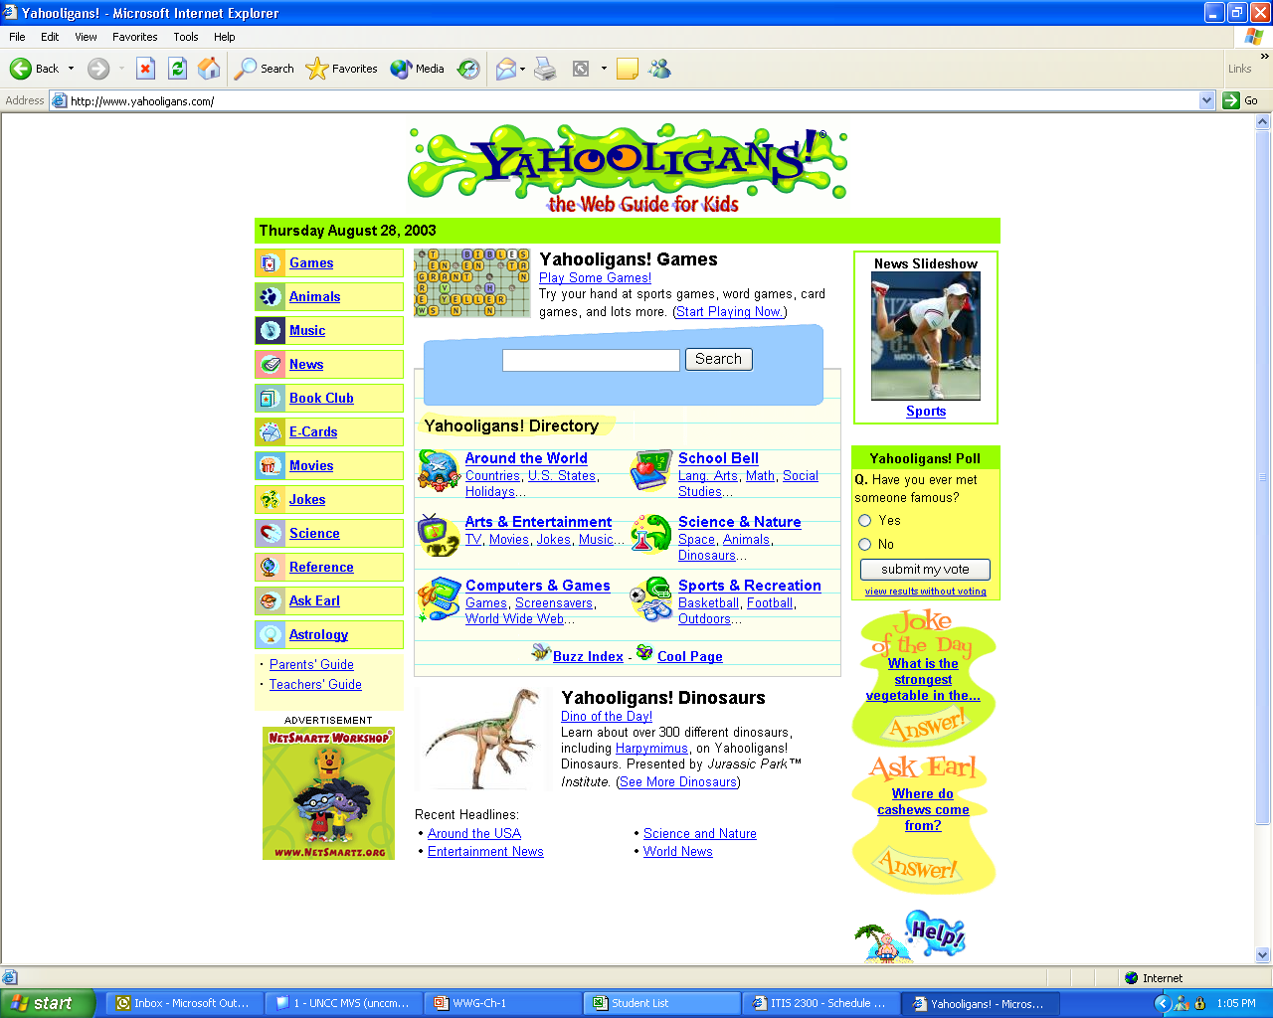

Slide 7
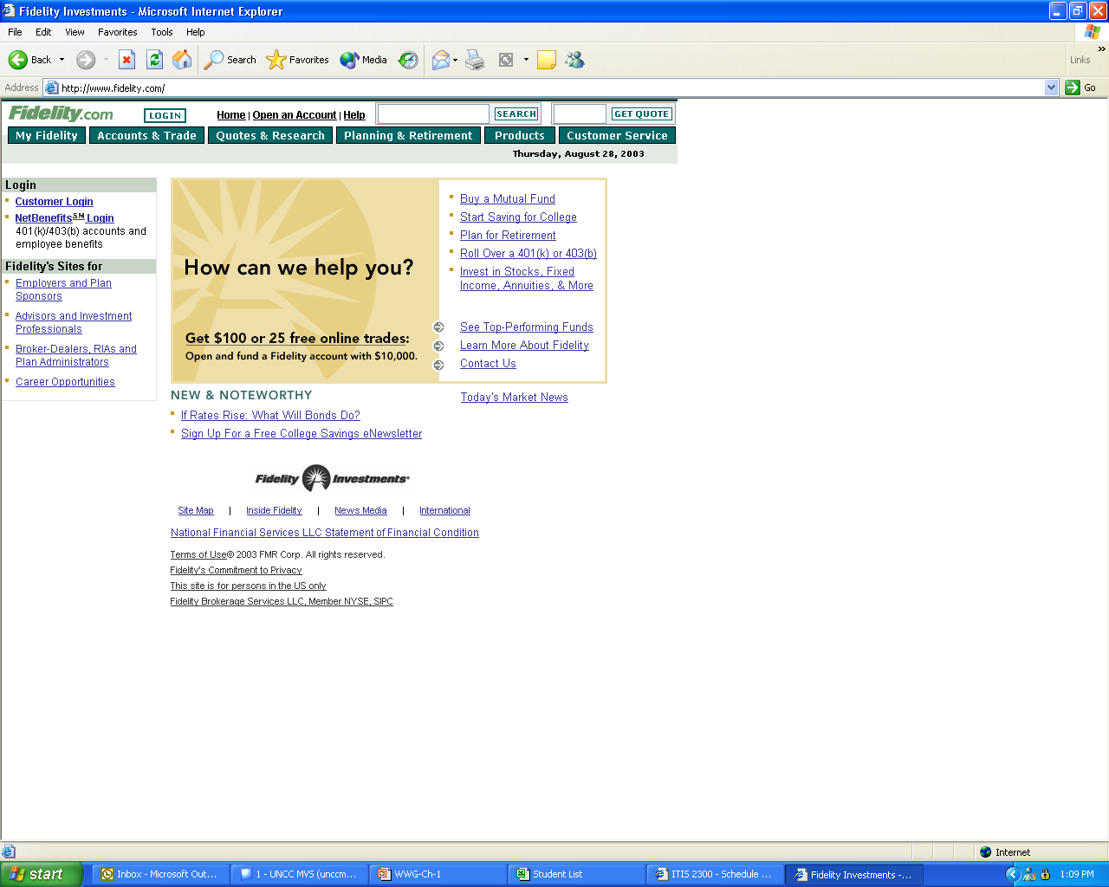

Slide 8
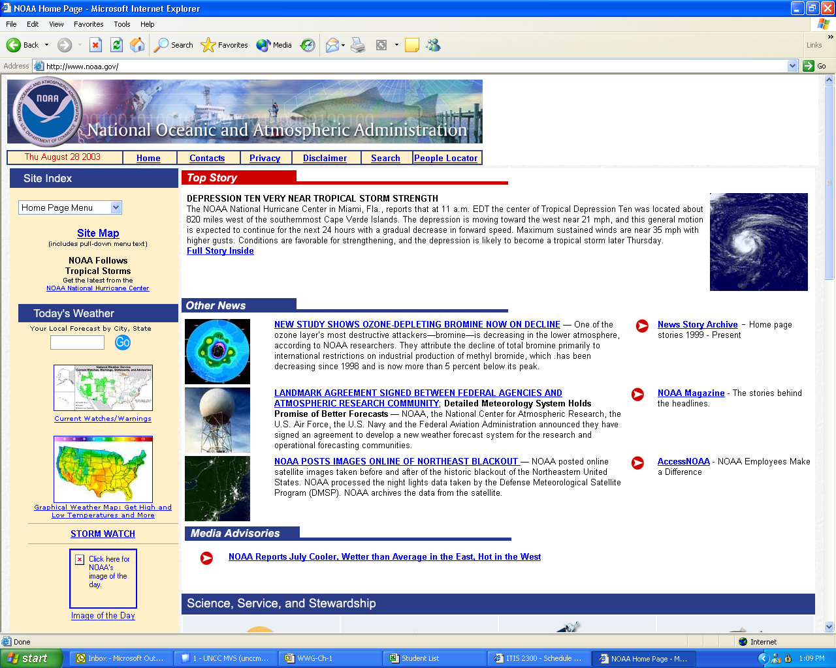

Slide 9
Identifying the Audience
The sponsor is not the audience!
The customer is the audience
  The site’s user/browser
No customer → site’s purpose unfulfilled

Slide 10
Identifying the Audience
Possible Web site design approaches:
  Organization-centered
    Organization’s point of view
    Public perception?
  Technology-centered
    If you’ve got it, flaunt it
    Does the technology serve the needs of the site?
  User-centered
    Target audience

Slide 11
Identifying the Audience
Ways to define audience - demographics
  Age
  Gender
  Geography/Residence
  Income
  Education
  Ethnicity
  Interests
    Gardening, NASCAR, woodworking, etc.
  (Web) History
    Where have they surfed before?

Slide 12
Identifying the Audience
Define the audience
Study them:
  What do they need?
  How do they think?
  Are there common characteristics?
Develop site
  Use technologies to support purpose
  So visitors can understand and use

Slide 13
Identifying the Audience
Steps to define audience:
  Picture them at the computer
    Who are they?
      Range of ages
      Gender
      Income
    Why are they at this site?
    How did they get to this site?
    Do they have a history with this organization?
  Are there common characteristics?

Slide 14
Determining Site’s Purpose
What
  What will visitors do at the site?
Why
  Why do they want to do it?
  Why would they want to do it here and not somewhere else?
Definition serves both customer and organization needs

Slide 15
Determining Site’s Purpose
Organization’s Needs | Customer’s Needs
Provide services | Consume services
Inform potential customers about the organization | Find out what resources are available

Slide 16
Determining Site’s Purpose
Look at the verbs:
  Increase sales
  Purchase an item
  Communicate the mission
  Provide information…

Slide 17
Determining Site’s Purpose
Goals (strategic view)
  Long-term
  Organization-centered (usually)
Objectives (tactical view)
  Specific means by which goals will be accomplished
  User-centered (usually)
Many Web sites serve a variety of purposes
Understand them from the beginning

Slide 18
Determining Site’s Purpose
How does success look?
  Always provide a means to measure the success of the site
  Specify these criteria from the beginning
  What means will be used?
  How will they be quantified?

Slide 19
Planning the Structure
“Form follows function”
Design the functions first, the form will follow naturally
Flow Chart
  How the subdivisions work or are organized
Statement of functions
  The purpose each subdivision serves
  Each subdivision serves a unique purpose
  (What happens if this concept is violated?)

Slide 20
Planning the Structure
Avoid meaningless generalities
Be concrete
Be detailed
Use action verbs
Consider user’s perspective

Slide 21
Planning the Structure
Flow charts
  Map the navigation for the site
  Documents the web site
  Complex sites may need details broken into more than one sheet

Slide 22
Simple Flow Chart Example

Slide 23
Planning the Structure
Specifications
  Filename
  Text
  Images
  Links
  Menus

Slide 24
Details
Function1 Detail1 Step 2
Filename: func1det1st2.htm
Images: none
Multimedia: none
Text: Do step 2 here
Links: home, http://link1, http://link2
Menu Items: next, back

Slide 25
Possibilities of the Web
Text
  Efficient means of transferring information
  But remember:
    The screen not as comfortable as the printed page
Hypertext
  How will your site use links?
    For navigation?
    To access content?
  How will the links be represented?

Slide 26
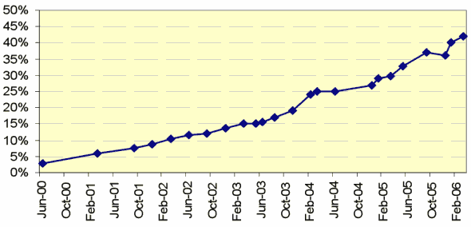
Possibilities of the Web
Images
  Most frequently used after text
    Content (the image is the message)
    Navigation
    Icons (represent an idea)
  Limited by bandwidth
    Measures rate at which data moves between points

Slide 27
Possibilities of the Web
Multimedia
  Animation
  Sound
  Video
  Virtual Reality
    http://www.virtualgettysburg.com/vg/panoramas/multi_node.html

Slide 28
Possibilities of the Web
Interactivity
  The user is not passive!
  Get the user involved with the page
Interactive pages allow user to:
  Choose
  Animate
  Search and find
  Buy and sell
  Manipulate
  Construct
  Question and answer
  Converse
  Play
Use what is appropriate

Slide 29
Complete Planning Table
Defined the audience
Defined purpose of the web site
Explored way to implement
Document in a table

Slide 30
Potential Planning Table Template:
Purpose | Structure | Function | Media

Slide 31
Summary
Web site satisfies the need of the audience
Web sites need a clear and specific purpose
To aid design of a site use
  Flow Charts
  Written Specifications
Use technologies appropriate to the audience
  Text
  Images
  Sound
  Video
  Interactivity
Document the design

Slide 32
Assignment
See Assignments web page for details

