Slide 1
The Web Wizard’s Guide to Web Design
Chapter 4
Gathering and Preparing Text, Numbers, and Images

Slide 2
Listing the Elements
After design then what?
Content
  Text
  Graphics
  Pictures
  Sounds
  Videos
  Logos

Slide 3
Listing the Elements
Remember your flow chart?
List the elements on each page

Slide 4
Preparing Text
For Large Organizations
  You will be supplied
    Text
    Pictures
    Sounds
    Data
  Your job will be to display it in the best context
For Smaller Organizations
  You may need to create some of the elements

Slide 5
Preparing Text
Sources of text
  Corporations: PR, Comm. Dept.
    Professional Writers
  Brochures, flyers, internal documents, press releases, annual reports
  Printed documents (scan to retrieve text)
  Retrieve from existing Web pages
    View source
    Copy from screen
  Retrieve from person responsible

Slide 6
Preparing Text
Editing
  Word processing formats are not Web formats
  Can’t use same techniques for formatting
  Remove:
    Carriage returns
    Tabs
    Columns
    Indents
    Justifications

Slide 7
Preparing Text
Editing (cont.)
  Place content in plain text form
  Eliminate unusual formatting or styles
  CHEK GUD SPELING AND GRAMeR!
  Make sure spill Czech her haws knot past you’re core wrecked lea spelt, butt in correct whirred!

Slide 8
Writing for the Web
Reader’s expectations:
  Fast, convenient, interactive
Web writing tips:
  Keep it short, essentials only
  Pyramid structure
    1st paragraph: who, what, where, why, when
    If they’re interested they’ll read on
    Tell more of the story in subsequent paragraphs

Slide 9
Writing for the Web
Web writing tips (cont.)
  Use subheadings that describe the content
  Use bullets to express separate but parallel ideas
    Omit transitional phrases
    Conserves space
    Faster reading
  Provide links to relevant materials not essential to your immediate purpose

Slide 10
Preparing Numbers
A couple of standards:
  Spell out numbers up to nine
  Use numerals for 10 and above
  Use comma separators
    Or country specific format
When using spreadsheets (tables):
  Keep labels short
  Eliminate blank rows and columns
  Save as tab-delimited text file

Slide 11
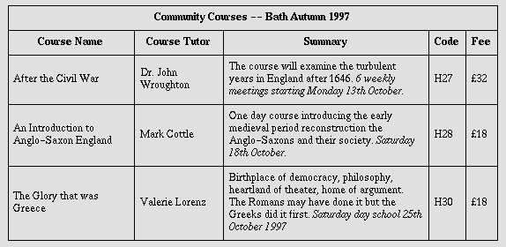
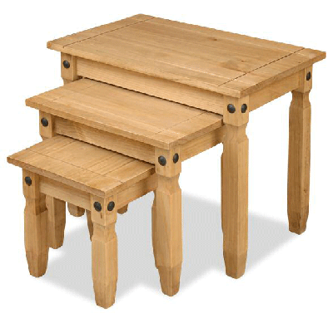
Preparing Numbers
Tables
  Good for:
    Reference
    Look-up

Slide 12
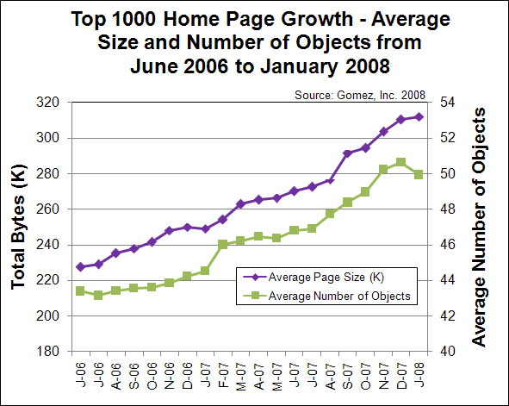
Preparing Numbers
Graphs
  Trends over time, comparisons, distributions
  Save as images

Slide 13
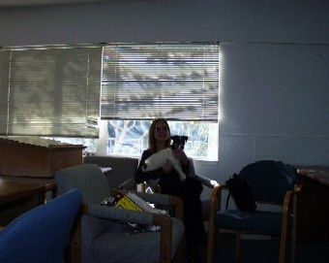
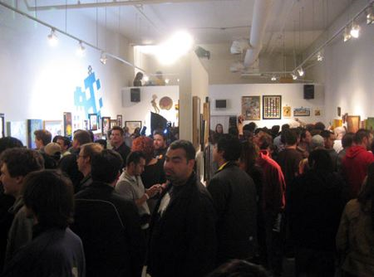

Preparing Images
Photography
  Brightly lit subjects photograph better
  Indirect lighting
  Fill frame with subject
  Small groups
  Avoid distracting backgrounds
  Don’t photograph text
  Candid vs. posed

Slide 14
Preparing Images
Formats – “Big 3”:
  GIF – Graphics Interchange Format
    Non-photographic images
    Images with lines and areas of solid color
  JPEG (or JPG) – Joint Photographic Experts Group
    Photographs
    Blended images with complex colors and shapes
  PNG – Portable Network Graphics
  Dozens of others
    here

Slide 15
Preparing Images
Compression
  Same physical dimensions
  Smaller in byte count but …
  Might not contain full information on every pixel
  320 x 240 pixel image
    225,000 bytes uncompressed … 33 seconds over 56K
    27,000 bytes compressed……. 3 seconds over 56K

Slide 16
Preparing Images
GIF
  “Lossless” for simple images
    Line drawings
    Simple cartoons
  Only stores 8 bits per pixel (256 color)
  Uses LZW compression algorithm patented by Unisys
  Technically, must pay royalties when using GIF

Slide 17
Preparing Images
JPEG
  “Lossy” technique
  Decompressed image not same as original
  Exploits human vision characteristics
    Small changes in brightness more easily perceived than small changes in color
  Can trade off size for image quality
  Stores 24 bits per pixel (16 million color)

Slide 18
Preparing Images
PNG
  Open format
  Compresses better than GIF
  Lossless
  Supports 48-bit true color

Slide 19
Preparing Images
Thumbnails
  Smaller versions of full picture
    Smaller dimensions
    Fewer bytes
  Use on main page to lessen page load
  Use clicks to get full picture when they want to see more details
RedOrbit.com

Slide 20
Preparing Images
Copyright
  Identify author of every element used
  No copyright registration or notice is required
  Authors own their work automatically
    Registration is a good idea for settling legal claims
  “Fair use” exceptions
    Students in class settings
    Works in the public domain
    Use in academic environment
    Others
  UNCC Guide
  UMUC Policy Guide

Slide 21
Assignment
To be combined with WWG Chapter 5

Slide 22
Resources
Web Content Accessibility Guidelines: http://www.w3.org/TR/WAI-WEBCONTENT/
What makes a great web site? http://www.webreference.com/greatsite.html
Art and the Zen of Web Sites
http://www.tlc-systems.com/webtips.shtml

