Slide 1
The Web Wizard’s Guide to Web Design
Chapter 5
Gathering and Preparing Multimedia Elements

Slide 2
Animation
Images that “move”
Attracts viewer’s eye
  May be distracting rather than enhancing
Warning:
Warning:
Warning:
Warning:%

Slide 3
Animation
Creating
  Photoshop
  GIF Construction Set
  Apple QuickTime Player Pro
  Macromedia
    Fireworks
    Flash
    Director

Slide 4
Animation
Basic technique
  Create/import images
  Arrange in sequence over time & space
  Determine size, speed, transitions
  Save in Web-compatible form

Slide 5
Animation
Displaying
  Not every browser supports every format
  Plug-ins may be required
    Some users may not be comfortable downloading or installing
  Characteristics of target audience help determine choices

Slide 6

Sound
Sound is continuous

Slide 7
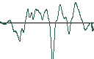
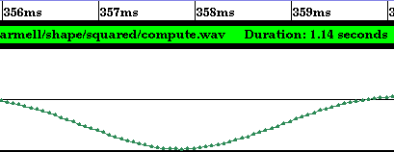
Sound
Problem: cannot express continuous data in a digital medium
Instead – sample
  Take a reading every so often
  Record the reading at that point

Slide 8
Sound
Sample rates
  Telephone: 8 kHz
  CD: 44 kHz
The data ends up being a long series of numbers
44,000 per second for a CD sound track
96,000 per second for DVD sound
  192,000 per second allowable

Slide 9
Sound
Sample accuracy
  CD: 16 bits
    Two channels for stereo
    96 dB range
  DVD-Audio: 24 bits
    Up to 5.1 (5 channels plus sub-woofer)
    144 dB range
  Typical human ear
    130+ dB range

Slide 10
Sound
Problem – Lots of numbers take lots of space
1 CD track contains 25MB
  About 10MB per minute
210,000,000 bits
Over a 56K modem – about an hour!
Solution: compress

Slide 11
Sound
Codec: compressor-decompressor
Algorithm used to:
  Compress sound files before they are sent to user
  Decompress them before they are played
Streaming
  Sound is transmitted to user continuously instead of in a single file
  Requires special server and user plug-in

Slide 12
Sound
Some streaming choices:
  RealAudio
  QuickTime
  Windows Media

Slide 13
Video
Frame rate
  TV: 30 frames per second (fps)
  Web: 12-15 fps
  Connection controls – cable/DSL vs. dial-up
Compression
  Frame of 320 x 240 pixels = 76,000 pixels
  1,228,000 bits at 16 bits per pixel
  At 15 fps, one minute = 1,105,920,000 bits!

Slide 14
Preparing Forms and Databases
One-way communication with users
  Collect feedback
  Survey
  Request services
Form elements …

Slide 15
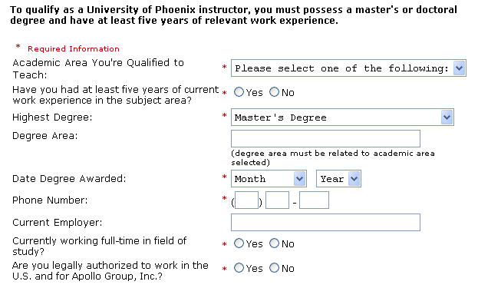
Radio Buttons
Option Menu
Field
Text Box

Slide 16
Preparing Forms and Databases
After form is filled:
  Submitted to server
  Program on server reads the data
  Performs action on data
    Gets commands from data
    Stores in a database at the server site
    Returns request based on data

Slide 17
Assignment
Combined WWG Ch. 4 and 5
See Assignments web page

Slide 18
Resources
Apple QuickTime:
  http://www.apple.com/quicktime/
RealNetworks:
http://www.realnetworks.com/
Windows Media:
  http://www.microsoft.com/windows/windowsmedia/default.aspx

