Slide 1
Web Dev Intro
Tony Kombol

Slide 2
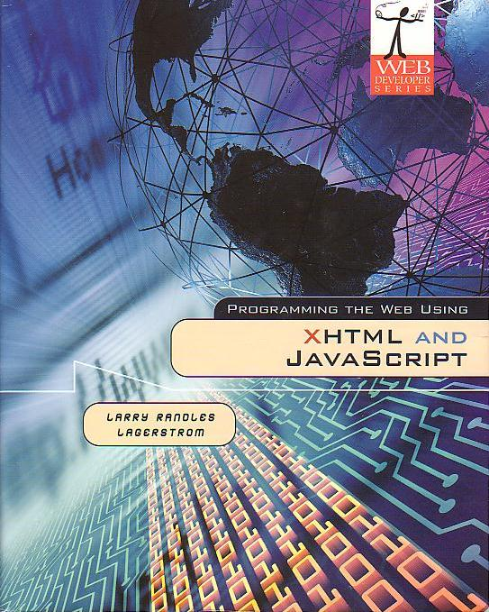

Books
Programming the Web Using XHTML and JavaScript
  Author: Larry Randles Lagerstrom
  Covers the mechanics of web design
Web Development – A Visual-Spatial Approach
  Author: Craig M. Baehr
  Covers the art of web design

Slide 3
Web Assignments
Three major criteria for a successful program:
  Must do the task (solve a problem)
  Must do it in a reasonable time
  Must be maintainable
    By yourself
    By others

Slide 4
Web Assignments
Source code
  Readable
  Maintainable

Slide 5
Web Assignments
No generated code!
  No FrontPage!
  No Dream Weaver!
  Etc…
Tools required
  Text Editor
    Notepad
      Comes with all Windows
    WordPad (be careful!)
    Notepad ++
      Recomended
      Free download
    Etc.
  Browser
    Internet Explorer (IE)
    FireFox (Mozilla or Netscape)
    Safari
    Etc.

Slide 6
Web Assignments
Must be Browser Agnostic!
Internet Explorer*
  Windows only
FireFox*
  Multi-platform
Mozilla
  Multi-platform
Opera
  Multi-platform
Safari*
  Apple Mac
Epiphany
  Linux GNOME
Konqueror
  Linux KDE
U.A.M…
* Browsers I will test with (mainly FireFox)

Slide 7
Materials Needed
Text Books:
  Programming the Web Using XHTML and JavaScript
  Web Development – A Visual-Spatial Approach
Access to a computer with Internet Access
  Browser
    Internet Explorer
    FireFox
  An editor
    Notepad will work fine
    Notepad++ is better!
  Thumb drive (USB)
    Highly recommended, but optional
    Useful for .Net assignments toward end of course

Slide 8
Material Covered

Slide 9
Material Covered
All chapters in “Programming the Web Using XHTML and JavaScript”
  Covers the “mechanics” of creating a web site
  May skip Chapter 13
All chapters in “Web Development”
  Covers the “aesthetics” of web design
Additional material on Server Side Processing
  ASP (Active Server Pages) via .NET
  CGI - if time
  JSP (Java Server Pages) – if time

Slide 10
Content Progression
Initial exercises and examples will use HTML only
  Static web pages
  Will progress to using XHTML
JavaScript
  Allows “Dynamic” web pages
  Data checking
Server Side processing
  Complex / Dynamic Web pages with “persistent” data

Slide 11
Web Application
What is needed to have a page displayed by a Web Browser?
  Browser, of course!
  What else?

Slide 12
Web Applications
HTML
  Relies on “tags” or elements
    Some characters between the symbols “<“ and “>”
    e.g. <b>, <table>, <style>
  Some tags are “stand alone”
    No additional information is required
    e.g. <br>, <hr>
  Some tags have extra data within the arrows
    Conveys addition information to “customize” the tag
    e.g. <font color=“red” size=“3”>
  Some tags start an action that need to be ended with a matching end tag. That ending tag has a “/” in it
    Starts doing some action and keeps doing it until the end tag is found
    e.g. <table> bunch of table stuff </table>

Slide 13
Web Applications
HTML browser “magic”
  May assume closing tags in many (but not all) cases
    Depends on browser!
  Very forgiving in syntax (at times)
    Can mask a problem
    Slightly changing code may show error
  Anything it doesn’t understand it either:
    Ignores
    - or -
    Displays it as raw data

Slide 14
Web Applications
XHTML warning
  Syntactically very similar to HTML
  But very strict in rules enforcement
    To avoid problems later with XHTML start using strict HTML coding techniques now

