Slide 1
AJAX

Slide 2
AJAX
Way to create interactive Web applications:
  Eg. Click map and drag it in the direction you want and the map view moves as you drag
“No waiting”
User is “in control”
Allows for creation of Web-based apps with the kind of user experience found on a traditional desktop application
“Client side” oriented

Slide 3
Applications
Google
  Gmail
  Google calendar
  Google Suggest
  Google maps
  Google mashups: googlemapsmania.blogspot.com
Yahoo!
  My Yahoo! Portal
  Yahoo! Front page
  Yahoo! Mail

Slide 4
AJAX
Used to stand for:
  Asynchronous Javascript And XML.
Now just the name
  XML part may be done by
    XML
    JSON
    Text
    …
Not a new programming language
  A new way to send and receive data between a web browser and a web server
Asynchronous means that the requests happen independent of other requests:
  Makes web applications smaller and faster

Slide 5
AJAX
Main parts of AJAX:
  (X)HTML (or servlets or PHP or…)
    Displays web page content
  CSS (Cascading style sheets)
    Makes the web page “pretty”
  The DOM (Document Object Model)
    Representation of objects within the document
    Accessed using JavaScript (where main functionality lies)
  XML (for data transfer):
    XML is just a method of transferring data
      Any type of transfer, including plaintext or JSON, can be used
  XMLHttpRequest to retrieve data from the server

Slide 6
AJAX
AJAX lets a web front end (html, JSP, servlets) make function calls to client side JavaScript
JavaScript, in turn, calls a server side application or script to return the desired results
Server side application can be php, perl, servlet, C⁺⁺ or any server program

Slide 7
AJAX
Synchronous vs. Asynchronous
  Traditional HTTP requests happen synchronously
    Pages are loaded one at a time
      A new request requires the browser to reload the returned webpage
  AJAX allows these requests to be asynchronous
    Allows new “requests” without having to reload entire web pages

Slide 8
AJAX
Client
Server
Client
Server
Initial Request
Initial Request
Browser
Blocked
Browser
Blocked
Page
Page
Render
Page
Render
Page
Interaction
Interaction
Browser
Blocked
update
partial
Render
Page
Page
Interaction
update
partial
Interaction
Interaction
Browser
Blocked
update
partial
Page
Render
Page
Non-AJAX Session
AJAX Session

Slide 9
XMLHttpRequest Object
JavaScript has an object
  The XMLHttpRequest object
This is the heart and soul of AJAX:
  This object is responsible for the actual sending and receiving of data between client and server
    Send method allows parameters to be sent to other web pages or scripts
  Contains methods to receive data
  Upon receiving data the JavaScript allows the data to be parsed and used

Slide 10
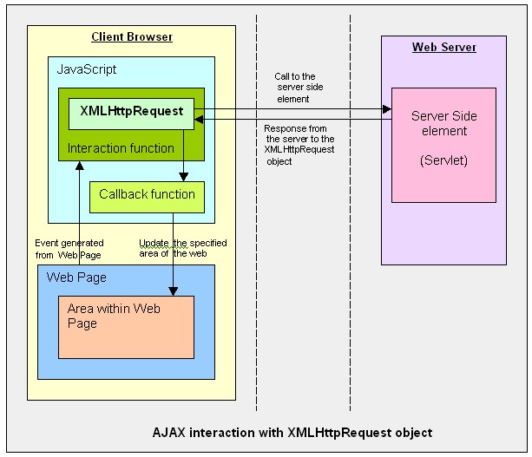
AJAX and XMLHttpRequest Object
Can handle multiple Requests at a time
(asynchronous)
http://www.javareference.com/jrexamples/printexample.jsp?id=111

Slide 11
XMLHttpReqeust Object
XMLHttpRequest methods:
  open()
    Sets up a request to a web server
  send()
    Sends a request to the server
  abort()
    Aborts the current server request

Slide 12
Creating XMLHttpRequest
Creating the XMLHttpRequest object depends on the browser type
  Since you never know what browser a user is using
    You have to check for each type
  Microsoft uses an ActiveXObject
  Other browsers may use the standard XMLHttpRequest object

Slide 13
Creating
First create a variable XMLHttp to use as your XMLHttpRequest object:
  Set the value to null
  Try to create the object the Microsoft way:
    Available in IE 6 and later:
    XMLHttp=new ActiveXObject("Msxml2.XMLHTTP")
  If this catches an error, try the older (Internet Explorer 5.5) way:
    XMLHttp=new ActiveXObject("Microsoft.XMLHTTP")
  If XMLHttp still has a null value, try to create the object the "standard" way:
    XMLHttp=new XMLHttpRequest()

Slide 14
XMLHttpRequest ReadyState
Readystate
  Allows the browser to stay informed of the current state of the request
Upon completion, the “onreadystatechange” property allows a function to be called to further process the returned data

Slide 15
XMLHttpReqest ReadyState
Open()
S0
S1
Send()
Create XMLHttpRequest Object
S2
Established Communication w/ server
S3
S4
Completed (HTTP 200)

Slide 16
XMLHttpRequest ReadyState
readyState=0
  after creating the XMLHttpRequest object
  before calling the open() method
readyState=1
  after calling the open() method
  before calling send()
readyState=2
  after calling send()
readyState=3
  after the browser has established a communication with the server
  before the server has completed the response
readyState=4
  after request has been completed
  after all response data has been completely received from the server
  the final state, similar to a HTTP 200

Slide 17
Callback Function
When readystate = 4
  onreadystatechange property allows the XMLHttpRequest object to call a function
  This function is called the “callback function”
JavaScript can then obtain the returned data
  Performs any type of processing that needs to be done on the data
Contain a check such as
  if(XMLHttpRequest.readyState == 4)
  Checks the state for processing

Slide 18
Processing Data
Data can be returned in the form of:
  Plaintext
  XML
  JSON
  or any acceptable format
XMLHttpRequest has functions to handle various types:
  XMLHttpRequest.responseText
    Returns the text in a “string” fashion
  XMLHttpRequest.responseXML
    Returns the XML data in parsable format
  XmlHttpRequest.responseJSON
    JSON parsable format

Slide 19
Parsing XML
When the XML is returned to the JavaScript
  JavaScript does the parsing of the XML
JavaScript has access to the DOM
  (Document Object Model)
With the DOM, you have access to elements
  Can call them by tag name
  Can get their value

Slide 20
Parsing XML
Example
  Say we have the following XML:
  <customer>
  <storeID>1234</storeID>
  </customer>
If we wanted to get the value of the <storeID> element we simply call it by its name
  getElementsByTagName(”storeID")[0].childNodes[0].nodeValue
  This will return the value of <storeID>: 1234
  childNodes[0] is the first childNode, in this example the only node, and that happens to be the value.
  Therefore we can obtain the value “nodeValue.”

Slide 21
Pointers
Whitespace as XML Node
  XML Specification states that it is whitespace preserving
  Reading Node[0] will return the whitespace instead of the first node
  <Node1> <Node2>Text</Node2></Node1>
Workarounds:
  Remove whitespace
  Programatically scan children when looking for specific nodes

Slide 22
Pointers
Location of JavaScript File
  Should be placed in public_html or a web-accessible subfolder
  Do not place in WEB-INF or a subfolder of WEB-INF

Slide 23
Pointers
Browser caching and browser issues
  More difficult to debug
  Browser caching may prevent some pages from reloading correctly
    Refresh page or disable caching of the page
  Browser versions and script interpreter versions may cause problems
    Having multiple browsers and adjusting settings can alleviate problems.

