Slide 1
Introduction to Secure Programming
Bill Chu
Nov. 2013

Slide 2
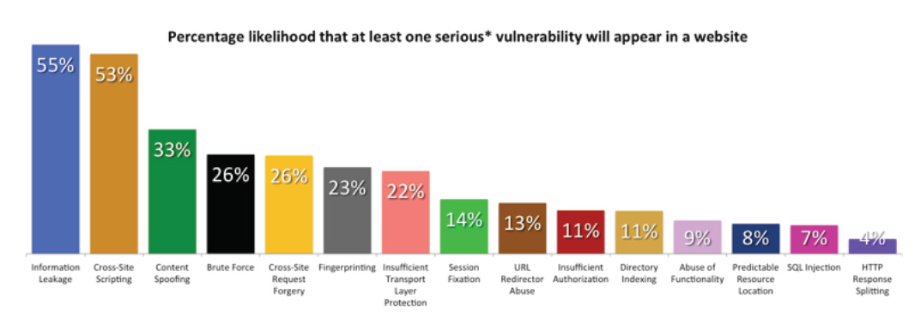
Source: White Hat Security based on 2012 data

Slide 3
SQL injection: normal case
UPDATE customers SET addr=“${newaddr}” WHERE “cid=1234@gmail.com”
Newaddr: 1234 myhouse ct
UPDATE customers SET addr=“1234 myhouse ct” WHERE “cid=1234@gmail.com”

Slide 4
SQL injection: attack case
UPDATE customers SET addr=“${newaddr}” WHERE “cid=1234@gmail.com”
Newaddr: 1234 hackerway” WHERE “cid=1234admin@gmail.com” --
UPDATE customers SET addr=“1234 hackerway” WHERE “cid=1234admin@gmail.com” --” WHERE “cid=1234@gmail.com”

Slide 5
Bit Tunnel Example
if (null != session.getAttribute(“user”)) {
f = this.getClassLoader().openResourceAsStream(request.getParameter(“filename”));
/* Send the bits */
}

Slide 6
Bit Tunnel Example
What if the user sends “/WEB-INF/web.xml”?
What if the user sends “/WEB-INF/src”?

Slide 7
What is Cross Site Scripting (XSS)?
  Injection of unexpected JavaScripts into HTML documents
  Demos
What Damage can XSS do?
How to prevent XSS?
High profile XSS cases
  www.xssed.com

Slide 8
Reconnaissance
<img src=”http://site1/photo.jpg”>
<img src=”http://site1/photo.jpg” onload=”ok()” onerror=”err()”>
<img src=”http://site1/loggedin.jpg” onload=”loggedin()” onerror=”notloggedin()”>

Slide 9
Penetrating firewalls
A browser behind firewall visits a trusted web site outside of the firewall with a XSS vulnerability
<iframe src=”http://192.168.1.1” onload=”detection()”>. </iframe>
This can sweep your internal network looking for printers, IP phones, routers, firewalls etc.
Can also force system configurations if an admin is the target and happens to be logged into an aministrative web page (CSRF)

Slide 10
Types of security vulnerabilities
Causes of vulnerabilities
Design/implementation
  Algorithm: e.g. flawed encryption algorithm or key exchange protocol
  Design: e.g. no per page token included to prevent cross site request forgery, flawed network design that led to a bypass vulnerability
  Implementation: failed to properly sanitize untrusted data, misconfiguration of firewalls
Operation
  People not following proper procedures
Sources of vulnerabilities
Software (design + implementation)
End users
System misconfigurations
Complexity

Slide 11
CVE: Common Vulnerabilities and Exposures
http://cve.mitre.org/
A list of known software vulnerabilities and ways to mitigate them

Slide 12
Secure software ?= good software
Yes, but……
There are many characteristics for good software, security being one of them (e.g. readability, robustness, efficiency)
Good is always in contrast to bad. Unless you know what the problems are, it is difficult to exhaustively list all characteristics of good software
Secure software is generally high quality software
  Time and efforts to thing through things lead to higher quality
Defensive programming example in the book

Slide 13
Security features != secure features
Security software != secure software
Security features can be implemented poorly, like a poor quality lock
Many security disasters are caused by software that have nothing to do with security (see table 1.1)

Slide 14
Quality Fallacy
Quality control (testing) is to verify the software does what it is required to do
“Unintended” features are usually the cause of software security problems
Most text books do not pay enough attention to secure programming (e.g. example on p. 10)
Requirements
Implementation
Security
Problems
Bugs

Slide 15
Overview
Input validation is the #1 cause of application vulnerabilities
Input validation approaches
    White list
      Pick list
      Regular express
      Logic test ( can the user access to item 37?)
    Blacklist
      Bad idea, avoid it if you can
Cost of performing input validation
  Cost vs. benefit
Cost of not performing input validation
  Cost of reputation

Slide 16
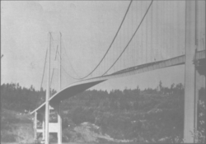

Tocoma Narrows Bridge
(11/7/1940)

Slide 17
What to validate
Validate all input
  Data entered by user
  “Trusted sources”
  Accessed only by “trusted users”
  Think about defense in depth
Validate input from all sources
  Command-line parameters
  Configuration files
  Data base queries
  Environment variables
  Network services,
  Registry values
  System properties
  Temporary files
  Other sources outside of your program
Syntax check vs. semantic checks

Slide 18
A1: Injection Attacks
Use Parameterized SQL
  Embedded SQL
  Hibernate
  .Net
Validate Input
  Use of frameworks
Implement CSP if you can

Slide 19
Query parameterization
String newName=request.getParameter(“newName”);
String id=request.getParameter(“id”);
PrepareStatement pstmt=con.prepareStatement(“UPDATE EMPLOYEE SET NAME=? WHERE ID=?”):
pstmt.setString(1,newName);
pstmt.setString(2,id);

Slide 20
A2: Broken Authentication and Session Management

Slide 21
Session management
Use session object, not cookies, to store session information
Send session id using encryption (e.g. https)
Invalidate session object upon logout
Destroy state information maintained by the application
Set cookie with session id as “http only”
Use good session id randomly
  Don’t use time sequence information

Slide 22
A3: Cross-Site Scripting

Slide 23
Review of XSS attack
Attackers using XSS more frequently
  Session hijacking
  site defacement
  network scanning
  undermining csrf defense
  Site redirection/phishing
  load of remotely hosted scripts
  data theft
  keystroke logging

Slide 24
Examples of XSS defense
Problem: Web page build in Java JSP is vulnerable to XSS
The solution
1) <input type=”text” name=”data” value=”<%= Encode.forHtmlAttribute(dataValue) %>” />
2) <textarea name=”text”><%= Encode.forHtmlContemnt(textValue) %>” />
3) <button
onclick=”alert(‘<%= Encode.forJavaScriptAttribute(alertMsg) %>’);”>
click me
</button>
4) <script type=”text/javascript”>
var msg=”<%= Encode.forJavaScriptBlock(message) %>”;
alert(msg);
</script>

Slide 25
XSS defense by data type and context
Untrusted Data | Context | defense
String | HTML body | HTML entity encoding
String | HTML attribute | Attribute encoding
String | GET parameter | URL encoding
String | Untrusted URL | URL validation, avoid javascript: URLs, Attribute encoding, safe URL verification
String | CSS | Strict structural validation, CSS Hex encoding, good design
HTML | HTML body | HTML Validation (JSoup, AntiSamy, HTML Sanitizer)
Any | DOM | DOM XSS Cheat Sheet
Untrusted Javascript | Any | sandboxing
JSON | Client Parse time | JASON.parse() or json2.js

Slide 26
OWASP Java Encoder Project
No third party libraries or configuration necessary
this code was designed for high-availability/high-performance encoding functionality
Simple drop-in encoding functionality
Redesigned for performance
More complete API (uri and uri component encoding, etc) in some regards
Java 1.5+
Last updated Feburary 14, 2013 (version 1.1)

Slide 27
OWASP Java encoder https://www.owasp.org/index.php/OWASP_Java_Encoder_Project
HTML Contexts
Encode#forHtmlContent(String)
Encode#forHtmlAttribute(String)
Encode#forHtmlUnquotedAttribute(String)
XML Contexts
Encode#forXml(String)
Encode#forXmlContent(String)
Encode#forXmlAttribute(String)
Encode#forXmlComment(String)
Encode#forXmlComment(String)
Encode#forCDATA(String)
CSS Context
Encode#forCssString(String)
Encode#forCssUrl(String)
JavaScript Contexts
Encode#forJavaScript(String)
Encode#forJavaScriptAttribute(String)
Encode#forJavaScriptBlock(String)
Encode#forJavaScriptSource(String)
URI/URL contexts
Encode#forUri(String)
Encode#forUriComponent(String)

Slide 28
OWASP Java Encoder
<script src=”/my-server-side-generated-script”>
class MyServerSideGeneratedScript extends HttpServlet {
void doGet(blah) {
response.setContentType(“text/javascript; charset=UTF-8”);
PrintWriter w = response.getWriter(); w.println(“function(){“);
w.println(“ alert(‘“ + Encode.forJavaScriptSource(theTextToAlert) + “‘);”);
w.println(“}”);
}
}

Slide 29
Other libraries
ESAPI
.NET AntiXSS Library

Slide 30
OWASP HTML Sanitizer Project
HTML Sanitizer wirtten in Java which lets you include HTML authored by third-parties in your web applications while protecting against XSS.
This code was written with security best practices in mind, has an extnesive test suite, and has undergone adverarial security review
https://code.google.com/p/owasp-java-html-sanitizer/wiki/AttackReviewGroundRules
Very easy to use
It allows for simple programmatic POSITIVE Policy configuration. No XML config.
Actively maintained by Mike Samuel from Google’s AppSec Team
This code is from the Caja project that was donated by Google. it is rather high performance and low memory utilization

Slide 31
The Problem: Web page is vulnerable to XSS because of untrusted HTML
The solution:
PolicyFactory policy=new HtmlPolicyBuilder()
.allowElements(“a”)
.allowURLProtocols(“https”)
.allowAttributs(“href”).onElements(“a”)
.reireRelNofollowOnlinks()
.build();
String safeHTML=policy.sanitize(untrustedHTML);

Slide 32
other html sanitizers
Pure JavaScript
http://coe.google.com/p/google-caja/wiki/JsHtmlSanitizer
Pyton
https://pyi.python.org/pypi/bleach
PHP
http://htmlpurifier.org
http://www.bioinformatics.org/phplabware/internal_utlities/htmlLawed
.NET
AntiXSS.getSafeHTML/getSafeHTMLFragment
http://htmlagilitypack.codeplex.com
Ruby on Rails
http://api/rubyonrails.org/classes/HTML.html

Slide 33
A4: Insecure Direct Object Reference
Lack of access control
Misconfiguration of environments

Slide 34
Privilege Escalation
Classic term used for switching execution rings in a ringed security model
In webapps, means performing another user’s actions without logging in as them
Vertical or Horizontal

Slide 35
Least Privilege
Every program and every user of the system should operate using the least set of privileges necessary to complete the job
Least privilege is important because it can help reduce damage caused if a system is compromised.
A compromised application running with full privileges can perform more damage than a compromised application executing with reduced privileges.

Slide 36
Build, test, and deploy in least priviledge environments
Developers sometimes build and test applications using full privilege accounts, such as root or members of the administrators group
This can lead to problems during deployment, which are usually conducted in low-privilege environments
It is strongly recommended that all developers and testers build and test applications using least privilege accounts

Slide 37
A5: Security Misconfigurations
Web server configurations
Database server configurations
Framework configurations

Slide 38
System specific concepts
Run application in a sand box and explicitly grant it minimum privilege necessary
  Android: AndroidManifest.xml
  Windows Phone7: WMAppManifest.xml
  iOS: entitlements
  .NET: app.manifest file
  JAVA: java.policy
  Windows: account’s Security Identifier [SID] is granted group membership and privileges
  Linix: applications and daemons run under an account that has implicit privileges
  Some Linux distributions (e.g.; Fedora and RedHat) use SELinux, which provides extensive technologies including SIDs and labels.
  Some Linux distributions (e.g.; Ubuntu and Suse) use AppArmor, which supports some POSIX 1003.1e draft capabilities and supports application profiles
  Grsecurity is a set of patches for Linux that provide, amongst other security tools, role-based access control (RBAC) mechanisms

Slide 39
Tamper proof configuration
A least privilege environment must include tamper proof configuration, otherwise applications or users might be able to grant more trusted capabilities

Slide 40
A6: Sensitive Data Exposure
Use proper encryption algorithms and procedures
Protect passwords

Slide 41
System Password storage
Hard coding password
  Insecure if source code is leaked
  Can even be guessed from binary code
  Discourages changes
Configuration files
  Too much trust being put on folks that do system maintenance
“Most secure”
  Have authorized administrator provide password on start up
  But it makes auto restart impossible
Compromised strategy
  Store encrypted password (using a strong encryption method) in configuration file
  Store encryption key in a separate file that cannot be accessed by system maintenance people

Slide 42
Customer Password Defense
Disable browser autocomplete
  <form AUTOCOMPLETE =”off”>
  <input AUTOCOMPLETE =”off”>
Only send passwords over HTTPS POST
Do not display passwords in browser
  input type = password
Do not store password in plain text
Assume hashed password will be stolen, make it difficult to brute force attack on password hash so that you can react before bad guys succeed
  Use a salt (de-duplication)
  SCRYPT/PBKDF2 (slow, performance hit, easy)
  HMAC (requires good key storage, tough)

Slide 43
Forgot password secure design
Require identify questions
  Last name, account number, email , DOB
  Enforce lockout policy
Ask one or more good security questions
  https://www.owasp.org/index.php/Choosing_and_Using_Security_Questions_Cheat_Sheet
Send the user a randomly generated token via out-of-band email, SMS, or token
Verify code in same web session
Enforce lockout policy
Change password, enforce password policy

Slide 44
Use good crypto methods
Strong random numbers
Use vetted crypto algorithms, don’t roll your own
Use vetted crypto protocols, don’t roll your own
SSL implementation
  Checking certificate principle
  Checking revocation list

Slide 45
Fixing the TLS and the CA system
HSTS (Strict Transport Security)
  Do not downgrade connection to http after login, use https throughout
Certificate pinning
  https://www.owasp.org/index.php/Pinning_Cheat_Sheet
Browser Certificate Pruning
  Etsy/Zane Lackey
Certificate Creation Transparency
  http://certificate-transparency.org

Slide 46
Certificate Pinning
What is Certificate Pinning?
  Pinning is a key continuity scheme
  Detect when an imposter with a fake but CA validated certificate attempts to act like the real server
  2 types of pinning
Carry around a copy of the server’s public key
  Great if you are distributing a dedicated client-server application since you know the server’s certificate or public key in advance
Note of the server’s public key on first use
  Trust-on-First-Use, Tofu
  Useful when no a priori knowledge exists, such as SSH or a Browser

Slide 47
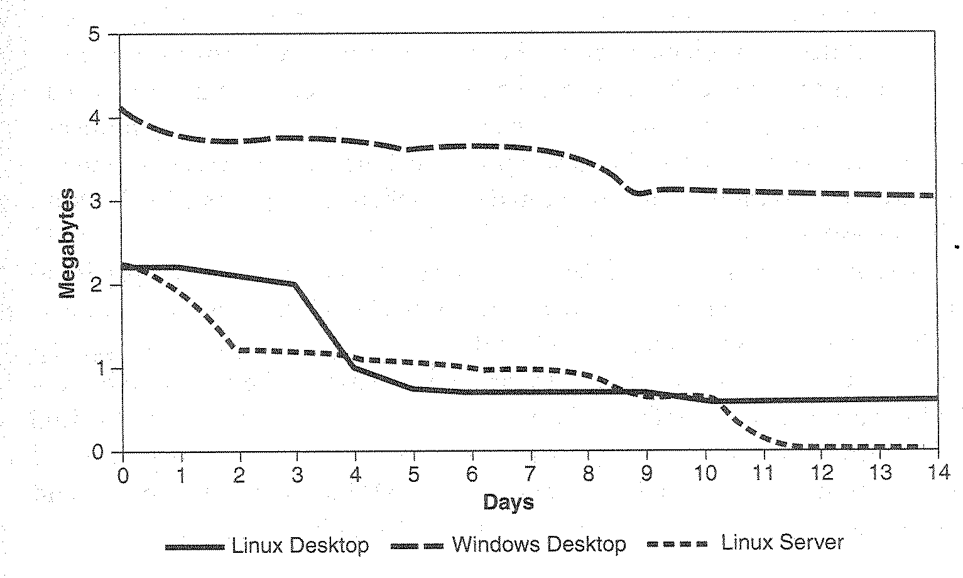
“Memory retention”

Slide 48
Secrets in memory
Minimize time spent holding secrets (password, encryption key)
Share secrets sparingly

Slide 49
Erase secrete securely
void GetData (char *MFAddr) {
char pwd[64];
if (GetPassword(pwd, sizeof(pwd)))){
if ((ConnectToMainframe(MFAddr, pwd)){
// connection to mainframe
}
memset (pwd, 0, sizeof(pwd));
}
void GetData (char *MFAddr) {
char pwd[64];
if (GetPassword(pwd, sizeof(pwd)))){
if ((ConnectToMainframe(MFAddr, pwd)){
// connection to mainframe
}
memset (pwd, 0, sizeof(pwd));
*(volatile char*) pwd=*(volatile ch*) pwd;
}

Slide 50
Prevent unnecessary duplication
if (get_secret(cleartex) {
if (cleartext=realloc(cleartext, BUFSIZE) {
process(cleartext);
scrub_memory(cleartext, BUFSIZE);
}
}
realloc() can internally copy the contents of old memory block into a new and larger block
The original secret data may still be in memory, but inaccessible by program

Slide 51
Logging and Debugging
Using a centralized logging framework, e.g. log4j
Avoid ad hoc logging through System.out and System.err
Include time stamps
Sanitize information to be logged (prevent log poisoning)
Log every important action
  Administration commands
  Network communication
  Authentication attempts
  Modification of ownership of objects
  Log account creation
  Password reset requests
  Purchases
  sales,
  Paid download
  Other application event in which something of value changed hands
Include sufficient details but no sensitive information
Failures are often as important as successes
Keep debugging aids and back-door access code out of production
Cline out back up files
Do not tolerate easter eggs

Slide 52
A7: Missing functional level access control

Slide 53
Preventing broken authentication
 | Option rendered (menu item) | Form of manipulation rendered (bill pay form) | Action performed (committing fund transfer)
Subject (billchu@bank.com) | Before displaying billchu, make sure billchu is the subject logged in | Before displaying the bill pay form for billchu, make sure billchu is the subject logged in | Before committing fund transfer, make sure that billchu is the subject logged in
Object (account 123) | Before displaying account 123, make sure it belongs to billchu | Before displaying the bill pay form for account 123, make sure that it belogns to billchu | Before committing fund transfer, make sure that account 123 belongs to billchu
Action (bill pay) | Before displaying the bill pay button, make sure that billchu is authorized to perform bill pay on account 123 | Whenever bill pay form is displayed for account 123, make sure the account is for the subject logged in | Before committing fund transfer, make sure that billchu is authorized to perform bill pay function for acount 123

Slide 54
Access control anti-patterns
Hard-coded role checks in application code
Lack of centralized access control logic
Untrusted data driving access control decisions
Access control that is “open by default”
Lack of addressing horizontal access control in a standardized way (if at all)
Access control logic that needs to be manually added to every endpoint in code
Access control that is sticky per session
Access control that requires per-user policy

Slide 55
Access control best practices
Build a centralized AuthZ (authentication+ authorization) mechanism
Code to the ACTIVITY, not the role
Design AuthZ as a filter
Deny by default, fail securely
Server-side trusted data should drive AuthZ
Be able to change entitlements in real time
Design standardized data contextual AuthZ
Build grouping for users and permissions

Slide 56
Don’t hard code roles
if (user.isRole(“JEDI”) ||
user.isRole(“PADWAN”) ||
user.isRole(“SITH_LORD”)||
user.isRole(“JEDI_KILLING_CYBORG”)
){
log.info(“You may use a lightsaber ring”);
} else {
log.info(“Lightsaber rings are for schartz masters.”);
}

Slide 57
Use capabilities (Apache Shiro)
if ( currentUser.isPermitted(“lightsaber:wield”)){
log.info(“You may use a lightsaber ring”);
} else {
log.info(“Lightsaber rings are for schartz masters.”);
}

Slide 58
The problem: web application needs to secure access to a specific object
The solution:
int innebagoId = request.getInt(“winnebago_id”);
if (currentUser.isPermitted(“winnebago:drive:” + winnebagoId)) {
log.info(“You are permitted to ‘drive’ the ‘innebago’. Here are the keys.”);
} else {
log.info(“Sorry, you aren’t allowed to drive this winnebago!”);
}

Slide 59
A8: Cross Site Request Forgery

Slide 60
Using Per page token or Frameworks
JSF
HDIV
By configuration

Slide 61
A9: Using Components with Known vulnerabilities
Be informed about the implementation
  Implementations differ
  Docs are not always good
  Understand defaults and hidden assumptions
  Unit Test your implementation
  Corporate standards
  Monitor bugs
  Be aware that frameworks may force you to upgrade instead of patching up

Slide 62
A10: Unvalidated redirects and forwards
Avoid redirects and forwards if possible
Input validation

