Slide 1

XML, Web Services

Slide 2
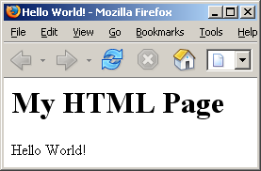
HTML
<!DOCTYPE html PUBLIC "-//W3C//DTD XHTML 1.0 Transitional//EN“>
<html>
<head>
<title>Hello World!</title>
</head>
<body>
<h1>My HTML Page</h1>
<p>Hello World!</p>
</body>
</html>

Slide 3
HTML Elements
Structural markup – Describes the purpose of text:
  <h2>Golf</h2> directs the browser to render "Golf" as a second-level heading
  Does not denote any specific rendering, but most web browsers have standardized on how elements should be formatted (e.g., large bold text).
Presentational markup – Describes the appearance of the text, regardless of function:
  <b>boldface</b> will render "boldface" in bold text.
  Typically, using presentational markup is inappropriate, CSS should be used.
  Better to use logical/semantic equivalents instead of physical, e.g., <em> instead of <i>.
Hypertext markup – Links parts of the document to other documents:
  <a href="http://www.uncc.edu/">UNCC</a>
  Renders the word UNCC as a hyperlink to the specified URL.

Slide 4
XHTML vs. HTML
XHTML elements must be properly nested
XHTML documents must be well-formed
Tag names must be in lowercase
All XHTML elements (including empty) must be closed
No: <b><i>This text is bold and italic</b></i>
Yes: <b><i>This text is bold and italic</i></b>
No: <ul><li>item 1 <li>item 2 </ul>
Yes: <ul><li>item 1</li><li>item 2</li></ul>
All XHTML elements must be nested within the <html> root.
All other elements can have sub (children) elements.
Sub-elements must be in pairs and correctly nested within parent.
Like Java, XML is case-sensitive, so <p> and <P> are different tags.
No: <BODY><P>This is a paragraph</P></BODY>
Yes: <body><p>This is a paragraph</p></body>
No: <p>one paragraph <p>another paragraph
Yes: <p>one paragraph</p><p>another paragraph</p>
No: break:<br> h-rule:<hr> image <img src="happy.gif">
Yes: break:<br /> h-rule:<hr /> image <img src="happy.gif“ />

Slide 5
XHTML vs. HTML
Attribute names must be in lower case
Attribute values must be quoted
Attribute minimization is forbidden
The id attribute replaces the name attribute
The XHTML DTD defines mandatory elements
No: <table WIDTH="100%">
Yes: <table width="100%">
No: <table width=100%>
Yes: <table width="100%">
No: <input checked>
Yes: <input checked="checked" />
No: <img src="picture.gif" name="picture1" />
Yes: <img src="picture.gif" id="picture1" />
XHTML documents must have a DOCTYPE declaration
html, head and body elements must be present
title must be present inside the head element
<!DOCTYPE Doctype goes here>
<html xmlns="http://www.w3.org/1999/xhtml">
<head><title>Title goes here</title></head>
<body>Body text goes here</body>
</html>

Slide 6
XHTML Main Points
Documents must conform to a precise structure
Structure is defined by a known and accepted set of rules
Following this kind of protocol enables more powerful applications by providing guarantees about structure and content:
  More standard tools can be used

Slide 7
Tag Structure
<html>
<head>
<title>Hello World!</title>
</head>
<body>
<h1>My HTML Page</h1>
<p>Hello World!</p>
</body>
</html>
html
head
body
title
h1
p
cdata
“Hello World!”
cdata
“My HTML Page”
cdata
“Hello World!”

Slide 8
Document Object Model (DOM)
W3C DOM is a platform and language neutral interface
  Allows programs and scripts to dynamically access and update the content, structure, and style of a document
Provides a standard set of objects for representing HTML and XML documents
  Standard interface for accessing and manipulating them
DOM is separated into different parts (Core, XML, and HTML) and different levels (DOM Level 1/2/3):
  Core DOM - defines a standard set of objects for any structured document
  XML DOM - defines a standard set of objects for XML documents
  HTML DOM - defines a standard set of objects for HTML documents

Slide 9
JavaScript
Client-side (browser) scripting language
Java/C like syntax
When embedded in browser, has access to:
  Browser objects / control
    e.g., mouse events, alert boxes
  Document object model
    Page “data” elements

Slide 10
DHTML
Dynamic HTML
Combination of:
  (X)HTML
  Client side scripting language
    (e.g., JavaScript)
  Presentation definition language
    (e.g., cascading style sheets)
  Document object model

Slide 11
RSS
Family of Webfeeds:
  Really Simple Syndication (RSS 2.0).
  Webmasters put content in standardized format.
  Programs known as feed readers or aggregators can check a list of feeds on behalf of a user and display any updated articles that they find.
<?xml version="1.0" encoding="ISO-8859-1"?>
<rss version="2.0">
<channel>
<title>CNN.com</title>
<link>http://www.cnn.com/rssclick/?section=cnn_topstories</link>
<description>
CNN.com delivers up-to-the-minute news and information on the latest top stories, weather,
entertainment, politics and more.
</description>
<language>en-us</language>
<copyright>© 2005 Cable News Network LP, LLLP.</copyright>
<pubDate>Wed, 16 Nov 2005 14:24:28 EST</pubDate>
<ttl>5</ttl>
<item>
<title>Dangerous storms take aim at Northeast</title>
<link>http://www.cnn.com/rssclick/2005/WEATHER/11/16/severe.weather/index.html?section=cnn_topstories</link>
<description>
Much of the northeastern United States is in the path of powerful thunderstorms after they spawned dozens
of tornadoes in five states. At least two storm-related deaths are reported. Dangerous storms threatened
high winds and heavy rain in Pennsylvania, New York and Maryland.
</description>
<pubDate>Wed, 16 Nov 2005 12:50:56 EST</pubDate>
</item>
<item>
<title>Human bird flu cases confirmed in China</title>
<link>
http://www.cnn.com/rssclick/2005/HEALTH/conditions/11/16/bird.flu.china/index.html?section=cnn_topstories
</link>
</item>
…

Slide 12
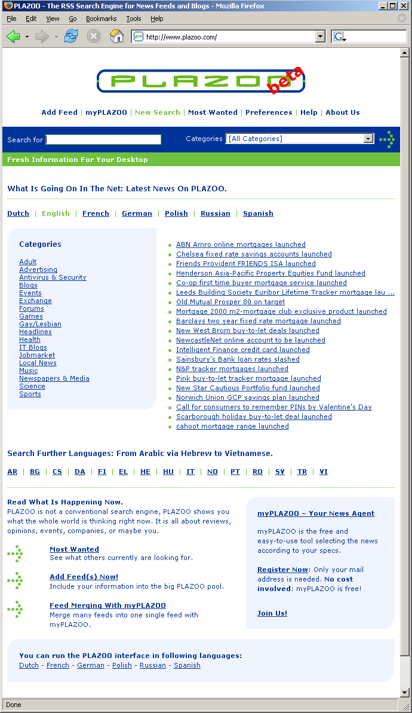
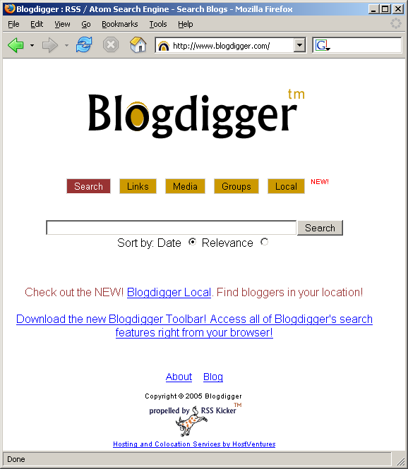
RSS Web Applications

Slide 13
XML vs. XHTML
XML provides a standard general framework for “marking up” or structuring different kinds of information
Markup for building new data structures:
  Rather than specifically for presentation
    As in HTML
XML allows the semantics of data to be defined
  Provided there is agreement
Think of XML as a protocol like TCP/IP upon which particular applications can be built
XML + HTML DTD = XHTML.
Document made up of tags, document object model and programmatic control apply to XML

Slide 14
Web Services

Slide 15
What is a Web Service?
A Web Service is simply a service available via the Web
Service can be implemented as
  Java application
  C++ application
  PHP
  etc.
Usually, web service implies a service that can be accessed programmatically

Slide 16
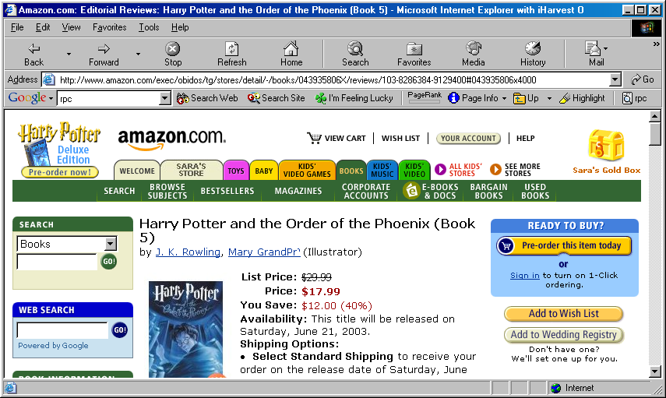
Difficulties in Using a Web Site As a Web Service
http://www.amazon.com/exec/obidos/tg/stores/detail/
-/books/043935806X/reviews/
103-8286384-9129400#043935806x4000
How do we find the price? Use Parsing ☹
How do we find this URL?
17.99

Slide 17
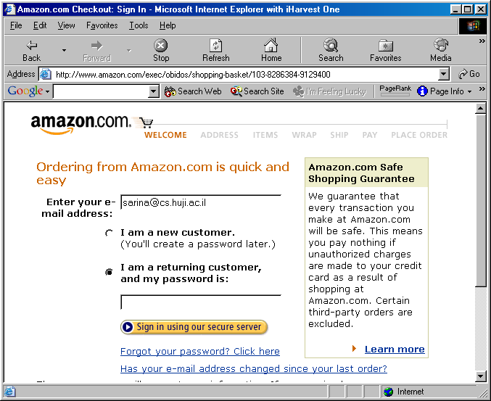
More Difficulties
(Filling out a Form)
Forms span multiple pages
How do we find this URL?

Slide 18
Web service
Rather than pulling data off web sites with the implicit understanding of the data format, which is subject to change
  Web services can obtain data in XML and application standards

Slide 19
What Would We Like to Do?
Call functions such as:
  Amazon.getPrice("Harry Potter").
  Amazon.buyBook("Harry Potter", myId).
The language that our program uses shouldn't depend on the language that Amazon uses
Use a standard underlying protocol
  HTTP, FTP, SNMP, etc.

Slide 20
SOAP
Simple Object Access Protocol

Slide 21
A Solution: SOAP
SOAP
  "Simple Object Access Protocol”.
Used for "Remote Procedure Calls", similar to:
  IIOP (for Corba), ORPC (for DCOM), RMI (for Java).
Difference:
  SOAP is text-based
    Actually XML
    Not binary
  Firewall Friendly
  Language independent
    Can call a program in any language
  Uses standard port, since it uses standard protocols
Notes:
IIOP Internet Inter-orb Protocol ORPC Object oriented RPC

Slide 22
SOAP
Light-weight protocol for message exchange:
  Decentralized, distributed environment
SOAP defines XML based format for sending messages:
  Envelope - what is in a message and how to process it.
  Data encoding - express instances of application defined data types.
  RPC convention - represent RPCs and responses.
Unlike XML-RPC, SOAP tries to be neutral to transportation protocol:
  HTTP
  SMTP
  Java Message Service
.Net also uses SOAP as the RPC mechanism.

Slide 23
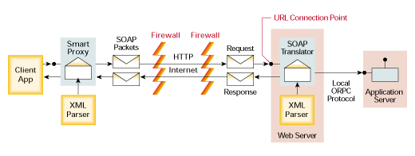
SOAP Intuition
Notes:
SOAP uses application layer protocol as a transport protocol (HTTP instead of TCP/UDP) hence frowned upon. Messaging pattern used is RPC.

Slide 24
A generalized SOAP architecture
HTTP
SMTP
SOAP
Envelope
SOAP
Server
Server
Application
FTP
JMS
Others
Notes:
JMS Java Messaging Service

Slide 25
SOAP Message Structure
Delivery
(binding)
via HTTP
Envelope
Header
Body
Header
Body
<!DOCTYPE HTML PUBLIC "-//W3C//DTD HTML 4.01 Transitional//EN">
<html>
</html>
<head><title>My Home Page</title></head>
Somewhat like
HTML
<body>
<h1>Home Page!</h1>
</body>

Slide 26
Simplified SOAP Request
Consider the Java interface:
    public interface Hello {
    public String sayHelloTo(String name);
    }
Suppose that a client wants to call the server's sayHelloTo method
  It could send an XML message:
    <?xml version="1.0"?>
    <Hello>
    <sayHelloTo>
    <name>John</name>
    </sayHelloTo>
    </Hello>
Name of the Interface
Name of the Method
Name of the Parameter

Slide 27
Simplified SOAP Response
The Server could respond with:
    <?xml version="1.0"?>
    <Hello>
    <sayHelloToResponse>
    <message>
    Hello John, how are you?
    </message>
    </sayHelloToResponse>
    </Hello>
Name of the Interface
Name of the Method +
Response

Slide 28
Simplified SOAP
HTTP Request/Response
Client Request to Server
Server Response to Client
Request Line
POST /~anraja/index.html HTTP/1.1
Host: ws.uncc.edu
Content-Type: text/xml
SOAPAction: http://ws.uncc.edu/hi
Status Line
HTTP/1.1 200 OK
Date: Wed, 31 Aug 2005 19:21:54 GMT
Content-Length: 6227
Content-Type: text/xml
Headers
Headers
CRLF
CRLF
Optional
Data
Optional
Data
<?xml version="1.0"?>
<Hello>
<sayHelloToResponse>
<message>
Hello John, how are you?
</message>
</sayHelloToResponse>
</Hello>
<?xml version="1.0"?>
<Hello>
<sayHelloTo>
<name>John</name>
</sayHelloTo>
</Hello>

Slide 29
Stock Quote Soap Request
Command Line POST /soap HTTP/1.1
Content-Length 518
Host 64.124.140.30:9090
User-Agent Mindreef SOAPscope 4.1.9999 (http://www.mindreef.com)
SOAPAction "urn:xmethods-delayed-quotes#getQuote"
Content-Type text/xml; charset=UTF-8
<soap:Envelope
xmlns:mrns0="urn:xmethods-delayed-quotes"
xmlns:soap="http://schemas.xmlsoap.org/soap/envelope/"
xmlns:soapenc="http://schemas.xmlsoap.org/soap/encoding/"
xmlns:xs="http://www.w3.org/2001/XMLSchema"
xmlns:xsi="http://www.w3.org/2001/XMLSchema-instance">
<soap:Body soap:encodingStyle="http://schemas.xmlsoap.org/soap/encoding/">
<mrns0:getQuote>
<symbol xsi:type="xs:string">GOOG</symbol>
</mrns0:getQuote>
</soap:Body>
</soap:Envelope>

Slide 30
Stock Quote SOAP Response
Status Line HTTP/1.1 200 OK
Connection Keep-Alive
Content-Length 491
Date Tue, 19 Apr 2005 20:24:10 GMT
Content-Type text/xml
Server Electric/1.0
<soap:Envelope soap:encodingStyle="http://schemas.xmlsoap.org/soap/encoding/"
xmlns:soap="http://schemas.xmlsoap.org/soap/envelope/"
xmlns:xsi="http://www.w3.org/2001/XMLSchema-instance"
xmlns:xsd="http://www.w3.org/2001/XMLSchema"
xmlns:soapenc="http://schemas.xmlsoap.org/soap/encoding/">
<soap:Body>
<n:getQuoteResponse xmlns:n="urn:xmethods-delayed-quotes">
<Result xsi:type="xsd:float">191.4</Result>
</n:getQuoteResponse>
</soap:Body>
</soap:Envelope>

Slide 31
XML-RPC: forerunner to SOAP
XML formatted message
Using HTTP Post to transmit the message
Enable any web service with CGI interface to accept the message
Universal acceptance, even through firewalls!
Many implementations: www.xmlrpc.com

Slide 32
An example
XML-RPC Request
POST /RPC2 HTTP/1.0
User-Agent: Frontier/5.1.2 (WinNT)
Host: someserver.com
Content-Type: text/xml
Content-length: 181
<?xml version=“1.0”?>
<methodCall>
<methodName> lookup.getStateFromAreaCode </methodName>
<params>
<param>
<value> <int> 512 </int> </value>
</param>
</params>
</methodCall>

Slide 33
Example Response
HTTP/1.1 200 OK
Connection: close
Content-length: 158
Content-Type: text/html
Date: Fri, 17 Jan 2001 11:50:13 GMT
Server: UserLand Frontier/5.1.2-WinNT
<?xml version=“1.0”?>
<methodResponse>
<params>
<param>
<values> <string>Texas</string></value>
</param>
</params>
</methodResponse>

Slide 34
WSDL
Web Service Description Language

Slide 35
Web Service Description Language (WSDL)
Defines a web/network service:
  XML format.
  Set of end-points operating on messages containing either document-oriented or procedure-oriented information.
Key elements of a web service:
  Documentation – English description.
  Types – Data type (e.g. structure).
  Message – Message format.
  PortType – Abstract set of operations supported by one or more endpoints.
  Binding – Concrete protocol and data format spec for a port Type.
  Service – Specifies web addresses.
WSDL description may be automatically generated based on Java class definitions.

Slide 36
Universal Description, Discovery, and Integration (UDDI)
Web-based distributed directory:
  Enables businesses to list themselves on the internet and discover each other.
XML formatted information for:
  Business entity - “white pages”
  Business service - “yellow pages”
  Binding Template - “green page”:
    technical information on service entry point and binding spec
  tModels - specs for services or taxonomies

