Slide 1
ITIS 3105 Server Side Applications and Data Management
Tony Kombol
AJAX

Slide 2
AJAX

Slide 3
AJAX
Way to create interactive Web applications:
  Click map and drag it in the direction you want and the map view moves as you drag
  Update a single field of information
“No waiting”
User is “in control”
Allows for creation of Web-based apps with the kind of user experience found on a traditional desktop application

Slide 4
Applications Examples
Google
  Gmail
  Google calendar
  Google Suggest
  Google maps
  Google mashups: googlemapsmania.blogspot.com
Yahoo!
  My Yahoo! Portal
  Yahoo! Front page
  Yahoo! Mail

Slide 5
AJAX
Used to stand for:
  Asynchronous Javascript And XML.
Now it is just the name
  XML part may be done by
    XML
    JSON
    text
Not a new programming language
  A new way to send and receive data between a Web browser and a Web server
Asynchronous means that the requests happen independent of other requests:
  Makes web applications smaller and faster

Slide 6
AJAX (cont.)
Main parts:
  (X)HTML (or php, servlets…)
    Displayed web page
  CSS (Cascading style sheets)
    Makes the web page “pretty”
  The DOM (Document Object Model)
    Representation of objects within the document
    Accessed using JavaScript (where main functionality lies)
  XML or other data format (for data transfer):
    XML is just a method of transferring data
      Any type of transfer, including plaintext or JSON, can be used
  XMLHttpRequest is used to retrieve data from the server

Slide 7
AJAX (cont.)
AJAX lets a web front end (client) make a function call to client side JavaScript
  html, php, jsp, servlets…
JavaScript, in turn, calls a server side application or script to return the desired results
Server side application can be php, perl, servlet, etc…

Slide 8
AJAX (cont.)
Synchronous vs. Asynchronous
  Traditional HTTP requests happen synchronously
    Pages are loaded one at a time
      A new request requires the browser to reload the returned webpage
  AJAX allows these requests to be asynchronous
    Allows new “requests” without having to reload entire web pages

Slide 9
AJAX
Client
Server
Client
Server
Initial Request
Initial Request
Browser
Blocked
Browser
Blocked
Page
Page
Render
Page
Render
Page
Interaction
Interaction
Browser
Blocked
update
partial
Render
Page
Page
Interaction
update
partial
Interaction
Interaction
Browser
Blocked
update
partial
Page
Render
Page
Non-AJAX Session
AJAX Session

Slide 10
XMLHttpRequest Object
JavaScript has an object
  XMLHttpRequest
This is the heart and soul of AJAX:
  This object is responsible for the actual sending and receiving of data between client and server
    Send method allows parameters to be sent to other web application or scripts
  Has methods to receive data
  Upon receiving data the JavaScript can parse the data and use it

Slide 11
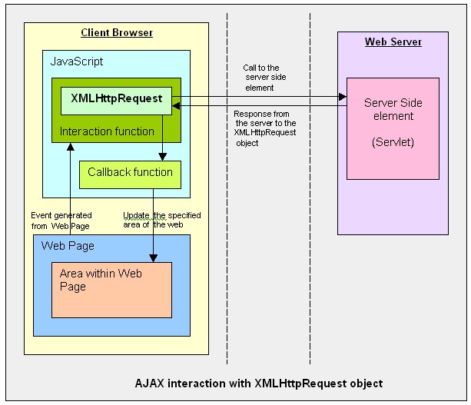
AJAX and XMLHttpRequest Object
Can handle multiple Requests at a time
(asynchronous)
http://www.javareference.com/jrexamples/printexample.jsp?id=111

Slide 12
XMLHttpReqeust Object (cont.)
XMLHttpRequest methods:
  The open() method.
    The open() method sets up a request to a web server
  The send() method.
    The send() method sends a request to the server
  The abort() method.
    The abort() method aborts the current server request

Slide 13
Creating XMLHttpRequest
Creating the XMLHttpRequest object depends on the browser type
  Since you never know what browser a user is using
    You have to check for each type
  Microsoft uses ActiveXObject
  Other browsers may use a standard XMLHttpRequest object

Slide 14
Creating (cont.)
First create a variable XMLHttp to use as your XMLHttpRequest object:
  Set the value to null
  Then try to create the object the Microsoft way:
    Available in IE 6 and later:
    XMLHttp=new ActiveXObject("Msxml2.XMLHTTP")
  If this catches an error, try the older (Internet Explorer 5.5) way:
    XMLHttp=new ActiveXObject("Microsoft.XMLHTTP")
  If XMLHttp still has a null value, try to create the object the "standard" way:
    XMLHttp=new XMLHttpRequest()

Slide 15
XMLHttpRequest ReadyState
The readystate of an XMLHttpRequest object allows the browser to stay informed of the current state of the request
Upon completion, the “onreadystatechange” property allows a function to be called to further process the returned data (more later)

Slide 16
XMLHttpReqest ReadyState
Open()
S0
S1
Send()
Create XMLHttpRequest Object
S2
Established Communication w/ server
S3
S4
Completed (HTTP 200)

Slide 17
XMLHttpRequest ReadyState
readyState=0
  after you have created the XMLHttpRequest object, but before you have called the open() method
readyState=1
  after you have called the open() method, but before you have called send()
readyState=2
  after you have called send()
readyState=3
  after the browser has established a communication with the server, but before the server has completed the response
readyState=4
  after the request has been completed, and the response data have been completely received from the server. This is the final state, similar to a HTTP 200

Slide 18
Callback Function
Once the readystate hits 4, the onreadystatechange property allows the XMLHttpRequest object to call a function
  This function is called the “callback function”
Allows the JavaScript to obtain the returned data
  Performs any type of processing that needs to be done on the data
Will contain some sort of check such as
  if(XMLHttpRequest.readyState == 4)
  Checks the state for processing

Slide 19
Processing Data
Data can be returned in the form of
  Plaintext
  XML
  JSON
  or …
XMLHttpRequest has functions to handle both types:
  XMLHttpRequest.responseText;
    Returns the text in a “string” fashion
  XMLHttpRequest.responseXML;
    Returns the XML data in parse-able format.

Slide 20
Parsing XML
When the XML is returned to JavaScript
  JavaScript does the parsing of the XML
JavaScript has access to the DOM
  (Document Object Model)
With the DOM, you have access to elements
  Can call them by tag name
  Can get their value

Slide 21
Parsing XML Cont.
Example
  Say we have the following XML:
  <customer>
  <storeID>1234</storeID>
  </customer>
If we wanted to get the value of the <storeID> element we simply call it by its name
  getElementsByTagName(”storeID")[0].childNodes[0].nodeValue
  This will return the value of <storeID>: 1234
  childNodes[0] is the first childNode, in this example the only node, and that happens to be the value.
  Therefore we can obtain the value “nodeValue.”

