Slide 1
Server-Side Application and Data Management
APIs

Slide 2
APIs

Slide 3
API
API: Application Programming Interfaces
Example:
  Google provides a direct link to its powerful search engine via its API
  API gives developers access to services provided by Google’s search engine in an easy and standardized way
There are several mechanisms to implement APIs, the two major mechanisms are:
  SOAP
    About 18%
  REST
    About 71%

Slide 4
API Basics
Most commercial APIs require a registration before they can be used.
  This enables the API provider to track and control the API usage.
  Google has a limit on the number of API calls you can perform per day.

Slide 5
SOAP
Simple Object Access Protocol (SOAP):
  An XML based messaging protocol that enables the communication with web services
SOAP message also called a SOAP Envelope
  Composed of two parts:
    Header:
    Body:
SOAP is a defined protocol
Note: SOAP is covered in ITIS4166

Slide 6
REST
REpresentational State Transfer (REST) :
  Stateless method for applications to present requests to the required service
  REST is an architectural style
Each request has three essential parts:
  the endpoint (usually a URL)
  the message indicating the requested action or method
  the parameters required to perform the action
Example:
  http://www.abc.com/api.php?action=search&devkey=123&type=book&keyword=style
  Note: this is a similar format to a GET request from a web browser

Slide 7
REST
http://www.abc.com/api.php?action=search&devkey=123&type=book&keyword=style
  Endpoint:
    http://www.abc.com/api.php
  Action or method:
    action=search
    describes the required action which is search
  Parameters:
    devkey, type, keyword
    parameters required to perform the required search
      Developer key (devkey) is usually required to identify the application requesting the service

Slide 8
Simple API Example
Audioscrobber
(Last.fm)

Slide 9
Example
Audioscrobber
  Audioscrobbler system
    Database that tracks listening habits and does wonderful things with statistics
  Unless you are a programmer, you probably want our main site Last.fm instead
  http://www.audioscrobbler.net/
APIs
  http://www.last.fm/api

Slide 10
Example: Artist Search
Documentation:
  http://www.last.fm/api/show?service=272
Artist search test URL:
  http://ws.audioscrobbler.com/2.0/?method=artist.search&artist=cher&api_key=0c8f8e8a38124a50dbd243b3873cb4fa
    Note: requires a key
Returns an XML file
  List of Artists and data

Slide 11
Sample Test Code
<?php
// http://ws.audioscrobbler.com/2.0/?method=artist.search&artist=cher&api_key=0c8f8e8a38124a50dbd243b3873cb4fa
$endpoint = "http://ws.audioscrobbler.com/2.0/";
$method = "method=artist.search";
$artist = "cher";
$artist_request = "artist=".$artist;
$key = "0c8f8e8a38124a50dbd243b3873cb4fa";
$query = "?" . $method . "&" . $artist_request . "&api_key=" . $key;
$url = $endpoint . $query;
echo $url . "<br>\n";
$xml = simplexml_load_file($url);
echo "got load<br>\n";
foreach ($xml->results as $result) {
echo "got results<br>\n";
foreach ($result->artistmatches as $amatch) {
echo "got match<br>\n";
foreach ($amatch->artist as $artist) {
$name = $artist->name;
$url = $artist-> url;
echo "$name is at $url <br>\n";
}
}
}
?>
fmArtistSearchTest.php

Slide 12
<html>
<head>
<title>Artist Search</title>
</head>
<body>
<h1>Artist Search</h1>
<form name="AS" action="fmArtistSearch.php" id="AS" method="post">
Artist's Name:
<input type="text" name="aname" id="aname">
<br>
<input type="submit" value="Look up artist">
</form>
</body>
</html>
fmArtistSearchForm.htm
<?php
$endpoint = "http://ws.audioscrobbler.com/2.0/";
$method = "method=artist.search";
$artist = $_POST["aname"];
$artist_request = "artist=" . $artist;
$key = "0c8f8e8a38124a50dbd243b3873cb4fa";
$query = "?”.$method."&”.$artist_request."&api_key=“.$key;
$url = $endpoint . $query;
echo "Search URL:" . $url . "<br>\n";
$xml = simplexml_load_file($url);
echo "<table border=1>\n";
foreach ($xml->results as $result) {
foreach ($result->artistmatches as $amatch) {
foreach ($amatch->artist as $artist) {
echo "<tr>\n";
$name = $artist->name;
$url = $artist-> url;
echo "<td>$name</td><td>$url</td>\n";
echo "</tr>\n";
}
}
}
echo "</table>";
?>
fmArtistSearch.php

Slide 13
Catalog of Web APIs

Slide 14
API Catalogs and Resources
programmableweb API Catalog
  http://www.programmableweb.com/apis/directory
Network World’s list of top 10 (2006)
  http://www.networkworld.com/news/2006/121806-web-20-apis.html
National Data Catalog API (quality unknown)
  http://sunlightlabs.com/blog/2010/national-data-catalog-api/

Slide 15
Bad API Example

Slide 16
Rhyming API
programmableweb API Catalog
  http://www.programmableweb.com/apis/directory
Search for rhyming
  Rhyming Dictionary
  No authentication!
  Service endpoint
    http://www.zachblume.com/apis/rhyme
  Method
    ?format=xml&word=<INSERT WORD HERE>
  Complete URL example
    http://www.zachblume.com/apis/rhyme?format=xml&word=test
  Results NOT a valid XML document
    What is it’s problem?

Slide 17
Yahoo API

Slide 18
Our First Yahoo App
Where to find information about the Yahoo API’s?
  http://developer.yahoo.com/
We would like to design an application that uses the Yahoo Search API.
  Documentation is available at:
    http://developer.yahoo.com/search/boss/

Slide 19
Our first Yahoo Application
Application should use Yahoo search to query for a specific keyword and use XML/REST to interact with Yahoo.
Step 1:
  Apply for an application key:
  https://developer.apps.yahoo.com/wsregapp/
Step 2:
  Find what are the details of the end point, action and parameters required to search Yahoo.

Slide 20
Our first Yahoo Application
Located information:
SYNTAX:
  http://boss.yahooapis.com/ysearch/web/v1/
  {query}?appid={yourBOSSappid}
  [&param1=val1&param2=val2&etc]
EXAMPLE:
  http://boss.yahooapis.com/ysearch/web/v1/animals?appid=12345&format=xml&start=1&count=3
More details are available at:
  http://developer.yahoo.com/search/boss/

Slide 21
Our first Yahoo Application
The Endpoint for web search:
  http://boss.yahooapis.com/ysearch/web/v1/
Important parameters:
  query: describes the search query term.
  appid: is the application id.
  format: data format of the response.
  count: total number of results to return.
  start: ordinal position of first result where first position is 0
EXAMPLE:
  http://boss.yahooapis.com/ysearch/web/v1/animals?appid=12345&format=xml&start=1&count=3
  Searches for “animals”
    starting from result 1
    number of results 3
    format of the response is xml

Slide 22
Our first Yahoo Application
When using PHP to communicate with XML REST services:
  Use urlencode() function to correctly encode the parameters as part of the URL.
    Replaces spaces and other special characters with their correct URL encodings
Find out what is the xml tags of the response?

Slide 23
XML Response Example
<ysearchresponse responsecode="200">
<resultset_web count="10" start="0" totalhits="29440998“ deephits="881000000">
<result>
<abstract>
<![CDATA[World <b>soccer</b> coverage from ESPN, including Premiership, Serie A, La Liga, and Major League <b>Soccer</b>. Get news headlines, live scores, stats, and tournament information.]]>
</abstract>
<date>2008/06/08</date>
<dispurl>
<![CDATA[www.<b>soccernet.com</b>]]>
</dispurl>
<clickurl>
http://us.lrd.yahoo.com/_ylc=X3oDMTJvc3Nk/SIG=10u3e8260/**http%3A//www.soccernet.com/
</clickurl>
<size>94650</size>
<title>ESPN Soccernet</title>
<url>http://www.soccernet.com/</url>
</result>
</resultset_web>
</ysearchresponse>

Slide 24
Our first Yahoo Application
Step 1
Prepare the REST URL ($url)
Step 2
Get the prepared URL using simplexml_loadfile($url)
Step 3
Parse the received XML file.

Slide 25
Our first Yahoo Application
<?php
$appid = “Insert here you appid”;
$endpoint = “http://boss.yahooapis.com/ysearch/web/v1/”;
$query = “UNC Charlotte”;
$format = “xml”;
$count = “10”;
$url = $endpoint . urlencode($query).
”?appid=“.urlencode($appid).
“&format=“.urlencode($format).
”&count=“.urlencode($count);
$xml = simplexml_load_file($url);
$resultweb = $xml->{resultset_web};
echo “Total number of hits = “ . $resultweb[‘totalhits’]. “ <br>“;
foreach($resultweb->result as $result)
{
echo $result->title . “($result->url)”;
echo “$result->date <a href=‘$result->clickurl’> $result->dispurl </a><BR>”;
}
?>

Slide 26
Google

Slide 27
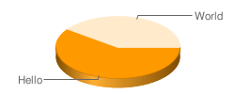
Google Charts API
Dynamically generate charts
It is a REST API that you send the data
  Response is an image representing this data
For example:
  http://chart.apis.google.com/chart?cht=p3&chd=t:60,40&chs=250x100&chl=Hello|World

Slide 28
Google Charts API
  Example:
    http://chart.apis.google.com/chart?cht=p3&chd=t:60,40&chs=250x100&chl=Hello|World
Where:
  http://chart.apis.google.com/chart?
    the Chart API's location
  &
    separates parameters
  chs=250x100
    the chart's size in pixels
  chd=t:60,40
    the chart's data
  cht=p3
    the chart's type
  chl=Hello|World
    the chart's label
For more information about Google Charts API:
  http://code.google.com/apis/chart/

Slide 29
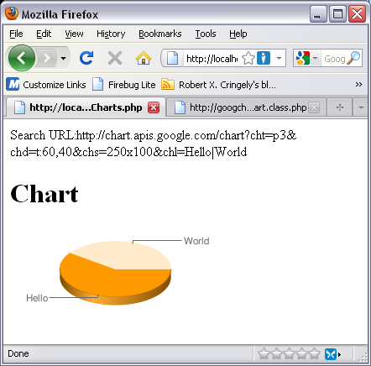
Google Charts Example
<?php
$endpoint = "http://chart.apis.google.com/chart";
$query = "?cht=p3&chd=t:60,40&chs=250x100&chl=Hello|World";
$url = $endpoint . $query;
echo "Google Charts URL:" . $url . "<br>\n";
echo "<h1>Chart</h1>\n";
echo "<img src='$url'>";
?>
googleCharts.php

Slide 30
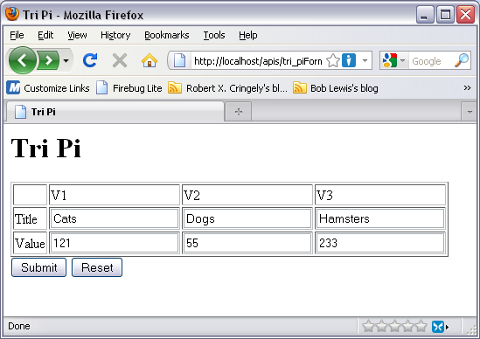
tri_piForm.htm
<html>
<head><title>Tri Pi</title></head>
<body>
<h1>Tri Pi</h1>
<form method="POST" action="googleChart3.php">
<table border="1">
<tr>
<td>&nbsp;</td>
<td>V1</td>
<td>V2</td>
<td>V3</td>
</tr>
<tr>
<td>Title</td>
<td><input type="text" name="T1" size="20"></td>
<td><input type="text" name="T2" size="20"></td>
<td><input type="text" name="T3" size="20"></td>
</tr>
<tr>
<td>Value</td>
<td><input type="text" name="V1" size="20"></td>
<td><input type="text" name="V2" size="20"></td>
<td><input type="text" name="V3" size="20"></td>
</tr>
</table>
<input type="submit" value="Submit" name="B1">
<input type="reset" value="Reset" name="B2">
</form>
</body>
</html>

Slide 31
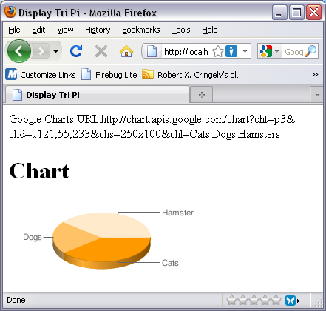
googleChart3.php
<html>
<head><title>Display Tri Pi</title></head>
<body>
<?php
$endpoint = "http://chart.apis.google.com/chart";
$t1 = $_POST["T1"];
$t2 = $_POST["T2"];
$t3 = $_POST["T3"];
$v1 = $_POST["V1"];
$v2 = $_POST["V2"];
$v3 = $_POST["V3"];
$query = "?cht=p3&chd=t:$v1,$v2,$v3&chs=250x100&chl=$t1|$t2|$t3";
$url = $endpoint . $query;
echo "Google Charts URL:" . $url . "<br>\n";
echo "<h1>Chart</h1>\n";
echo "<img src='$url'\n>";
?>
</body>
</html>

Slide 32
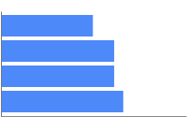
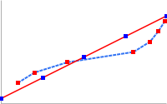
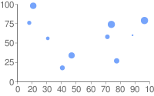
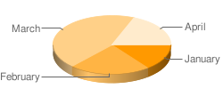
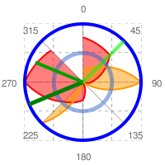

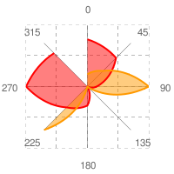
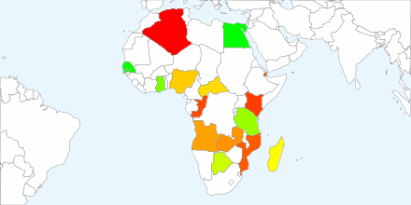
Google Chart API
Other types of charts:
  Line charts
  Bar charts
  Pie charts
  Venn diagrams
  Scatter plots
  Radar charts
  Maps

Slide 33
Combining both Yahoo Search and Google Charts API
The neat feature of APIs is that that they can be combined to generate smart applications.
For example, can we combine both Yahoo Search and Google Charts to generate a comparison between the hits of two keywords?
  YES WE CAN ☺

