Slide 6
PHP and Relational Databases
(AJK Side Note)
PDOs
  Object oriented
    Methods access data
    Consistent across RDBs
  Work with various RDB servers
    DB2 (IBM)
    Oracle
    MySQL
    …
  For PHP 5.1 and later
  May not work with all new features on an RDB
Extensions
  Procedural
    Specific for each RDB
  Specific driver for each server
    mysqli is the extensions for PHP to access MySQL
    OCI8 is the extensions for Oracle
  Works with earlier PHP versions
  May support the latest features of an RDB
    e.g. mysqli supports the latest MySQL features, PDO does not

Slide 24
Product Viewer Application

Slide 25
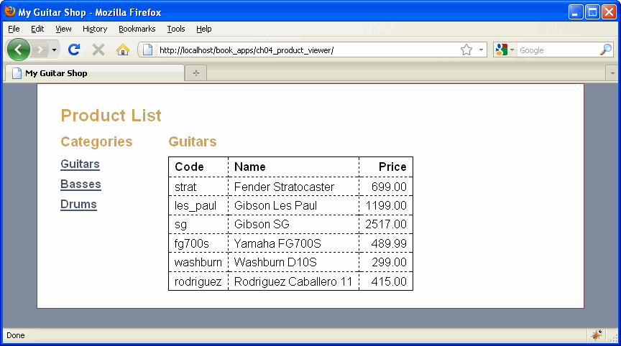

Slide 26
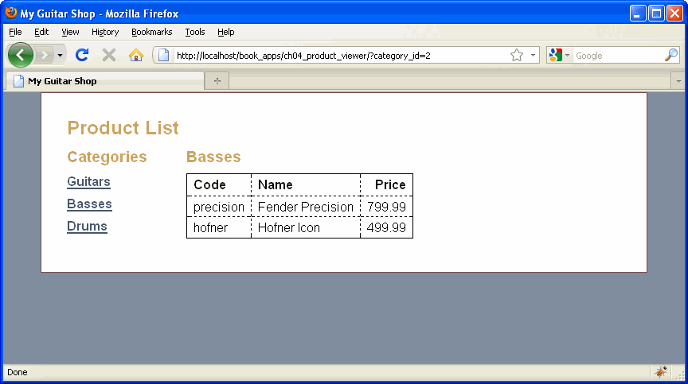

Slide 35
Product manager application

Slide 36
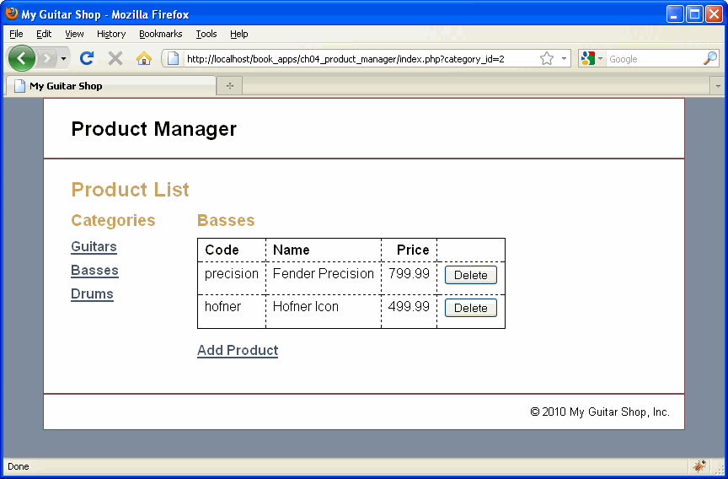

Slide 37
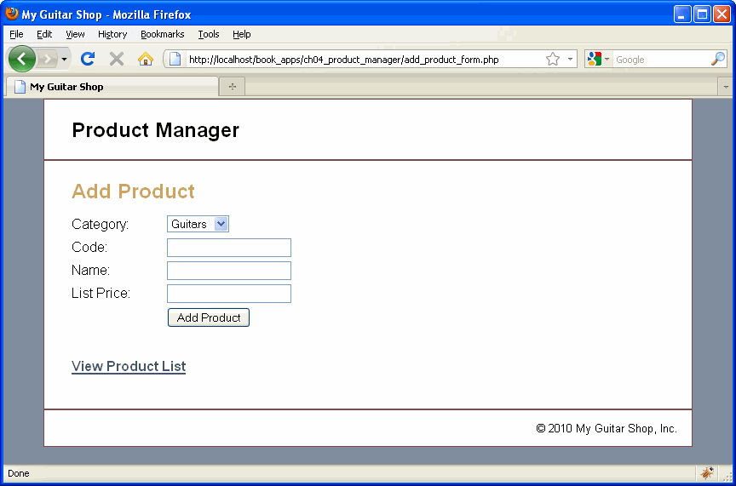

Slide 51
Not using PDO
AJK material

Slide 52
Opening DB
In code:
//+++++++++++++++++++++++++++++++++++++++++++++++++++++++++++++++++++++++++
include("../support/openSciFiDBMode.inc");
//+++++++++++++++++++++++++++++++++++++++++++++++++++++++++++++++++++++++++
openSciFiDBMode.inc:
<?php
//+++++++++++++++++++++++++++++++++++++++++++++++++++++++++++++++++++++++++
// open the connection to the DB
$link = mysql_connect('localhost', 'root', 'bigbadpa55');
if (!$link)
{ die('Could not connect: ' . mysql_error()); }
// echo "Connected to DB successfully\n";
if ($mode == "live")
{ // use live database
$scifidb = 'scifi';
}
else if ($mode == "test")
{ // use test database
$scifidb = 'scifitest';
}
else
{ // bad run mode
die ("Improper run mode: [$mode]");
}
?>

Slide 53
Connect to DB and create query
// connect to the scifi DB
$db = mysql_select_db($scifidb, $link);
if (!$db)
{ die('Could not open $scifidb'); }
// echo "opened SciFi DB successfully\n<br>";
//=========================================================================
// create the query
//=========================================================================
//
//===========================================================================
if ($vkey == "all")
{
$sql = "select lname, fname, title, series, editor, author2, titles.scifiid "
. "from authors, titles "
. "where authors.scifiid = titles.scifiid "
. "order by lname, fname, series, title";
}
else
{
}
// echo "\n <br>sql: $sql\n<br>";
$result_books = mysql_query($sql, $link);

Slide 54
Retrieve some data & create html
//=========================================================================
while ($row = mysql_fetch_array($result_books))
{
$scifiid = $row['scifiid'];
$theLName = $row['lname'];
echo $td;
echo $num;
echo $col;
echo $theLName; // last name
echo $col;
echo $row['fname']; // first name
echo $col;
echo $row['title']; // title
echo $col;
echo $row['series'];
echo $col;
echo $row['editor'];
echo $col;
echo $row['author2'];
echo $col;
echo $row['scifiid'];
echo $col;
echo $top; // anchor to top at each new letter
// echo $col;
// echo $top;
echo $end;
echo "\n";
$num++;
} // end while
?>

